Slide 1
Welcome to 31266 Introduction to Information Systems
Course coordinator
Dr Morteza Saberi
Email:
Morteza.Saberi@uts.edu.au

Slide 2
Content
Welcome/introduction
What’s in IS for Me?
Reviewing Subject Outline,
Assessment Information
Instructions

Slide 3
Welcome/introduction
All our students
In the chat please share one of the interesting things about yourself that you would like to share with the class(60 sec)

Slide 4
What’s In IS For Me?

Slide 5
What is IS?
Input your answer in the chat : 1 minute

Slide 6
What is IS?
Integrated set of components that collect, process, store, analyse, and disseminate information for a specific purpose.
Purpose of information systems - getting the right information to the right people, at the right time, in the right amount, and in the right format.

Slide 7
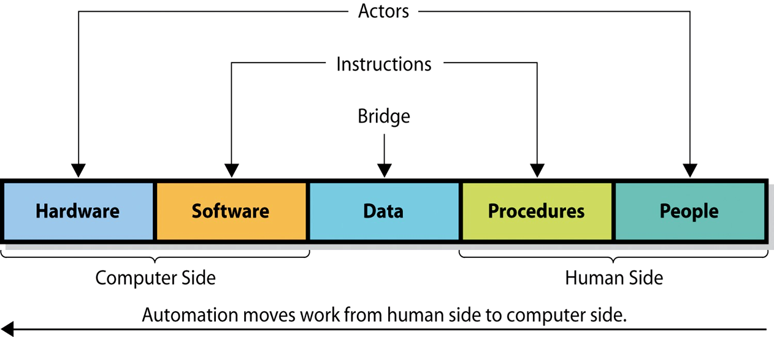
Components of Information Systems:
people, information technology and procedures

Slide 8
Why Should I know About IS?
Input your answer in the chat : 1 minute

Slide 9
Competitive advantage

Slide 10
The Business Problem
In today World software has been developed and integrated and can be delivered globally for all industries
Billions of people now access the Internet via broadband connections.
Worldwide, more than 5 billion people use cell phones.
In addition, software programming tools and Internet-based services allow companies in many industries to launch new software-powered start-ups without investing in new infrastructure or training new employees.
In essence, software is disrupting every industry, and every organization must prepare for this disruption

Slide 11
What is software disruptions

Slide 12
Software Disruptions-Exampel1
In 2001, Borders agreed to hand over its online business to Amazon because the bookstore was convinced that online book sales were nonstrategic and unimportant
Notes:
INSTRUCTIONS
1. Delete blue box.
2. Then click icon, bottom left, to insert image.

Slide 13
Software Disruptions-Exampel2
Notes:
INSTRUCTIONS
1. Delete blue box.
2. Then click icon, bottom left, to insert image.

Slide 14
Software as a service: SaaS
delivering applications over the Internet—as a service.
Instead of installing and maintaining software
Free from complexity
E.g. Google Apps, Dropbox

Slide 15
Software Disruptions-Exampel3
shop directory
Notes:
INSTRUCTIONS
1. Delete blue box.
2. Then click icon, bottom left, to insert image.

Slide 16
Results
An increasing number of major businesses and industries are being run on software and delivered as online services
These services includes from motion pictures to agriculture to national defence.
Also, companies face constant competitive threats from both established rivals and entrepreneurial technology companies that are developing disruptive software.
These threats will force companies to become more agile and to respond to competitive threats more quickly, efficiently, and effectively.

Slide 17
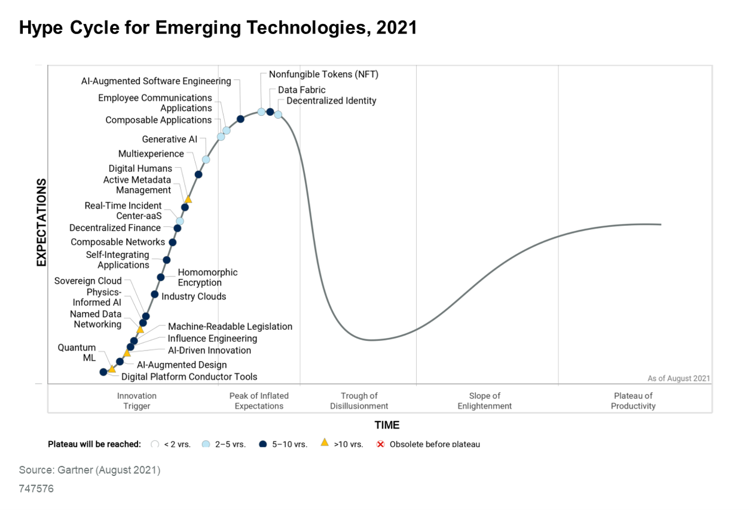
FACULTY OF ENGINEERING AND it
As a student, you should do the right investment to building the necessary skills for your current/future career
visual representation of the maturity and adoption of emerging technologies

Slide 18
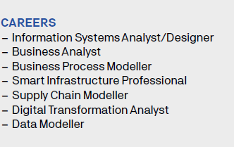
FACULTY OF ENGINEERING AND it
IS graduates
IS graduates are most likely to end up in roles that require analysis of roles/requirements/impact/barriers/context of IT - BAs, Info Governance, Digital transformation teams, etc.
IT trends are highly favourable – impact is receiving increasing attention: e.g. AI and ethics, or AI and accountability are strong callings for IS, data governance issues (IoT/cybersecurity/geospatial data).
Wide ranges of opportunities are there

Slide 19
Example: User Experience
Wide ranges of opportunities are there
Psychology of Colours

Slide 20
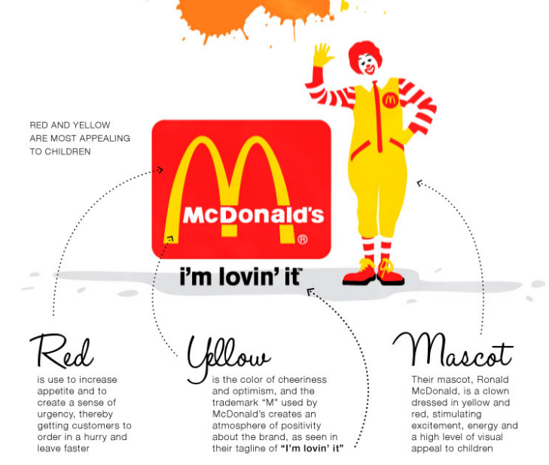
Psychology of Colours

Slide 21
Reviewing Subject Outline

Slide 22
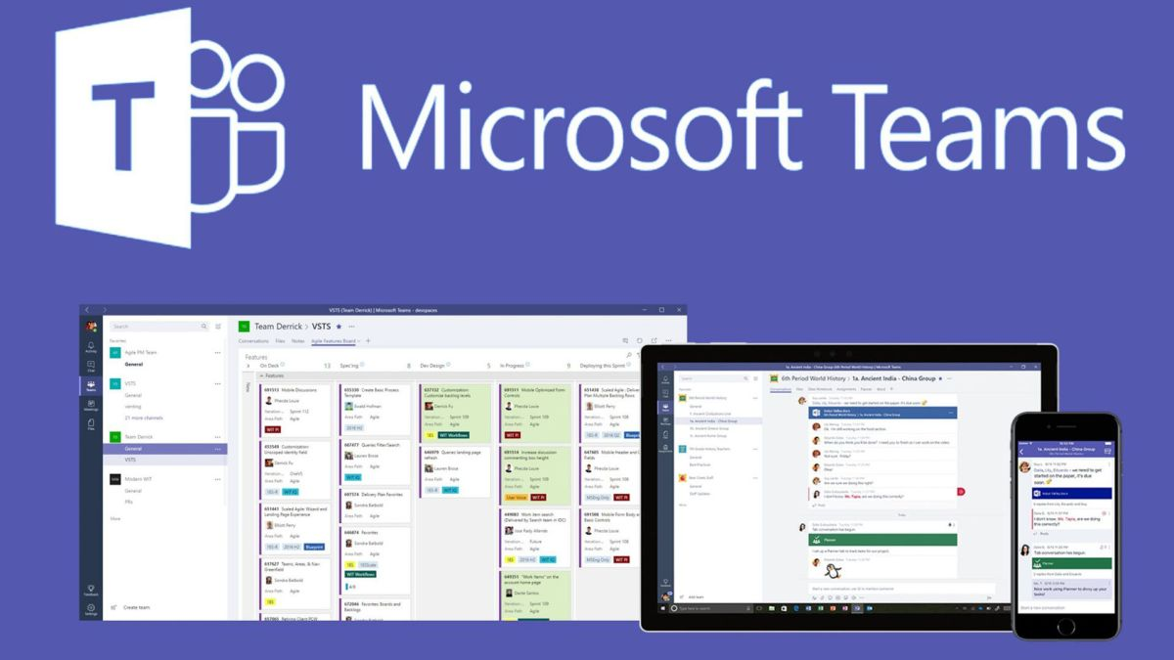
Delivery mode
We conduct all the lectures on MICROSOFT TEAMS.
If your tutorial mode is online, it will be delivered on MICROSOFT TEAMS.
Some weeks for the on campus tutorials will be online too.

Slide 23
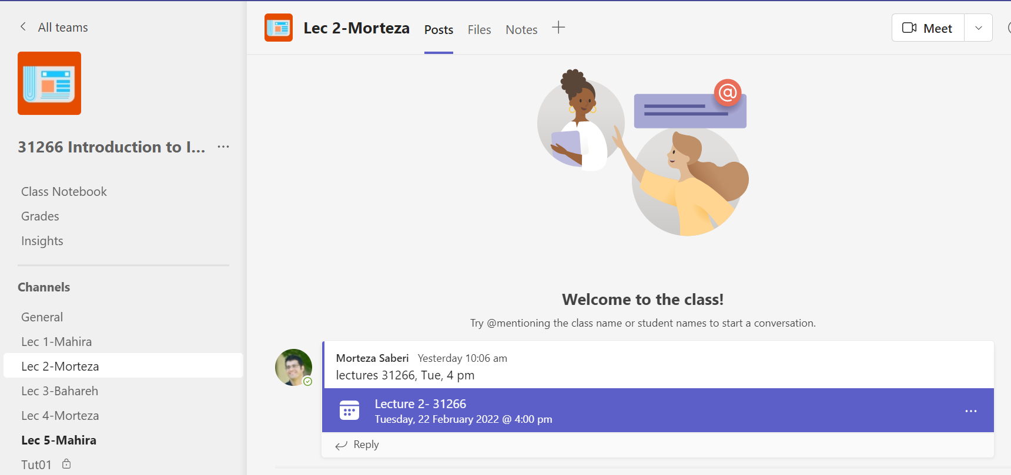

Slide 24
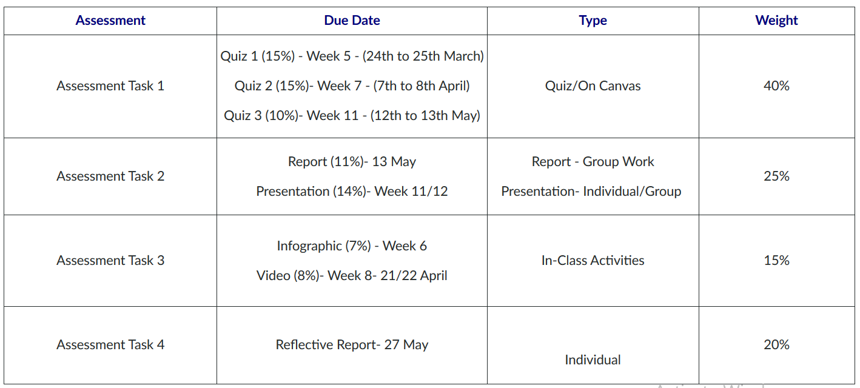
Assessments due

Slide 25
Group works
You should form the group during the first/second tutorial.
The group leader should email the group formation file to his/her tutor by Monday, March 14, 2022, by 11:59 PM.
Who submits the assessment? Group leader
Students who do not form a group by the due date/time will be randomly put into groups by the teaching team.

Slide 26
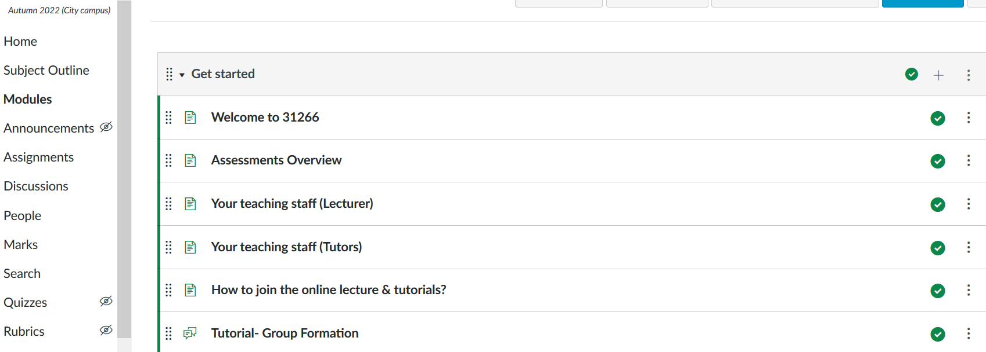
group formation file

Slide 27
Assignment 1: Quizzes

Slide 28
Assignment 1: Quizzes
This task will include three online quizzes from some given subject topics.
Weight: 40%
Due:
Quiz 1: Week 5 (Individually assessed-15%)
Quiz 2: Week 7 (Individually assessed-15%)
Quiz 3: Week 11 (Individually assessed-10%)
The quizzes will be conducted online on Canvas.

Slide 29
Assignment 1: Practice Quizzes
A sample quiz is available in Canvas as "Practice Quiz".
We suggest you attempt this quiz to get familiar with how to attempt a quiz in Canvas.

Slide 30
Assignment 1: Quiz1
Quiz 1 includes topic from Week 2, 3, 4,5
Related content available on from the weekly lecture notes.
Weight: 15%
Due: Week 5
The quiz will be conducted online on Canvas.

Slide 31
Assignment 1: Quiz2
Quiz 2 includes topic from Week 6, 7
Related content available on from the weekly lecture notes.
Weight: 15%
Due: Week 7
The quiz will be conducted online on Canvas.

Slide 32
Assignment 1: Quiz3
Quiz 3 includes topic from Week 10 and 11
Related content available on from the weekly lecture notes.
Weight: 10%
Due: Week 11
The quiz will be conducted online on Canvas.

Slide 33
Assignment 2: Group assignment

Slide 34
Assignment 2: Group assignment
The purpose of this assessment is to examine students' ability to identify the emerging topics in the area of information systems.
Each group is required to make a fifteen minutes presentation during their tutorial class in Week 11 or Week 12 (in your enrolled tutorial class).
Each group is required to submit a report with maximum 1200 words and minimum 1000 words.

Slide 35
Assignment 2 :
You should summary the finding of three articles which are published in
MIT Sloan management review
https://sloanreview.mit.edu/
The articles should be chosen from the magazine section:

Slide 36
Assignment 2:Choosing Topic
All three articles can be chosen from the same issue or different issues listed below based on your tutorial number. You should choose the issue using the formula given in the table:
Tutorial number <=8 | 8<Tutorial number <=16 | 16<Tutorial number <=24
Fall 2021 Issue | Winter 2019 Issue | Spring 2017 Issue
Fall 2018 Issue | Spring 2016 Issue | Summer 2016 Issue
Winter 2021 Issue | Winter 2016 Issue | Spring 2021 Issue
Summer 2019 Issue | Winter 2020 Issue | Spring 2020 Issue

Slide 37
Assignment 2:Choosing Topic
Example 1: if your tutorial number is tut1-05, you choose the three articles from the first column (Green column).
Example 2: if your tutorial number is tut1-10, you should choose the three articles from the second column (Grey column).
Example 3: if your tutorial number is tut1-21, you should choose the three articles from the third column (red column).

Slide 38
Assignment 2 : Choosing Topic
You should summary the finding of three articles which are published in MIT Sloan management review
You can seek your tutor advice or support for choosing a paper.

Slide 39
Assignment 2
Weight: 25%
Presentation: 14%, Report: 11%
Due: 13 May 2022
Submission portal: Canvas

Slide 40
Assignment 3: In class activities

Slide 41
Assignment 3: In class activities
This task will include two problem-solving and discussion activities (group-work).
Activity 1: Infographic
Activity 2: Video making
Due:
Activity 1: Week 6 (Group assessed-7%)
Activity 2: Week 8 (Group assessed-8%)

Slide 42
Assignment 3: In class activities
This is an in-class activity so NO submission of already designed Infographs will be accepted or marked.
You should choose one problem along with the proposed solution from the following journal: “Harvard Business Review”
https://hbr.org/
on a social, business or technology problem (e.g. Poor quality of life etc., customer service, AI) as a topic for your knowledge management activity

Slide 43
Assignment 3: Infographic
This is an in-class activity so NO submission of already designed Infographs will be accepted or marked.
If you are interested in a particular topic, you may visit the topic pages through the links below
https://hbr.org/topics

Slide 44
Assignment 3: Infographic
Issue: Overthinking!

Slide 45
Assignment 3: Infographic
Issue: Rushing to solutions

Slide 46
Assignment 3: Video making
You should summarize the content of the same paper which used for infographic activity.
You should demonstrate sound understanding of the paper.
Each group is required to make a (minimum) five minutes presentation in week 8!
The Group leader should upload the video to YouTube and submit the link in Canvas.

Slide 47
Assignment 4: Reflective Report

Slide 48
Assignment 4: Reflective Report
This is a solo assessment task.
This assessment task requires you to critically reflect on your experiences with the
Week 6-Class Activity (Infographic) and
Week 8-Class Activity (Video Making)
and how both activities relate to your career and future.
Also assessment task requires you to present (i) your key insights of the HBR paper (Infographic).
Weight: 20%
Due: 27th May
Submission portal: Canvas

Slide 49
Course structure on CANVAS

Slide 50
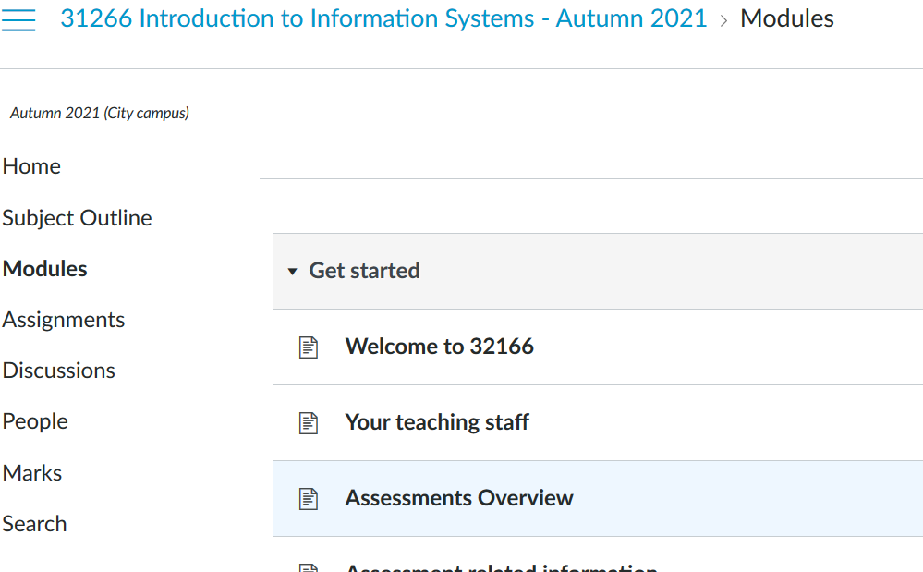
Course structure on CANVAS
We have three modules.
You can see their related lectures and tutorials in Canvas.

Slide 51
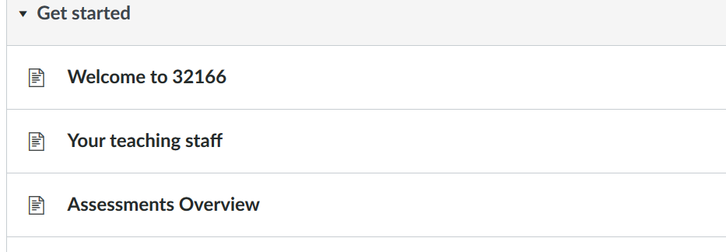
Course structure on CANVAS
Please review the overview of assessments in “Get started section” under modules

Slide 52
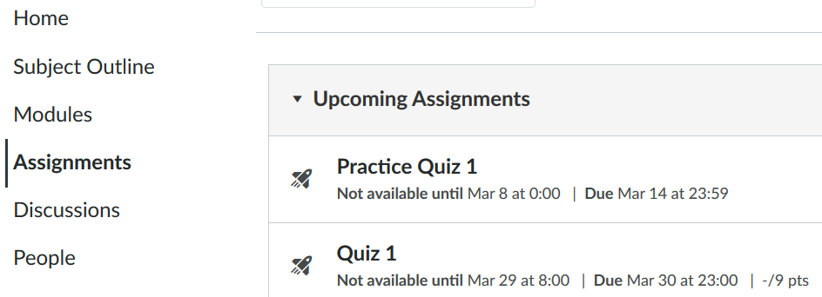
Course structure on CANVAS
The detailed explanations for each assignment are provided in the “assignment section”

Slide 53
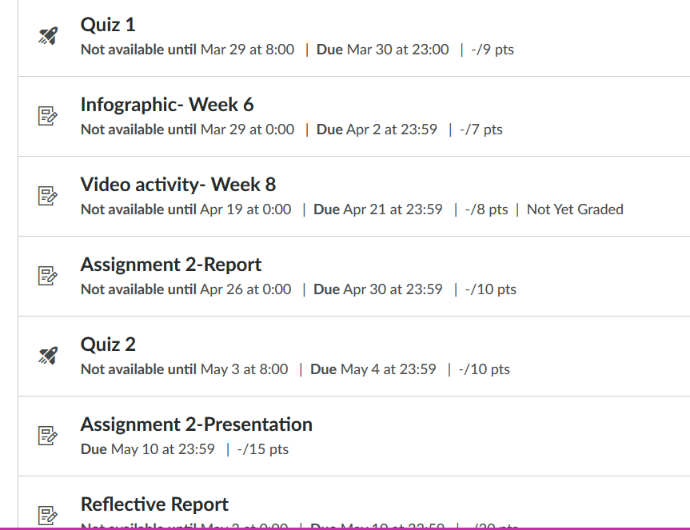
Course structure on CANVAS
You can see the weights and due of
the assignments in this page

Slide 54
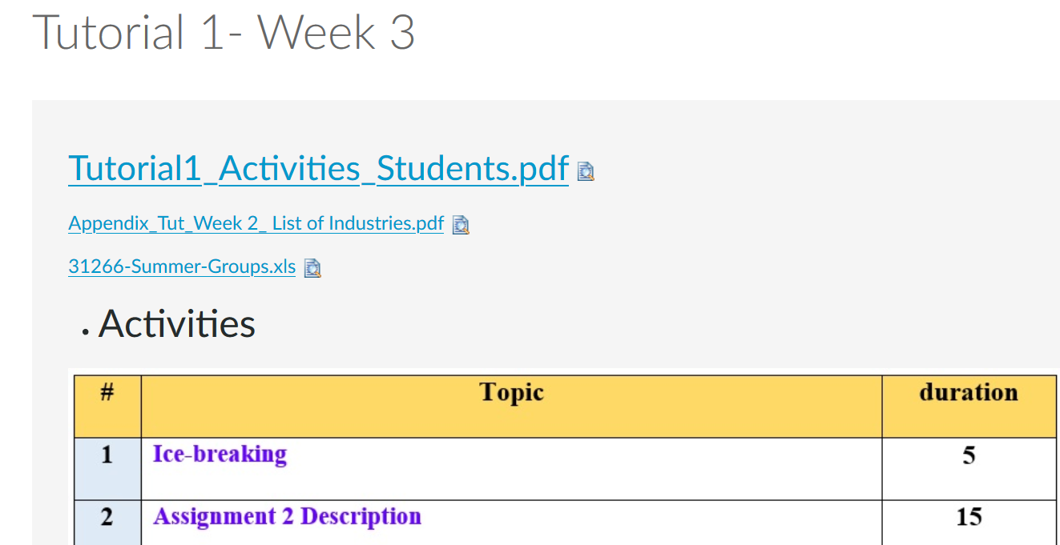
Course structure on CANVAS
You can download the lectures and tutorials materials in “ modules section”

Slide 55
Q & A

Slide 56
Next Week
Introduction to IS

Slide 57
See you next week!

