Slide 1
Introduction to Information System 31266 Week10
UTS CRICOS 00099F

Slide 2
Information Security

Slide 3
Objectives
Discusses different types of security threats to information systems
Identify major types of security safeguards/ controls
Explain risk management concept
Notes:
So far, you have learnt about diverse ways in which Information Systems have made organization more productive, efficient and responsive to consumers. Unfortunately, information systems can also be misused, often with devastating consequences. In this lecture we will describe some of threats to Information Systems and we will discuss Information systems security process to address the threats.

Slide 4
Security threats

Slide 5
Threat
Threat to IS undesirable events that can cause harm to IS:
Threat source
Internal threats: can arise from individuals or events inside of a company
External threats: can arise from individuals or events outside of a company
Threat intent
- Intentional(Deliberate): threats result from a harmful decision (e.g., identity theft). More examples????
- Unintentional: threats introduced without awareness and malicious intent such as a user or operator error. More examples????
Vulnerability weaknesses in an organization’s systems or security policies that can be exploited to cause damage(e.g., lack of solid control approaches)

Slide 6
Threat agents
Threat agents
Human Threats: Caused by human actions such as insiders or hackers which cause harm in systems.
Environmental Threats: threats caused by non human agent
(e.g. natural disaster)
Technological Threats: caused by physical and chemical processes on material.

Slide 7
What are factors contributing to vulnerability of IS?
Communication Networks
Smaller, more portable storage devices
Decreasing skills necessary to be a computer hacker
Lack of management support
lack of awareness and care concerning information security
International organized crime taking over cybercrime

Slide 8
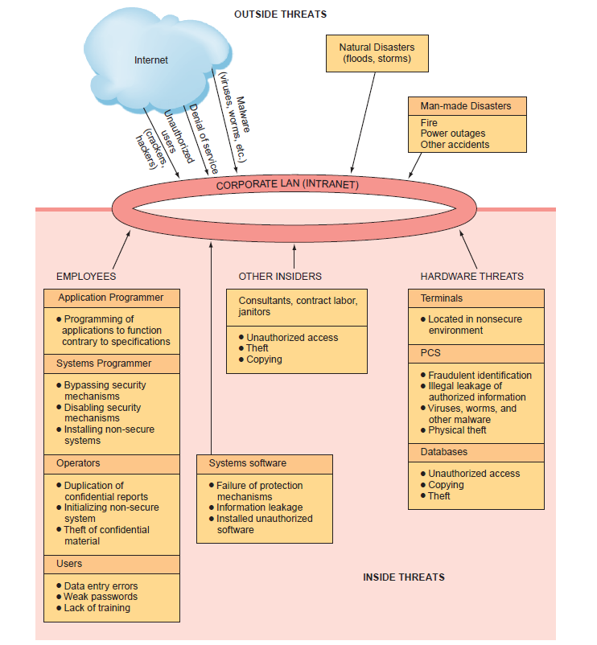
Security threats

Slide 9
Unintentional Threats to Information Systems
A significant category of unintentional threats is human error.
Two areas of the organization pose especially significant threats to information security:
human resources &
information systems
Other: contract labour, consultants, and janitors and guards
lack of awareness comes from the organization's poor education and training efforts.

Slide 10
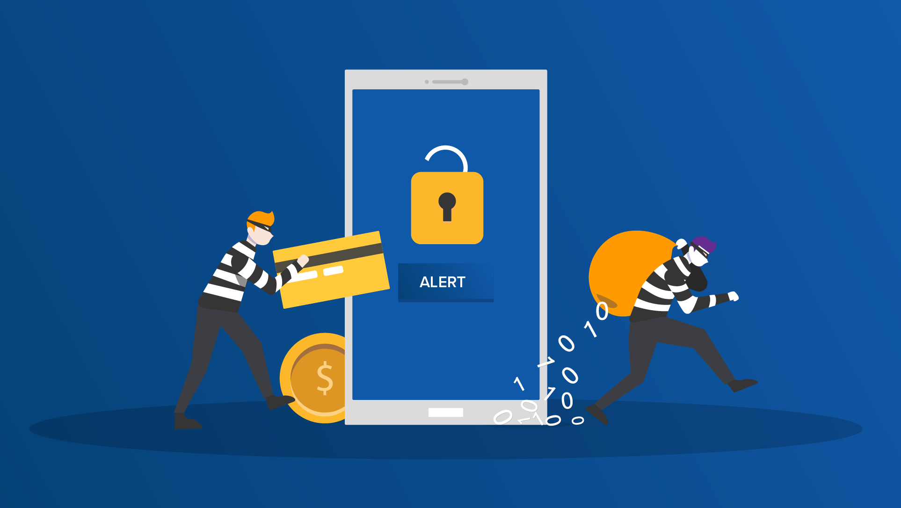
Social Engineering
The perpetrator uses social skills to trick or manipulate legitimate users into providing confidential information.
Link: https://www.youtube.com/watch?v=lc7scxvKQOo

Slide 11
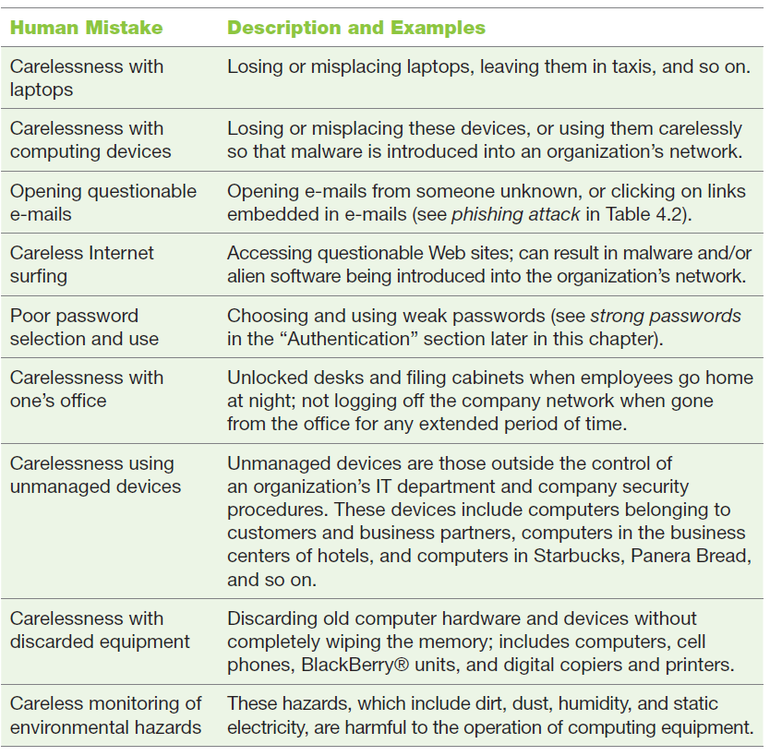

Slide 12
Deliberate Threats to Information Systems
Espionage or trespass
An unauthorised individual attempts to gain illegal access to organizational information.
Denial of Service Attack
Offenders send so many information requests to a target computer system. The target computer cannot handle them successfully and typically crashes.

Slide 13
Software Attacks
Attackers use malicious software to infect as many computers worldwide as possible.
Three categories:
Remote attacks requiring user action;
Remote attacks requiring no user action;
Software attacks by programmers during the development of a system.

Slide 14
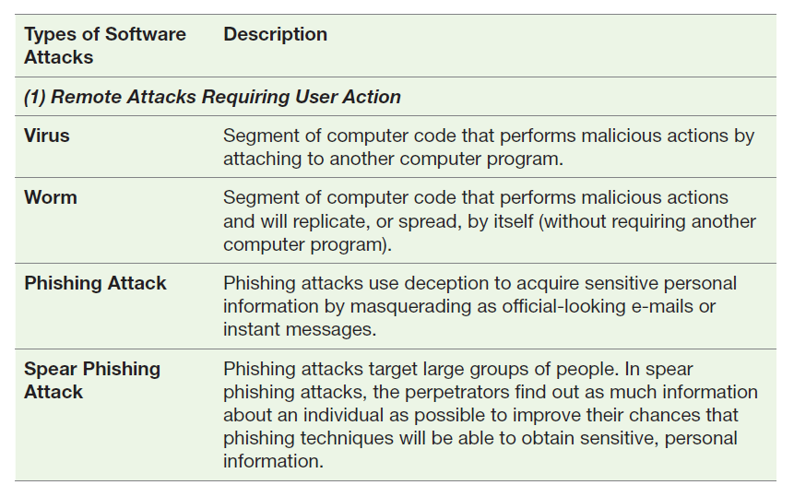
Types of software Attacks

Slide 15
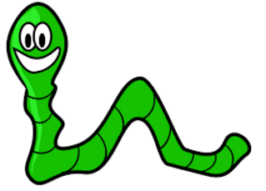
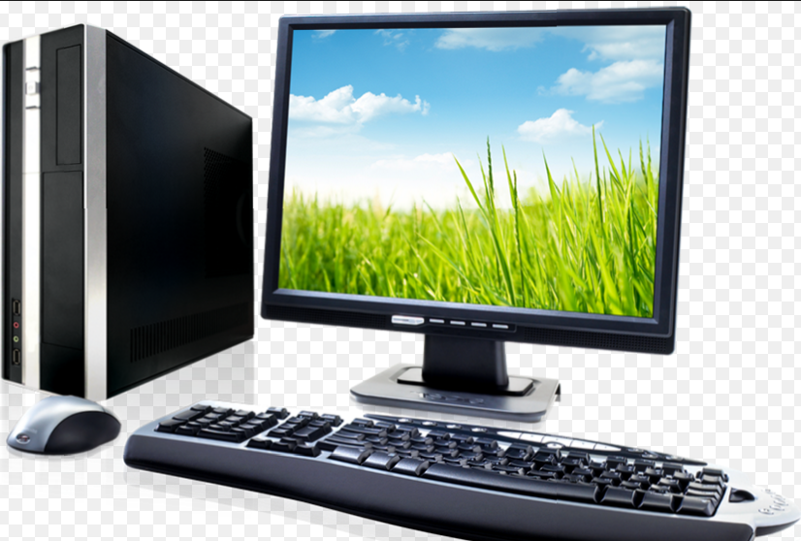
Information Security threat: Worm
Can travel without human action
k@gmail.com
A@gmail.com
X100
X Million
D@gmail.com
Web servers, network servers and individual computers to stop responding
D@gmail.com
REPLICATE

Slide 16
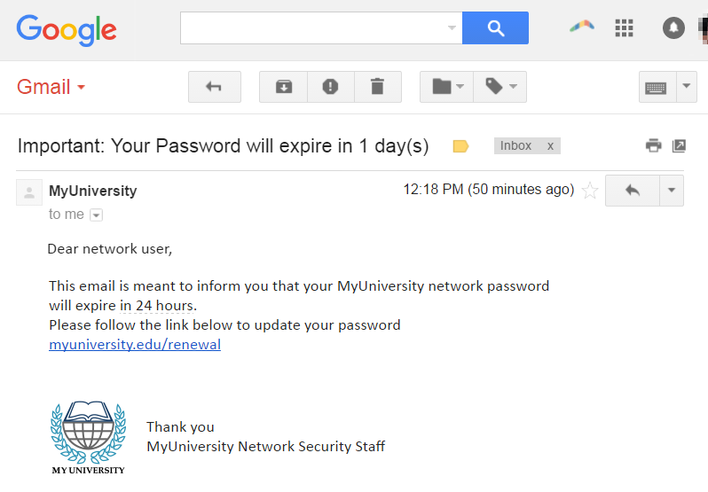
Phishing attack

Slide 17
Spear Phishing attack
Link: https://www.youtube.com/watch?v=cEMzwfqTHU4

Slide 18
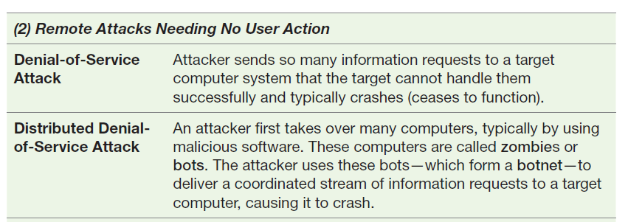
Types of software Attacks

Slide 19
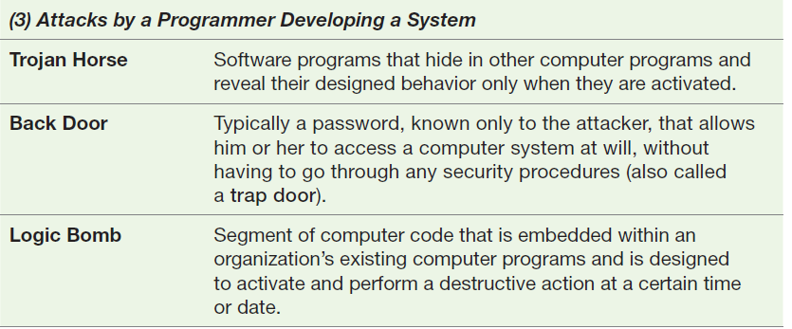
Types of software Attacks

Slide 20
Information systems Security
Information systems security: precautions taken to keep all aspects of information systems (e.g., all hardware, software, network equipment, and data) safe from
unauthorized access
destruction
Manipulation
while providing the intended functionality to legitimate users.

Slide 21
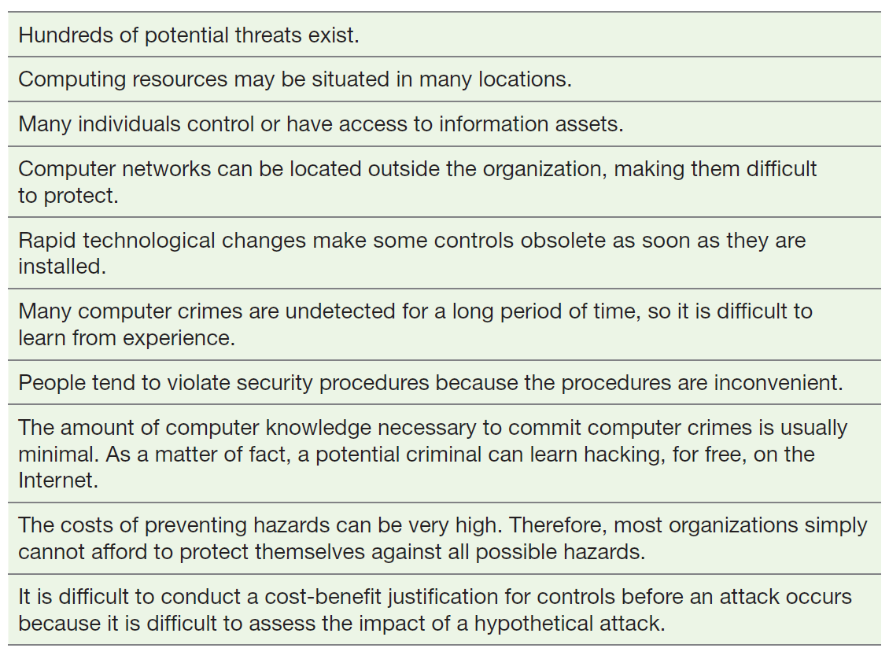
The difficulties in protecting Information Resources

Slide 22
Risk Management

Slide 23
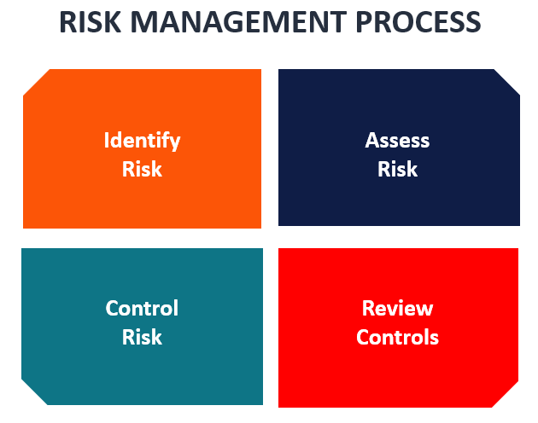
Risk Management
The goal of risk management is to identify, control, and minimize the impact of threats and reduce risk to acceptable levels.
Risk management consists of three processes:
risk analysis,
risk mitigation, and
controls evaluation.

Slide 24
Risk Analysis
Risk analysis involves three steps:
Assessing the value of each asset being protected,
Estimating the probability that each asset will be compromised,
Comparing the probable costs of the asset’s being compromised with the costs of protecting that asset.

Slide 25
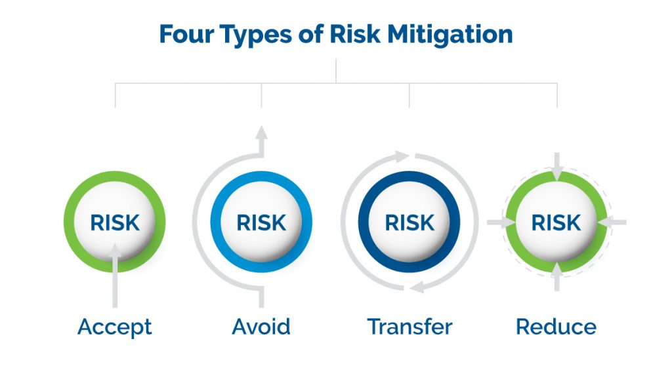
Risk mitigation
Risk mitigation has two functions:
Implementing controls to prevent identified threats from occurring,
Developing a means of recovery if the threat becomes a reality.

Slide 26
Risk mitigation strategies
Risk mitigation strategies
Risk acceptance: Accept the potential risk, continue operating with no controls, and absorb any damages that occur.
Risk limitation: Limit the risk by implementing controls that minimize the impact of the threat.
Risk transference: Transfer the risk by using other means to compensate for the loss, such as by purchasing insurance.

Slide 27
Information Security Controls
To protect their information assets, organizations implement controls or defence mechanisms
the single most valuable control is user education and training
Three major types of controls:
Physical controls,
Access controls,
Communications controls

Slide 28
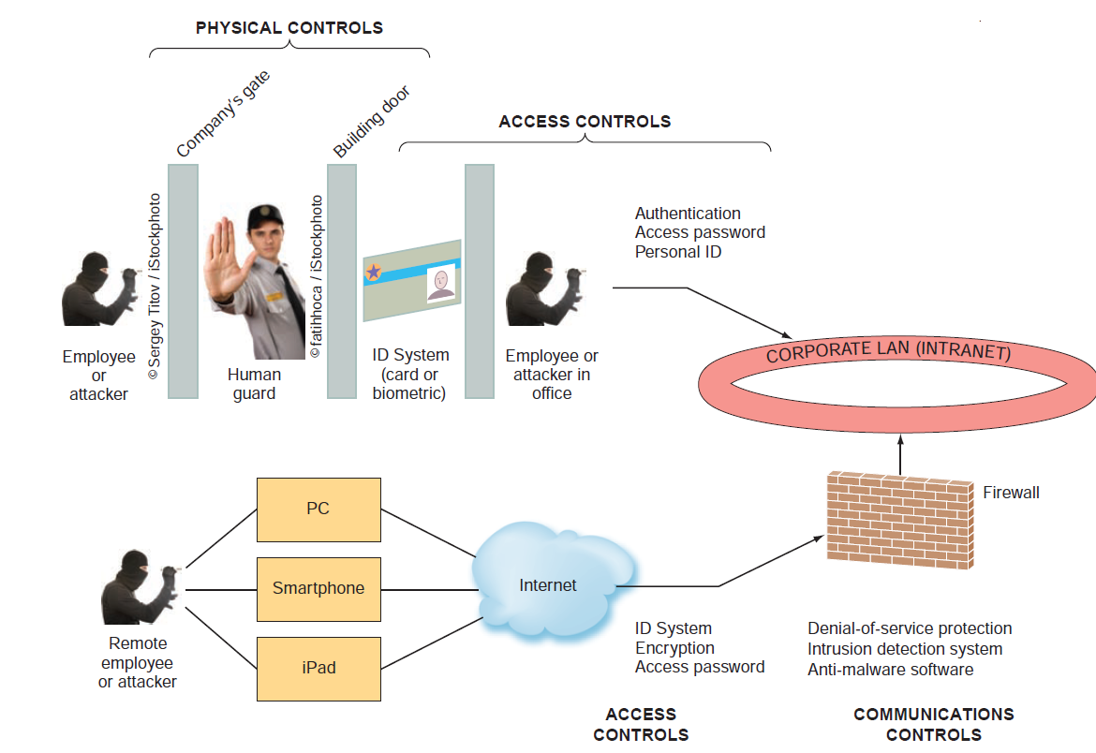
The location of defense mechanisms

Slide 29
Communications Controls
Firewall
a firewall is a network security system that monitors and controls the incoming and outgoing network traffic based on predetermined security rules
Encryption
Encryption is the process of encoding messages using an encryption key before they enter the network or airwaves, then decoding them using a matching key at the receiving end of the transmission so that the intended recipients can read or hear them
Anti-malware Systems (or antivirus software)
software packages that attempt to identify and eliminate viruses, worms, and other malicious software.

Slide 30
Communications Controls
Blacklisting
includes certain types of software that are not allowed to run in the company environment
Systems development controls
When systems are designed or purchased, care must be taken that all security features are implemented, enabled, and managed
Human controls
various human safeguards can help to protect information systems, specifically ethics, laws, and effective management.

Slide 32
Case study: Small businesses in danger
Questions:
What security controls should you and your business partner have adopted at a minimum?
How important are backup plans and file backup procedures to small businesses?

Slide 33
Case study: Small businesses in danger
Answers:
1. What security controls should you and your business partner have adopted at a minimum?
Update anti-virus software periodically
Backed-up client/business data
2. How important are backup plans and file backup procedures to small businesses?
It is very critical(it is inconvenient to not have the data available)
it is expensive and time-consuming to recreate the data

Slide 34
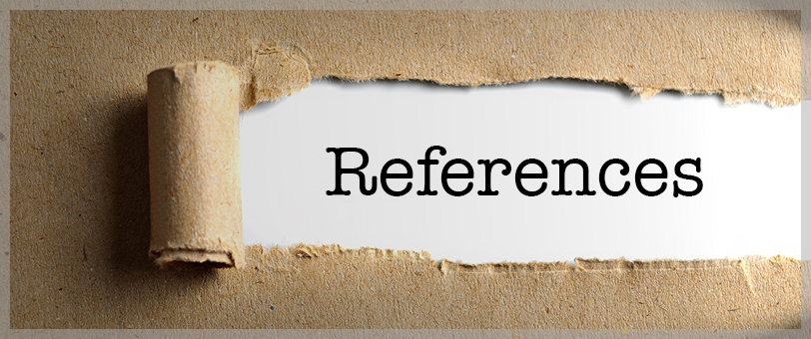
References
Rainer, R. Kelly, et al. Management Information Systems, Wiley, 2014, chapter7.

Slide 35
See you next week!

