Slide 1
Introduction to Information System 31266 Week11
UTS CRICOS 00099F

Slide 2
Ethics and Privacy

Slide 3
Objectives
What is Ethics?
Explain the Ethical Frameworks
Ethical issues & Information Technology
Define Privacy Codes & Policies

Slide 4
Background
Do you download or share music and films that you did not pay for?
Would you copy an image from someone else’s blog and claim it as your own?
Would you download an obscure article or essay, customize it and claim it as your own original work?
What if you were an employer, would you monitor your employees’ internet usage and track their history?
Would you install keylogging software on work-issued devices without their knowledge?
With many mobile devices incorporating GPS (global positioning system) capabilities, would you monitor the movements of your mobile fleet?

Slide 5
Ethics

Slide 6
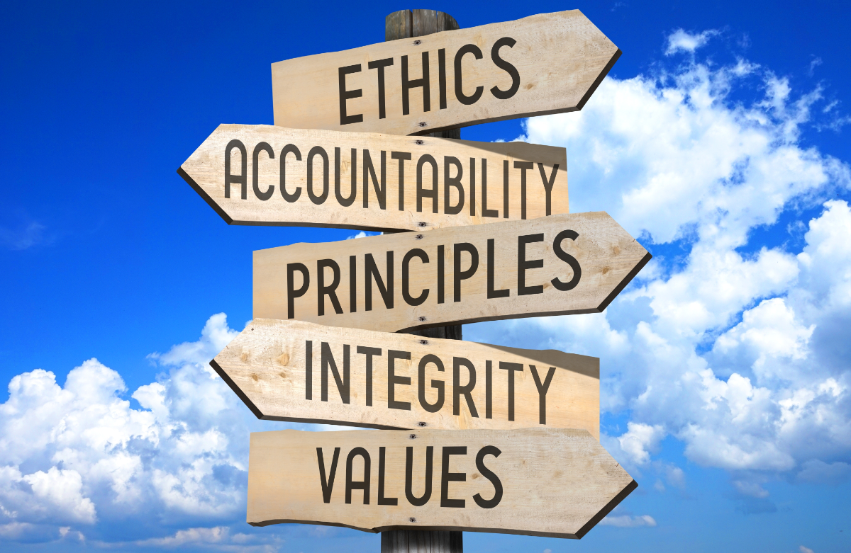
Ethics
The principles of right and wrong that individuals use to make choices that guide their behaviour.
- It is not always easy to decide what is right or wrong. However, the available frameworks can help us make ethical decisions.

Slide 7
Ethics
Fundamental Tenets of Ethics
Responsibility: means that you accept the consequences of your decisions and actions.
Accountability: refers to determining who is responsible for actions that were taken.
Liability: A legal concept that gives individuals the right to recover the damages done to them by other individuals, organisations, or systems
What is Unethical is not necessarily Illegal
Ex: A bank’s decision to foreclose on a home can be technically legal, but it can raise many ethical questions

Slide 8
Ethical Frameworks
Utilitarian approach
An ethical action is the one that provides the most
good or does the least harm.
Rights approach
An ethical action is the one that best protects and respects the moral rights of the affected parties
Common good approach
An ethical action is the one that best serves the community as a whole, not just some members.

Slide 9
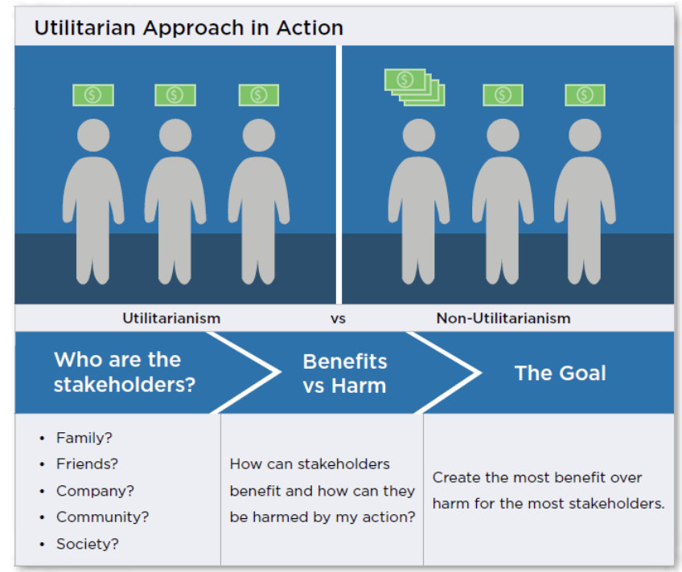
Utilitarian approach

Slide 10
Utilitarian approach examples
“Pharmaceutical companies release drugs that have been governmentally approved, but with known minor side effects because the drug can help more people than are bothered by the side effects”
“In the airline industry, for example, many planes offer first-, business-, and economy-class seats. Customers who fly in first or business class pay a much higher rate than those in economy seats. Still, they also get more amenities—simultaneously, people who cannot afford upper-class seats benefit from the economy rates. This practice produces the highest good for the greatest number of people. And the airline benefits, too. The more expensive upper-class seats help to ease the financial burden that the airline created by making room for economy-class seats.”

Slide 11
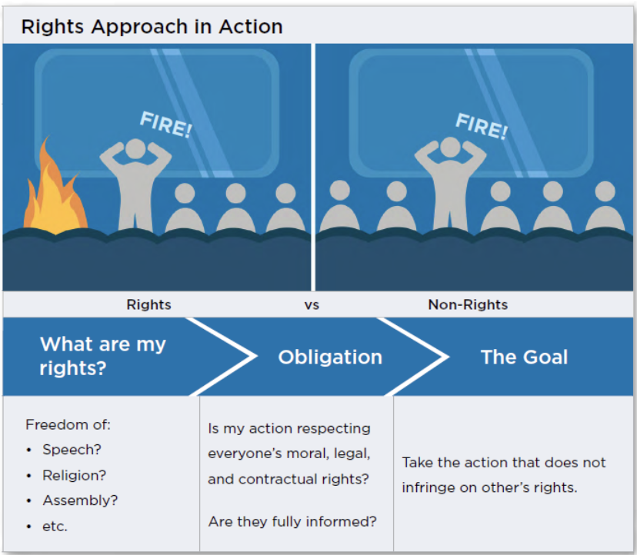
Rights approach

Slide 12
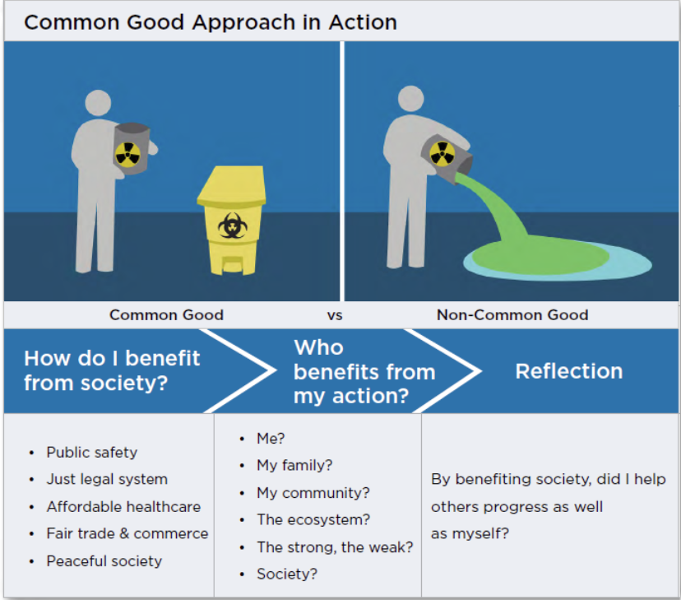
Common good approach

Slide 13
Ethical Frameworks
Recognise an ethical issue
Could this decision or situation damage someone or some group?
Does this decision involve a choice between a good and bad alternative?

Slide 14
Ethical Frameworks
Get the facts
What are the relevant facts of the situation?
Do I know enough to make a decision?
Have I consulted all relevant persons and groups?

Slide 15
Ethical Frameworks
Evaluate alternative actions under all four ethical standards
Which option will produce the best and has the least harm? (the utilitarian approach)
Which option best respects the rights of all stakeholders? (the rights approach)
Which option best serves the community as a whole and not just some members? (the common good approach)

Slide 16
Ethical Frameworks
Make a decision and test it
Which approach best addresses the situation?
Act and reflect on the outcome of your decision
How can I implement my decision with the greatest care and attention to the concerns of all stakeholders?
How did my decision turn out, and what did I learn from this specific situation?

Slide 17
Ethics in the Corporate Environment
Code of Ethics: A collection of principles that are intended to guide decision making by members of an organization.
Many companies and professional organisations develop their own codes of ethics
Examples:
ACS
ASA
UTS Code of Conduct

Slide 18
Ethical issues & Information Technology
Have you ever got the feeling somebody is trailing you on the Web, watching your every click?
Wonder why you start seeing display ads and pop-ups just after you’ve been scouring the Web for a car, a dress, or a cosmetic product?
Well, you’re right: your behavior is being tracked, and you are being targeted on the Web so that you are exposed to certain ads and not others.
The Web sites you visit track the search engine queries you enter, pages visited, Web content viewed, ads clicked, videos watched, content shared, and the products you purchase.

Slide 19
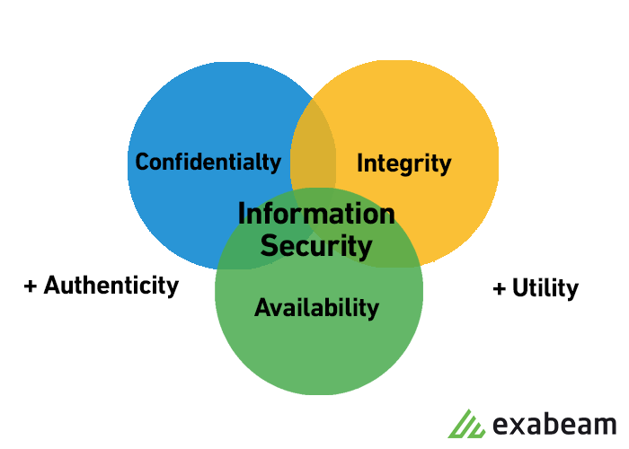
Ethical issues & Information Technology
Four General Categories of Ethical Issues Related to IT:
Privacy issues
Accuracy issues
Property issues
Accessibility issues

Slide 20
Privacy issues
Privacy issues involve collecting, storing, and disseminating information about individuals.

Slide 21
Accuracy issues
Accuracy issues involve the authenticity, fidelity, and correctness of the information that is collected and processed.

Slide 22
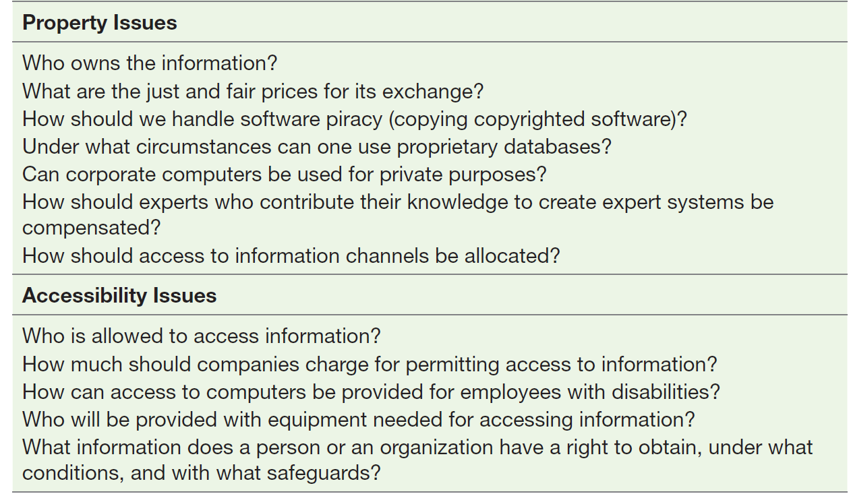
Property issues
Property issues involve the ownership and value of information.

Slide 23
Accessibility issues
Accessibility issues revolve around who should have access to information and whether a fee should be paid for this access

Slide 24
Now trends in IT and Ethics
TREND | IMPACT
Data storage advances | Databases enable organization to hold detailed data about individuals.
Data analysis advances | Advances in information technology enable organizations to analyse vast quantities of data gathered on individuals to develop detailed profiles of individual behaviour.
Network advances | The cost of moving data and making it accessible from anywhere falls exponentially. Access to data become more difficult to control
Mobile device growth | Individual cell phones may be tracked without user consent or knowledge.
Privacy, Accuracy, Property and Accessibility issues might arise

Slide 25
Privacy

Slide 26
What is Privacy Law?
Privacy law relates to the protection of an individual’s personal data and information
The Privacy Act regulates how personal information is handled
The Privacy Act allows you to:
know why your personal information is being collected, how it will be used and who it will be disclosed to
ask for access to your records (including your health information)
stop receiving unwanted direct marketing material
correct inaccurate information about you
make a complaint about an agency or organisation, if you think that they have mishandled your personal information.

Slide 27
Personal information in databases
There are several concerns about the information you provide to these record keepers. Some of the major concerns are:
Do you know where the records are?
Are the records accurate?
Can you change inaccurate data?
How long will it take to make a change?
Under what circumstances will personal data be released?
How are the data used?
To whom are the data given or sold?
How secure are the data against access by unauthorised people?

Slide 28
Privacy Codes and Policies
Privacy policies or privacy codes are an organization’s guidelines for protecting the privacy of its customers, clients, and employees.
Privacy laws revolve around requirements that mandate that organizations get users to opt-in or opt-out of specific data collection and processing activities.
Opting in means that users will take an affirmative action to offer their consent.
The most common way we see opt-in methods implemented is through checkboxes
Opting out means a user will take action to withdraw their consent.
Uncheck a marked box consent withdrawal

Slide 29
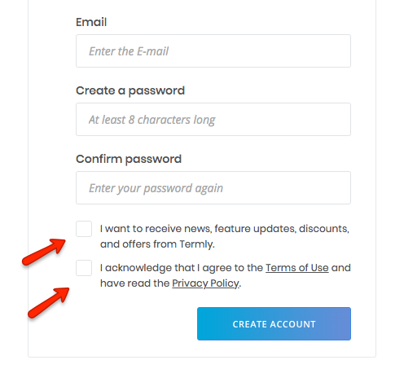
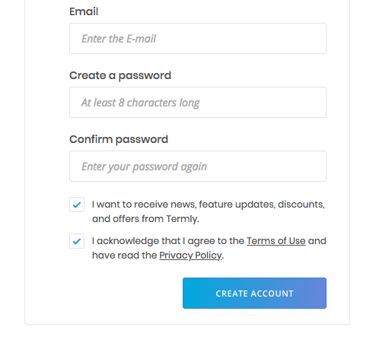
Opt-In vs Opt-Out
Opt-in Example
Opt-out Example

Slide 30
Privacy Policy Guidelines: Data Collection

Slide 31
Privacy Policy Guidelines: Data Accuracy

Slide 32
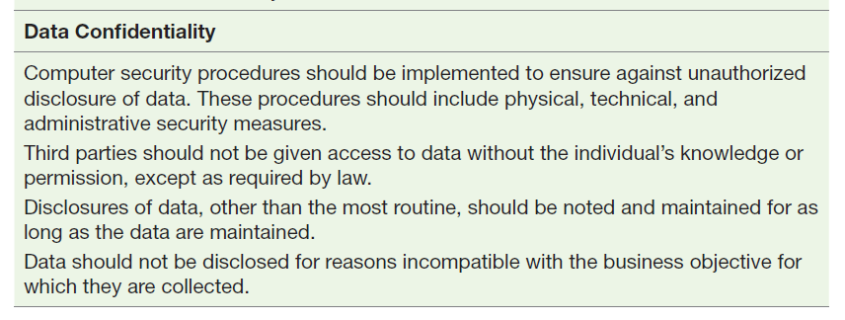
Privacy Policy Guidelines: Data Confidentiality

Slide 33
Ex1: Privacy- Surveillance for workers
From an employer’s perspective, does the benefit of ongoing surveillance of workers outweigh the presumption of privacy?
Q: What should employers do if they want to conduct electronic surveillance?

Slide 34
Ex1: Privacy- Surveillance for workers
Ongoing surveillance can outweigh the presumption of privacy as long as the employer is aware of the legal implications of privacy.
The employer should develop and implement privacy policies. They allow their employees to read the policies and give their informed consent in writing to this surveillance.
The employer should explain the location of surveillance devices, if they monitored employees share recorded results, explain how long the results are kept and where they are kept.

Slide 35
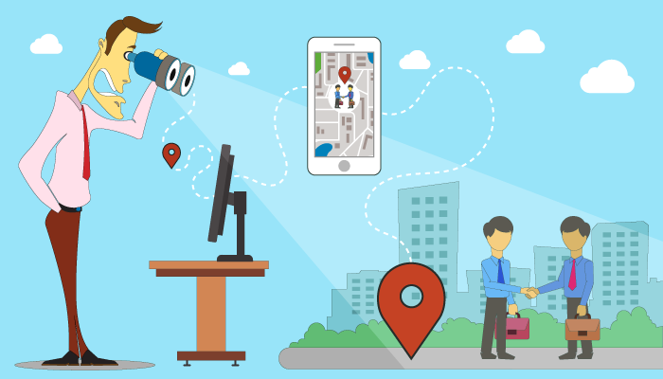
Ex2: Privacy- Track employees information
When is it appropriate to track employee's information resources outside business hours?

Slide 36
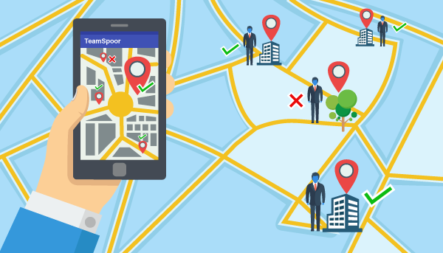
Ex1: Privacy- Surveillance for workers
When employees are suspected or may have the opportunity to steal property or services from their employer or work in industries where transferring information or money outside their work environment.

Slide 37
References
Rainer, R. Kelly, et al. Management Information Systems, Wiley, 2014, chapter6.

Slide 38
See you next week!

