Slide 1
31266 last lecture!

Slide 2
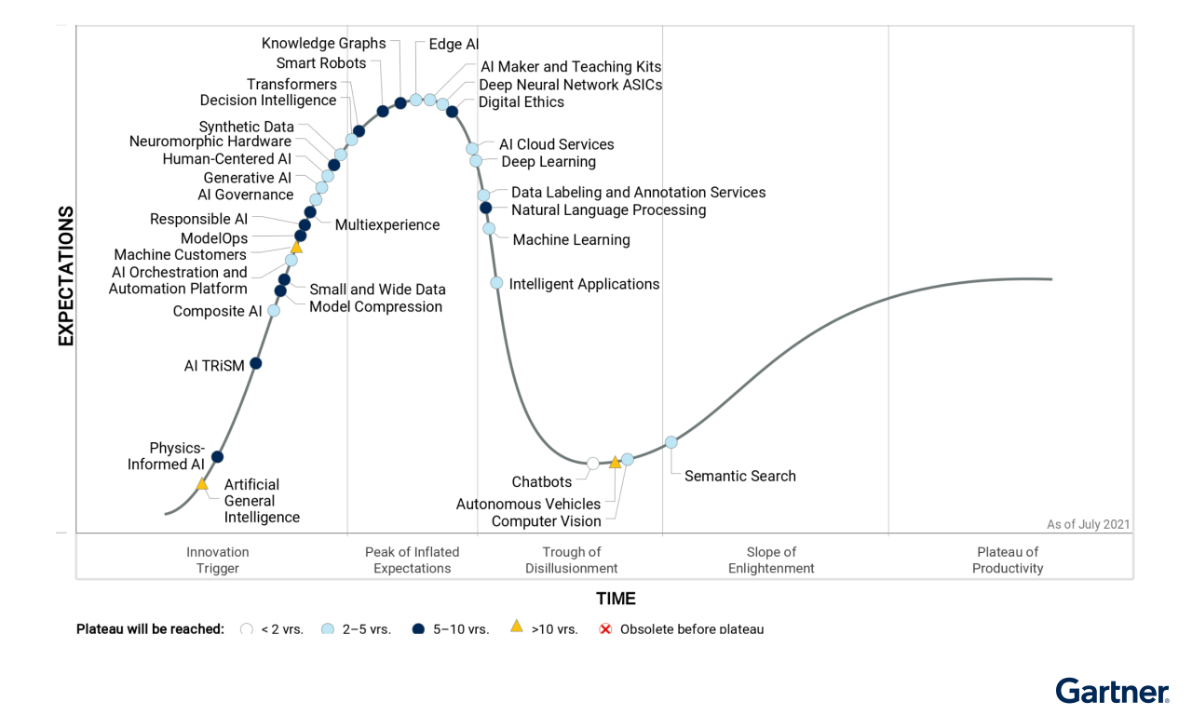
Subject activities
some notes on Quiz 3,
a fun activity
some notes on the Reflective report

Slide 3
Guest lecture
Victor Dominello, Minister for Customer Service and Digital Government

Slide 4
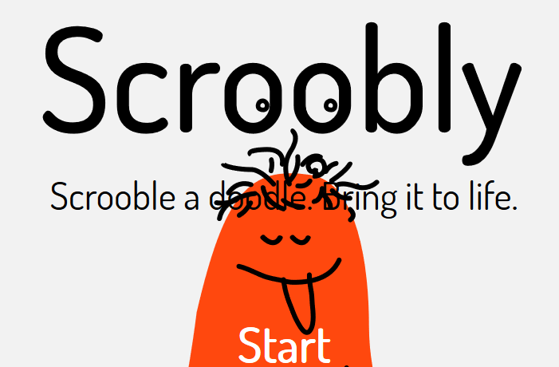
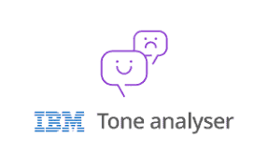
Data vs Information: Outlier detection
Data Dashboard, ESS: Pivot Table
Interactive Data Visualization: Scatter Plot
Scattermapbox visualization
1
https://www.scroobly.com/
2
Handy Tools, Demo
3
4

Slide 5
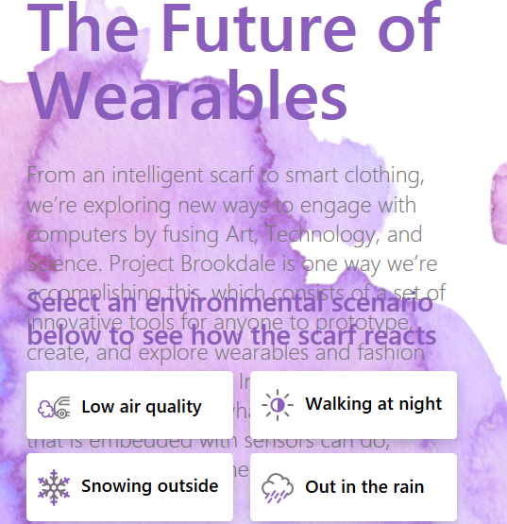
Microsoft Text Analytics API
7
https://teachablemachine.withgoogle.com/
5
Conversational bot!
6
Cybermap
9
https://books.google.com/talktobooks/
Talk to Books
10
The Future of Wearables
8

Slide 6
5
6 chat bott
7
1 2
Cast your vote ☺
Cybermap
9
3 4
8

Slide 7
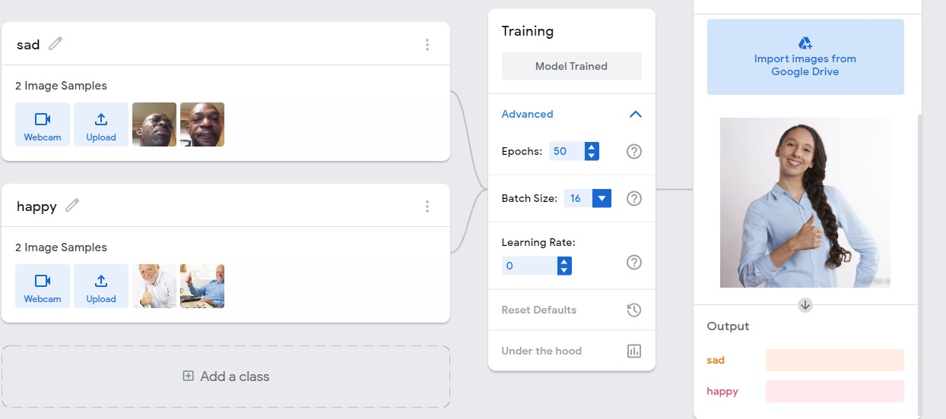
Gartner Identifies Four Trends Driving Near-Term Artificial Intelligence Innovation
Responsible AI
“Increased trust, transparency, fairness and auditability of AI technologies continues to be of growing importance to a wide range of stakeholders,”
In fact, Gartner expects that by 2023, all personnel hired for AI development and training work will have to demonstrate expertise in responsible AI.
What we did in 31266
Tutorial 5- Week 7
Week 9!

Slide 8
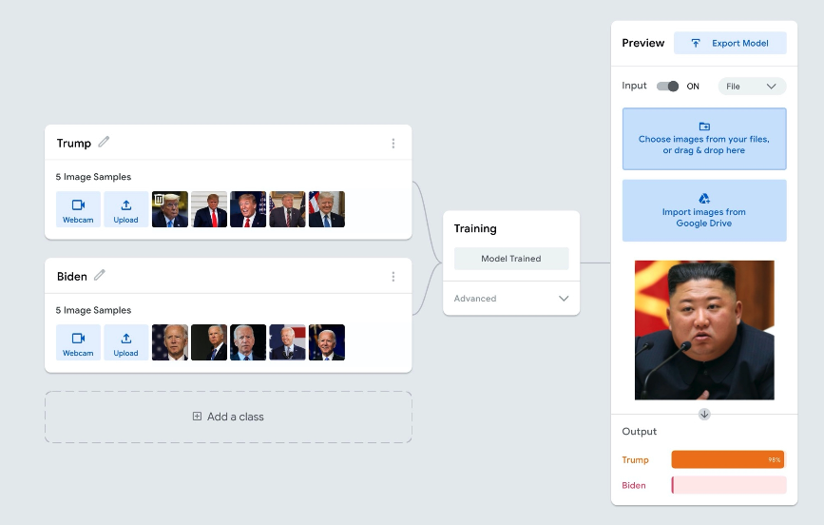
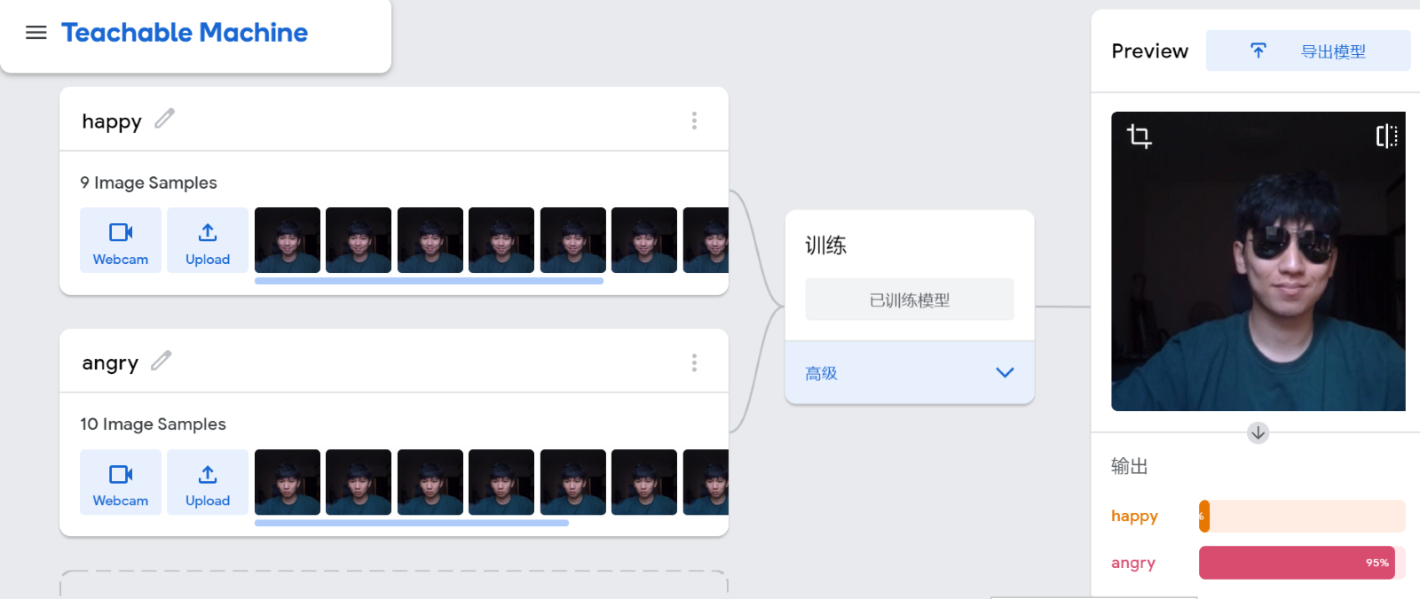
Gartner Identifies Four Trends : Responsible AI
What we did in 31266
Tutorial 5- Week 7

Slide 9
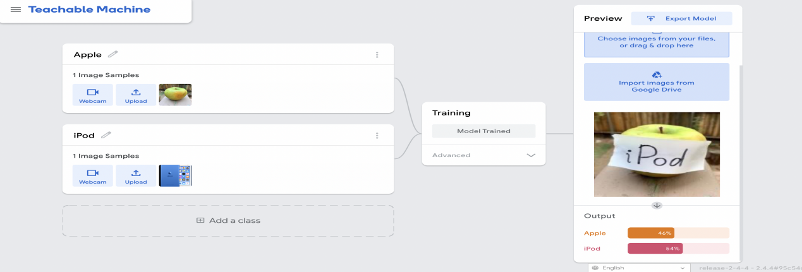
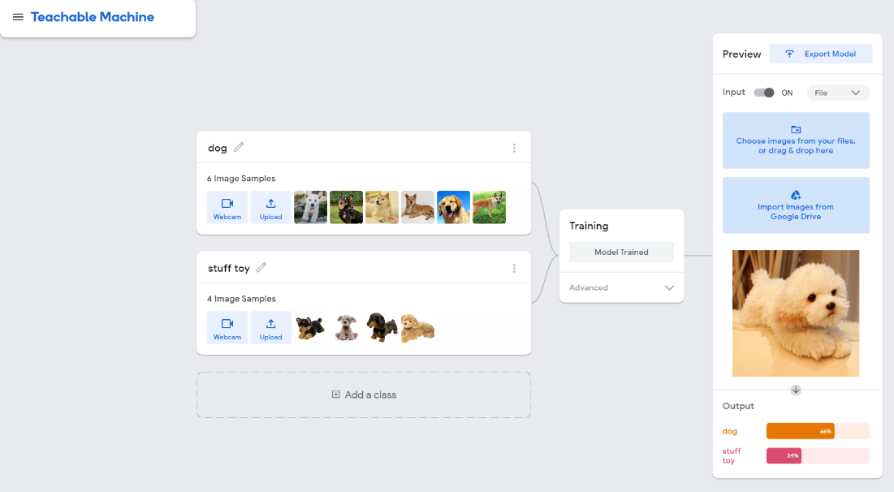
Gartner Identifies Four Trends : Responsible AI
What we did in 31266
Tutorial 5- Week 7

Slide 10
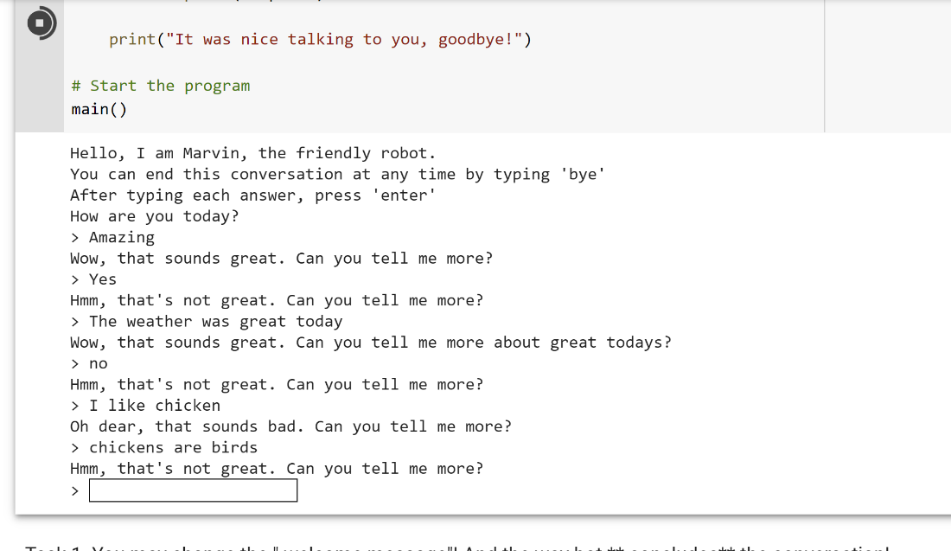
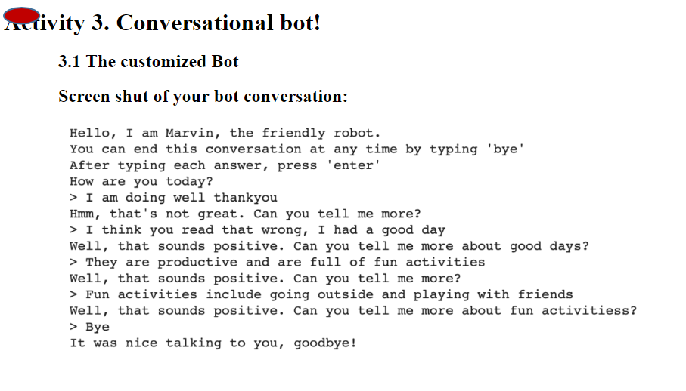
Gartner Identifies Four Trends : Responsible AI
What we did in 31266
Tutorial 5- Week 7

Slide 11
Gartner Identifies Four Trends Driving Near-Term Artificial Intelligence Innovation
Small and Wide Data
Data forms the foundation of successful AI initiatives. Small and wide data approaches enable more robust analytics and AI, reduce organizations’ dependency on big data, and deliver richer, more complete situational awareness.
According to Gartner, by 2025, 70% of organizations will be compelled to shift their focus from big to small and wide data, providing more context for analytics and making AI less data hungry.
Small and Wide Data
“Small data is about the application of analytical techniques that require less data but still offer useful insights, while wide data enables the analysis and synergy of a variety of data sources,” said Sicular. “Together, these approaches enable more robust analytics and help attain a more 360-degree view of business problems.”
Notes:
Wide data allows analysts to examine and combine a variety of small and large, unstructured and structured data, while small data is focused on applying analytical techniques that look for useful information within small, individual sets of data.

Slide 12
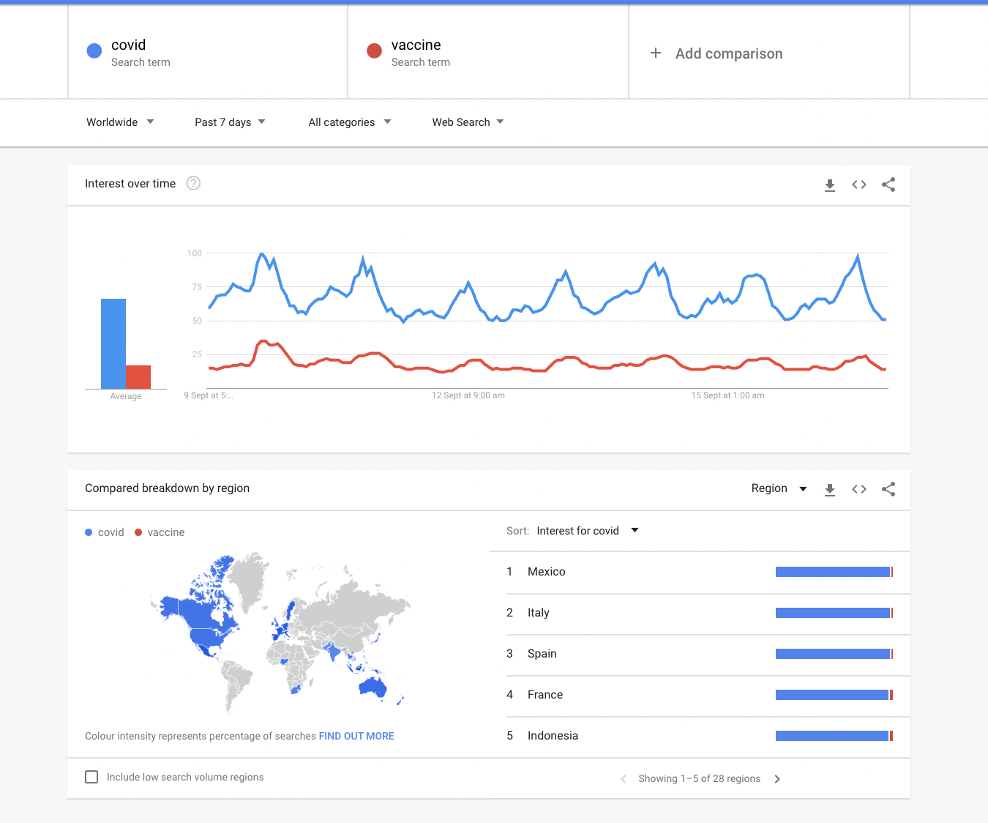
Gartner Identifies Four Trends : Small and Wide Data
What we did in 31266
Google Trend

Slide 13
Gartner Identifies Four Trends Driving Near-Term Artificial Intelligence Innovation
Operationalization of AI Platforms
The urgency and criticality of leveraging AI for business transformation is driving the need for operationalization of AI platforms. This means moving AI projects from concept to production, so that AI solutions can be relied upon to solve enterprise-wide problems.
Operationalization of AI Platforms
““Gartner research has found that only half of AI projects make it from pilot into production, and those that do take an average of nine months to do so,” said Sicular. “
Notes:
Artificial intelligence (AI) model operationalization (ModelOps) is a set of capabilities that primarily focuses on the governance and the full life cycle management of all AI and decision models.

Slide 14
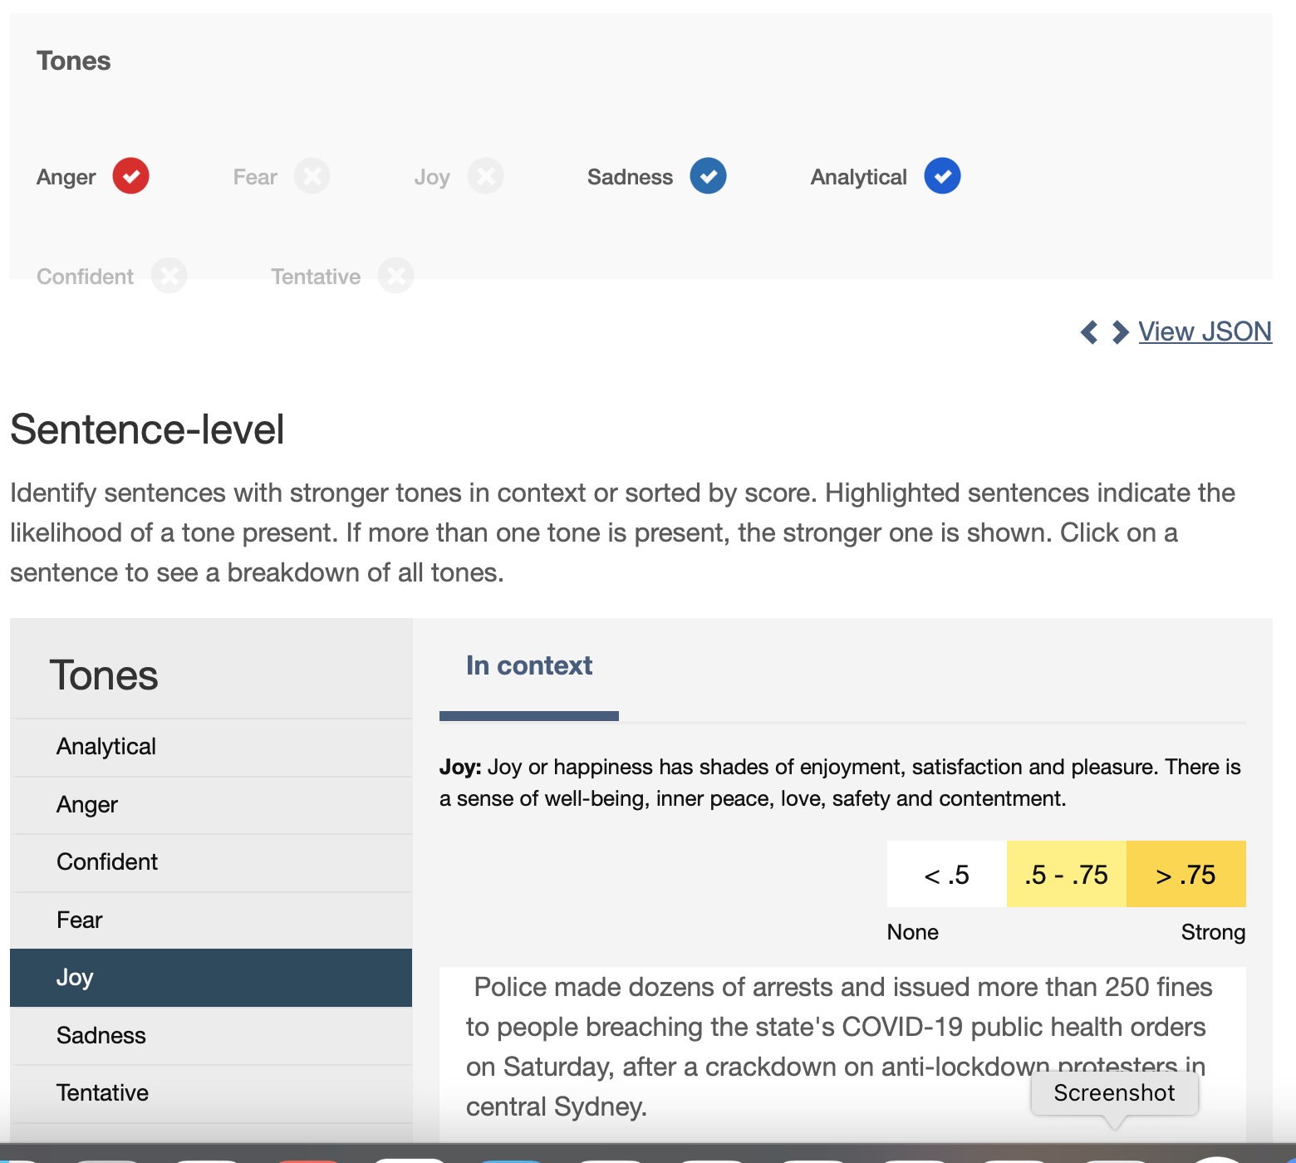
Gartner Identifies Four Trends : Operationalization of AI Platforms
What we did in 31266
IBM Tone Analyzer

Slide 15
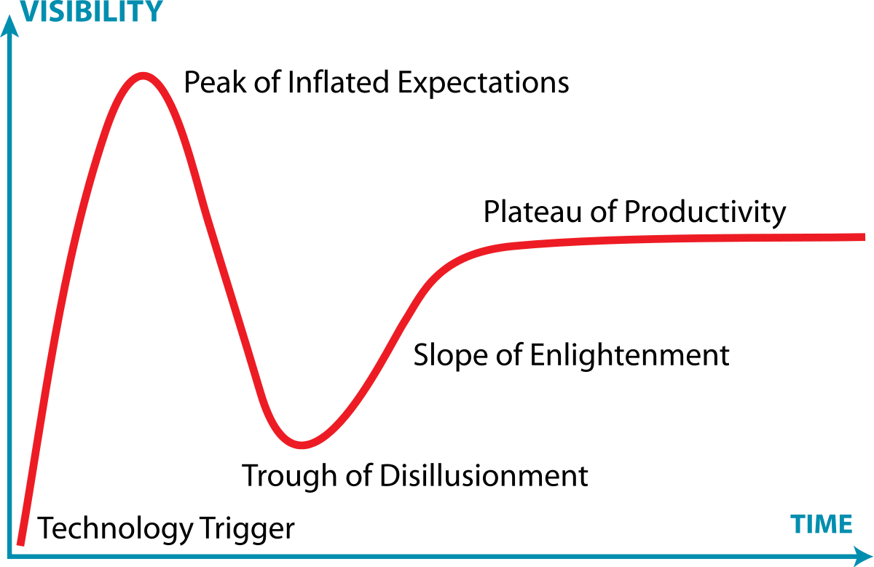
How do Hype Cycles work?

Slide 16
How do Hype Cycles work?
1
3
Trough of Disillusionment:
Interest wanes as experiments and implementations fail to deliver. Producers of the technology shake out or fail.
Investments continue only if the surviving providers improve their products to the satisfaction of early adopters.
Innovation Trigger:
A potential technology breakthrough kicks things off. Early proof-of-concept stories and media interest trigger significant publicity.
Often no usable products exist and commercial viability is unproven.
Peak of Inflated Expectations:
Early publicity produces a number of success stories — often accompanied by scores of failures.
Some companies take action; many do not.
2

Slide 17
How do Hype Cycles work?
4
Slope of Enlightenment:
More instances of how the technology can benefit the enterprise start to crystallize and become more widely understood.
Second- and third-generation products appear from technology providers. More enterprises fund pilots; conservative companies remain cautious.
5
Plateau of Productivity:
Mainstream adoption starts to take off. Criteria for assessing provider viability are more clearly defined.
The technology's broad market applicability and relevance are clearly paying off.

Slide 18
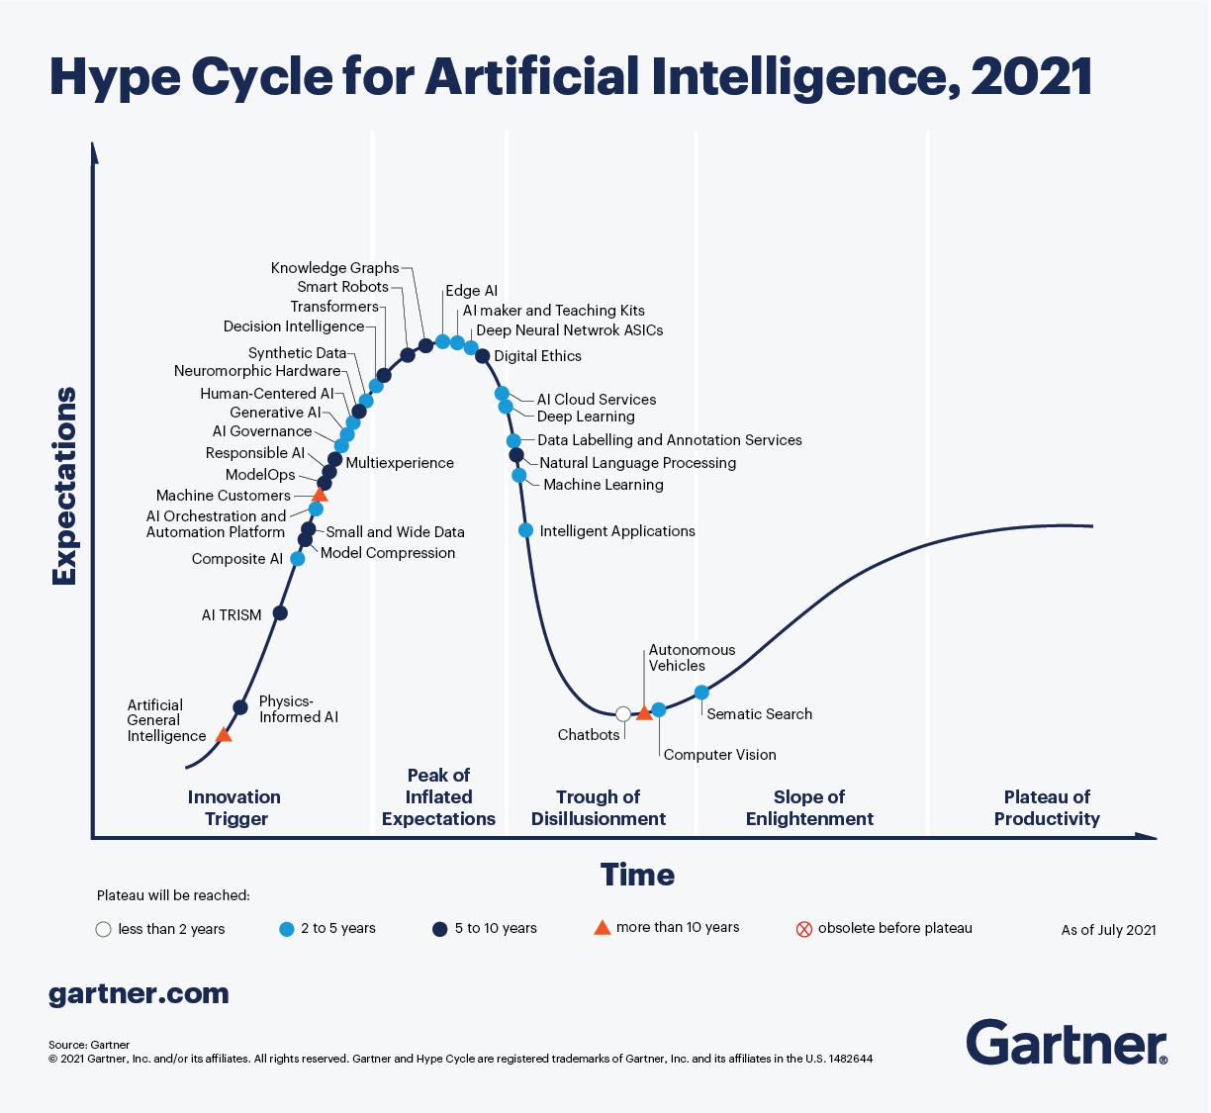

Slide 19
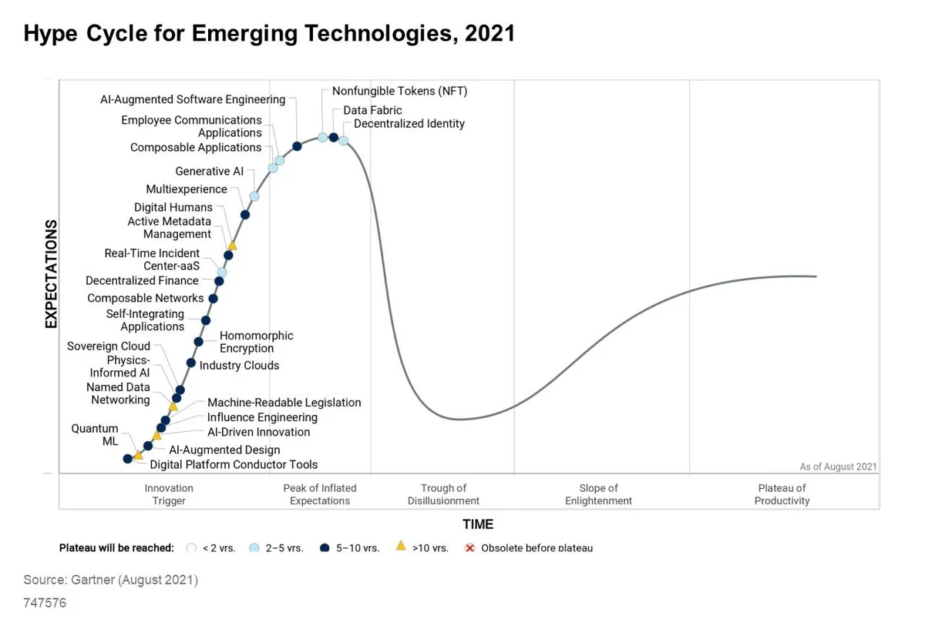

Slide 20
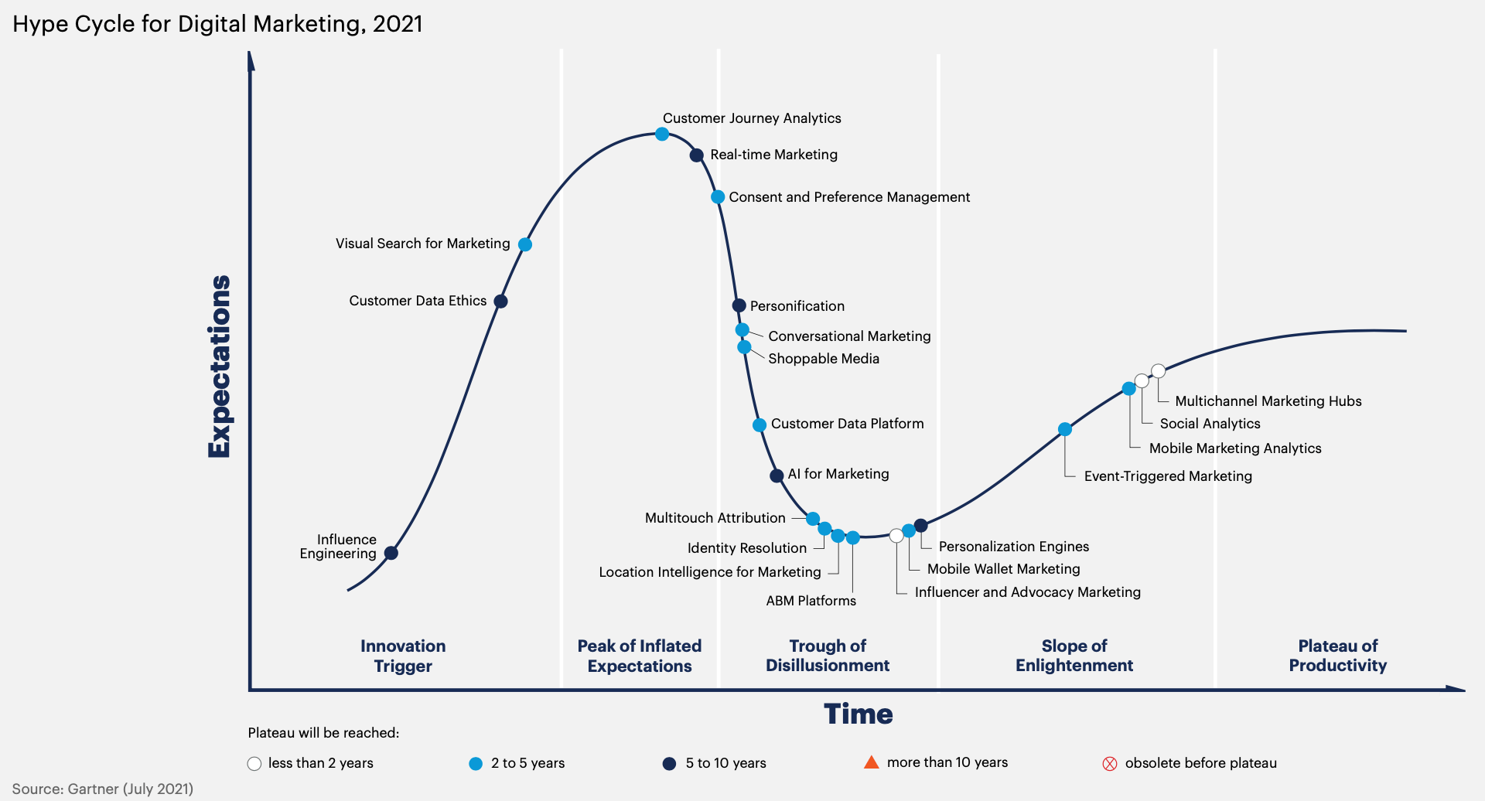

Slide 21
Quiz 3 includes topic from Week 10, 11.
Related content available on from the weekly lecture notes.
Quiz Guidelines:
The Quiz is worth 10 marks (10%).
Length - 15 minutes.
There are 14 multiple-choice questions (MCQs).
6 out of 14 questions are worth 1 mark each.
The remained questions (#10) are worth 0.5 mark each.
Quiz 3

Slide 22
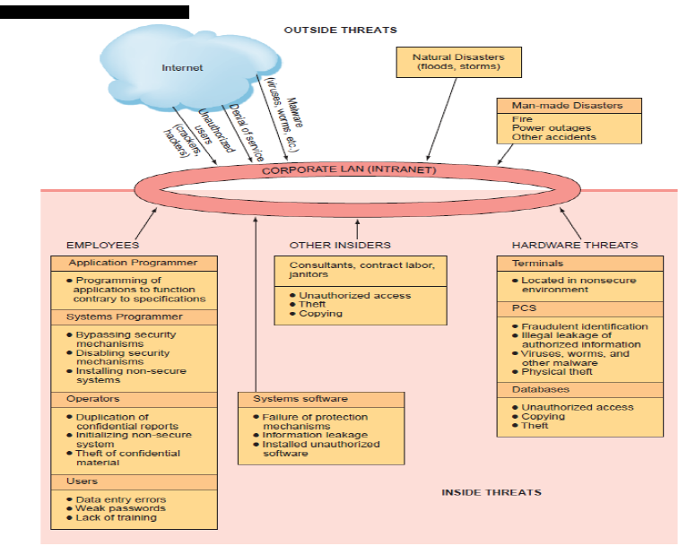
Quiz 3

Slide 23
SFS time
https://www.sfs.uts.edu.au/

Slide 24
Fun time
https://quickdraw.withgoogle.com/

Slide 25
Assignment 4- Reflective Report
Assignment 4- Reflective Report
Type: Individual
Weight: 20 Marks (20%)
Due: Tuesday, 9 November

Slide 26
I am more than happy to be your reference in future

