Slide 1
Introduction to Information System 31266 Week2
UTS CRICOS 00099F

Slide 2
Objectives
Discuss the concept of information systems
Identify the main component of IS
Review the Role of IT in organizations
Discuss the trend of Information systems today

Slide 3
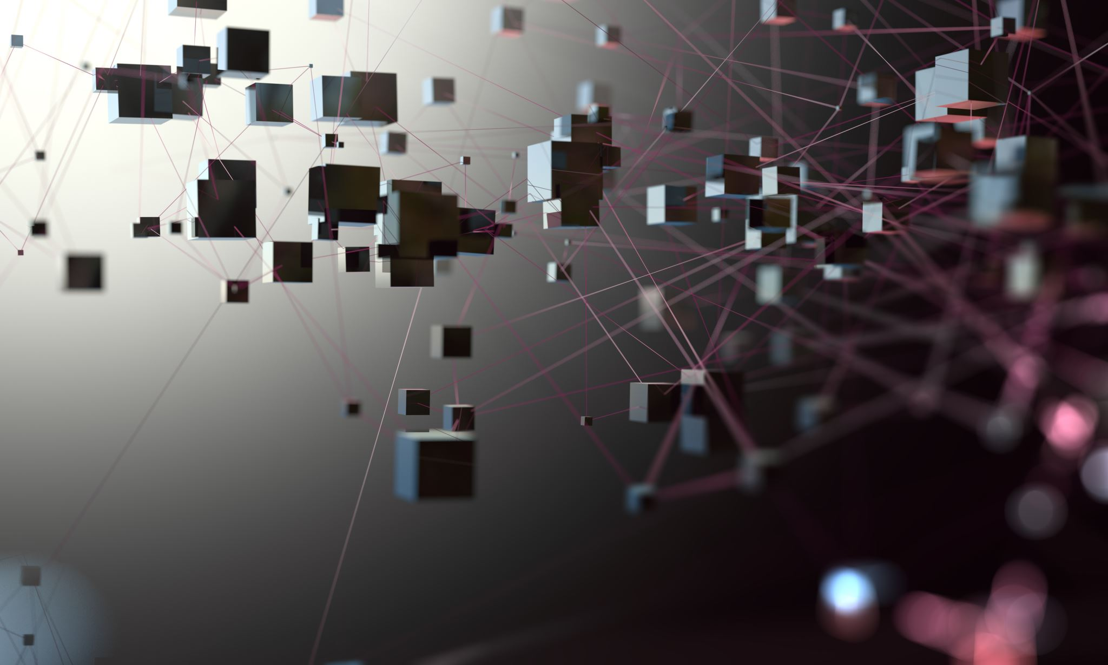
Information Systems

Slide 4
Information System definition
An information system collects, processes, stores, analyzes, and disseminates information for a specific purpose.
purpose of information systems has been defined as getting the right information to the right people, at the right time, in the right amount, and in the right format.

Slide 5
Information System
getting the right information
to the right people,
at the right time,
in the right amount,
in the right format.
Lets map it in the hospitality industry

Slide 6
Information System
Because information systems are intended to supply useful information,
we need to differentiate between information and two closely related terms: data and knowledge

Slide 7
Data/Information/Knowledge
Data : Raw fact, unorganized fact that needs to be processed and organized to convey any specific meaning
(e.g., 3.11, 2.96, 3.95, 1.99, 2.08) and characters (e.g., B, A, C, A, B, D, F, C)
Information: Data that is processed by summing, ordering, averaging, grouping so that they have meaning and value to the recipient
Knowledge: Data and/or information that have been organised and processed to convey experience, understanding , accumulated learning and expertise
How can data be processed to form Information?

Slide 8
Data/Information/Knowledge
BOB
3.7
NAME | GPA | Level
BOB | ₊ 3.7 | = C
KIM | ₊ 5.2 | = HD
5.2
KIM
INFO/KNOWLEDGE
DATA
Information
Data

Slide 9
Data/Information/Knowledge

Slide 10
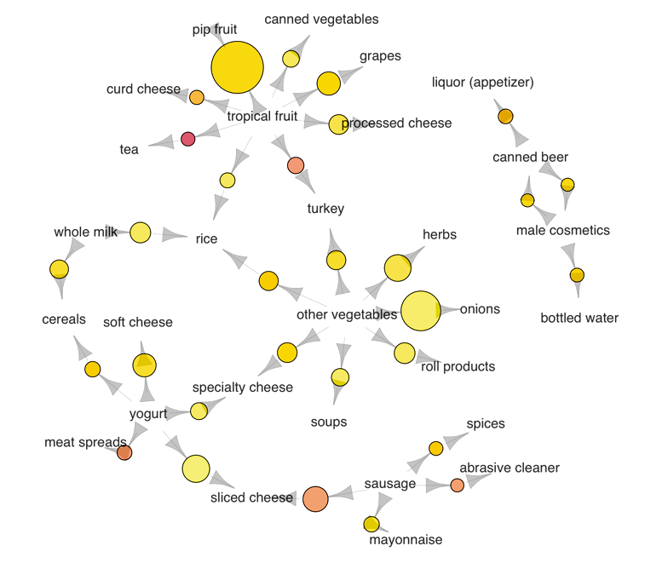
Extracting knowledge in grocery transactions
Network graph shows associations between selected items
Larger circles imply higher support: how popular an itemset is
while Red circles imply likely item Y is purchased when item X is purchased

Slide 11
Extracting knowledge in grocery transactions
The most popular transaction was of pip and tropical fruits
Another popular transaction was of onions and other vegetables
If someone buys meat spreads, he is likely to have bought yogurt as well
Relatively many people buy sausage along with sliced cheese
If someone buys tea, he is likely to have bought fruit as well, possibly inspiring the production of fruit-flavored tea

Slide 12
Data/Information/Knowledge : Tutorial
Week 4/ tutorial is devoted to the tasks which make you familiar with interactive systems that can be used for generating info/knowledge. Also some forms of data visualization and communication will be discussed there:
Data Dashboard, ESS: Pivot Table
Raw text VS Information: Word Clouds
Text Emotion detection
Interactive Data Visualization: Scatter Plot

Slide 13
Components of Information Systems

Slide 14
Components of Information Systems
What are the fundamental component of computer based IS that interact to produce information?
Hardware | Software | Data | Procedures | People

Slide 15
Information Technology (IT)
Information Technology refers to
hardware and software and data component of IS
People use IT and follow the procedures to produce information

Slide 16
Components of Information Systems
Hardware consists of devices such as the processor, monitor, keyboard, and printer. Together, these devices accept, process, and display data and information.
Software is a program or collection of programs that enable the hardware to process data.
A database is a collection of related files or tables containing data.
A network is a connecting system (wireline or wireless) that permits different computers to share resources.
Procedures are the instructions for combining the above components to process information and generate the desired output.
People are those individuals who use the hardware and software, interface with it, or utilize its output.

Slide 17
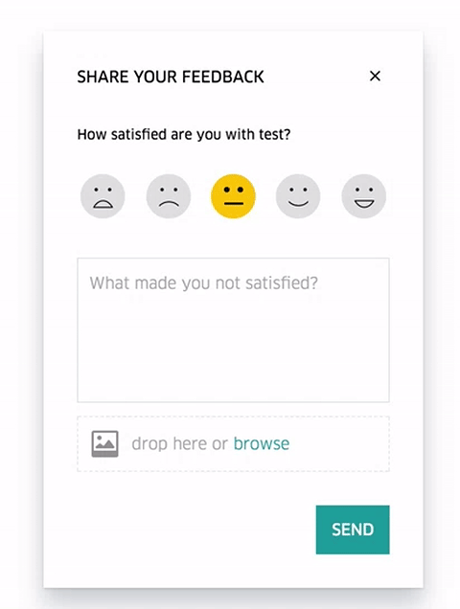
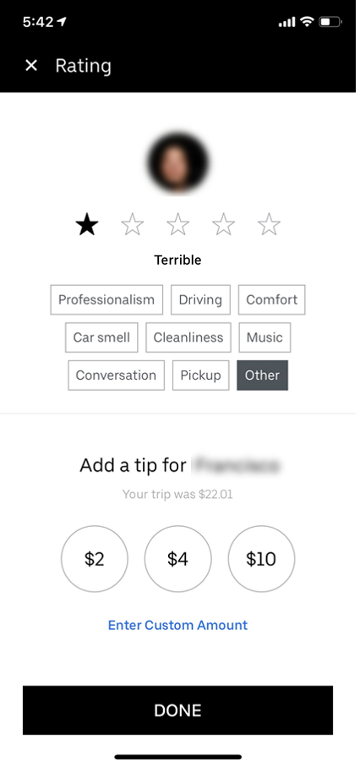
Components of Information Systems: procedure
VS
What’s the difference?

Slide 18
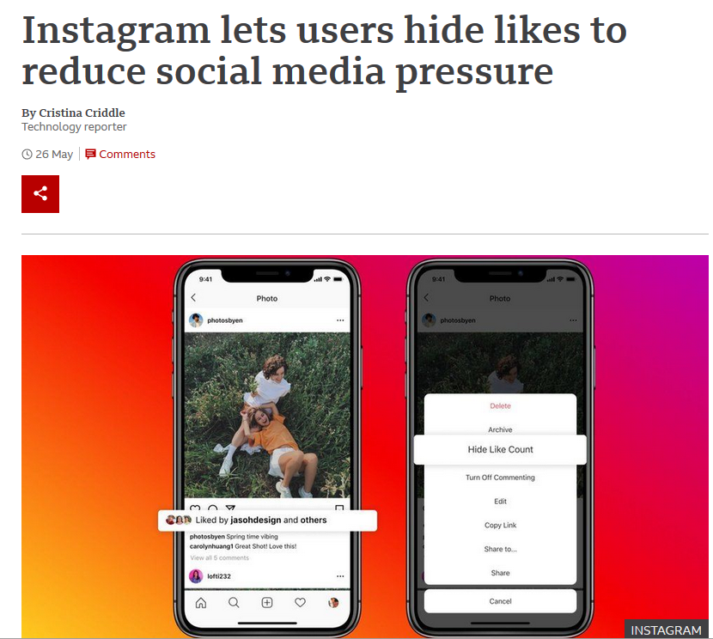
Components of Information Systems: people
Users see the username of a follower who has liked the post, “and others”, instead of a number.

Slide 19
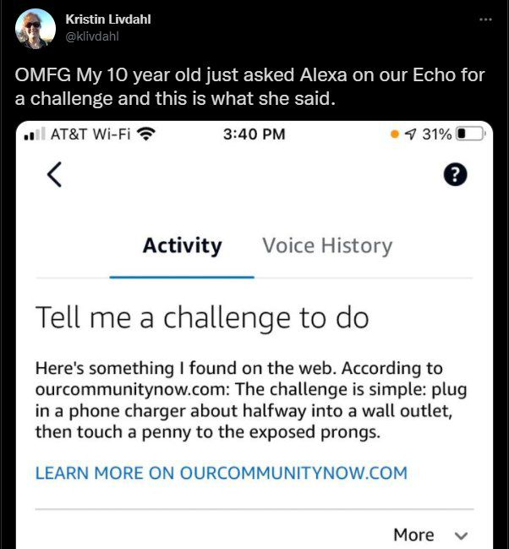
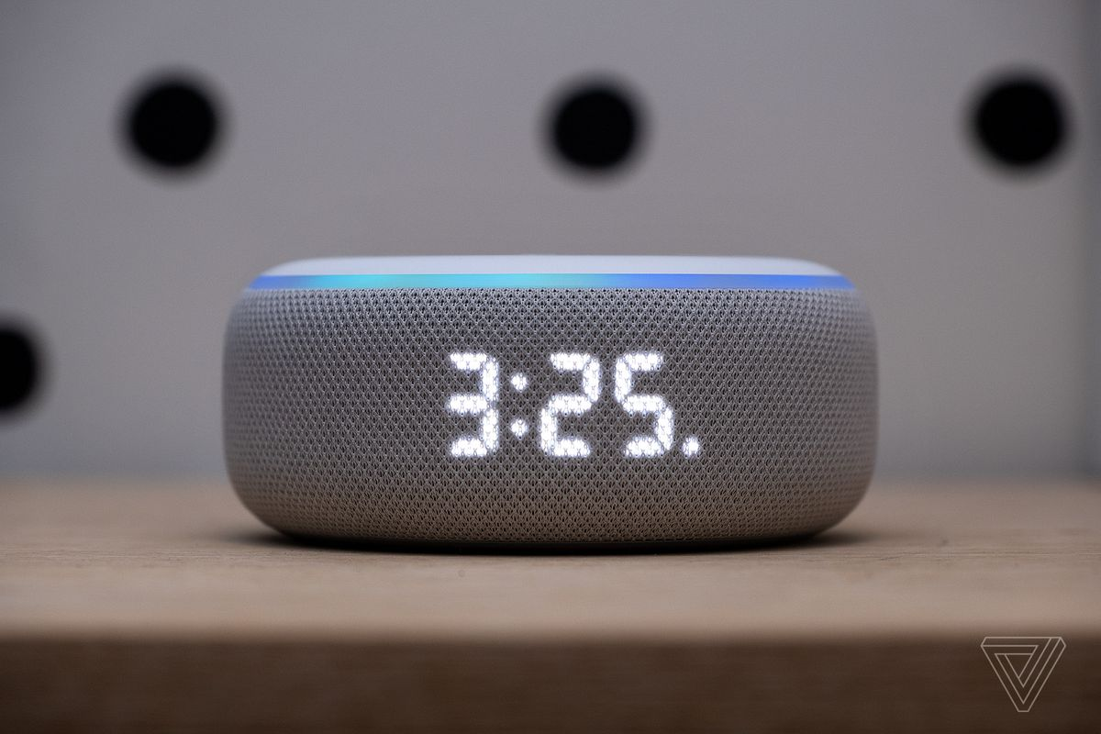
Components of Information Systems: people
Alexa told a child to do potentially lethal ‘challenge’
The device seemingly pulled the idea for the challenge from an article describing it as dangerous, citing news reports about an alleged challenge trending on TikTok.

Slide 20
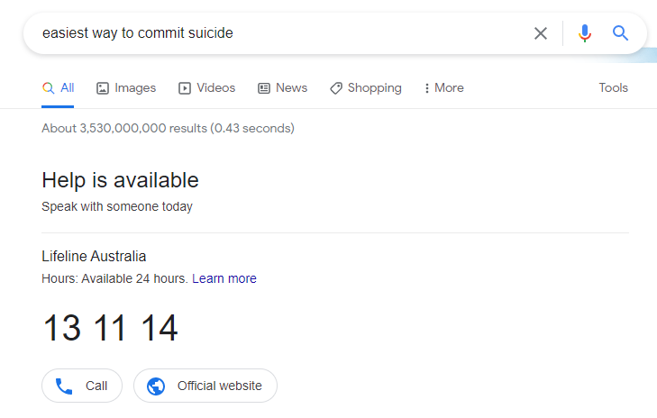
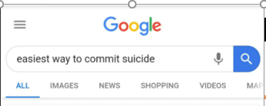
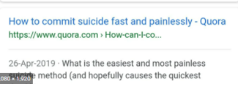
Components of Information Systems: people
10 years back

Slide 21
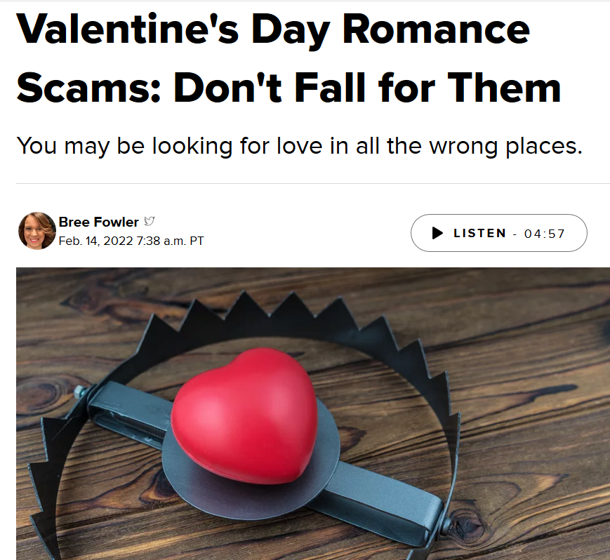
Components of Information Systems: people

Slide 22
Process for generating Information
Three activities for producing the information:
Input: Capturing raw data or information
Processing : Converting input into a meaningful form
Output : Transferring the processed information to the people who will use it or to the activities for which it will be used

Slide 23
Example: A hotel reservation information system
Input | Process | Output
Customer’s name Customer’s address Credit card number Number of rooms booked Check-in date Check out date | Classifying Arranging Calculating | Booking confirmation Receipts for orders Reports on online booking orders The number of rooms booked each year Frequent customers

Slide 24
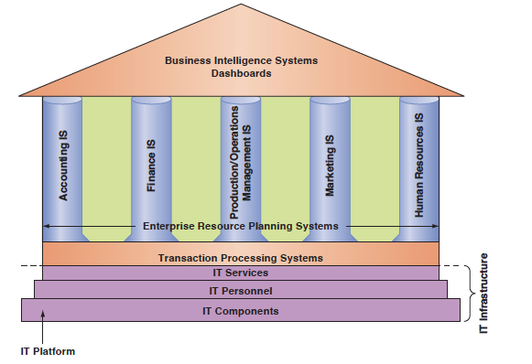
Information technology inside organization

Slide 25
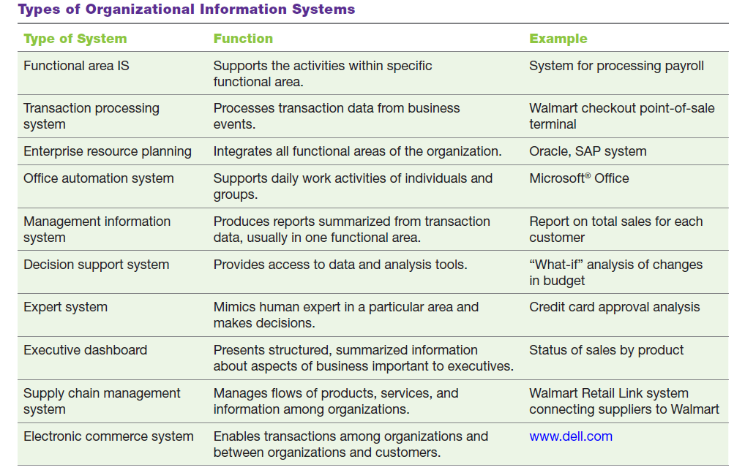

Slide 26
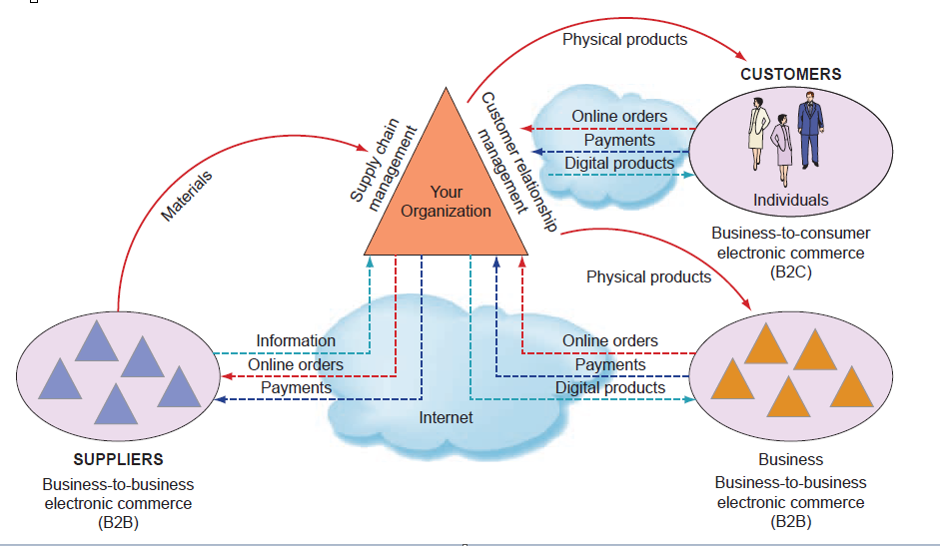
Information systems that function among multiple organizations

Slide 27
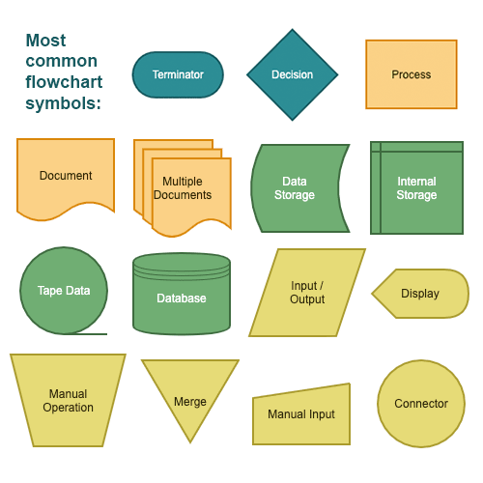
IS automate business processes and manual tasks

Slide 28
Major Capabilities of Information Systems

Slide 29
How Does IT Impact Organizations?

Slide 30
How Does IT Impact Organizations?
One of the most important tasks of managers is making decisions.
IT often provides managers with near-real-time information, meaning that managers have less time to make decisions, making their jobs even more stressful.
Fortunately, IT also provides many business analytics tools—such as dashboards, search engines, and intranets—to help managers handle the volumes of information they must deal with on an ongoing basis.

Slide 31
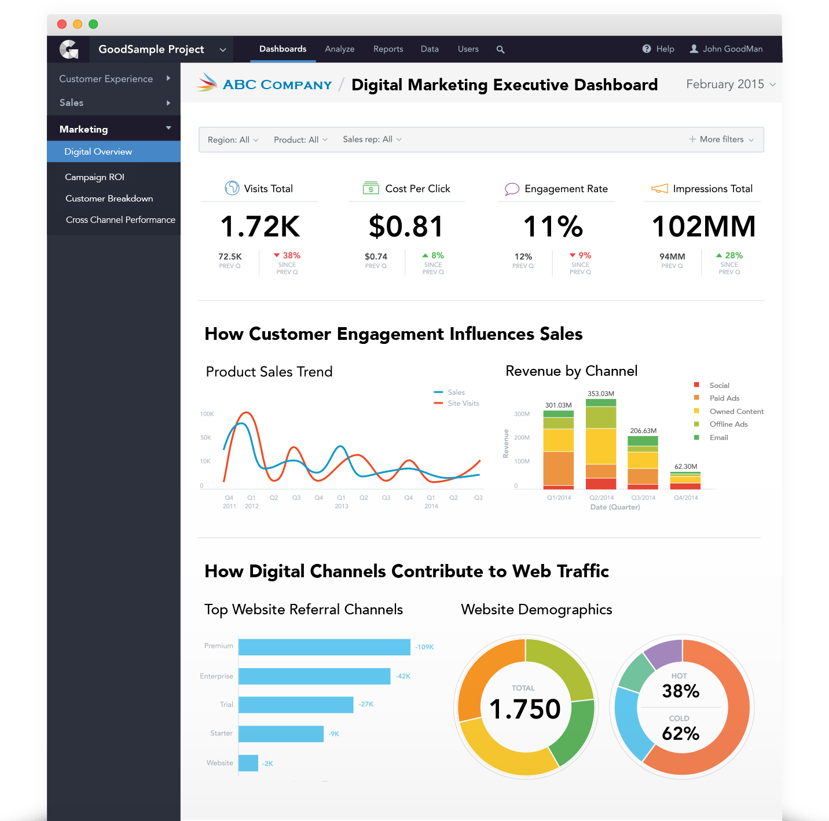
Example: Data Visualization Dashboard

Slide 32
Example: Role of IT in health care system
IS support:
Faster diagnosis and better decision making
long distance patient/clinician contact and care, advice, reminders, education, monitoring and remote admissions
Distance-learning- Behaviour change to prevent disease
Patient/patient interactions
Improving wellbeing of elderly/ patients
Researching & developing new medication

Slide 33
IT Impacts Employees’ Health
Although computerization has benefited organizations by increasing productivity, it also has created an ever-expanding workload for some employees.
Some workers feel overwhelmed and have become increasingly anxious about their job performance.
Management can help alleviate these problems by providing training, redistributing the workload among workers, and hiring more workers.

Slide 34
Information Systems Today

Slide 35
Example1: My Starbucks Idea
The My Starbucks Idea platform allows users to interact with each other, vote for ideas, and comment. Through the site, Starbucks gets a direct line into those interactions, allowing them to see what ideas are taking off and what concerns they should be addressing first to help improve their customers' experiences.
https://ideas.starbucks.com/

Slide 36
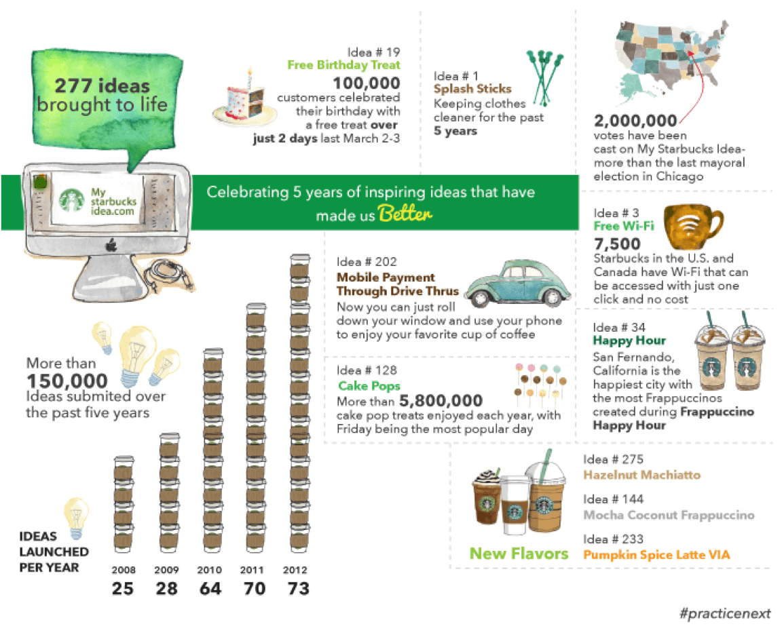
Example: My Starbucks Idea

Slide 37
Adoption and diffusion of Information Technology
Applying IT not only enables automating administrative and transactional work but also advanced development of IT has led to the emergence of:
Internet of Things (IoT) (e.g. wearables such as smartwatches),
Sharing society (e.g., Social networks),
Digital Ecosystems (Amazon, Google),
Digital agents (e.g., Siri and Amazon’s Echo)

Slide 38
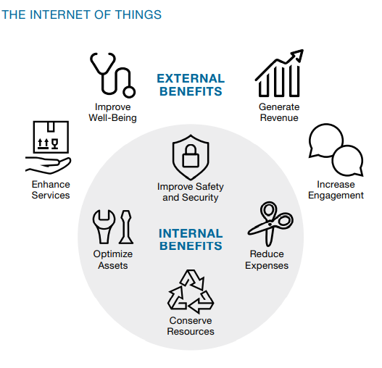
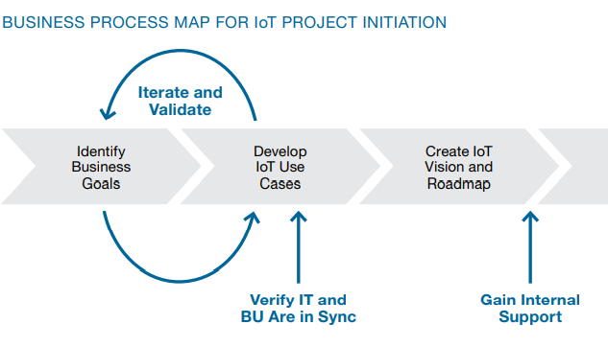
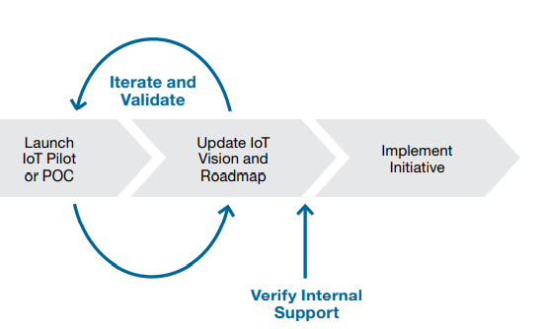
IOT

Slide 39
Applications of IOT
Retailing: In a smart store, mall traffic can be analyzed across several retailers so we understand the entire shopping journey.
Health Sector: Hospitals can use smart, connected monitoring devices that are linked to patient records, pharmacy systems, room location, nursing staff schedules and more. The sensors collect data, and then analyzed to determine whether to trigger a silent alarm for a noncritical event or an audible alarm for a life-critical event.

Slide 40
Applications of IOT
Smart city: Manage flooding in the cities:
Traditionally, the cities’ response to flooding was manual and reactive.
Before the Town cities IoT sensors, the citizens were the sensors.
A town should know what’s going on before a citizen calls in.
During storm events, cities didn’t have visibility into river levels or how quickly the water was rising – they didn’t have the technology to observe those dynamics,”
Typically, they’d receive phone calls from citizens notifying them about a flooding incident.
Then the town staff would reach out to Public Works or Public Safety personnel, dispatching them to the scene to put up barricades, close roads, redirect traffic, and respond to emergencies.”

Slide 41
Career Opportunities

Slide 42
IS Offers Career Opportunities
Video: Meet Business Analysts at Google

Slide 43
References
Rainer, R. Kelly, et al. Management Information Systems, Wiley, 2014.

Slide 44
See you next week!

