Slide 1
Welcome to 31266 Introduction to Information Systems
Course coordinator
Dr Morteza Saberi
Email:
Morteza.Saberi@uts.edu.au

Slide 2
Content
Define Transaction Processing Systems
Define Decision Support Systems
Define Management IS
Define Executive Support Systems
Explore Reports options
Define Expert Systems
Explore the Functional Area Information Systems
Define Enterprise Resource Planning (ERP) Systems

Slide 3
Information Systems within the Organisation

Slide 4
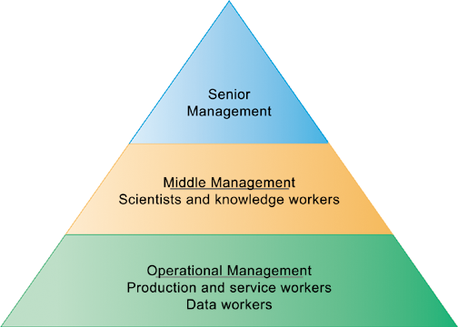
Information Systems and managerial levels
Different information systems are used by different levels of managerial pyramid
What types of Information systems serve each of these managerial levels?

Slide 5
Mapping between organisation level and type of IS

Slide 6
Transaction Processing Systems

Slide 7
Transaction Processing Systems (TPS)
Transaction: any event that generates data worthy of being captured.
Examples: A product manufactured, A service sold, A person hired, and A payroll check generated
TPS supports the monitoring, collection, storage, and processing of data from the organization’s basic business transactions, each of which generates data.
TPS collects data continuously, typically in real time and it provides the input data for the corporate databases.

Slide 8
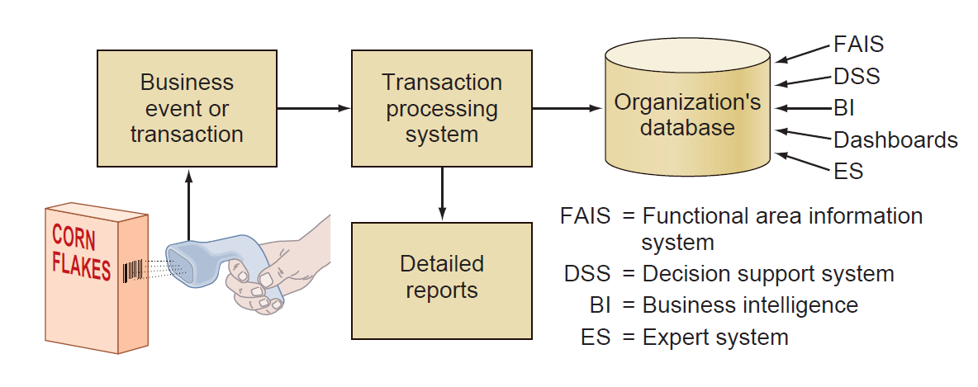
Transaction Processing Systems (TPS)

Slide 9
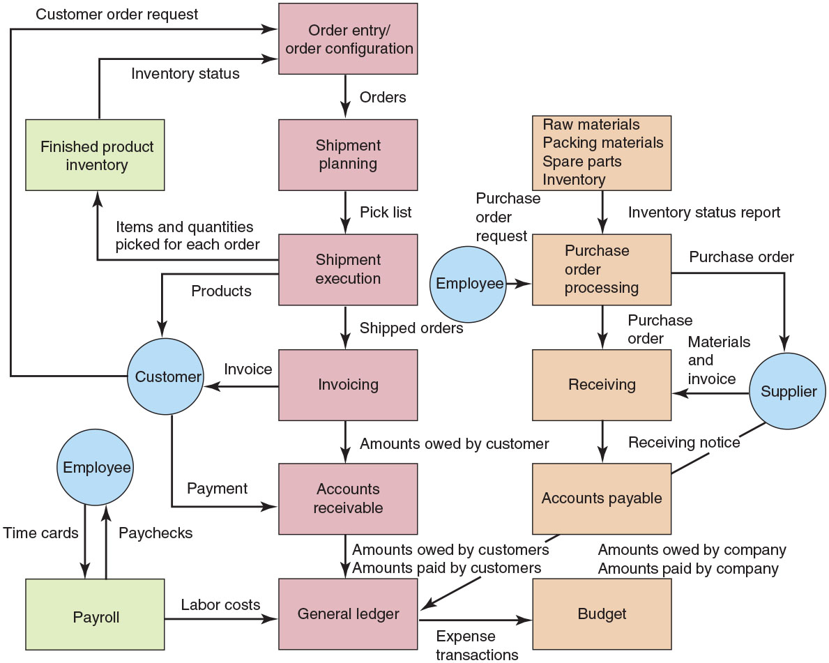
Integration of a firm’s TPS

Slide 10
The complexities of transactional data
When processing a transaction involves more than one computer, the database and all users must be protected against inconsistencies arising from a failure of any component at any time.
E.g an error at some point in an ATM withdrawal can enable a customer to receive cash, although the bank’s computer indicates that he or she did not.
(Conversely, a customer might not receive cash although the bank’s computer indicates that he or she did.)

Slide 11
Example: A Payroll TPS

Slide 12
How TPS processes data
TPS processes data in one of two basic ways:
Batch processing system
Business transactions are accumulated over a period of time and prepared for processing as a single unit or batch
Essential characteristic: delay between event and processing of related transaction to update records
Online transaction processing (OLTP)
Each transaction is processed immediately
Data in an online system reflects current status
Many find OLTP enables faster, more efficient service

Slide 13
Example: Online Transaction Processing (OLTP)
For example, when you pay for an item at a store, the system records the sale by reducing the inventory on hand by one unit, increasing sales figures for the item by one unit and increasing the store’s cash position by the amount you paid.

Slide 14
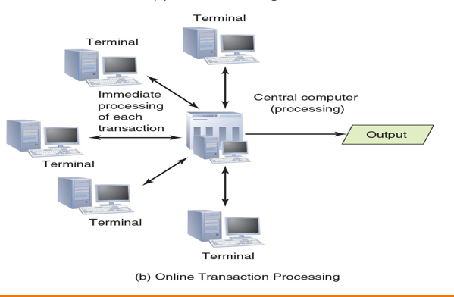
Batch versus online transaction processing
Batch processing inputs and processes data in groups
In online processing, transactions are processed as they occur

Slide 15
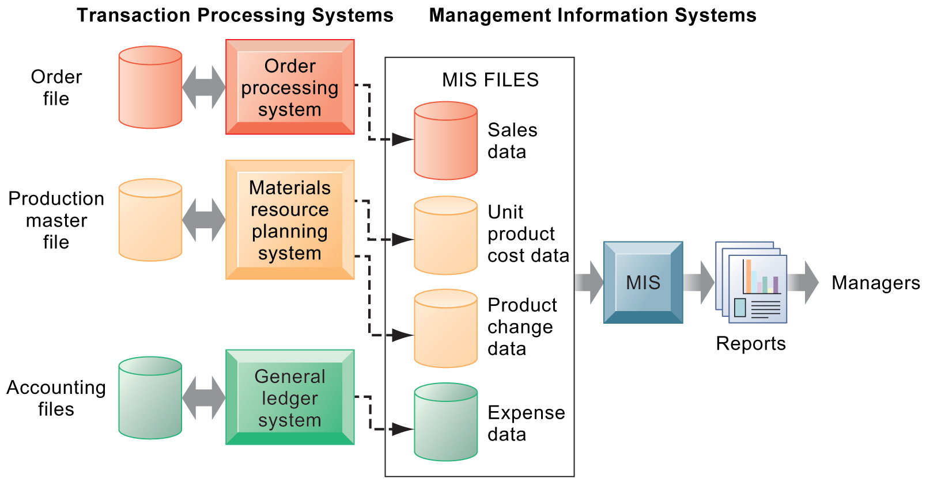
Management Information Systems (MIS)
provides middle management with reporting on organisational performance - used for planning, monitoring, and controlling the business
decision making
E.G
human resource
management systems
Inventory control system
maximize profit from investment

Slide 16
How Management Information Systems Obtain Their Data from the Organization’s TPS
TPS, MIS/DSS, and special information systems in perspective
A TPS provides valuable input to MIS, DSS, and KM systems.

Slide 17
Decision Support Systems (DSS)

Slide 18
Decision Support System (DSS)
enables middle managers to analyse large amount of detailed data from different internal and external sources and support their decision making.
Analyzing complex relationships among thousands or even millions of data to discover patterns, trends is one of the key uses associated with DSS .
Ex1: doctors may enter symptoms into a DSS so it can help diagnose and treat patients. Insurance company use DSS to gauge the risk of providing insurance to drivers who have imperfect driving records.
Ex2: DSS in the health: https://www.medexter.com/demos

Slide 19
Decision Support System (DSS)
What-if Analysis process of determining the effects on outcomes/output in a model through changes in input
Sensitive analysis allows to understand how different inputs values and their probability of occurring (e.g., rate of inflation and its probability of occurring) will affect the results of a model. It refers to varying the inputs to a model to see how the results change
Goal Seeking occurs when the decision maker has a specific outcome in mind and need to determine how it can be achieved. Finally, optimization models allow finding the best balance between certain parameters within given constraints.

Slide 20
Executive Support Systems (ESS)

Slide 21
Executive Support Systems (ESS)
What level of mangers can be served with these information systems(ESS)?
Serve senior managers
ESS Support
Strategic decision making
E.g., What products should we make in five years?
Nonroutine decision making
ESS Use portal with Web interface, or digital dashboard, to present content

Slide 22
Executive Support Systems (ESS)
A digital dashboard is a business intelligence tool that allows business leaders to:
track, analyze and report on KPIs and metrics.
Digital Dashboard Benefits
Turn data into business value
Rally key stakeholders
Move data literacy forward

Slide 23
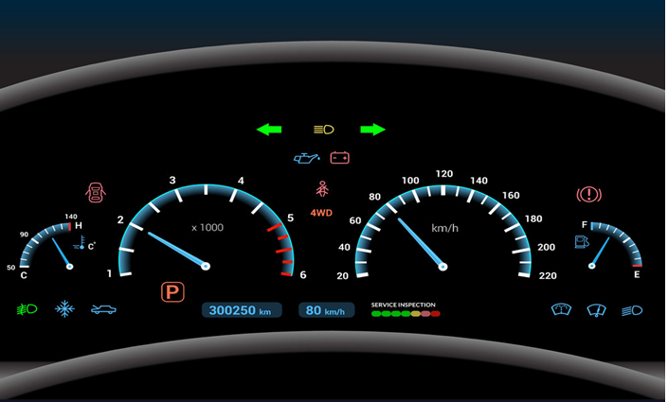
Digital Dashboard
You will work with “pivot table “ in Week 4-tutorial. It shows you how this concept can be used for quick access to some sorts of data.
https://www.qlik.com/us/dashboard-examples/digital-dashboard

Slide 24
Reports

Slide 25
Reports
All information systems produce three main reports:
Routine Reports: are produced at scheduled intervals. They range from hourly quality control reports to daily reports on absenteeism rates.
Ad-hoc (on-demand) reports:
Drill-down reports
Key-indicator reports
Comparative reports
Exception reports include only information that falls outside certain threshold standards: performance standards.

Slide 26
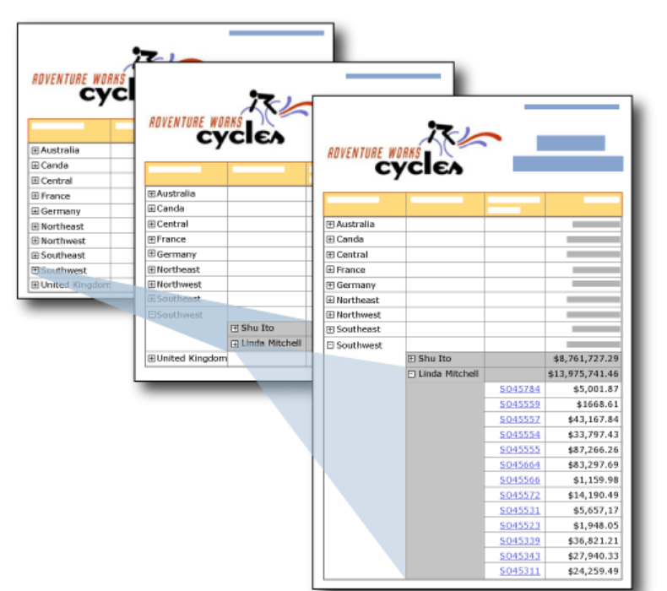
Drill-down reports
Drill-down reports display a greater level of detail.
E.g. a manager might examine sales by region and decide to “drill down” to more detail by focusing specifically on sales by store and then by salesperson.

Slide 27
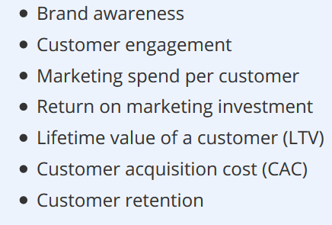
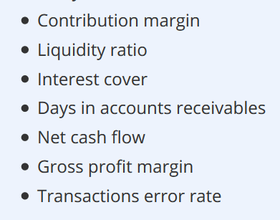
Key-indicator reports
Key-indicator reports summarize the performance of critical activities.
E.g. a chief financial officer might want to monitor cash flow and cash on hand.
Marketing metrics
Financial Metrics

Slide 28
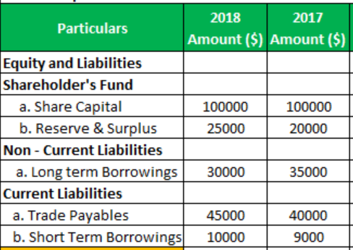
Comparative reports
Comparative reports compare, for example, the performances of different business units or of a single unit during different times.

Slide 29
Exception Reports
Exception reports: Include only information that falls outside of normal range.
Example: Fulfilment Time Exceptions
This exception report can help a customer service proactively head off customer dissatisfaction. If you establish "acceptable" shipping timeframes - the elapsed time between receiving an order from a customer and shipping it out - then you can generate exception reports that alert you only when an order has failed to ship within these timeframes.
We have a similar approach in “data analytics”, namely, outlier detection
The main difference between these two concepts is in the outlier detection we are not aware of the pattern and rules behind the data thus we take a data driven approach.

Slide 30
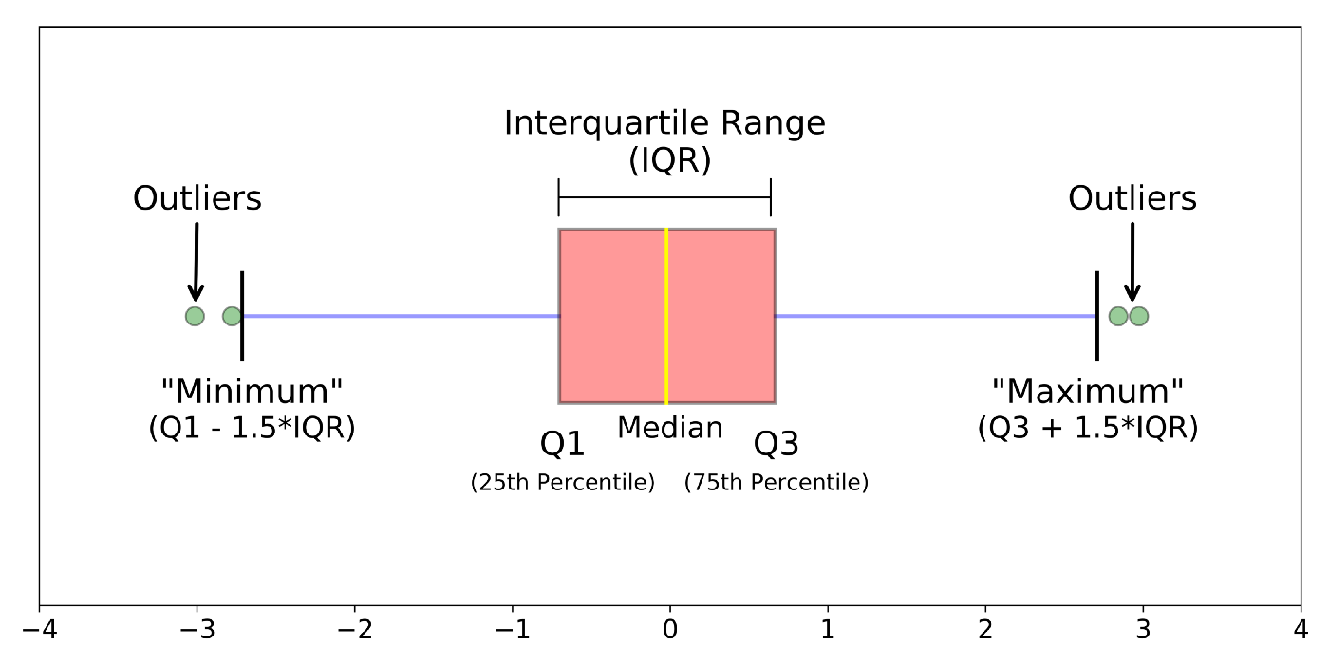
Exception Reports : Outlier detection
We introduce the IQR score technique in the first tutorial. You can working out with the provided code and see how this technique is working in the Google Colab platform.
the IQR score technique

Slide 31
Expert systems

Slide 32
Expert systems
Designed to be the most advanced and most reliable in solving complex problems, and they work in a specific domain
Capabilities of expert systems
Aiding in decision making
Data analysis, interpreting input, justifying conclusions
Characteristics of expert systems
Highly effective
Understandable
Reliable
Able to process data quickly
Capable of critical decision making

Slide 33
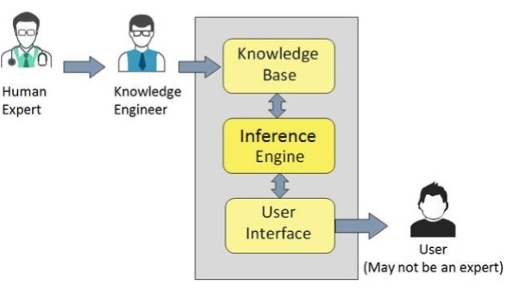
Participant in Expert Systems Development
Domain expert: person or group with the expertise or knowledge the expert system is trying to capture
Knowledge engineer: person who has training or experience in the design, development, implementation, and maintenance of an expert system
Knowledge user: person or group who uses and benefits from the expert system
Needs no previous training or experience

Slide 34
Components of Expert Systems
The components of ES include:
Knowledge base (the focus of this lecture)
Inference engine
User interface

Slide 35
Knowledge base component in ES
It contains domain-specific and high-quality knowledge.
Knowledge is required to exhibit intelligence. The success of any ES majorly depends upon the collection of highly accurate and precise knowledge.
The knowledge base of an ES is a store of both, factual and heuristic knowledge:
Factual Knowledge − It is the information widely accepted by the Knowledge Engineers and scholars in the task domain.
Heuristic Knowledge − It is about practice, accurate judgment, one’s ability of evaluation, and guessing.

Slide 36
Components of Knowledge Base
Knowledge representation: It is the method used to organize and formalize the knowledge in the knowledge base. It is in the form of IF-THEN-ELSE rules.
Knowledge Acquisition: The success of any expert system majorly depends on the quality, completeness, and accuracy of the information stored in the knowledge base.
The knowledge base is formed by readings from various experts, scholars, and the Knowledge Engineers. The knowledge engineer is a person with the qualities of empathy, quick learning, and case analyzing skills.

Slide 37
Knowledge representation

Slide 38
Functional Area Information Systems (FAISs)

Slide 39
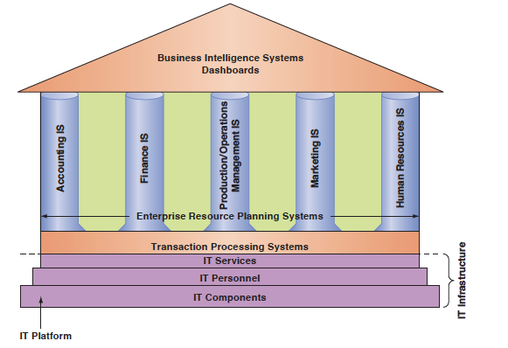
Information technology inside organization
https://app.mural.co/t/scottdanielutseduau0344/m/scottdanielutseduau0344/1646607753734/4a077aff61a14a4e84c96f5020012a5b2627241a?sender=u95354a4dec5f80c400c36780

Slide 40
Information Systems for Production/ Operations Management
In-House Logistics and Materials Management
Inventory Management. Excessive inventory and insufficient inventory create problems. Operations personnel make two basic decisions: (i) when to order and (ii) how much to order.
Quality Control. used by manufacturing units provide information about the quality of incoming material and parts, as well as the quality of in-process semifinished and finished products.

Slide 41
Information Systems for Production/ Operations Management
Computer-Integrated Manufacturing is an approach that integrates various automated factory systems.
Product Life Cycle Management is a business strategy that enables manufacturers to share product-related data that support product design and development and supply chain operations. Manages the product from its inception through its completion.
Example: https://sketch2code.azurewebsites.net/

Slide 42
Information Systems for Accounting and Finance
Expense management
Control and Auditing

Slide 43
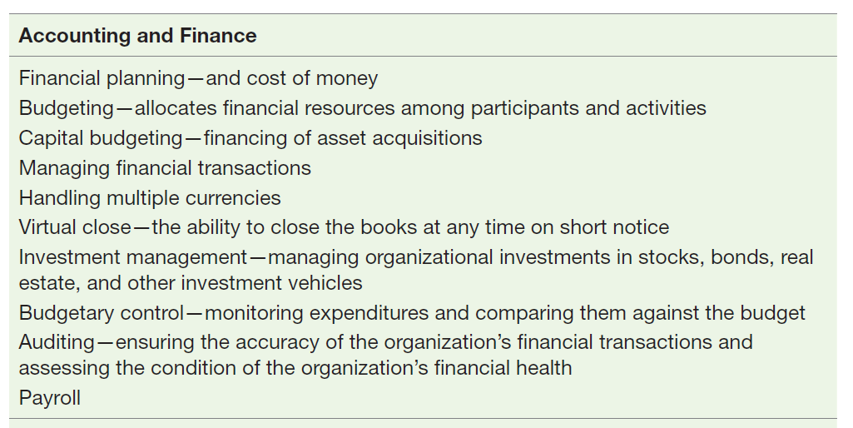
Information Systems for Accounting and Finance

Slide 44
Information Systems for Human Resource Management
Recruitment
Human Resources Planning and Management

Slide 45
Information Systems for Human Resource Management
Managing human resources in large organisations requires extensive planning and detailed strategy.
The following three areas are where IT can provide support:
• Payroll and employees’ records
• Benefits administration
• Employee relationship management
Ex: Recruitment Chatbot: https://www.talview.com/recruitment-chatbot

Slide 46
Information systems for marketing
Information systems provide numerous types of support to the marketing function.
Sales force automation help salespeople with the sales process
NIKEid

Slide 47
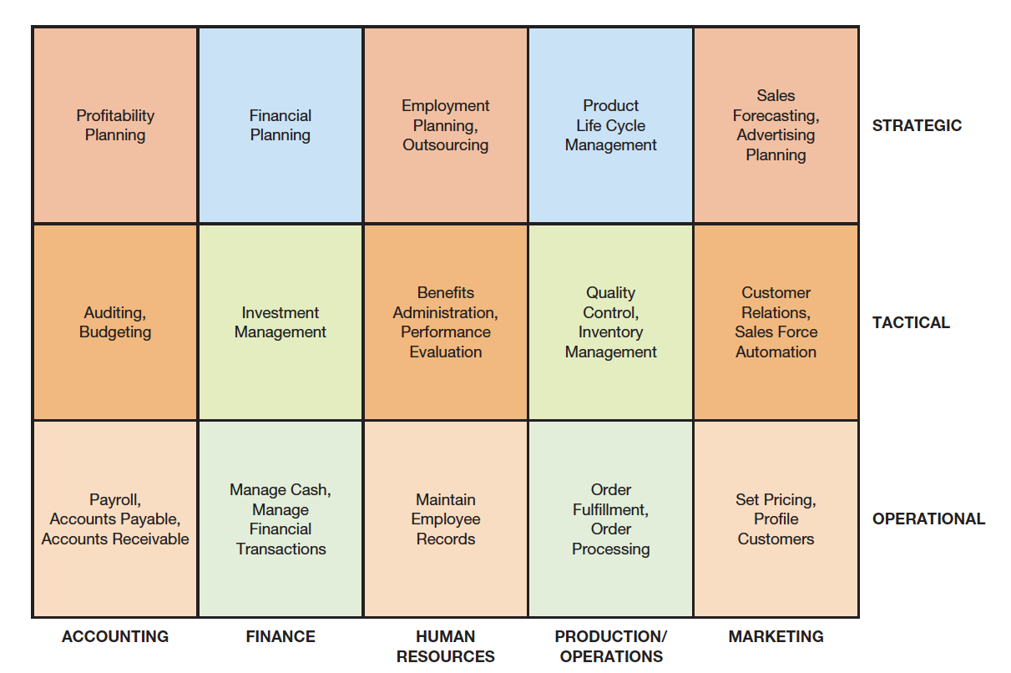
Examples of information systems supporting the functional areas

Slide 48
Enterprise Resource Planning (ERP) Systems
functional area information systems were developed independently of one another,
ERP systems are designed to correct a lack of communication among the functional area IS!
ERP systems tightly integrate the functional area IS via a common database.
The leading ERP software vendor is SAP!
Ex: Case studies- ERP Solutions

Slide 49
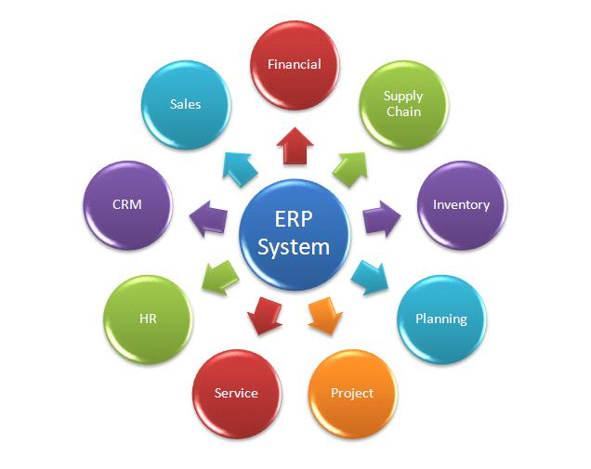
Enterprise Resource Planning (ERP) Systems

Slide 50
ERP II
ERP II describes web–based software that provides real–time access to employees and partners
Supply Chain Management (SCM)
Customer Relationship Management (CRM)

Slide 51
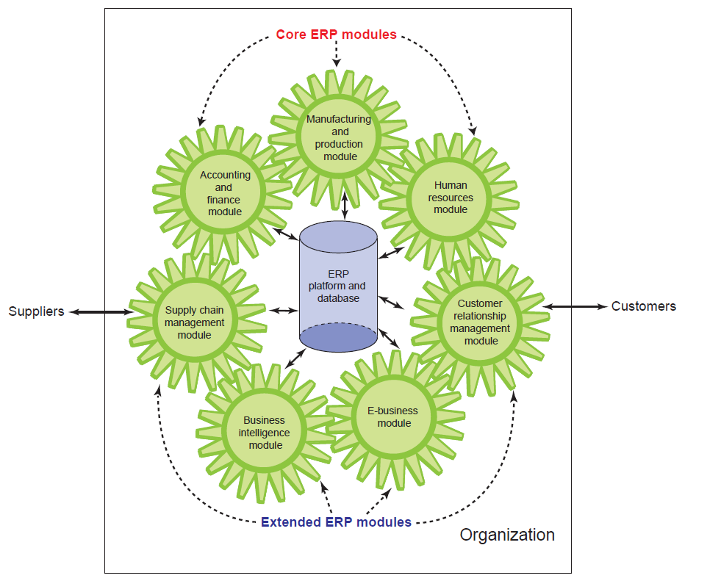
ERP II System

Slide 52
Benefits and limitations of ERP systems
Benefits | Limitations
Organizational flexibility and agility | Companies may need to change their existing business processes
Facilitating decision making | ERP systems can be complex, expensive
Improving quality and efficiency | time-consuming to implement

Slide 53
Supply Chain Management (SCM) Systems
SCM Support and Facilitate
relationships with suppliers, purchasing firms, distributors, and logistics companies
managing shared information about orders, production, inventory levels
Coordinating business processes that deal with customers in sales, marketing, and customer service
What are the goals of SCM?

Slide 54
Week 3- Tutorial

Slide 55
Group formation
Familiarity with the group assignments
We talked about this in Week 2, during the tutorial you get the chance to extend it and see how it can be beneficial for variety of industries.

Slide 56
IoT is one of the cutting edge technology which transform different industrial sectors. You can find it out more in your tutorial.
In Week 2, the difference between data/information/knowledge have been discussed. In the tutorial you will work on the a given company’s customer age to find out a possible outlier!

Slide 57
References
Rainer, R. Kelly, et al. Management Information Systems, Wiley, 2014.
https://examnightslive.wordpress.com/2018/11/18/type-of-information-systemcontd/

Slide 58
Q & A

Slide 59
See you next week!

