Slide 1
Welcome to Introduction to Information System 31266 Week4
UTS CRICOS 00099F

Slide 2
Organisational Strategy, Competitive Advantage, and Information Systems

Slide 3
Objectives
Define Organisational Strategy
Define Competitive Advantage
Explore Business Process concept
Identify Business Pressures
Explore how Information systems to address Business pressures
Describe Porter’s Competitive Forces Model

Slide 4
Organisational Strategy

Slide 5
Mural Activity
What does the term ‘strategy’ mean to you?
Does ‘strategy’ reflect a long term or a short-term perspective?
Do you have a ‘strategy’ in your life for achieving your important goals? How does your UTS degree help you achieve them?
Notes:
https://app.mural.co/t/scottdanielutseduau0344/m/scottdanielutseduau0344/1647293628471/466411c6daa0aeba5b689b43ae370176383dee63?sender=u95354a4dec5f80c400c36780

Slide 6
Competitive advantage

Slide 7
Competitive advantage
Acquiring competitive advantage is essential for your organization’s survival.
In many cases, organizations achieve Competitive advantage by managing their business processes more profitably than their competitors do.
Competitive advantage is an advantage in some measure such as cost, quality, or speed that is not easily imitable by competitors;
it leads to control of a market and to larger than average profits.

Slide 8
Business process
A business process is an ongoing collection of related activities that create a product or a service of value to the organization, its business partners, and/or its customers.
A process is comprised of three fundamental elements:
Inputs: Materials, services, and information that flow through and are transformed as a result of process activities
Resources: People & equipment that perform process activities
Outputs: The product or a service created by the process

Slide 9
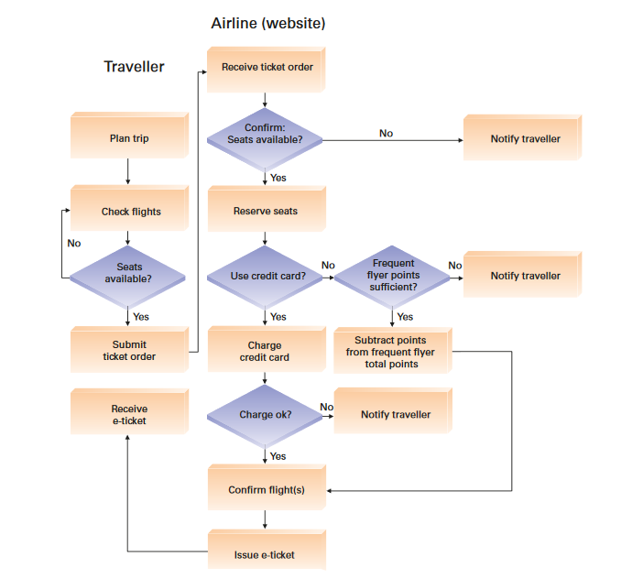
Ex:Business process for ordering e-ticket from airline Website

Slide 10
Information system and Business process
An organization’s business processes can create a competitive advantage if they enable the company to innovate or to execute more effectively and efficiently than its competitors.
An information system (IS) is a critical enabler of an organization’s business processes. Specifically, ISs play a vital role in three areas:
Executing the process
Capturing and storing process data
Monitoring process performance

Slide 11
Measures of competitive performance
How does an organization ensure business process excellence?
measures of competitive performance
Customer satisfaction
Cost reduction
Cycle and fulfillment time reduction
Quality
Differentiation
Productivity

Slide 12
Types of Business Pressure

Slide 13
How IS support organisations to respond business pressure?
Information systems enable organisations to respond to the different types of confronting modern pressures organisations.
Market Pressures
Technology Pressures
Societal/Political/Legal Pressures

Slide 14
Market Pressures
Market pressures are generated by the :
Globalization
The Changing Nature of the Workforce
Powerful Customers

Slide 15
Market Pressures- Globalization
Globalization Pressure operating on an international scale.
Organizations should apply approaches to compete in the international scales.
IS enable organization to respond to this pressure and to compete in the international scale. How?
E-Business and E-Commerce
Customer Relationship Management Systems; self- service systems
Make-to-Order systems; PAX Wardrobe planning tool

Slide 16
Market Pressures - Changing Nature of the Workforce
Workforce is Becoming More Diversified
Single Parents
Persons with Disabilities
are now employed in all types of positions
IS is easing the integration of these employees into the traditional workforce. How?
IS support Telecommuting Employees
IS support speech- and vision-recognition capabilities(for persons with disabilities)

Slide 17
Market Pressures- Powerful Customers
Increasing consumer sophistication & expectation
Consumer became more knowledgeable about
Products and services
Price comparisons
IS can help organization to respond to pressure generated by powerful customers and enhances customer intimacy
Customer Relationship Management Systems
Business Intelligence (BI) systems

Slide 18
Technology Pressure
Technological Innovation & Obsolescence Information Overload
IS enable organization to respond to pressure generated by
Rapid development of both new and substitute products & services
Vast stores of data, information, & knowledge that creates difficulties in managing data for decision making
Intelligent data management systems
Business Process Management (BPM)Systems

Slide 19
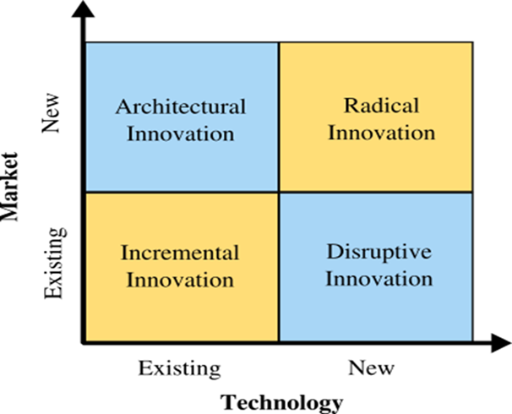

Slide 20
Societal/Political /Legal Pressure
IS enable organization to respond to Societal / Political / Legal Pressures
IS support and facilitate
Social Responsibility (through web 1.0 and web 2.0 applications)
Ovarian Cancer Australia
U3A Online
dNet
Compliance with Government Regulations
Protection against Terrorist Attacks

Slide 21
Porter’s Competitive Forces Model

Slide 22
Business-IT Alignment
Organizations should provide Business-IT Alignment. Tight integration of the IT functions with the strategy, mission, and goals of the organization
Characteristics of good business-IT alignment:
- Organizations view IT as an engine of innovation
- Organisations rotate business and IT professionals across departments
- Organisations provide overarching goals that are completely clear to each IT and business employee

Slide 23
Information systems & Competitive strategy
Information systems should support organizations’ competitive strategy
(The long term plan of a particular company in order to gain competitive
advantage)
Organization should determine the information systems that can support the organizations’ competitive strategy
How?

Slide 24
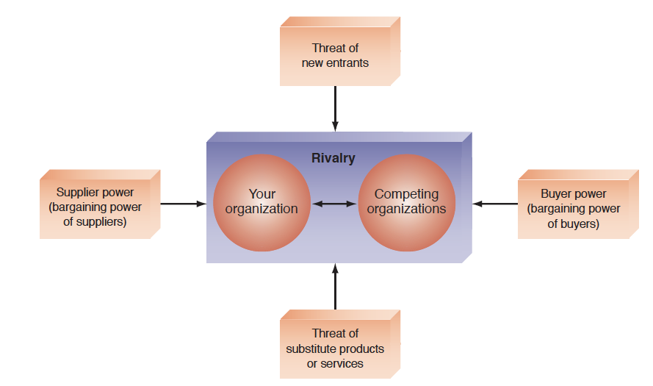
Porter’s Competitive Forces Model
The best-known framework for analysing competitiveness is Michael Porter’s competitive forces model (Porter, 1985)

Slide 25
Porter’s five competitive forces
Threats | High | Low
New market entrants | Market entry is easy | Significant barrier to enter the market
Suppliers (bargaining power) | Buyers (companies) have few choices | Buyers (companies) have many choices
Customers (bargaining power) | Buyers (customers) have many choices | Buyers (customers) have few choices
Substitute products/services | There are many substitutes | There are few substitutes
(Established) competitors | Intense competition among many firms | Less intense competition among few firms

Slide 26
Porter’s Value Chain Model
Organizations use the Porter competitive forces model to design general strategies.
To identify specific activities where they can use competitive strategies for
greatest impact, they use his value chain model (1985).
A value chain is a sequence of activities through which the organization’s inputs, are transformed into more valuable outputs.
The value chain model identifies points where an organization can use information technology to achieve competitive advantage
Every organization has a value chain

Slide 27
EX: Porter’s Value Chain Model in Manufacturing
Manufacturing companies typically perform five primary activities in the following sequence:
Inbound logistics (inputs)
Operations (manufacturing and testing)
Outbound logistics (storage and distribution)
Marketing and sales
Services

Slide 28
Porter’s Value Chain Model

Slide 29
Strategies for Competitive Advantage

Slide 30
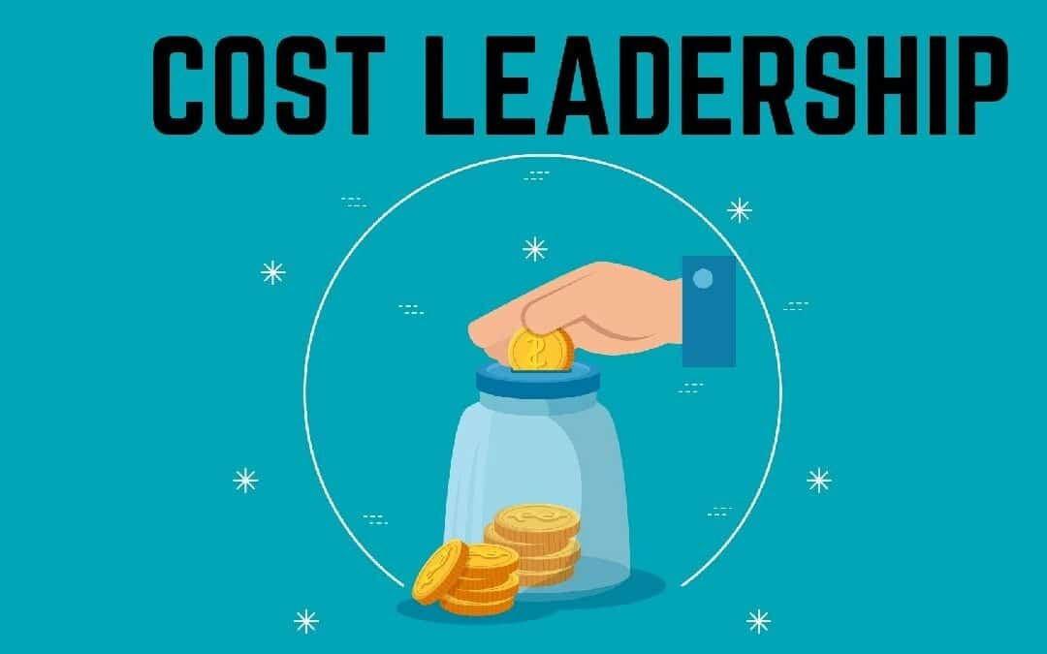
Cost leadership strategy
Produce products and/or services at the lowest cost in the industry.
An example is Walmart’s automatic inventory replenishment system, which enables Walmart to reduce inventory storage requirements.
As a result, Walmart stores use floor space only to sell products, and not to store them, thereby reducing inventory costs.

Slide 31
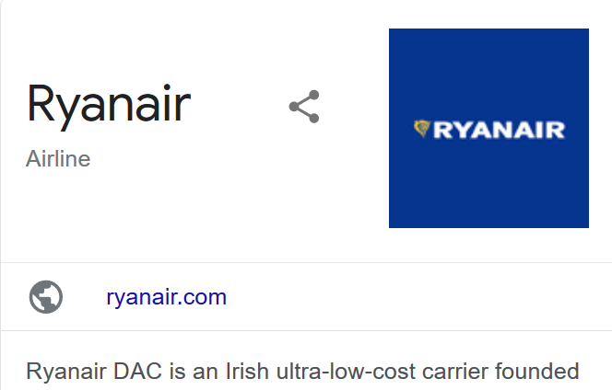
Ex1: Ryanair: The lowest cost airline in Europe
Airports: Ryanair flies to small secondary airports, which are sometimes located further away from the city centers.
Point-to-Point Routes: As opposed to a hub-and-spoke model used by national airlines, Ryanair’s model is a point-to-point model, which reduces customer transfer costs.
Labor Costs: Ryanair has the lowest labor costs in the industry
Standard Fleet: Ryanair uses a single type of jet (Boeing 737) for its entire fleet. This enables Ryanair to reduce its Maintenance, Repair and Overhaul costs, reduce its staff training, and increase flexibility in staff allocation.

Slide 32
Ex2: Huawai
Huawai entered the market as an unknown low-cost mobile technology brand.
Focusing on producing high quality products at a low-cost to the consumer.

Slide 33
Differentiation Strategy
Offer different products, services, or product features than your competitors.
This has proved to be a winning strategy for competing in the highly competitive industry.

Slide 34
Differentiation strategy examples
Apple inc, iconic, elegant and minimalist design
High price, set with the idea of being proportionate to the level of quality
Niche Down On Scale: Organic and natural food market

Slide 35
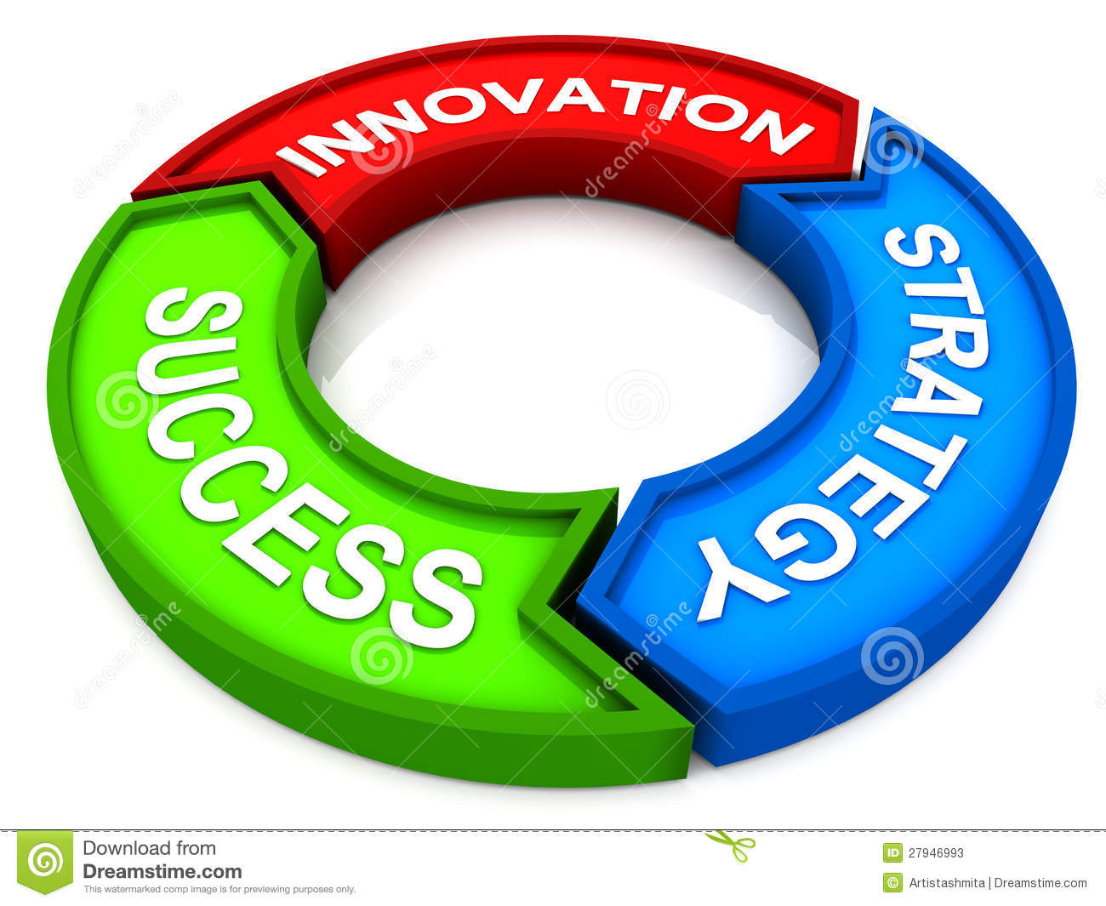
Innovation Strategy
Introduce new products and services, add new features to existing products and services, or develop new ways to produce them.
A classic example is the introduction of automated teller machines (ATMs) by Citibank. The convenience and cost-cutting features of this innovation gave Citibank a huge advantage over its Competitors.
Like many innovative products, the ATM changed the nature of competition in the banking industry. Today, an ATM is a competitive necessity for any bank.

Slide 36
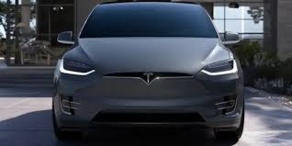
Ex: Tesla: Product Innovation
Tesla entered the automotive industry offering market-disruptive electric vehicles that are environmentally friendly and extremely high tech

Slide 37
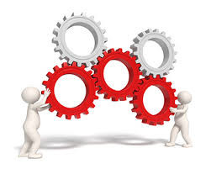
Operational Effectiveness Strategy
Operational effectiveness strategy Improve the manner in which a firm executes its internal business processes so that it performs these activities more effectively than its rivals. Such improvements increase quality, productivity, and employee and customer satisfaction while decreasing time to market.

Slide 38
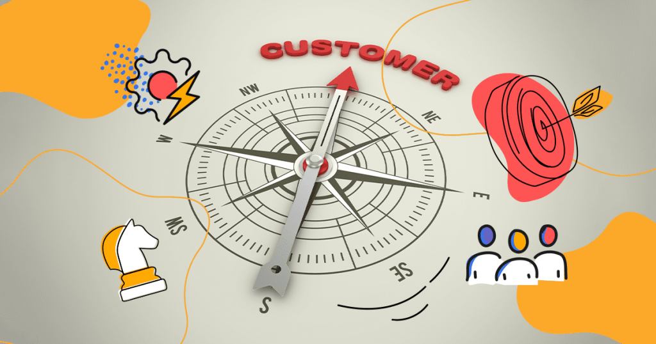
Customer- Orientation Strategy
Customer-orientation strategy Concentrate on making customers happy. Web-based systems are particularly effective in this area because they can create a personalized, one-to-one relationship with each customer.

Slide 39
Ex: Emirates
Narrow spaces between the seats, no entertainment and a limited variety of foods and drinks…Emirates can’t relate!

Slide 40
How to use Porter five forces model?
Organization analyse the structure of their industry to understand organizations' competitive environment by applying Porter five forces model.
Then they formulate their strategy

Slide 41
How to use Porter five forces model?
forces | Strategy
Powerful supplier | Cost leader
Threat of new entrants | Innovation
Powerful customer | Differentiation
Threat of substitute products/services | Operational effectiveness
 | Customer oriented
You may think of different scenarios and come up with your strategy. The table may help you for better organization of your thoughts and solutions.
In next two slides, you see some generic mapping which focused on cost/differentiation and scope {narrow, broad}.
Then some examples of IS role in this space is given.

Slide 42
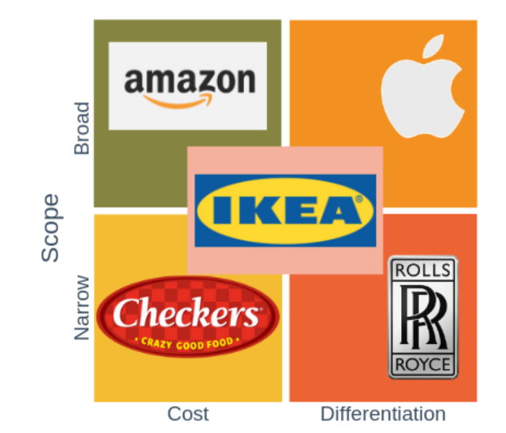
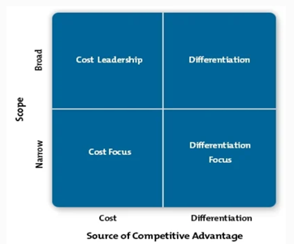
Porter's Generic Strategies

Slide 43
Porter's Generic Strategies

Slide 44
IS role in Strategies for Competitive Advantage
Strategy | IS role
Cost Leadership | Provide Unique operational and managerial support that reduce costs
Differentiation Strategy | Provide tools to identify and develop unique goods/services
Innovation | Provide the technology necessary for innovation
Operational Effectiveness Strategy | Develop information systems to support the business process
Customer- Orientation | Customized CRM

Slide 45
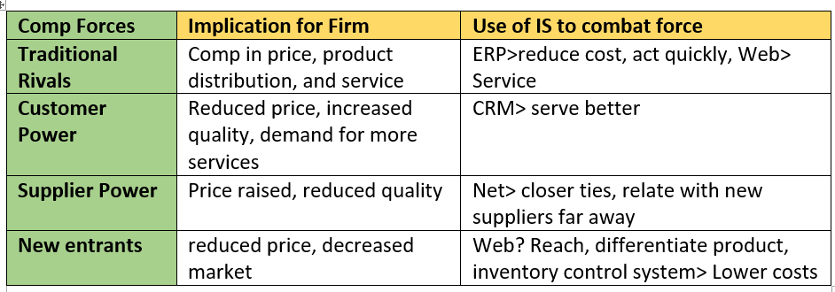
Use IS to combat forces

Slide 46
Week 4- Tutorial

Slide 47
Executive Support Systems
Raw Textual data > Information
Useful tool for Knowledge extraction
Raw Textual data > Information
Sentiment analysis

Slide 48
References
Rainer, R. Kelly, et al. Management Information Systems, Wiley, 2014, Chapter2.

Slide 49
See you next week!

