Slide 1
Introduction to Information System 31266 Week5
UTS CRICOS 00099F

Slide 2
Acquiring Information Systems and Applications

Slide 3
Objectives
Planning for developing information system
Exploring strategies for acquiring information systems
Exploring systems Development Life Cycle (SDLC)

Slide 4
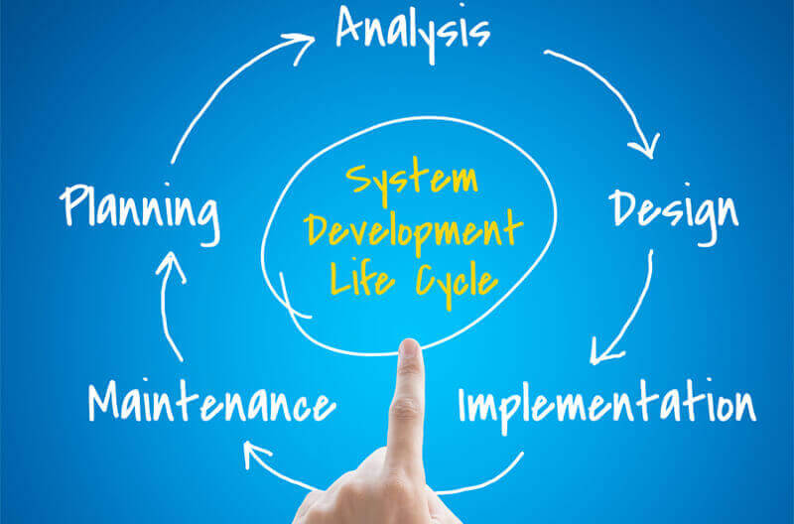
Why System Acquisition and Development?
Where does an organization start when looking to acquire or develop supporting information systems?
How can you work with IS personnel to get the information systems you need to succeed on the job or in your own business?

Slide 5
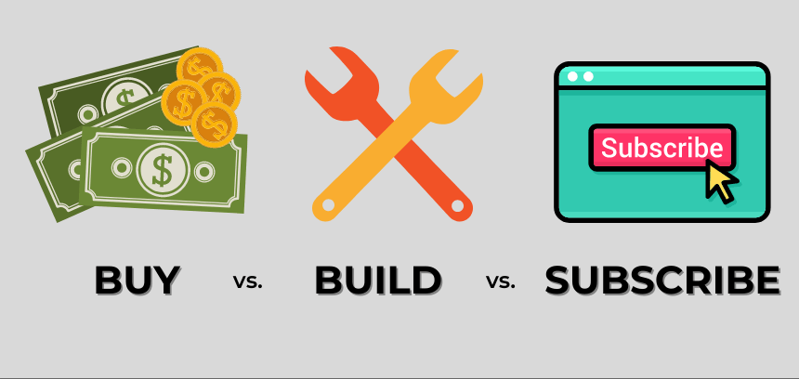
System development
System development
Set of activities involved in building information systems to meet users’ needs
Projects can range from small to very large and are conducted in fields as diverse as nuclear science research and video game development

Slide 6
Opening case: One of the most disastrous IT projects
Implementation of Queensland Health’s payroll system A contract began as a
$6.19 million
between the state of Queensland and IBM Australia to replace Queensland Health’s ageing payroll system eventually cost taxpayers
$1.25 billion.
Two weeks
was allocated to determine
the business requirements and solution scope
of the complex payroll project.
---------------------------------
Queensland Health, CorpTech and IBM agreed to a seven month timeframe
to deliver a payroll system with complex award structures

Slide 7
Opening case: One of the most disastrous IT projects
LESSONS LEARNT?
Organisations must consider appropriate planning for IS acquisition/IS modification
Developing an IS plan is the first step in the acquisition process
When a company examines its needs and performance, it generates a prioritised list of both existing and potential IT applications, called the application portfolio.

Slide 8
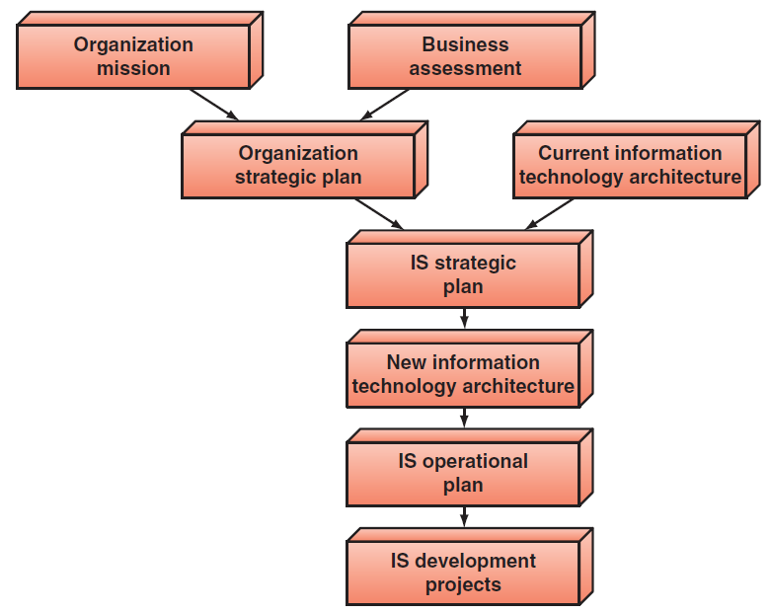
Information Systems planning process
Analyse the organisation’s strategic plan
Identify the firm’s mission, goals, and steps required to reach these goals
Develop the IS strategic plan
Develop a set of goals that describe IT infrastructure, and resources needed to reach the organization goals.
Develop IS operational plan
Develop a set of IS projects that will be executed to support the IS strategic plan

Slide 9
IT steering committee
IT Steering Committee: comprised of a group of managers and staff who represent the various organizational units.
Critical component in developing and implementing the IS strategic plan
Group of managers and staff establish IT priorities
to approve the allocation of resources
to ensure that the IS function is meeting the organization’s needs.
Notes:
.

Slide 10
Strategies for Acquiring IT Applications
Purchase a prewritten application.
Customise a prewritten application.
Custom-write an entire application (write all new computer code).
Lease the application (use application service providers and software-as-a-service vendors).
Employ custom development. (The basic, backbone methodology for custom development is the systems development life cycle (SDLC)

Slide 11
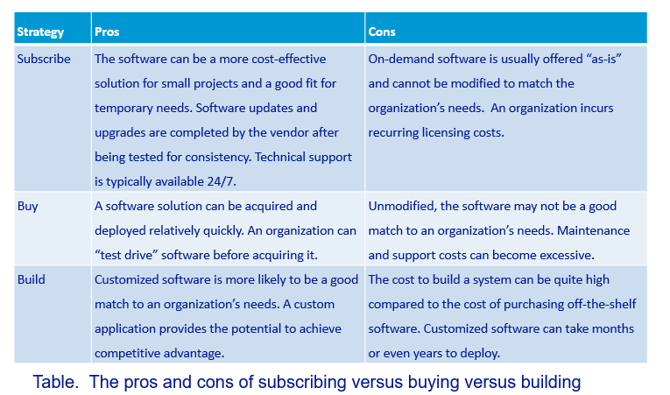
Subscribe vs. Buy vs. Build

Slide 12
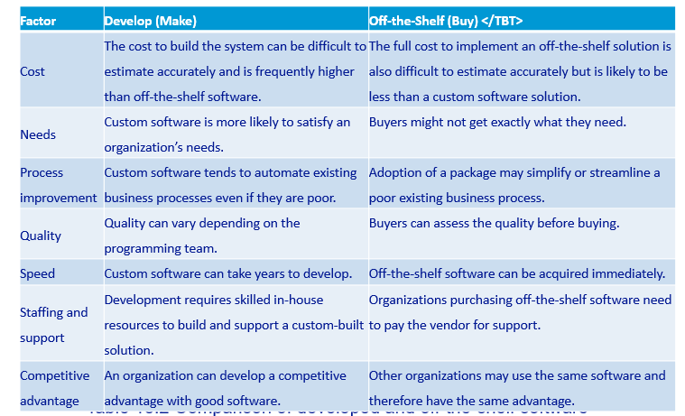
Buying Off-The-Shelf-Software

Slide 13
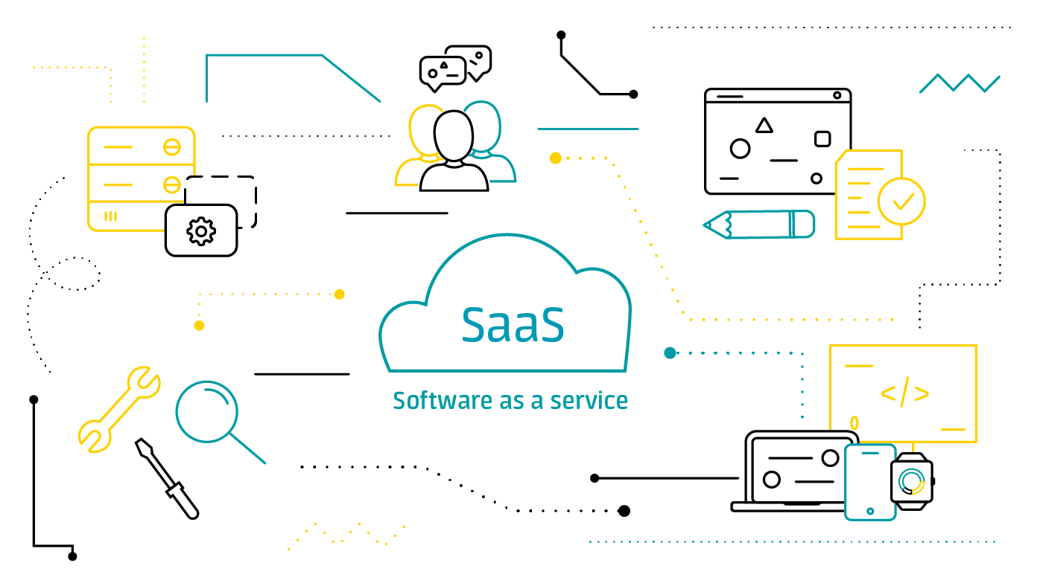
Software as a Service (SaaS)
SaaS is a method of delivering software in which a vendor hosts the applications and provides them as a service to customers over a network, typically the internet.
Customers do not own the software; rather, they pay for using it. SaaS eliminates the need for customers to install and run the application on their own computers.

Slide 14
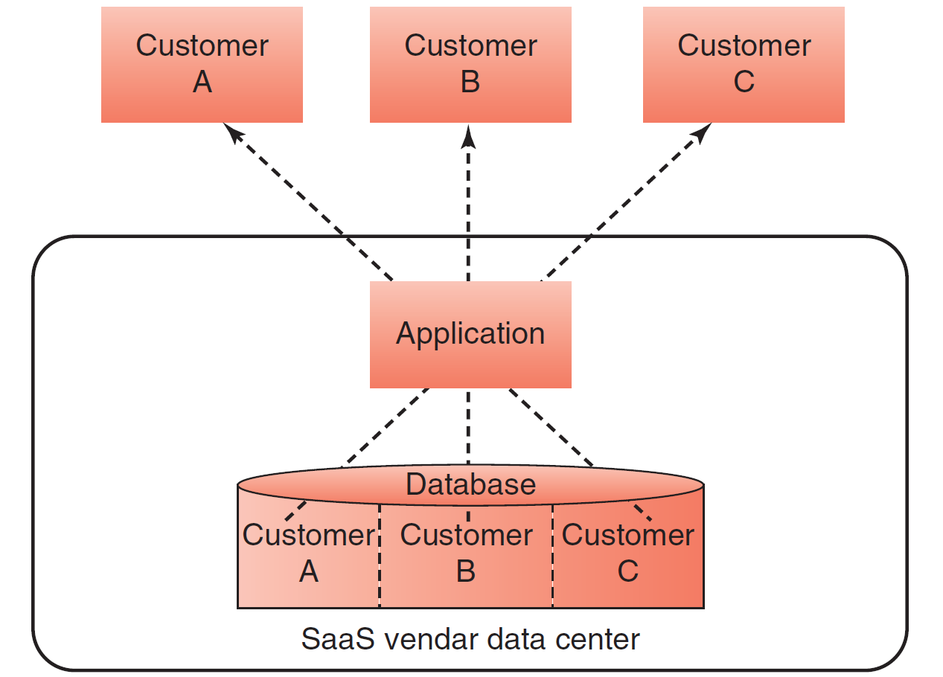
Software as a Service (SaaS)

Slide 15
Software as a Service (SaaS)
Advantages | Disadvantages
company can benefit from the software quickly | Must meet needs
Technical support typically offered | Requires stable Internet
Lower implementation costs | Security and privacy concerns

Slide 16
Employ custom development Systems Development
Systems development requires more than programming and technical expertise.
Systems development requires:
Business knowledge (Knowledge of business activities)
Technical skills
Non-technical human relations skills
Interview skills, group dynamics skills (to identify requirements)
Skills to develop job descriptions and to train staff

Slide 17
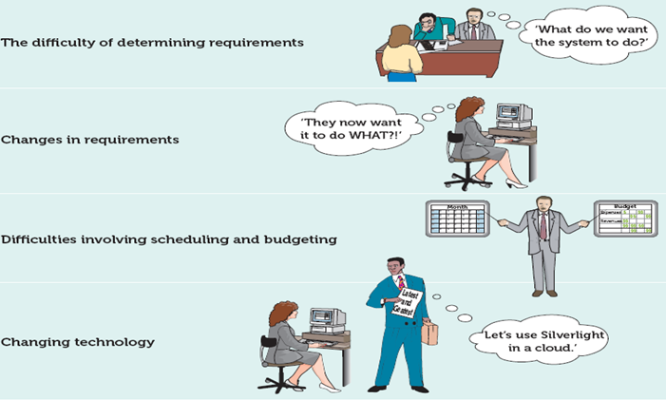
Why is Systems Development Difficult and Risky?

Slide 18
Why is Systems Development Difficult and Risky?
Systems Development is Difficult and Risky, hence development methodologies have emerged to facilitate the process
Systems Development Life Cycle (SDLC) is one of the most common methods

Slide 19
The Traditional Systems Development Life Cycle
Systems Development Life Cycle (SDLC): the traditional systems development method that organizations use for large-scale IS projects. The SDLC is a structured framework that consists of sequential processes by which information systems are developed :
Systems Investigation
Systems Analysis
Systems Design
Programming and Testing
Implementation
Operation and Maintenance

Slide 20
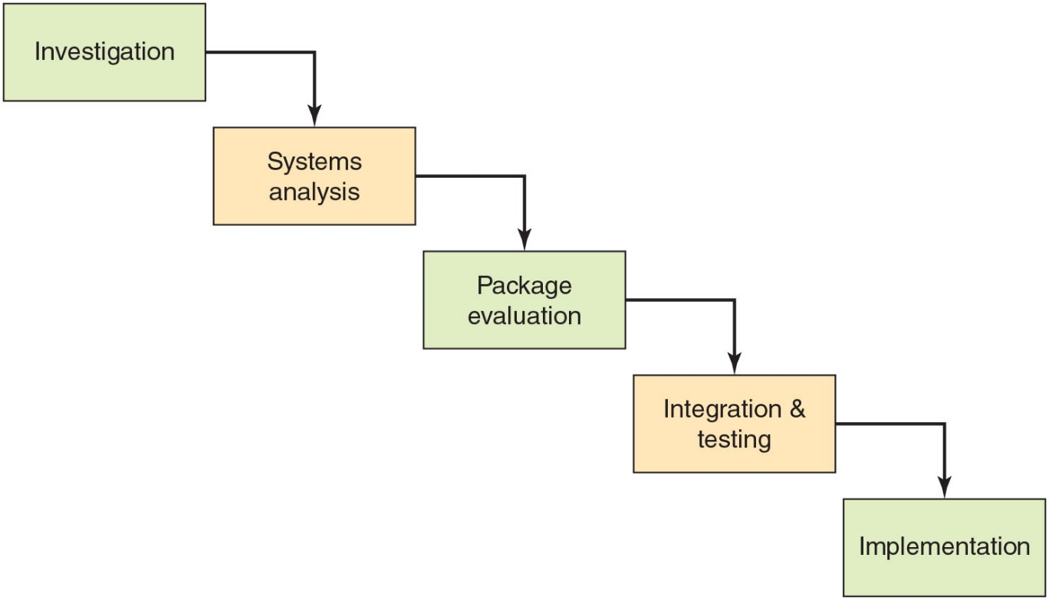
Waterfall approach: Software package implementation process
Notes:
Software package implementation eliminates several of the phases of the Waterfall approach.

Slide 21
SDLC: Systems Investigation
Understanding the needs of business that can be addressed by new system
Define goals of the new system
Ensuring feasibility
Technical, Economic, Behavioral
Forming a project team
Notes:
Define goals of the system to solve the identified problems and are in line with organization strategy,
Define goals of the system to support business processes, or Improve decision making
Examples: Create quality relationships with quality customers
Create effective learning system
If the project is deemed feasible, a project team is created:
Manager(s): champion and conduit to senior management
Business analysts: specialise in understanding business needs, strategies and goals; help businesses to implement systems to accomplish their competitive strategies
Systems analysts: IT professionals with a knowledge of business and technology; interfaces between and programmers communicate with both technical and user team members
Programmers and software testers
Users: essential throughout the entire SDLC process but part-time during some of the stages; their involvement builds commitment to the new system

Slide 22
SDLC: Systems Investigation/ feasibility
Technical feasibility
It checks whether the existing technical resources can support the candidate system or not or up to what extent it supports
Economic feasibility
to determine the benefits and savings that are expected from a candidate system and compare them with costs.
Behavioural feasibility
addresses the human issues of the systems development project(e.g. would it be easily acceptable by the employees?)
Go/No Go Decision

Slide 23
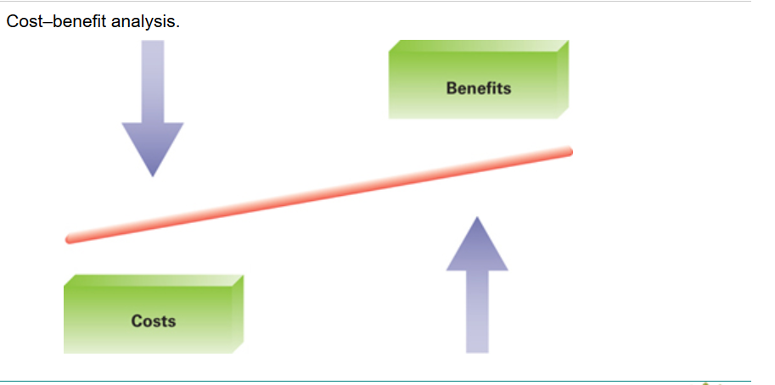
Evaluating and justifying IT investment
Assessing the costs:
fixed costs among different IT projects
costs for maintaining, debugging and improving the system
Assessing the benefits:
Tangible (refers to items that can be measured in dollars ) and Intangible (e.g improvement of employee morale, employees' job satisfaction) benefits
Calculating the costs, assessing the benefits (values) and comparing the two.

Slide 24
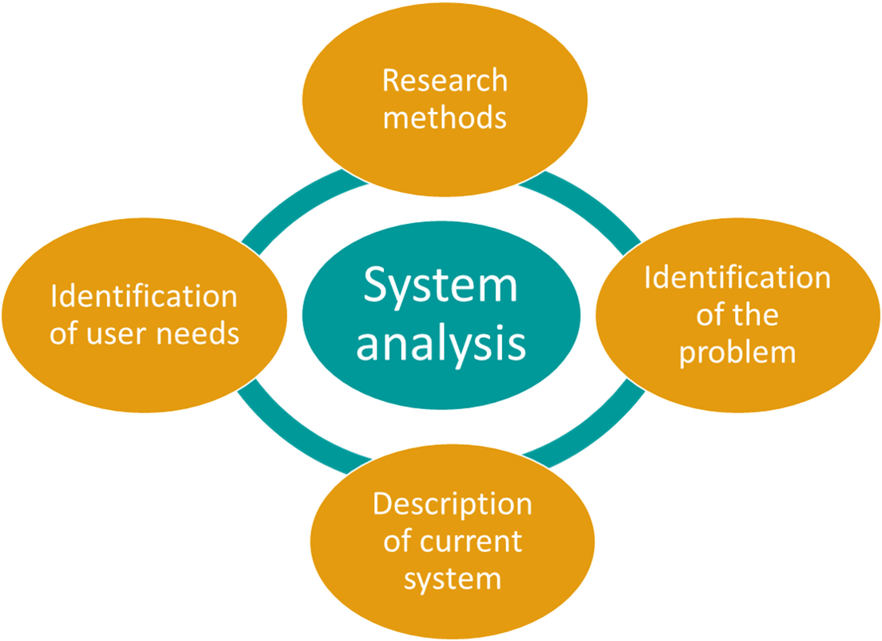
SDLC: Systems Analysis
Analyzing end-users’ needs/identifying user requirements
that the system must satisfy
(This can be done through : Interview users)
Notes:
Systems Analysts: IS professionals who specialize in analyzing and designing information systems.
User Requirements: identifying business requirements the system must satisfy which is provided by users. Determine and document features and functions
In this stage team consider the functional requirement of the system. System analysts performs system analysis to analyse the needs of end-users to ensure the new system can meet their expectation, team gather information about the existing system in order to determine the requirements for new system.
Interview users
Document requirements
Examine existing system
Review reports, forms, queries, application features
Identify security and control issues
What features do you want?
Do you really need them?
What functions should it have?
What data do you have?
What information do you want provided?
And so on . . .

Slide 25
SDLC: Systems Analysis
Systems Analysts: IS professionals who specialize in analyzing and designing information systems.
User Requirements: identifying business requirements the system must satisfy which is provided by users. Determine and document features and functions
Interview users
Document requirements
Examine existing system
Review reports, forms, queries, application features
Identify security and control issues
Notes:
What features do you want?
Do you really need them?
What functions should it have?
What data do you have?
What information do you want provided?
And so on . . .

Slide 26
What Are Requirements?
System Requirements =
Functional requirements
Non-functional requirements
Functional Requirements– the activities the system must perform
Business uses, functions the users carry out
Non-Functional Requirements– other system characteristics
Constraints and performance goals

Slide 27
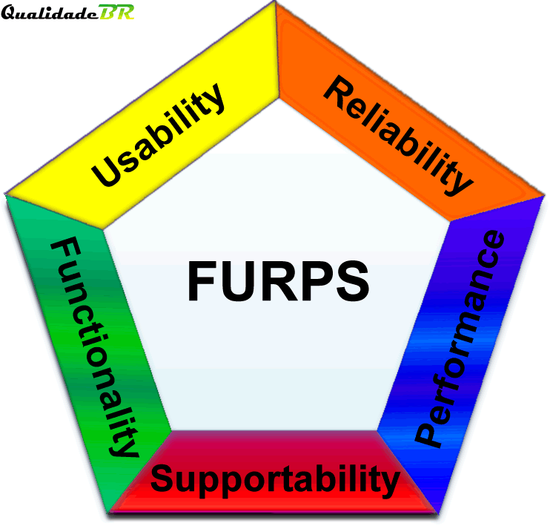
FURPS+ Requirements Acronym
Functional requirements
Usability requirements
Reliability requirements
Performance requirements
Security requirements
+ even more categories…

Slide 28
What Are Requirements?

Slide 29
SDLC: Systems Design
Describes technical system’s specifications based on approved user requirements
Deliverable:
a set of technical system specifications(Hardware, software..)
Technical Specifications include following:
• System outputs, inputs, and user interfaces
• Hardware, soft ware, databases, telecommunications, personnel, and procedures
• A blueprint of how these components are integrated

Slide 30
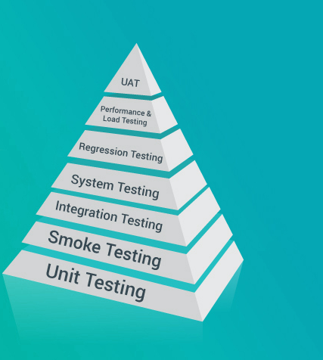
SDLC: Programming &Testing
Translating the design specifications into computer code.
Checking to see if the proposed design will produce the expected and desired results
Quality assurance professional constructs test plan

Slide 31
SDLC: Implementation
Implementation
The process of converting from an old computer system to a new one
Major Conversion Strategies
Direct conversion
Pilot conversion
Phased conversion
Parallel conversion

Slide 32
SDLC: Implementation

Slide 33
SDLC: Implementation
Direct conversion
The old system is cut off and the new system is turned on at a certain time is the least expensive and the most risky.
Pilot conversion
Introduces the new system in one part of the organization. If the system works properly, the system is implemented in other parts of the organization.

Slide 34
SDLC: Implementation
Phased Conversion
Introduces components of the new system, such as individual modules, in stages. Each module is assessed. If it works properly, then other modules are introduced, until the entire new system is operational.
Parallel Conversion
Old and new systems operate simultaneously for a time, but this strategy is seldom used today(Expensive and time consuming, Data must be entered twice)

Slide 35
SDLC: Operations & Maintenance
After the new system is implemented, it will operate for a period of time, until it no longer meets its objectives
Systems require several types of maintenance
Debugging the program
Finding errors and removing
Updating
Modify the system to accommodate changes in business conditions

Slide 36
References
Rainer, R. Kelly, et al. Management Information Systems, Wiley, 2014, Chapter14.

Slide 37
See you next week!

