Slide 1
Introduction to Information System 31266 Week6
UTS CRICOS 00099F

Slide 2
Data and Knowledge Management

Slide 3
Objectives
Managing Data
Describing the Database Approach
Defining Big Data
Defining Data Warehouses and Data Marts
Defining knowledge Management

Slide 4
Data and Knowledge Management
To stay ahead of the competition organisations need effective information systems
Some organisation don’t have timely, accurate or relevant information because their data have been poorly organised and managed
An effective information system provides users with accurate, timely and relevant information
Accurate information is free of error
Information is timely when it is available to decision makers when it is needed
Information is relevant when it is useful and appropriate for the types of work and decision that require it

Slide 5
Why Managing data is very important?
Amount of data is increasing exponentially
Big Data are scattered throughout organisations and collected by many individuals using various methods and devices
Data are subject to data rot (outdated, destroyed storage media)Inconsistent data due to non-integrated information systems

Slide 6
Retailing example

Slide 7
Retailing example

Slide 8
How do organisation ensure the availability, usability, integrity and security of company data ?

Slide 9
Establish Data Governance
Data Governance is all about ensuring that data standards and policies are defined, and enforced across the entire organization
The objective is to make information available, transparent, and useful for the people who are authorized to access it, from the moment it enters an organization until it is outdated and deleted.

Slide 10
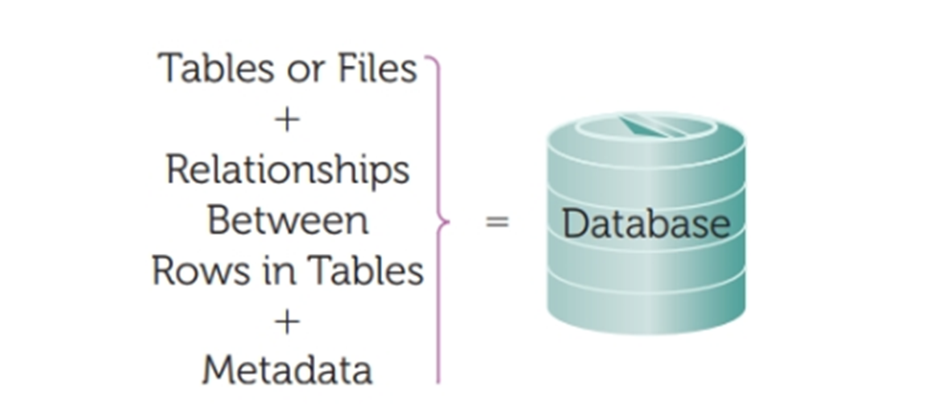
What is a Database?
A database is an organised collection of data, generally stored and accessed electronically
A database refers to a self-describing collection of integrated records.

Slide 11
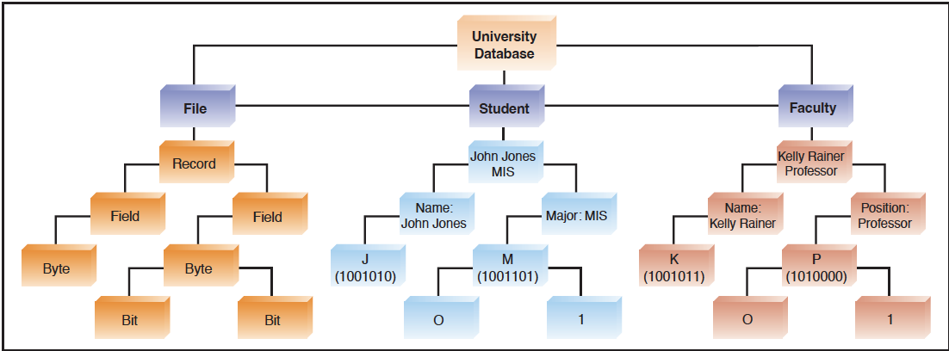
Table or File

Slide 12
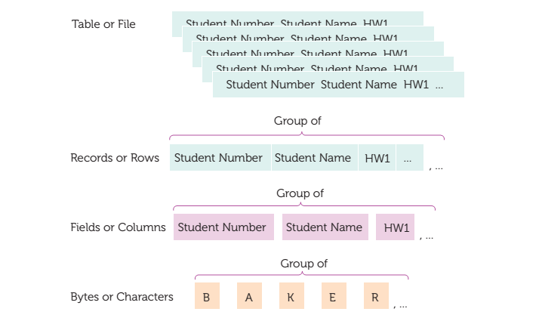
Hierarchy of the Data
Notes:
Agile Development: Agile methodology is based on iterative and incremental development, where requirements and solutions evolve through collaboration between self-organizing, cross-functional teams.. Emphasis collaboration and Team is open to changing requirements rather than resistant(team work for a while, revisit the plan, make changes they want and start again; thigh irritation), they have quick meetings, extremely collaborative.

Slide 13
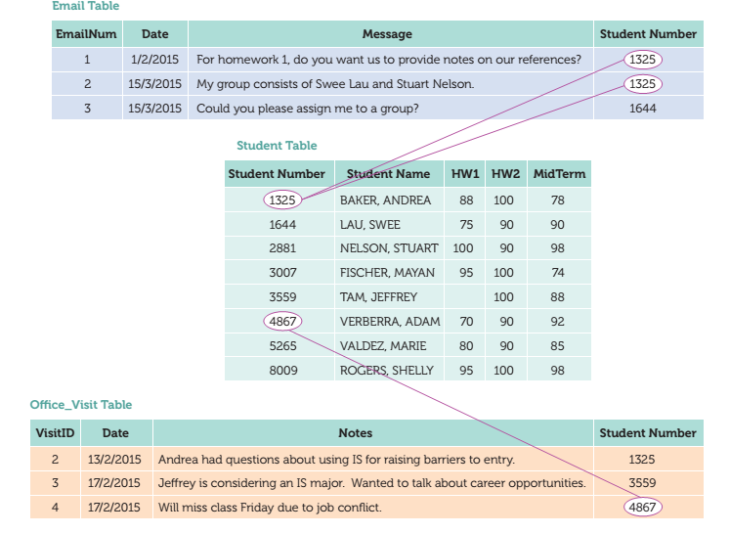
Relationships Between Rows in the Database

Slide 14
Relationships
Advantages | Description
Minimal data redundancy | A single copy of data ensures that storage requirements are minimised.
Improved data consistency | Eliminating redundancy greatly reduces the possibilities of inconsistency.
Increased security | A centralised system makes it easier to enforce access restrictions.
Improved data quality | Centralised control, minimised redundancy, and improved data consistency help to enhance the quality of data.
Improved data accessibility and sharing | A centralised system makes it easier to deploy and control access for personnel within or outside organisational boundaries.
Enforcement of standards | A centralised system makes it much easier to enforce standards and rules for data creation, modification, naming, and deletion.
Increased productivity of application development | Data standards make it easier to build and modify applications.

Slide 15
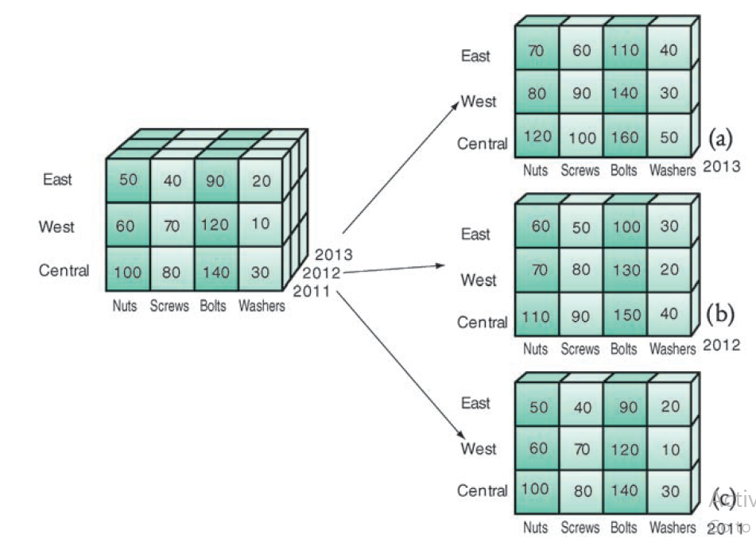
Data Cube
Data are organized by subject—for example, by customer, vendor, product, price level, and region.
This arrangement differs from transactional systems, where data are organized by business process, such as order entry, inventory control, and accounts receivable.

Slide 16
What is Big Data?

Slide 17
Big Data
Big data is considered as an extremely large and complex data collections
Old software, hardware, and analysis processes are unable to deal with them
There are four common characteristics of big data:
Volume – This relates to the huge amounts of data generated every second by IT systems.
Velocity – This relates to the speed of transmission of data across the globe.
Variety – This relates to the many types of data that are being generated, such as numeric (e.g. financial data), text (social media feeds) and video.
Veracity – This relates to the messiness of the data being generated, such as speech patterns, Twitter posts with hashtags, and abbreviations and typos.

Slide 18
What are the benefits of making Big Data available ?
Making Big Data available enables Organisations
To gain value
To improve performance
Banks are using big data to analyse the likelihood of a customer repaying a loan

Slide 19
Retailing example

Slide 20
Retailing example

Slide 21
Retailing example

Slide 22
Retailing example

Slide 23
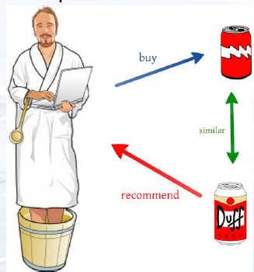
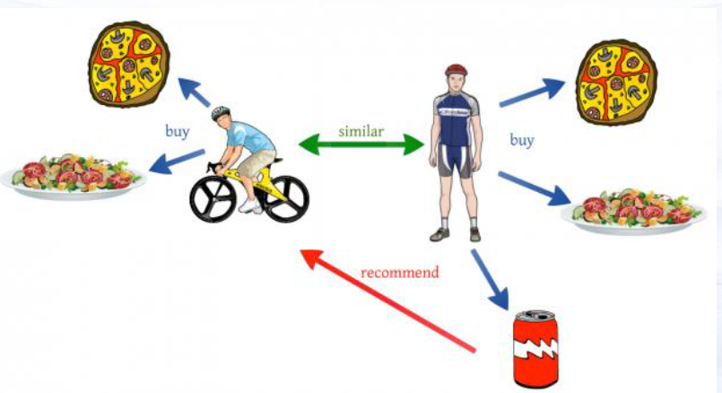
Recommender systems- Retailing example
Collaborative Filtering
Content Based Recommendation

Slide 24
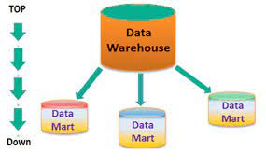
Data Warehouses & Data Marts
To make some decisions; analyses of data from various sources are needed.
Data Warehouse
Central repositories of integrated data from disparate sources. They contain both historic and (almost) current data for analysis and reporting.
Data Mart
A low-cost, scaled-down version of a data warehouse designed for end-user’s needs in an individual department.

Slide 25
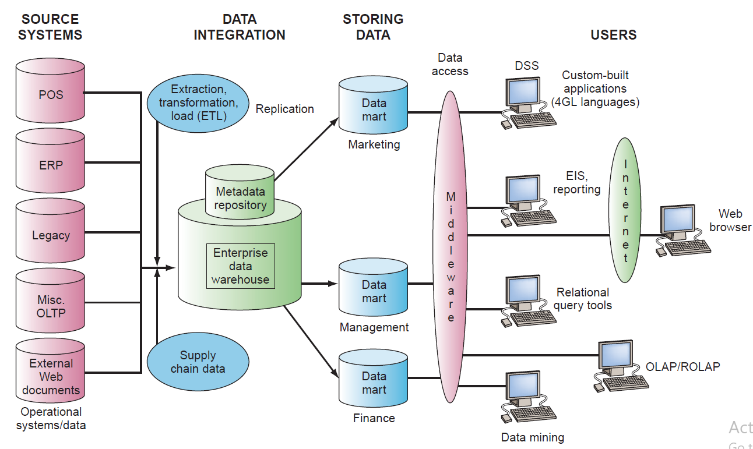
Data warehouse framework and views

Slide 26
Data Warehouses & Data Marts
To successfully implement and main a data warehouse, an organization must:
Link source systems that provide data to the warehouse or mart.
Prepare the necessary data for the data warehouse using data integration technology and processes.
Decide on an appropriate architecture for storing data in the data warehouse or data mart.
Select the tools and applications for the variety of organizational users.
Ensure that metadata, data quality, and governance processes are in place to ensure that the data warehouse or mart meets its purposes..

Slide 27
Knowledge Management (KM)

Slide 28
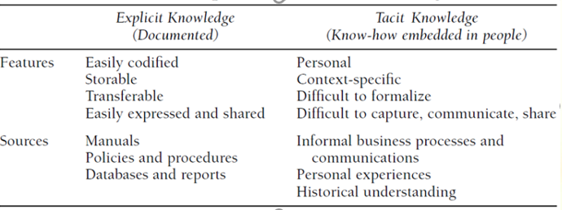
Two dimensions of knowledge in organisations

Slide 29
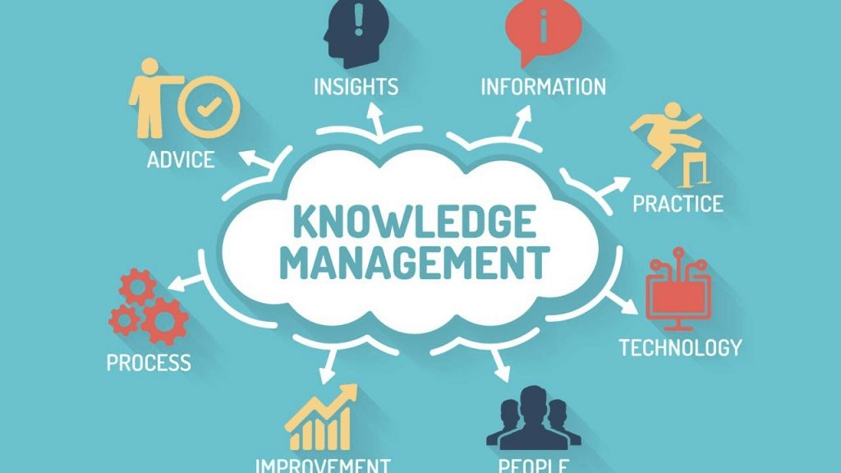
The role of IT in KM
Knowledge management steps include the processes of knowledge creation, capture, refine, storage, manage , and disseminate Knowledge to achieve coemptive advantage
Knowledge management is an organized approach of organizations to take advantage of both explicit and tacit knowledge

Slide 30
KM benefits and challenges
Benefits:
More efficient product development;
Improved employee morale and retention.
Best practices are readily available to a wide range of employees
Improved customer service
Challenges:
Employees must be willing to share their personal tacit knowledge
Organizations must create a knowledge management culture that rewards employees who add their expertise to the knowledge base
The knowledge base must be continually maintained and updated
Companies must be willing to invest in the resources needed to carry out these operations.

Slide 31
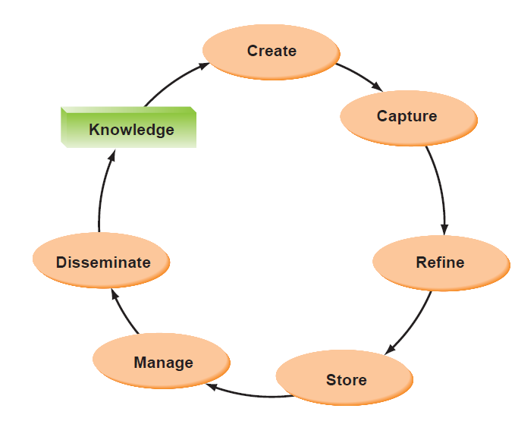
KMS Cycle

Slide 32
Knowledge management cycles(Basic steps)
knowledge creation: Knowledge is created as people determine new ways of doing things or develop know-how.
Capture knowledge: New knowledge must be identified as valuable and be represented in a reasonable way.
Refine knowledge: New knowledge must be placed in context so that it is actionable. This is where tacit qualities (human insights) must be captured along with explicit facts.

Slide 33
Knowledge management cycles(Basic steps)
Knowledge storage: Useful knowledge must then be stored in a reasonable format in a knowledge repository so that others in the organization can access it.
Manage knowledge: Like a library, the knowledge must be kept current. It must be reviewed regularly to verify that it is relevant and accurate.
Disseminate knowledge: Knowledge must be made available in a useful format to anyone in the organization who needs it, anywhere and anytime.
KMS refer to a class of information systems applied to support and enhance the organizational processes of knowledge creation, capture, refine, storage, manage , and disseminate.

Slide 34
References
Rainer, R. Kelly, et al. Management Information Systems, Wiley, 2014, Chapter3.

Slide 35
See you next week!

