Slide 1
Introduction to Information System 31266 Week7
UTS CRICOS 00099F

Slide 2
Business Analytics

Slide 3
Objectives
Managers and Decision Making
What Is Business Intelligence?
Business Intelligence Applications for Data Analysis

Slide 4
Decision Making

Slide 5
Managers and Decision Making
Management is a process by which an organization achieves its goals using resources (people, money, materials, and information).
All managers perform three basic roles:
Interpersonal roles: figurehead, leader, liaison
Informational roles: monitor, disseminator, spokesperson, analyser
Decisional roles: entrepreneur, disturbance handler, resource allocator, negotiator
We focus on the support that IT can provide for decisional roles.

Slide 6
What is Decision
A decision refers to a choice among two or more alternatives that individuals and groups make.

Slide 9
Decision making major phases
Decision making three major phases:
Intelligence,
Design,
Choice

Slide 10
Decision making major phases
Intelligence phase: managers examine a situation and identify and define the problem or opportunity.
Design phase: decision makers construct a model for the situation. They do this by making assumptions that simplify reality and by expressing the relationships among all the relevant variables. Managers then validate the model by using test data.
Choice phase involves selecting a solution or course of action that seems best suited to resolve the problem.

Slide 11
Why Managers Need IT Support?
Making good decisions is very difficult without solid information
Decision making is difficult due to the following trends:
The number of alternatives is constantly increasing, due to innovations in technology, improved communications, the development of global markets, and the use of the Internet and e-business.
Most decisions must be made under time pressure. It often is not possible to manually process information fast enough to be effective.
Due to increased uncertainty in the decision environment, decisions are becoming more complex.
It often is necessary to rapidly access remote information, consult with experts, or conduct a group decision-making session, all without incurring large expenses.

Slide 12
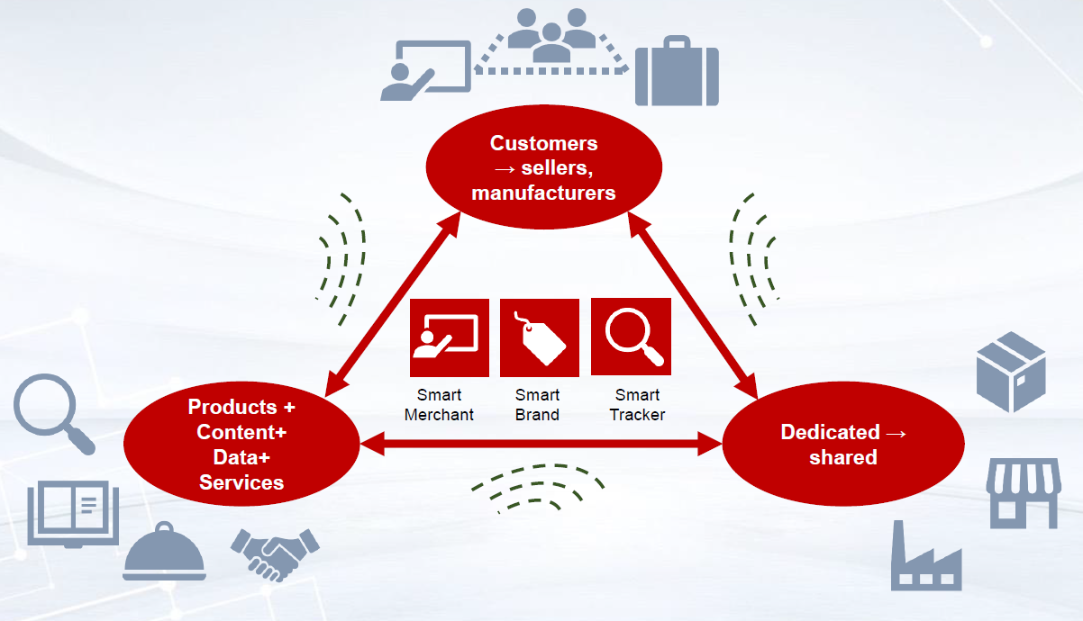

Slide 13
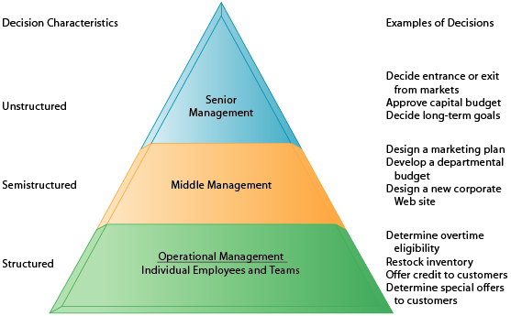
A Framework for Computerized Decision Analysis
Two major dimensions of decisions:
Problem structure
The nature of the decision

Slide 14
Problem structure
Structured: deal with routine and repetitive problems for which standard solutions exist.
Unstructured decisions: there is no standardized procedure for carrying out any of the three phases.
Semi-structured: Located between structured and unstructured decisions are semi structured decisions, in which only some of the decision process phases are structured.

Slide 15
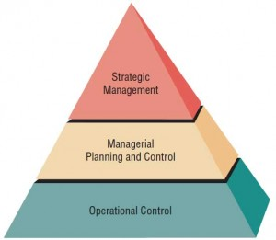
Nature of Decisions
Strategic planning: the long-range goals and policies for growth and resource allocation.
Management control: acquiring and using resources efficiently in accomplishing organizational goals.
Operational control: executing specific tasks efficiently and effectively.

Slide 16
The Decision Matrix

Slide 17
Business Intelligence

Slide 18
What Is Business Intelligence?
Data Warehouses & Data Marts BI encompasses not only applications, but also technologies and processes.
It includes both “getting data in” (to a data mart or warehouse) and “getting data out” (through BI applications).
The use of BI in organizations varies considerably.
In smaller organizations, BI may be limited to Excel spreadsheets.
In larger ones, BI often is enterprise wide, and it includes applications such as data mining/predictive analytics, dashboards, and data visualization.

Slide 19
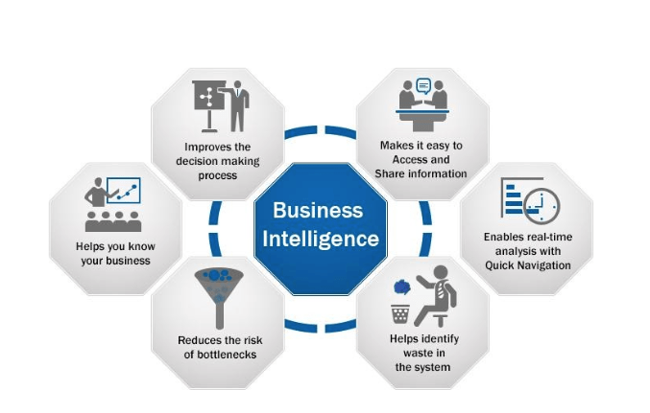
BI targets
Lets examine three specific BI targets that represent different levels of change:
The development of one or a few related BI applications
The development of infrastructure to support enterprise wide BI
Support for organizational transformation.

Slide 20
One or few related BI applications
This BI target often is a point solution for a departmental need, such as campaign management in marketing.
Sponsorship, approval, funding, impacts, and benefits typically occur at the departmental level.
For this target, organizations usually create a data mart to store the necessary data.
Note: Organizations must be careful that the data mart—an “independent” application—does not become a “data silo” that stores data that are inconsistent with.

Slide 21
Development of Infrastructure to Support Enterprise wide BI
A crucial component of BI at this level is an enterprise data warehouse.
Because it is an enterprise wide initiative, senior management often provides sponsorship, approval, and funding.
In addition, the impacts and benefits are felt throughout the organization.

Slide 22
Support for Organizational Transformation
With this target, BI is used to fundamentally transform the ways in which a company competes in the marketplace.
BI supports a new business model, and it enables the business strategy.
Because of the scope and importance of these changes, critical elements such as sponsorship, approval, and funding originate at the highest organizational levels.
The impact on personnel and processes can be significant, and the benefits are organization wide.

Slide 23
Business Intelligence Applications for data analysis

Slide 24
BI applications
A variety of BI applications for analysing data are available. They include:
Multidimensional Analysis or Online Analytical Processing (OLAP)
Data Mining
Decision Support Systems

Slide 25
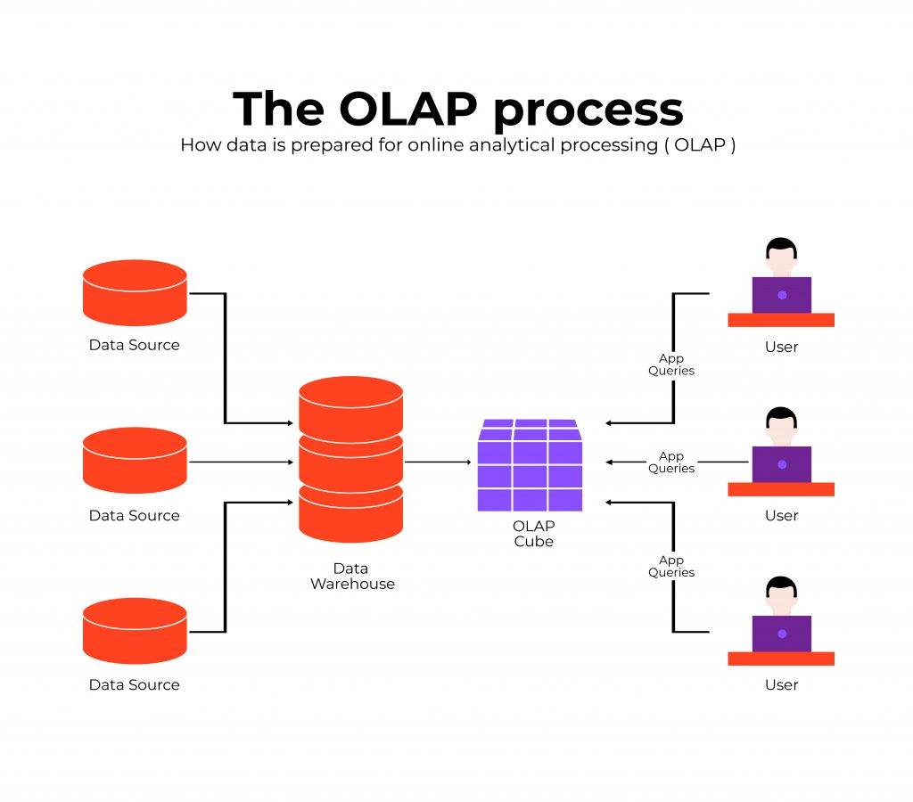
Multidimensional Analysis or Online Analytical Processing
OLAP involves “slicing and dicing” data stored in a dimensional format, drilling down in the data to greater detail, and aggregating the data.

Slide 26
Multidimensional Analysis or Online Analytical Processing
The product is on the x-axis,
geography is on the y-axis,
and time is on the z-axis.
Now, suppose you want to know how many nuts the company sold in the West region in 2011.
You would slice and dice the cube, using nuts as the specific measure for product, West as the measure for geography, and 2011 as the measure for time.

Slide 27
Multidimensional Analysis or Online Analytical Processing
The value or values that remain in the cell(s) after our slicing and dicing is (are) the answer to our question ?

Slide 28
Data Mining
Data mining refers to the process of searching for valuable business information in a large database, data warehouse, or data mart.
Data mining can perform two basic operations:
Predicting trends and behaviors,
Identifying previously unknown patterns.
BI applications typically provide users with a view of what has happened; data mining helps to explain why it is happening, and it predicts what will happen in the future.

Slide 29
EX: Demand Forecasting in E-Commerce

Slide 30
EX: Using Data Mining for Modelling

Slide 31
Decision Support Systems
Decision support systems (DSSs) combine models and data in an attempt to analyse semi-structured problems and some unstructured problems that involve extensive user involvement. Models are simplified representations, or abstractions, of reality.
DSSs enable business managers and analysts to access data interactively, to manipulate these data, and to conduct appropriate analyses.
They have the related capabilities of
Sensitivity analysis
What- if analysis
Goal-seeking analysis

Slide 32
Sensitivity analysis
Most models include two types of input variables:
Decision variables: “What is our reorder point for these raw materials?
Environmental variables: (external to the organization): “What will the rate of inflation be?”

Slide 33
Sensitivity analysis
Companies generally perform a sensitivity analysis to determine the impact of environmental variables analysis.
Sensitivity analysis is extremely valuable because it enables the system to adapt to changing conditions and to the varying requirements of different decision-making situations.
It provides a better understanding of the model as well as of the problem that the model purports to describe.

Slide 34
What-if Analysis
A model builder must make predictions and assumptions regarding the input data, many of which are based on the assessment of uncertain futures.
The results depend on the accuracy of these assumptions, which can be highly subjective.
Attempts to predict the impact of a change in the assumptions (input data) on the proposed solution.
For example, what will happen to the total inventory cost if the originally assumed cost of carrying inventories is 12 percent rather than 10 percent? In a well-designed BI system, managers themselves can interactively ask the computer these types of questions as often as they need to.

Slide 35
Goal-Seeking Analysis
Goal-Seeking Analysis represents a “backward” solution approach.
It attempts to calculate the value of the inputs necessary to achieve a desired level of output.
EX1: let’s say that an initial BI analysis predicted a profit of $2 million.
EX2: Management might want to know what sales volume would be necessary to generate a profit of $3 million.

Slide 36
References
Rainer, R. Kelly, et al. Management Information Systems, Wiley, 2014, Chapter5.

Slide 37
See you next week!

