Slide 1
Introduction to Information System 31266 Week8
UTS CRICOS 00099F

Slide 2
Customer Relationship Management and Supply Chain Management

Slide 3
Objectives
Explore Customer Relationship Management
Explore Supply chain management

Slide 4
Customer Relationship Management

Slide 5
Customer Relationship Management
CRM is not a process or a technology per se; rather, it is a customer-centric way of thinking and acting.
In today’s hypercompetitive marketplace, customers are increasingly powerful
if they are dissatisfied with a product and/or a service from one organization, a competitor is often just one mouse click away
The CRM approach is designed to achieve customer intimacy.
This approach is enabled by information technology in the form of various CRM systems and applications.

Slide 6
Customer Relationship Management
Businesses market to each customer individually rather than market to a mass of people or companies.
By employing this approach, businesses can use information about each customer—For example, previous purchases, needs, and wants—to create offers that customers are more likely to accept.
However, Customer relationship management is not only about the software.
Sometimes the problem with managing relationships is simply time and information.
Old systems may contain needed information, but this information may take too long to access and may not be usable across a variety of applications.
The result is that companies have less time to spend with customers.

Slide 7
CRM- customer-focused and customer-driven
Customer relationship management (CRM) is a customer-focused and customer-driven organizational strategy.
Organizations concentrate on assessing customers’ requirements for products and services and then providing high-quality, responsive service.
In general, organizations recognize that customers are the core of a successful enterprise, and the success of the enterprise depends on effectively managing relationships with them.

Slide 8
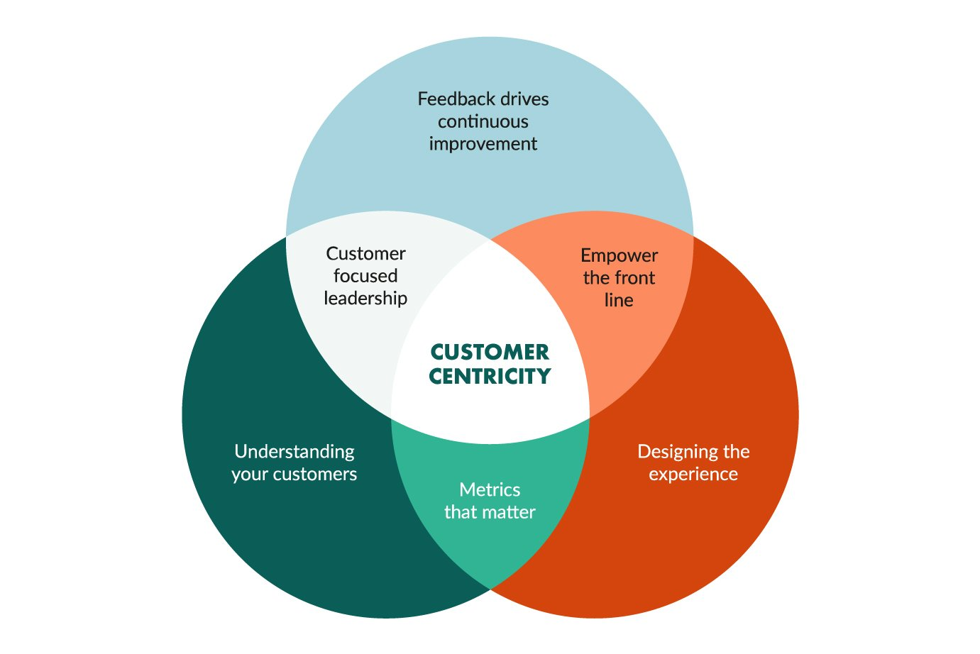
CRM- customer-focused and customer-driven
CRM builds sustainable long-term customer relationships that create value for the company as well as for the customer.
CRM helps companies acquire new customers and retain existing and expand their relationships with profitable existing customers.

Slide 9
CRM process
Prospective customers: The process begins with marketing efforts, where the organization solicits prospects from a target population of potential customers.
Customers: A certain number of these prospects will make a purchase and thus become customers.
Repeat customers: A certain number of these customers will become repeat customers.
Segmentation: The organization then segments its repeat customers into low-value and high-value repeat customers.

Slide 10
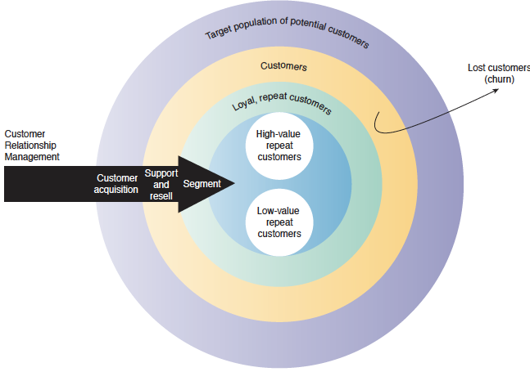
CRM process

Slide 11
CRM and organization’s overall goal
An organization’s overall goal is to maximize the lifetime value of a customer, which is that customer’s potential revenue stream over a number of years.
Over time all organizations inevitably lose a certain percentage of customers, a process called customer churn. The optimal result of the organization’s CRM efforts is to maximize the number of high-value repeat customers while minimizing customer churn.

Slide 12
Successful CRM strategy
CRM is basically a simple idea: Treat different customers differently, because their needs differ, and their value to the company also may differ.
A successful CRM strategy not only improves customer satisfaction, but it makes the company’s sales and service employees more productive, which in turn generates increased profits.

Slide 13
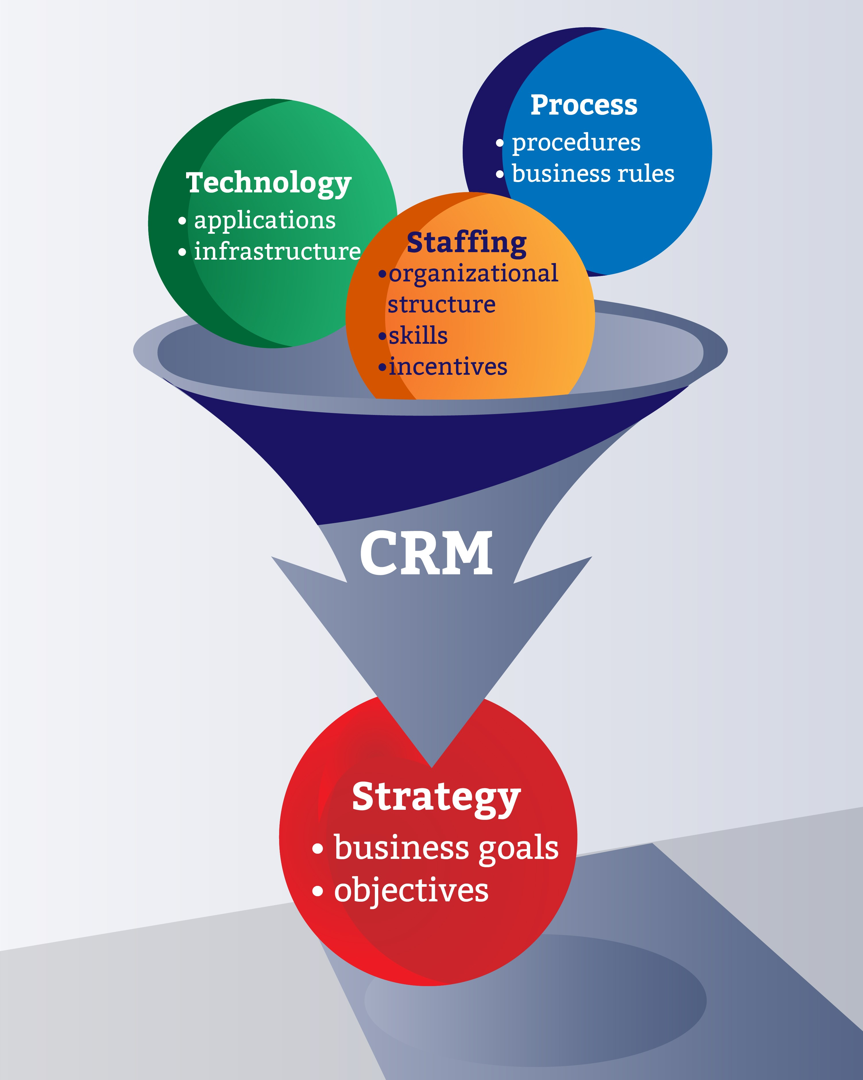
CRM strategy and CRM systems
It is important to distinguish between a CRM strategy and CRM systems. Basically, CRM systems are information systems designed to support an organization’s CRM strategy.
Because customer service and support are essential to a successful business, organizations must place a great deal of emphasis on both their CRM strategy and their CRM systems.

Slide 14
CRM and Information Systems
All successful CRM policies share two basic elements:
The company must identify the many types of customer touch points.
It needs to consolidate data about each customer.

Slide 15
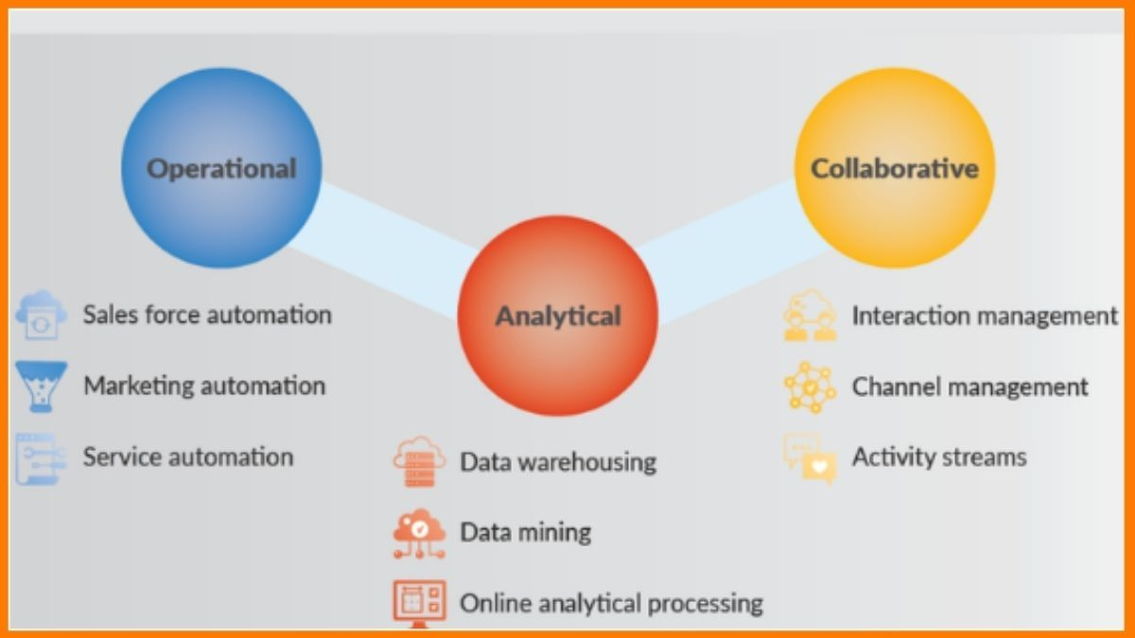
Types of CRM

Slide 16
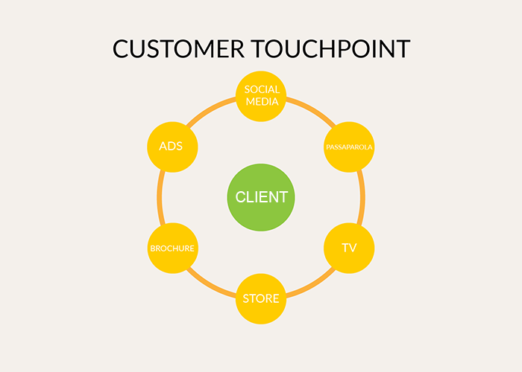
Customer Touch Points
Organizations must recognize the numerous and diverse interactions that they have with their customers.
These various types of interactions are referred to as customer touch points.
Traditional customer touch points include telephone contact, direct mailings, and actual physical interactions with customers during their visits to a store.

Slide 17
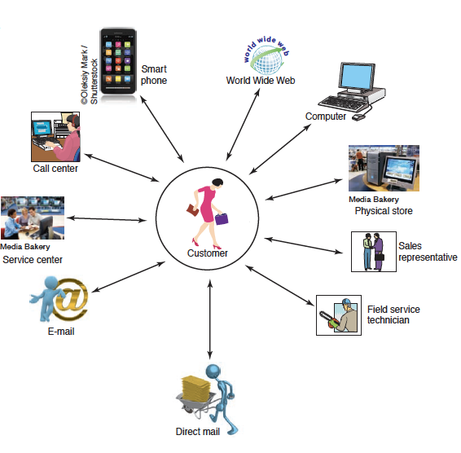
Customer touch points

Slide 18
Data Consolidation
Data consolidation also is critical to an organization’s CRM efforts.
The organization’s CRM systems must manage customer data effectively. In the past, customer data were stored in isolated systems (or silos) located in different functional areas across the business (e.g., in separate databases in the finance, sales, logistics, and marketing departments).
Consequently, data for individual customers were difficult to share across the various functional areas.

Slide 19
Data Consolidation
Modern, interconnected systems built around a data warehouse now make all customer-related data available to every unit of the business.
This complete data set on each customer is called a 360-degree view of that customer.
By accessing this view, a company can enhance its relationship with its customers and ultimately make more productive and profitable decisions.

Slide 20
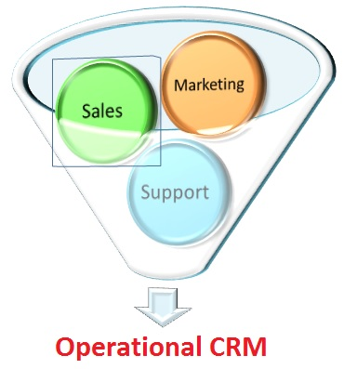
Operational CRM Systems
Operational CRM systems support front-office business processes
Front-office processes are those that directly interact with customers; that is, sales, marketing, and service.

Slide 21
Operational CRM benefits and components
Efficient, personalized marketing, sales, and service;
A 360-degree view of each customer;
The ability of sales and service employees to access a complete history of customer interaction with the organization, regardless of the touch point.
The two major components of operational CRM systems are
Customer-facing applications
Customer touching applications

Slide 22
Customer-Facing Applications
In customer-facing CRM applications, an organization’s sales, field service, and customer interaction center representatives interact directly with customers.
These applications include customer service and support, sales force automation, marketing, and campaign management.
Customer service and support refers to systems that automate service requests, complaints, product returns, and requests for information.

Slide 23
Customer-Touching Applications
Corporations have used manual CRM systems for many years. In the mid-1990s, organizations began using the Internet, the Web, and other electronic touch points to manage customer relationships.
In contrast with customer-facing applications, where customers deal directly with a company representative, customers interact directly with these technologies and applications.
Such applications are called
customer-touching CRM applications
or
electronic CRM (e-CRM) applications.
Customers typically can use these applications to help themselves. There are many types of e-CRM applications. Now we examine some of the major ones.

Slide 24
Customer-Touching Applications
Search and Comparison Capabilities: It is often difficult for customers to find what they want from the vast array of products and services available on the Web. To assist customers, many online stores and malls offer search and comparison capabilities, as do independent comparison Web sites (see www.mysimon.com).
Technical and Other Information and Services. Many organizations offer personalized experiences to induce customers to make purchases or to remain loyal.
Notes:
For example, Web sites often allow customers to download product manuals. One example is General Electric’s Web site (www.ge.com), which provides detailed technical and maintenance information and sells replacement parts to customers who need to repair outdated home appliances.

Slide 25
Customer-Touching Applications
Personalized Web Pages. Many organizations permit their customers to create personalized Web pages.
FAQs. Frequently asked questions (FAQs) are a simple tool for answering repetitive customer queries. Customers may find the information they need by using this tool, thereby eliminating the need to communicate with an actual person.
Notes:
Customers use these pages to record purchases and preferences, as well as problems and requests. For example, American Airlines generates personalized Web pages for each of its approximately 800,000 registered travel-planning customers.

Slide 26
Analytical CRM Systems
Whereas operational CRM systems support front-office business processes, analytical CRM systems provide business intelligence by analyzing customer behavior and perceptions.
These systems also create statistical models of customer behavior and the value of customer relationships over time, as well as forecasts about acquiring, retaining, and losing customers.
Notes:
For example, analytical CRM systems typically provide information concerning customer requests and transactions, as well as customer responses to the organization’s marketing, sales, and service initiatives.

Slide 27
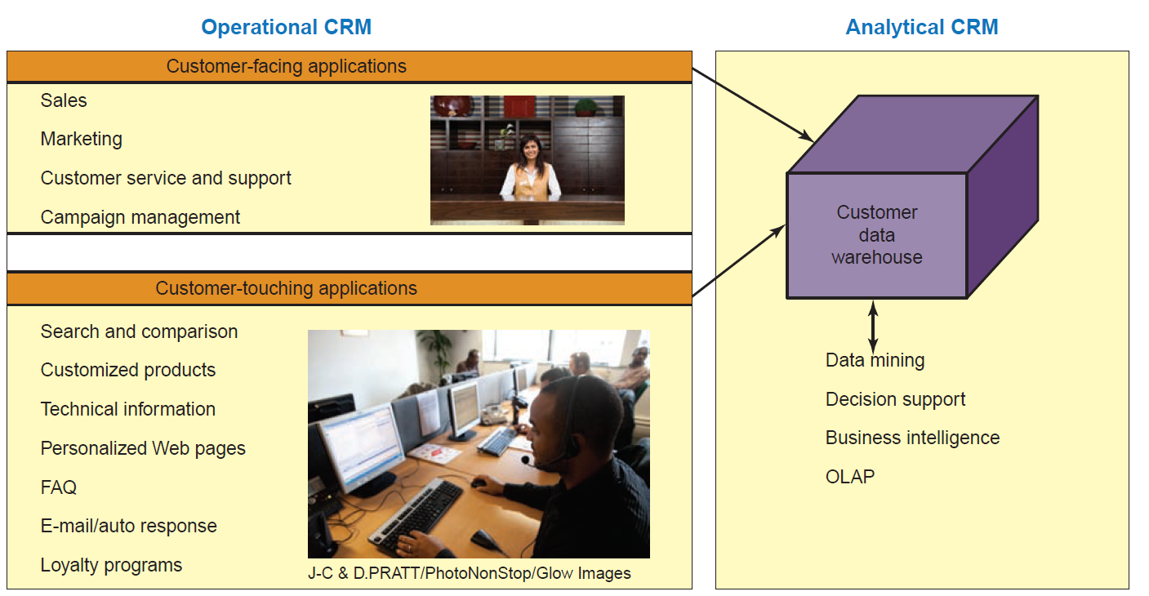
The relationship between operational CRM and analytical CRM
Notes:
For example, analytical CRM systems typically provide information concerning customer requests and transactions, as well as customer responses to the organization’s marketing, sales, and service initiatives.

Slide 28
Supply Chains

Slide 29
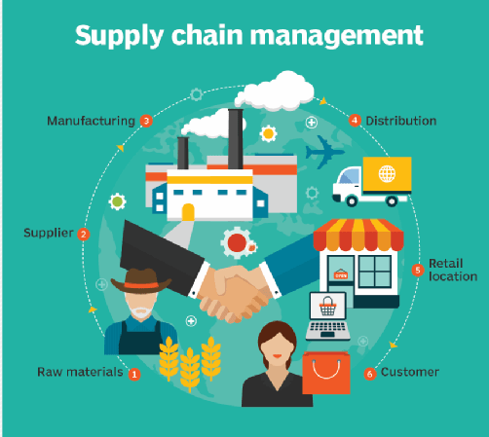
Supply Chains
A supply chain is the flow of materials, information, money, and services from raw material suppliers, through factories and warehouses, to the end customers.
Supply chains improve trust and collaboration among supply chain partners, thus improving supply chain visibility and inventory velocity.

Slide 30
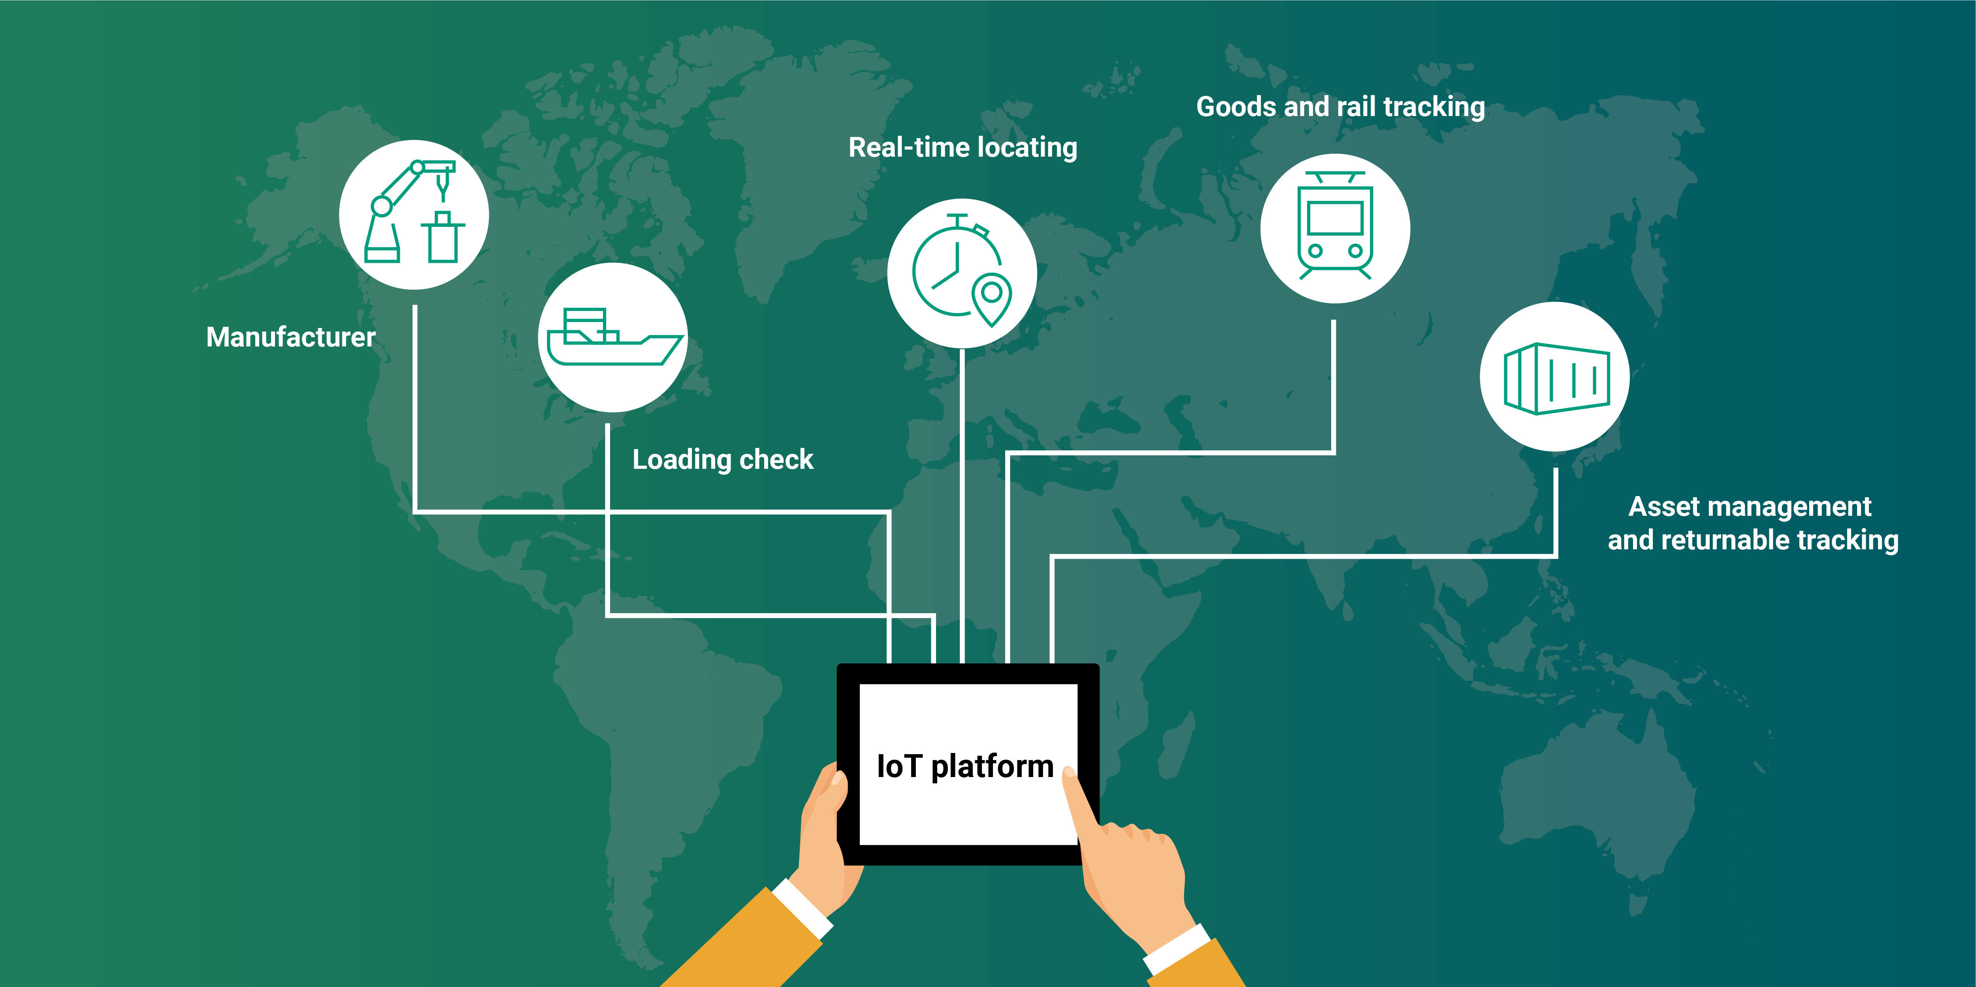
Supply Chains visibility
Supply chain visibility is the ability for all organizations in a supply chain to access or view relevant data on purchased materials as
these materials move through their suppliers’ production processes and transportation networks to their receiving docks

Slide 31
Why do I need to study supply chain management?
The answer is that supply chains are critical to modern organizations.
Therefore, regardless of your position within an organization, you will be involved with some aspect of your company’s supply chain.
Notes:
You might think that supply chain management is only for large organization. However, small organizations must carefully manage their supply chains as well.

Slide 32
The Structure and Components of Supply Chains
The term supply chain comes from a picture of how the partnering organizations are linked Together.
Supply chain involves three segments:
Upstream, where sourcing or procurement from external suppliers occurs.
Internal, where packaging, assembly, or manufacturing takes place.
Downstream, where distribution takes place, frequently by external distributors.

Slide 33
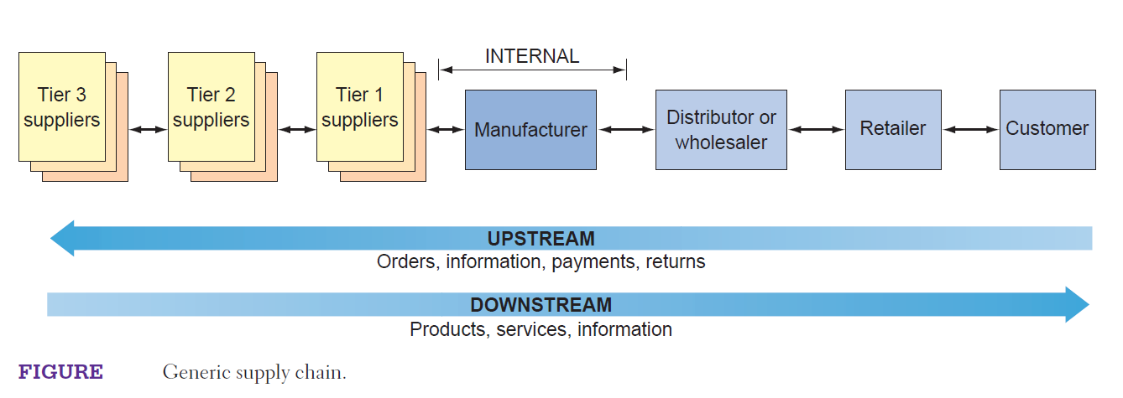
The Structure and Components of Supply Chains

Slide 34
Supply chain management
Supply chain management is the process of planning, organizing, and optimizing the various activities performed along the supply chain.

Slide 35
Supply chain management Components
There are five basic components of SCM:
Plan: Organizations must have a strategy for managing all the resources that go toward meeting customer demand for their product or service.
Source: Organizations choose suppliers to deliver the goods and services they need to create their product or service.
Return: Supply chain managers must create a responsive and flexible network for receiving defective, returned, or excess products back from their customers, as well as supporting customers who have problems with delivered products.

Slide 36
Supply chain management Components
Deliver: This component, often referred to as logistics, is where organizations coordinate the receipt of customer orders, develop a network of warehouses, select carriers to transport their products to their customers, and set up an invoicing system to receive payments.
Make: This is the manufacturing component. Supply chain managers schedule the activities necessary for production, testing, packaging, and preparation for delivery

Slide 37
References
Rainer, R. Kelly, et al. Management Information Systems, Wiley, 2014, Chapters 12 and 13.

Slide 38
See you next week!

