Slide 1
Introduction to Information System 31266 Week9
UTS CRICOS 00099F

Slide 2
Human-AI Interaction

Slide 3
Objective
AI is not ready yet
Determine Best practices and examples for designing products with AI

Slide 4
Lets search for “ Professor style”, Image section

Slide 5
Lets search for

Slide 6
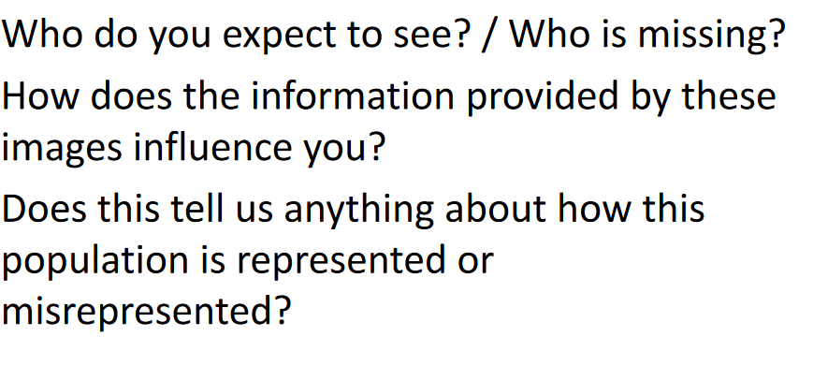

Slide 15
Best practices

Slide 16
Best practices and examples for designing products with AI

Slide 17
1.How AI adds value
AI is better at some things than others.
AI is well-suited for applications like:
Recommending different content to different users, such as movie suggestions
Predicting future events, such as weather events or flight price changes
Natural language understanding
Image recognition
Make sure that it’s the right technology for the user problem you’re solving

Slide 18
Heuristic-based solution
Heuristics is an approach to problem-solving in which the objective is to produce a working solution within a reasonable time frame.
Heuristics are used in Artificial Intelligence (AI) when it's impractical to solve a particular problem with a step-by-step algorithm.
A rule or heuristic-based solution may be better when:
Maintaining predictability is important
Users, customers or developers need complete transparency
People don’t want a task automated

Slide 19
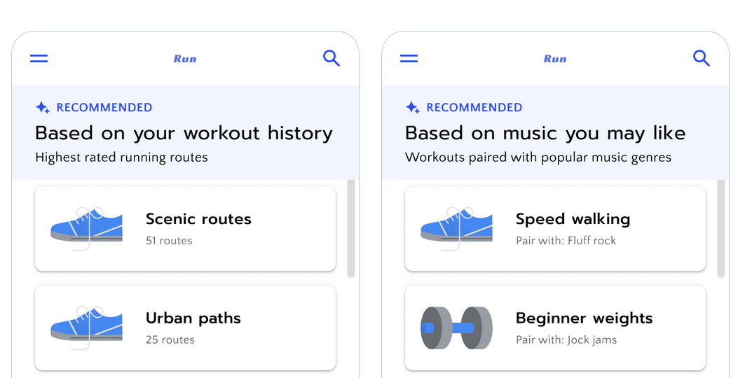
Aim for
Use AI when the predictive system can create a valuable personalized experience that couldn’t exist without it.
Avoid
Don’t use AI just because you can. Here, using music preferences to suggest workouts will likely lead to a worse experience than letting people manually choose workouts.

Slide 20
Case study1: AI and new drug treatments
Case study: BenchSci - AI design for user trust in biomedical research
https://www.youtube.com/watch?v=1LZBM-S-Rw0&t=4s

Slide 21
2. Set the right expectations
Be transparent with your users about what your AI-powered product can and cannot do.
Because AI systems are probabilistic, your system will probably give an incorrect or unexpected output at some point.
This makes it critical that you help users calibrate their expectations about system functionality and output.
Do this by being transparent about both its capabilities and limitations.
For example, indicating a prediction could be wrong may cause the user to trust that particular prediction less. However, in the long term, users may use or rely on your product more, because they’re less likely to over-trust your system and be disappointed.

Slide 22
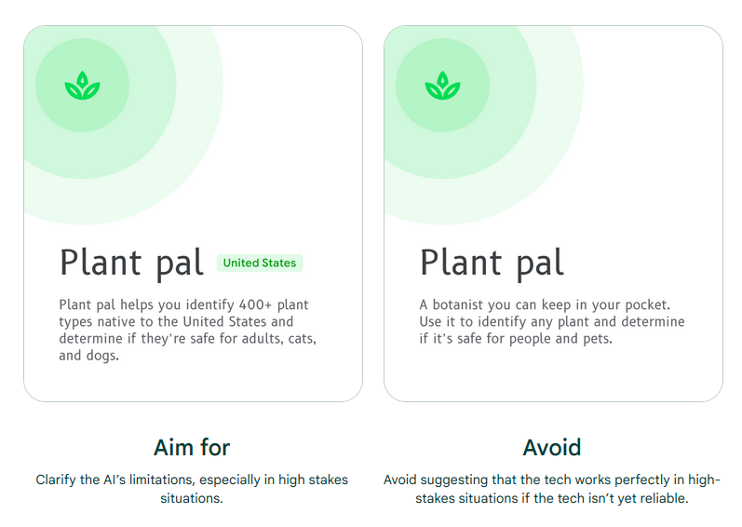

Slide 23
Case study2: AI and child literacy
Case study: Read Along - Voice and AI design to grow child literacy
https://www.youtube.com/watch?v=fllbN6ZixnE&list=PLJ21zHI2TNh-pgTlTpaW9kbnqAAVJgB0R&index=4

Slide 24
3. Explain the benefit, not the technology
Help users understand your product’s capabilities rather than what’s under the hood.
AI as a technology has unlocked a wide array of new, and often exciting, products and services.
But no matter how novel your use of AI, when explaining your AI-powered product to your users, focus primarily on conveying how it makes part of the experience better or delivers new value, versus explaining how the underlying technology works.
Run user studies to answer questions like:
What do users need to know about how the system works to understand and use your product?
Why is this knowledge useful to the users?

Slide 25
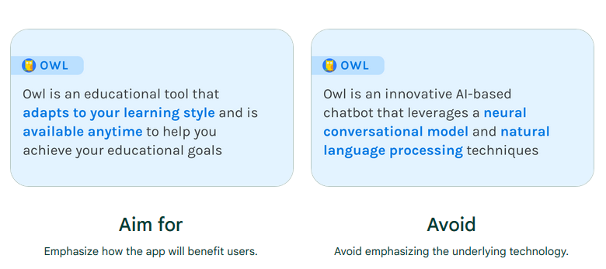

Slide 26
Case study3: AI and toxic comments
Case study: Tuning out Toxic Comments, with the Help of AI
https://medium.com/google-design/tuning-out-toxic-comments-with-the-help-of-ai-85d0f92414db

Slide 27
4. Be accountable for errors
Understand the types of errors users might encounter and have a plan for resolving
From early in the product development process, plan for the fact that your AI system will make bad predictions at some point. This is an important part of confirming that AI is the right technology for your project.
Think through the types of errors that your system could make, and their consequences. You should have an informed point of view about what's at stake for your user for a given error and expected impact of false positive and false negative predictions.

Slide 28
Users errors

Slide 29
20
40
10
200
Model A
50
10
40
160
Model B

Slide 30
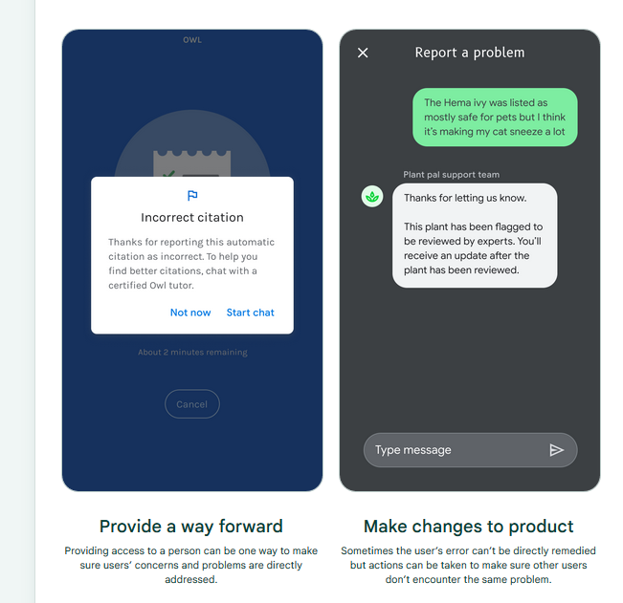
How to resolve the users error
Plan to remediate for such errors using approaches like:
Setting users expectations about your system with explanations
Providing manual controls when the AI fails
Offering high-touch customer support

Slide 31
5. Invest early in good data practices
The better your data planning and collection processes, the higher quality your end output.
AI-powered products can suffer without the right level of focus and resources on data from early on.
We call such downstream effects “data cascades” and they can be hard to diagnose and detect until your product experience is impacted.

Slide 32
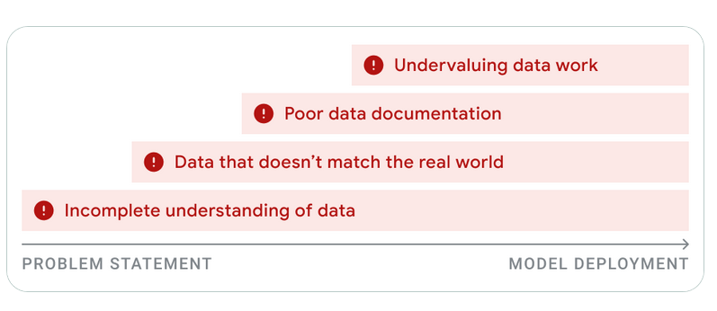
How to avoid data cascades
Good planning and scrutiny of your dataset can help you avoid issues downstream. Some actions that you can take include:
Collect data in batches
Embrace “noisy” data
Plan for data maintenance
Partner with domain experts

Slide 33
6. Make precision and recall trade-offs carefully
Determine whether to prioritize more results or higher quality results based on your product's goals.
When designing your AI-powered product, evaluate the trade-offs between having the set of recommendations your system gives to be broad (prioritizing recall) or accurate (prioritizing precision). This decision will have a big impact on the end user experience.

Slide 34
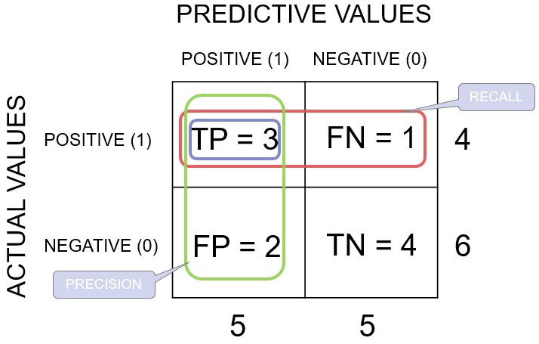
6. Make precision and recall trade-offs carefully
Precision: 3/5
Recall: 3/4

Slide 35
Prioritize recall
Prioritize recall: if your product is in a lower stakes domain and it’s not a problem for users to sort through a longer list of recommendations (for example, music recommendations), you might prefer to prioritize recall.
This means your user will get a larger set of results, offering the chance for surprising or serendipitous discoveries, but some of them may be less relevant.

Slide 36
Prioritize precision
Prioritize precision: If you are building a product in a high stakes domain (such as healthcare), and the risks stemming from an error are high, you will likely want to be more conservative with your model output, and only give recommendations for the things the system is most confident of.
This means prioritizing precision.

Slide 37
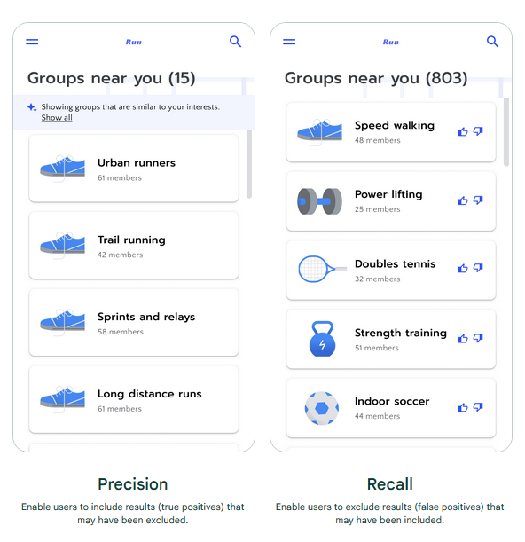

Slide 38
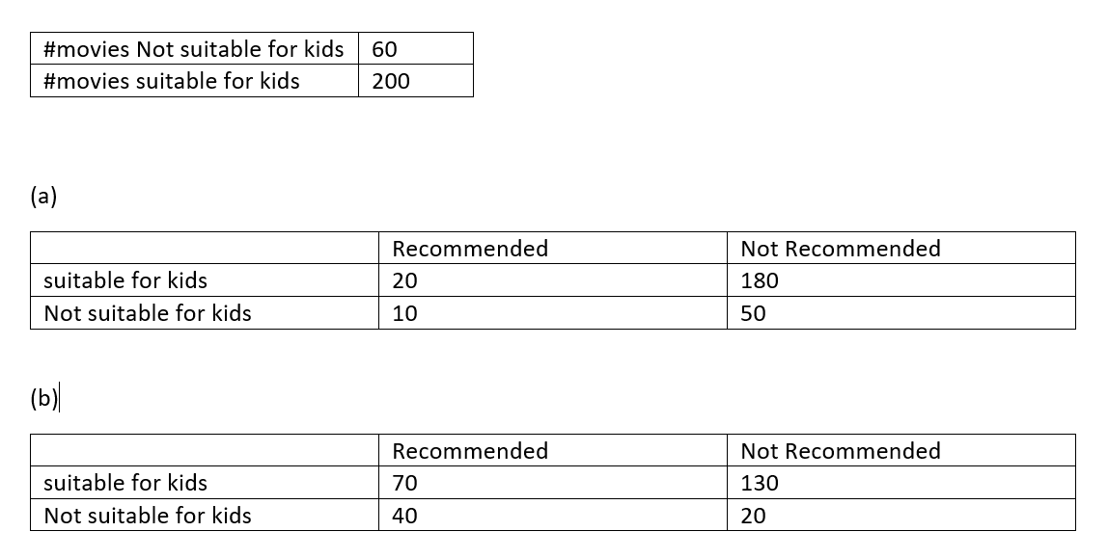

Slide 39
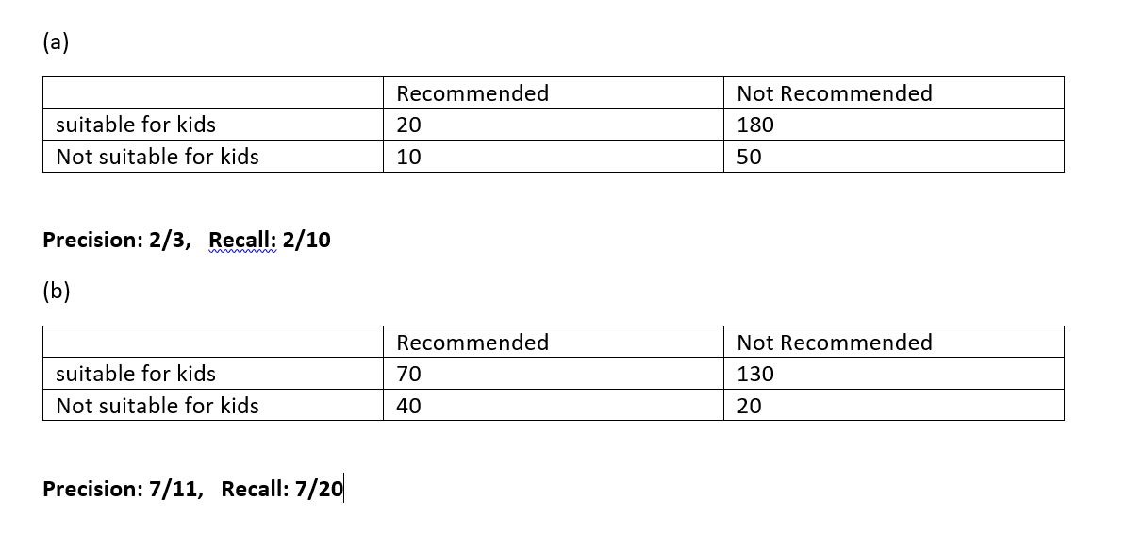

Slide 40
7. Be transparent about privacy and data settings
From initial onboarding through ongoing use, continue to communicate about settings and permissions.
Many AI systems rely on user data to personalize their recommendations or optimize the system.
If you are collecting user data, proactively ask users for permissions early on, and make it easy for them to adjust their settings.
Over time, you might also need to remind your users of the settings that they’ve chosen so that they can update to match their current preferences.
When prompting users to set or review their permissions, explain what you’re using their data for and why, and make sure your explanations are easily understandable.

Slide 41
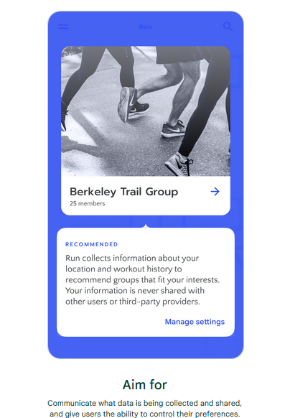

Slide 42
8. Make it safe to explore
Let users test drive the system with easily reversible actions.
AI systems often require access to some data or input from their users to provide them with personalized recommendations.
Before asking new users what and how much data they are willing to share, give them the opportunity to test your system.
For example, this can be done by offering an initial experimentation experience.
This will help new users who are eager to get started, or who don’t have time to fully consider and configure their preferences before diving in.
It will also support users who are wary of sharing this information before they fully understand what the system offers in return.

Slide 43
8. Make it safe to explore
Let users test drive the system with easily reversible actions.
Even after onboarding is complete, continue to make user actions and decisions reversible where possible.
User preferences and context are always changing.
Giving piecemeal undo options allows them to manipulate preferences recommendations without needing to resort to a nuclear reset option.

Slide 44
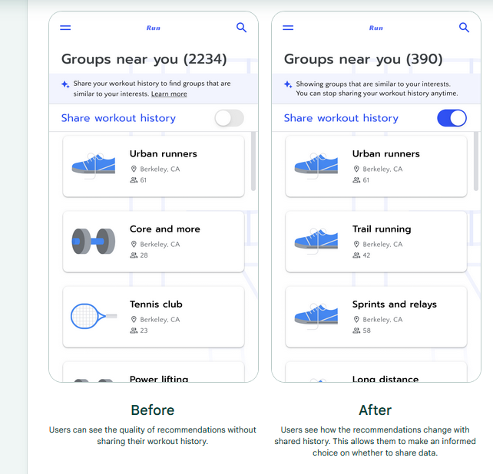

Slide 45
9. Add context from human sources
Help users appraise your recommendations with input from third-party sources.
In high stakes domains or when users are new, it can be useful to provide users with contextual information from other people to help them determine the value of your recommendations.
Third-party experts, whose information can help users vet the quality of your output relevant community groups, who can help users calibrate their trust through human-to-human connection.
This additional context, in tandem, with explanations and confidence displays, can help set user expectations about the quality of your recommendation.

Slide 46
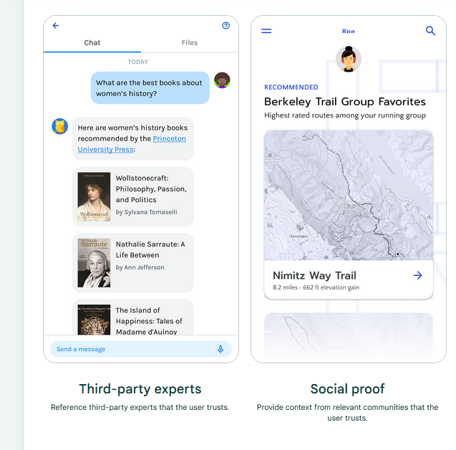

Slide 47
10. Determine how to show model confidence
If you decide to show model confidence, make sure it’s done in a way that’s helpful to your users.
In some situations, you can help users gauge how much trust to put in the AI output with model confidence displays that explain how certain the AI is in its prediction, and the alternatives considered.
However, in other contexts, confidence displays can be challenging for users to understand.
If you decide to use them, test different types of displays early in the product development process to find what works best for your users.

Slide 48
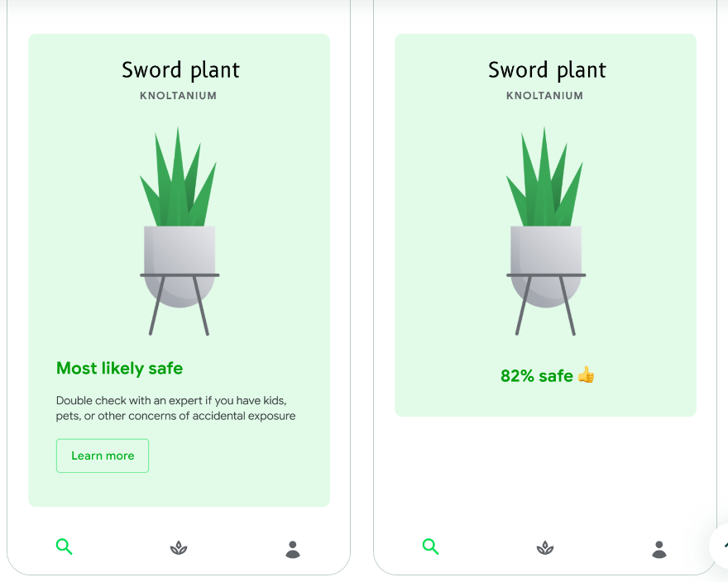

Slide 49
11. Automate more when risk is low
Consider user trust and the stakes of the situation when determining how much to automate.
When determining how much to automate your product flows, think about the stakes of your product, and the level of comfort that users may have with your type of product.
In low risk, well-established products, like content recommendation systems, you might choose to prioritize a more heavily automated product flow where user control is available but optional.
However, when onboarding to a new type of product, or in high-stakes situations, errors can be particularly problematic, and can corrode user trust and potentially cause dangerous situations.
In such cases, design your system to give users more control over the system.

Slide 50
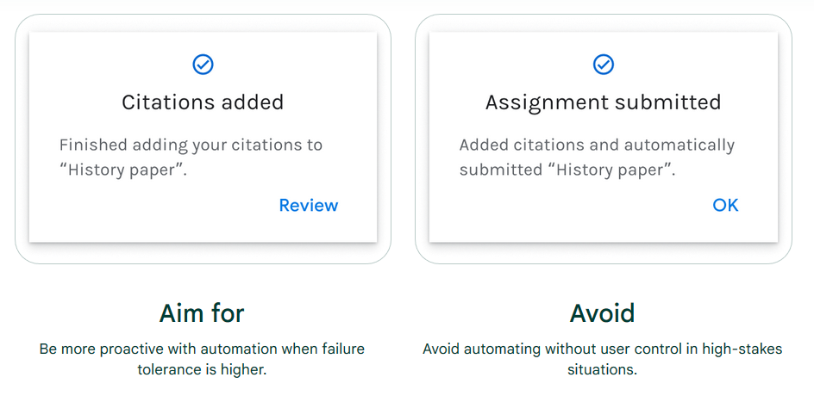

Slide 51
12. Let users give feedback
Give users the opportunity for real-time teaching, feedback and error correction
Giving a thumbs up or thumbs down on a recommendation
Hiding unwanted recommendations
Flagging or reporting problematic recommendations
Once a user gives feedback, acknowledge that you received it.
If possible, let them know how the system will respond to the feedback.

Slide 52
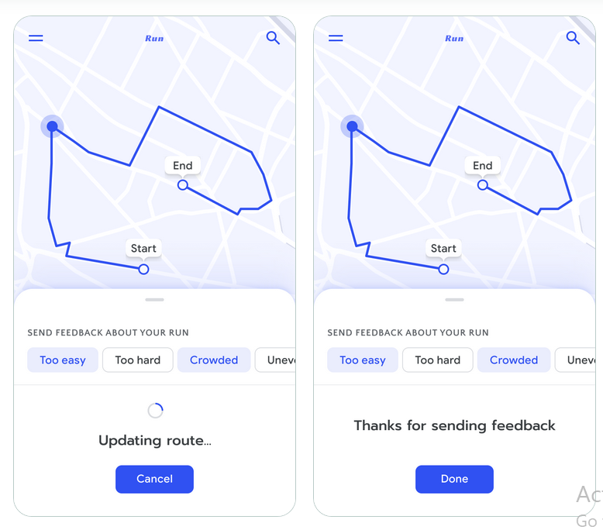

Slide 53
13. Let users supervise automation
Maintaining control over automation helps users build comfort and correct when things go wrong.
This is helpful to users in a number of ways, including:
Building comfort in new or high stakes situations with the support of controls to override the system if needed.
Learning how the system works as they exercise their controls. For example, by manually confirming an appointment time recommendation, they become more familiar with the system’s appointment recommendations.
Giving them a way to complete their task when the system doesn’t work as intended.

Slide 54
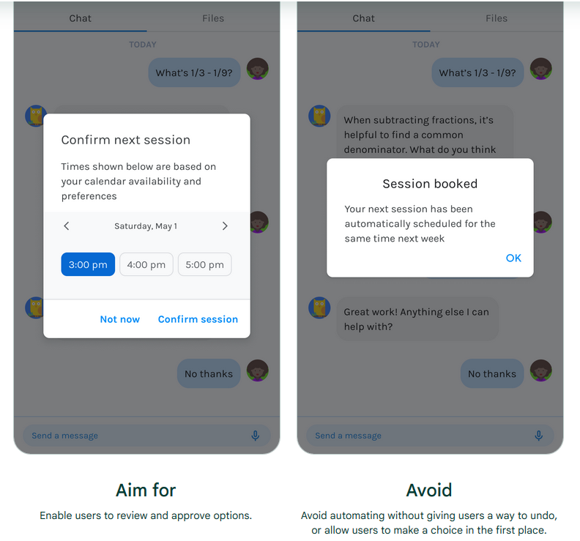

Slide 55
References

Slide 56
See you next week!

