Slide 1
31269: Business Requirements Modelling
Week 10 Lecture
Interaction Modelling with Sequence Diagrams

Slide 2
Object Oriented Modelling
  Last Week
    Class Modelling
  This Week
    Interaction Modelling (Sequence Diagrams)
    How do objects (or actors) interact with each other (or the system of interest) to execute the functionality of a use case narrative/scenario

Slide 3
Interaction Diagram (Sequence Diagram):
Relationship with Use Cases and Process Model
USE CASE 1
Main flow
Exception
Sequence
diagram 1
Sequence
diagram 2
Process Model
USE CASE 2
Main flow
Alternative
Sequence
diagram 3
Sequence
diagram 4
Notes:
Any alternate flows that you have in your use case narrative needs to be shown either in the same/original sequence diagram (preferred) using a Frame, or shown in a separate sequence diagram as depicted in the above slide.

Slide 4
Interaction Diagrams
The UML includes Interaction Diagrams to illustrate how objects interact via messages.
Interaction diagrams model how group of objects collaborate to perform some behaviour.
Interaction diagrams should be used when you want to look at the behaviour of several objects within a single use case (object level).
There are two types of Interaction Diagrams:
  Sequence Diagram
  Collaboration Diagram
Notes:
the interaction that takes place in a collaboration that either realizes a use case or an operation (instance diagrams or generic diagrams)
high-level interactions between user of the system and the system, between the system and other systems, or between subsystems (sometimes known as system sequence diagrams)
Sequence diagram emphasizes on time sequence of messages and collaboration diagram emphasizes on the structural organization of the objects that send and receive messages.
https://www.tutorialspoint.com/uml/uml_interaction_diagram.htm

Slide 5
Sequence Diagram: What is it and its purpose
Sequence Diagram:
  A graphical/visual representation of a scenario/narrative of a use case. Typically, it captures the behaviour of one use case and visualises a use case.
  Objects are identified in the use case narrative (or process model) and represented as a “Lifeline box” (see next slide).
  Shows communication between the identified objects in terms of messages that are passed from source to target lifeline over a period of time (see next slide).
  Shows a succession of interactions (methods) between classes or object instances over time in a sequence.
  Shows graphically the sequence, structure, and content of each message from an actor to the system. It also shows messages from the system to external systems.
Notes:
System sequence diagram
Object sequence diagram

Slide 6
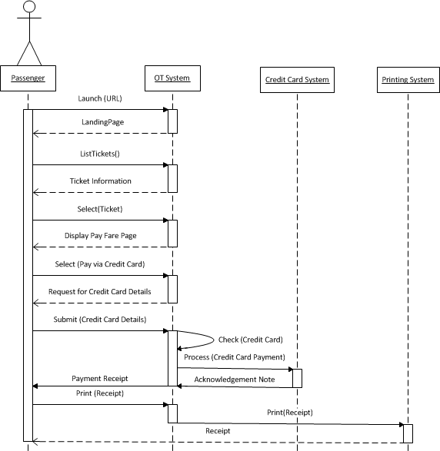
Example of a System Sequence Diagram
Lifeline box (Participant): Classes/Objects/Actors/System
Messages

Slide 7
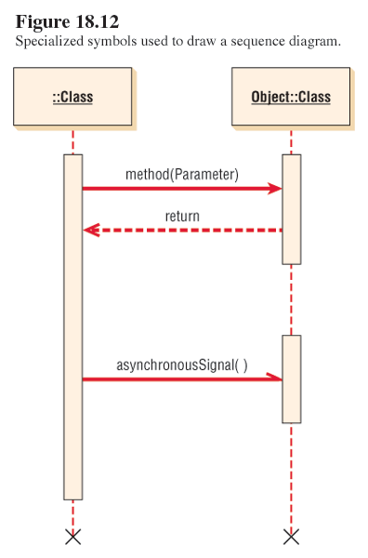
Sequence Diagram: Notations
: Class
Object: Class
Lifeline box representing a participant: System, Object, Actor (Class)
(object name: ClassName)
Message line
Activation bar (execution bar)
Lifeline
The X at the bottom of an Activation bar indicating object destruction (optional)

Slide 8
Sequence Diagram Components
Sequence diagrams illustrate interactions in a kind of fence format, in which each new object is added to the right as shown on previous slide.
Sequence diagrams have a tabular layout
  Columns and Rows
Columns
  Lifeline box– an individual participant (Object/Class/Actor) in a sequence diagram represented in a rectangular box
  Objects represented as “Lifeline box” are column “Headings”
  Activation/execution bar shows the period of time during which an operation/method executes and is shown along the lifeline. It indicates the focus of control and how long the object is active.
  First Lifeline or column initiates the interaction or communication
Rows
  Messages are in the rows and messages are sequenced in Time Order from top to bottom

Slide 9
Sequence Diagram Components
Lifeline Boxes and Lifelines
  Object or Actor or System composed of objects
  Lifeline boxes include a dashed vertical line extending below them which represents the actual lifeline of an object during interaction.
Types of Messages:
  Synchronous messages
  Asynchronous messages
  Self-Message
  Conditional Message
  Loops or Iterations
  Alternative “alt” and Optional “opt” fragments

Slide 10
Sequence Diagram: Messages
Horizontal arrows represent messages or signals sent between classes.
  Solid full arrowheads represent synchronous calls (the sending class waits for a response).
  Synchronous calls are more like functions (value returning methods).
  Half arrowheads represent asynchronous calls (sent without waiting for a returning signal).
  Asynchronous calls are like procedures (void methods).
  See the notes section of this slide
Notes:
Synchronous calls are more like functions (value returning methods) and Asynchronous calls are like procedures (void methods).
A method that calculates and returns a value is called a “function”:
double cube(double n)
{
return Math.pow(n,3);
}
A method that performs some action but returns nothing is called a “procedure”:
void deposit(double amount)
{
balance = balance + amount;
}

Slide 11
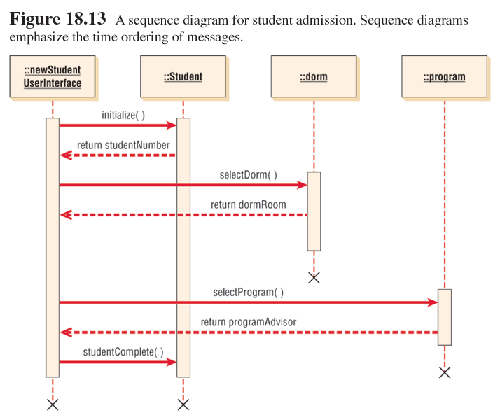
A sequence diagram for student admission.
Sequence diagram emphasize the time ordering of messages.
: newStudent
UserInterface
: student
: dorm
: program
New Student is created
New Student is assigned to a Dormitory
New Student is
assigned to an
academic program
and given an
academic advisor
Admission of a
new student
is complete
return AdmissionID

Slide 12
Sequence Diagram: (Where to from here?)
User Stories (Week 7)
Use Case Diagram (Week 8)
Use Case Scenarios or Narratives (Week 8)
Class Diagram (Week 9)
Sequence Diagram (one diagram for each use case narrative)
Read each use case narrative and identify Participants and messages via which these participants interact with each other.

Slide 13
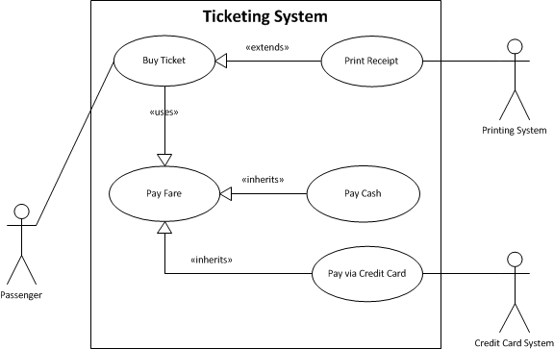
Use Case Diagram from Week 8

Slide 14
Steps in Drawing A Sequence Diagram – for Buy Ticket Use Case Narrative
  Refer the Buy Ticket use case narrative from Week 8 Task available in week 8 folder on Canvas.
  Read the narrative and follow the following steps:
    Find Participants: Identify Classes/Objects within the System you are interested in. Read the use case narrative and identify nouns, concepts, places, and people.
    Identify messages/methods by finding verbs and verb phrases. These will become your messages in the sequence diagram. Messages in the sequence diagram must match the steps in the main flow of use case narratives.

Slide 15
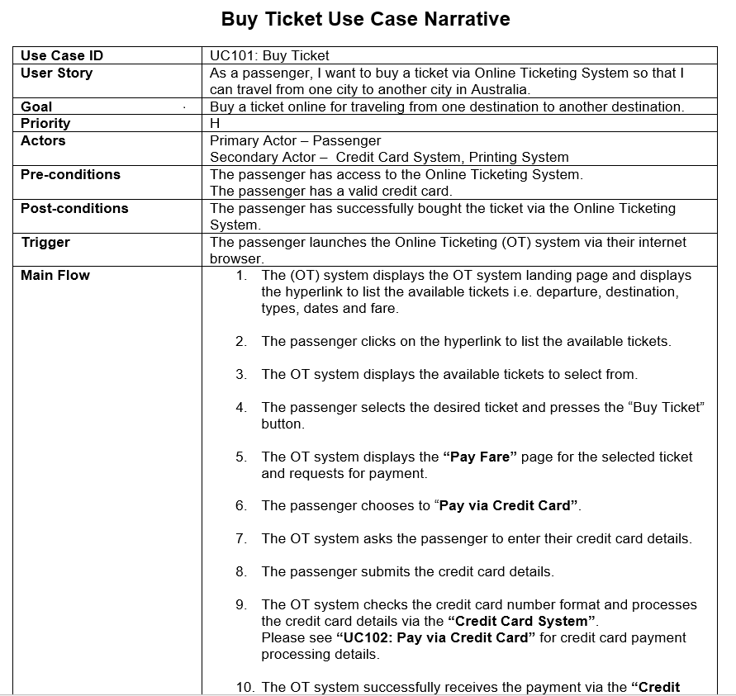
System Sequence Diagram for “Buy Ticket”
System Sequence Diagram shows interaction between Actor and System (OT System) as a black box.

Slide 16
System Sequence Diagram for “Buy Ticket” Use Case

Slide 17
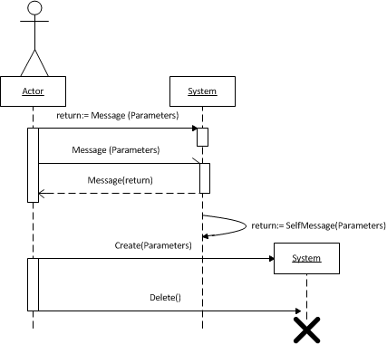
System Sequence Diagram
System is composed of objects, but is shown as a black box (can’t see its workings inside it).
For example in the previous diagram we have shown the OT System, but cannot see the objects within it.
System Sequence Diagram shows interaction between Actor and System as a black box.

Slide 18
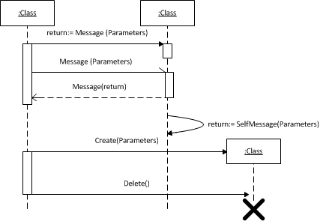
Object Sequence Diagram (at Object level)
Shows all the objects within the System
These are the Objects identified within the system of interest to us and the interaction is between these objects.
Object or Instance of a Class without name
Object Sequence Diagram is used generally to show interactions between the objects identified within the system of interest (objects within OT System)

Slide 19
Diagram Frames in a Sequence Diagram
To support conditional and looping constructs, the UML uses frames.
Frames are regions or fragments of the diagrams; they have an operator or label (such as loop) and a guard (conditional clause).
Some common frame operators:
  alt: For conditional messages (for example, if condition)
  loop: To implement a looping or iterative message
  opt: Optional fragment that executes if guard is true. Could be used for exceptions in a use case narrative.

Slide 20
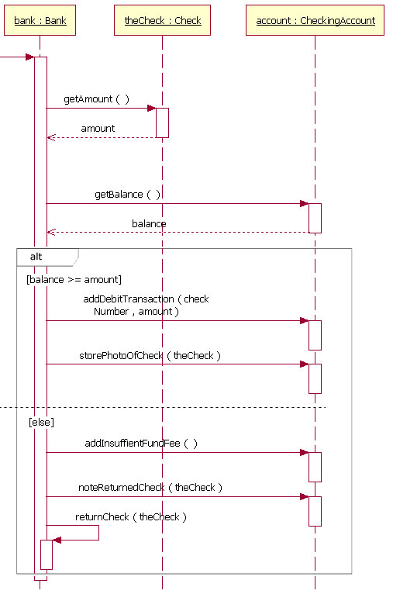
Sequence Diagram: Conditional Messages
operator
frame
guard

Slide 21
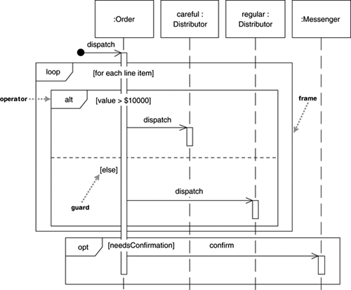
Sequence Diagram: Iterative Messages
Optional message

Slide 22
Example Scenario/Narrative – Booking a room
Customer queries for available rooms
Store customer details
Check diary for room availability
Room is available
Advise customer of availability
Customer requests reservation
Provisionally book room
Figure out price and advise customer
Customer accepts terms
Provisionally book room
Check customer credit
Customer credit Is OK
Reserve room

Slide 23
Step 1: Identify Participants: Classes/Objects (Nouns)
Customer Queries for Available Rooms
Store Customer Details
Check Diary for Room Availability
Room is Available
Advise Customer of Availability
Customer Requests Reservation
Provisionally Book Room
Figure Out Price and Advise Customer
Customer Accepts Terms
Provisionally Book Room
Check Customer Credit
Customer Credit Is OK
Reserve Room

Slide 24
Step 2: Identify Messages/Methods (Verbs)
Customer Queries for Available Rooms
Store Customer Details
Check Diary for Room Availability
Room is Available
Advise Customer of Availability
Customer Requests Reservation
Provisionally Book Room
Figure Out Price and Advise Customer
Customer Accepts Terms
Check Customer Credit
Customer Credit Is OK
Reserve Room

Slide 25
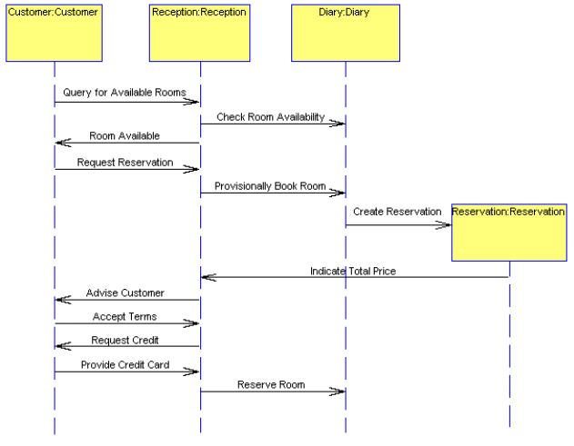
Draft of sequence diagram

Slide 26
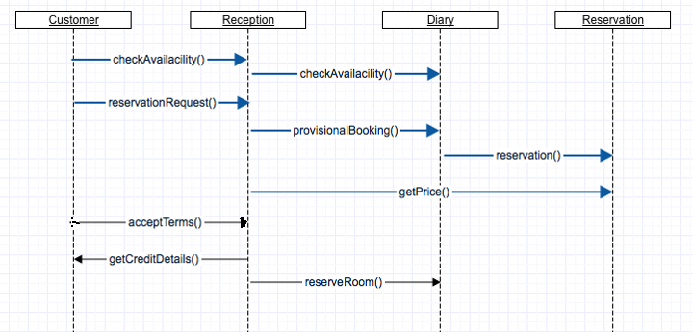
More Formal
Please see the notes section.
Notes:
Message names should be as close to the methods in classes as possible
Its better to use the same message names as method names in classes for consistency
Message parameters are optional but a very good convention to show them in a sequence diagram

Slide 27
Class Diagram from last week revisited

Slide 28
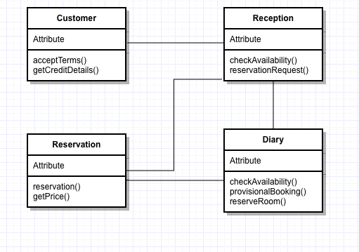
Relationship between Class Diagram and Sequence Diagram
Class diagram (developed earlier) should be updated after developing sequence diagrams.
Addition of new methods
Deletion of (never used) methods
Addition of new classes (created during the sequence diagrams)
Notes:
A class receiving a message in sequence diagram should have the method with same name in the class diagram.

Slide 29
Summary
Lifeline box: Actor or System or Object
Lifeline
Interaction or Communication
Sequence
Messages

Slide 30
Assignment 4 – Improved COS
Object Oriented Requirements Analysis and Specification Report – 30 Marks
Same Case Study as Assignment 1: Customer Onboarding System (COS) for Streamable
Functional and non-functional requirements
  Functional requirements using:
    User Story Map
    User Stories, Use Cases (narratives) and Use Case Diagram (Project boundary)
    Sequence Diagrams (minimum two at Object level)
  Data Requirements using:
    Class Diagram
    State Transition Diagram
  Non-functional requirements:
    User Interface requirements using wireframes
    Security requirements
    Performance requirements

Slide 31
Sequence Diagrams for Assignment 4
So far you should have finished your User Stories and Use Case Narratives for assignment 2.
Document two (or more) Sequence Diagrams (at Object Level) for the improved COS.
1) Any one use case of your choice for Customer and
2) Any one use case of your choice for Onboarding Team.
Hint: Convert any two Use Case Narratives into two Sequence Diagrams for the improved COS.
Read the use case narratives for Customer and Onboarding Team and follow the following steps:
  Find Participants: Identify Classes/Objects within the System you are interested in. Read the use case narrative and identify nouns, concepts, places, and people.
  Identify messages/methods by finding verbs and verb phrases. These will become your messages in the sequence diagram.
Both your diagrams must be drawn at an Object-level showing all the objects (participants) interacting within that use case (and within the COS) instead of just showing one object for the entire system such as COS object.
Messages in the sequence diagram should match with the main flow of the corresponding use case narrative. These messages should be in a logical sequence and cover the narrative from the start to the end.
Make sure that the messages start with a verb and sound like a method.
Make sure that the messages are being sent to correct participants.
Any Alternate flows narrated in your use case narrative must be shown either in the same/original sequence diagram (preferred method) using an Alt frame or shown in a separate sequence diagram.

Slide 32
Conclusion
This week
  Interaction modelling
  Sequence diagram
Next week
  State and event modelling

