Slide 1
31269: Business Requirements Modelling
Week 11: Lecture
State and Event Modelling with State Transition Diagrams

Slide 2
Object Oriented Modelling
  Last Week
    Interaction Modelling (Sequence Diagrams)
    Message passing between objects
    Synchronous and Asynchronous messages
  This Week
    State and Event Modelling (State Transition Diagrams)
    Shows different states of an object.

Slide 3
Classes and Objects
A Class is a definition of Objects.
A Class is a template or a blueprint for creating Objects.
An Object is an instance of a Class. One to many objects can be created from a class.

Slide 4
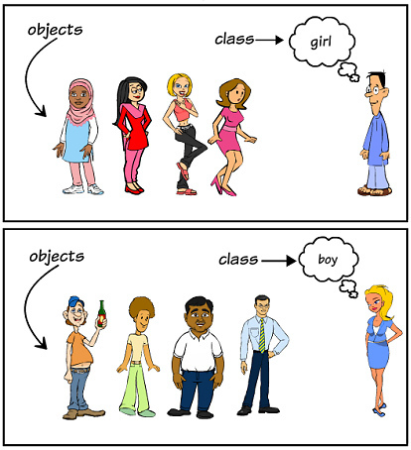
Classes and Objects
Person
Jim
Max
Carl
David

Slide 5
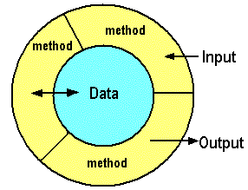
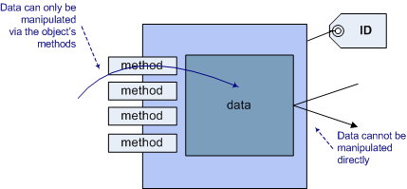
Objects have…
Properties/Data/State that is defined by
  Attributes of the class
Behavior that is defined by
  Methods of the class

Slide 6
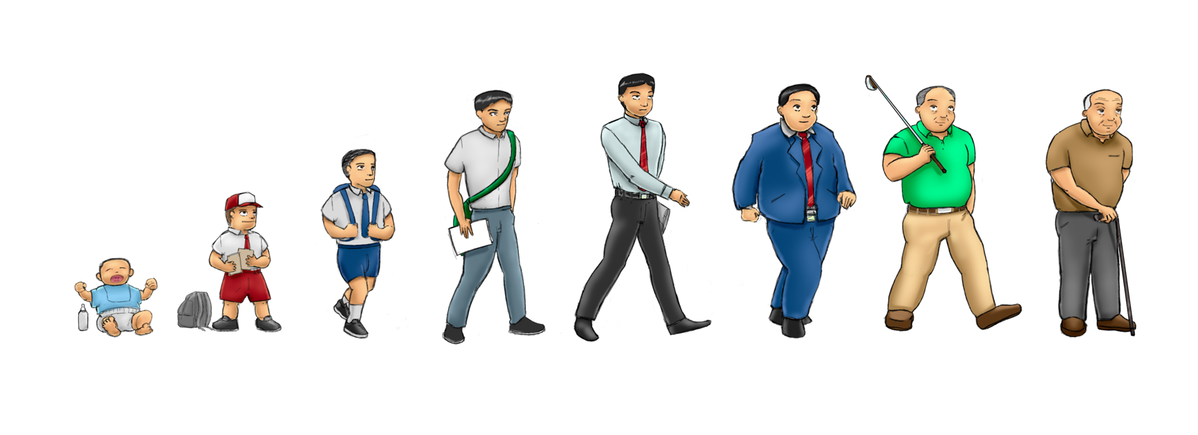
Objects have “States”
Name = Jim
Age = 24
Weight = 70
Height = 173
Name = Jim
Age = 74
Weight = 85
Height = 173
Name = Jim
Age = 4
Weight = 12
Height = 80
What has changed in these objects?
Notes:
These objects have change in the values of their attributes….that changes the state of these objects

Slide 7
State and Event Modelling with State Transition Diagrams
A state transition diagram shows the various states of a single object.
There must be a separate state transition diagram for each object/class in your class diagram.
It helps analysts, designers and developers understand the behaviour of the objects in the system. They won’t have to guess about what the object is supposed to do.
State-transition diagrams are very useful for describing the behavior of individual objects over the full set of use cases that affect those objects.
Create State Transition Diagrams when the business logic for a particular flow is very complex, or needs greater understanding by the developer to be coded perfectly.
Notes:
Transition Diagram is another method or another way to see methods as changing the state of an object

Slide 8
  Why State and Event Modelling?
To track an object’s lifecycle.
To provide status of an object at a given point in time.
To better understand the several states that an object goes through.

Slide 9
State and Event Modelling
Show an object’s states, and the events that cause them to transition between states.
Movement from one state to another is called transition and is triggered by an event. When its triggering event occurs, a transition is said to fire.
An event happens at a specific time and place.
  Events cause a change of state for an object as the transition “fires”.

Slide 10
State and Event Modelling
Objects change their state in response to events (time and non-time events).
  e.g. When you press a switch/button, a Light object changes its state from off to on.
  e.g. The enrol() method changes the state of the Student object from being ‘prospective’ to ‘enrolled’.
Each time an object changes state, some of its attributes must change.

Slide 11


UML Syntax for State Transition Diagram
 | Initial State: This shows the starting point or first activity of the flow. Denoted by a solid circle.
 | State: Represents the state of an object at an instant of time; one for each state of the Object we are describing. Denoted by a rectangle with rounded corners and compartments
 | Transition: An arrow indicating the Object is to transition from one state to the other. The actual trigger event and action causing the transition are written besides the arrow, separated by a slash.
 | Final State: The end of the state diagram is shown by a bull's eye symbol.
State Name
Action and Activities
Event/Action

Slide 12
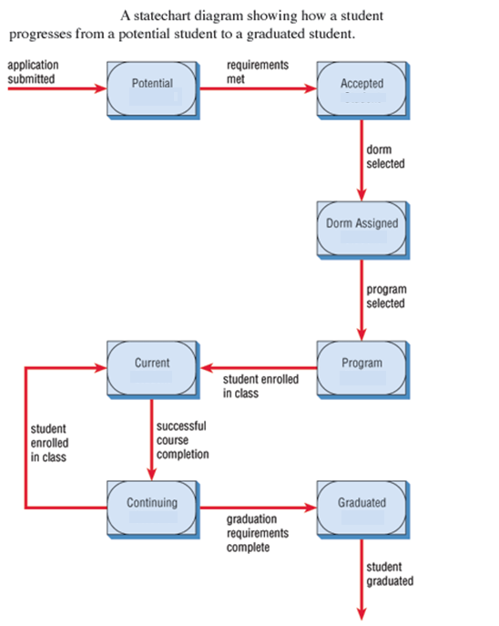
Example 1:
State Transition Diagram for the “Student” object
- The above example lets us understand the different states of a “Student” object and the events that trigger/cause those states of a Student object to change.

Slide 13
Example2: State Transition Diagram for the “Buyer” object
Initiate trade
Receive offers
Waiting
Considering offers
Select offer
Paying
Confirming
Payment sent
Confirmation received

Slide 14
Example3: State Transition Diagram for the“SalesPerson” object
c1:Customer
s1:SalesPerson
Item2:StoreItem
enquirePrice(customer, item-name)
requestStorePrice(item-name)
Store price
quoteSalesPrice(item-name, price)
Methods are shown that change state of the SalesPerson
enquirePrice
quoteSalesPrice
Replying
Talking
Waiting
Store price
requestStorePrice
- The customer requests the price and availability of the item from the Sales Person.
- The Sales Person calls the store requesting a store-price.
- The store provides the store price of the item.
- Sales Person computes a commission and quotes a sales price to the customer.

Slide 15
Sequence Diagram for ATM Machine
Customer
ATM
Bank System
Insert card
Request for PIN number
Enter PIN number
Check PIN and card information
Display Account numbers
Confirm PIN OK with account numbers
Select account
Selected account
Confirm Limits
Display Limits
Enter Amount
Amount
Send Approval
Print Receipt

Slide 16
Example4: State Transition Diagram for ATM machine Object
Printing and dispensing
Receipt
Customer inserts card
Reading
Request PIN
Waiting
Customer enters amount
Customer enters PIN
Waiting for selection
Contacting bank
Request security check
Limits
Accounts
Displaying limits
Customer selects account
Waiting for selection
Displaying accounts
PIN OK
Waiting for bank

Slide 17
State Transition for ATM machine with alternatives
Printing and dispensing
Receipt
Customer inserts card
Reading
Request PIN
Waiting
Customer enters amount
Customer removes card
Customer enters PIN
Limit exceeded
Request PIN again
Contacting bank
Waiting for selection
Waiting for selection
Limit reminder
Displaying incorrect PIN
Request security check
Limits
PIN Not OK
Accounts
Displaying limits
Customer selects account
Waiting for selection
Displaying accounts
PIN OK
Waiting for bank

Slide 18
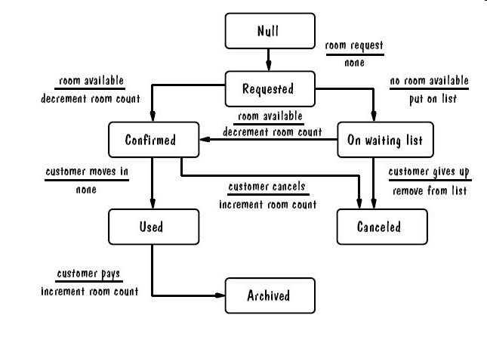
Example5: State Transition Diagram for “Reservation” object (for hotel room reservation)
18

Slide 19
State Transition Diagram
Ticketing System Example

Slide 20
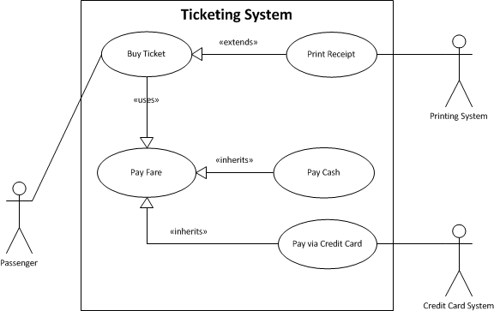
Use Case Diagram for Ticketing System

Slide 21
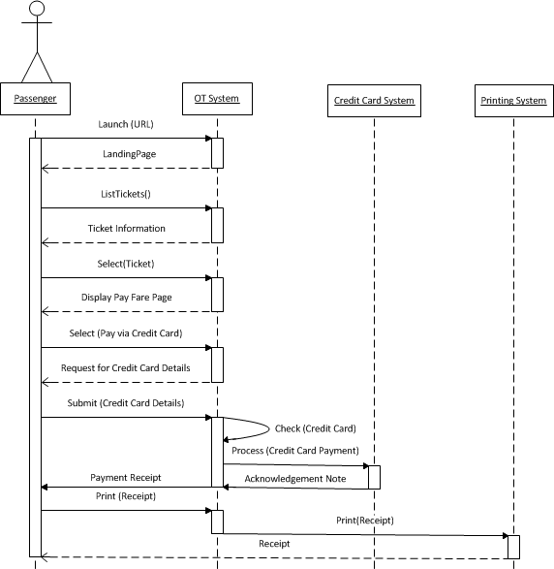
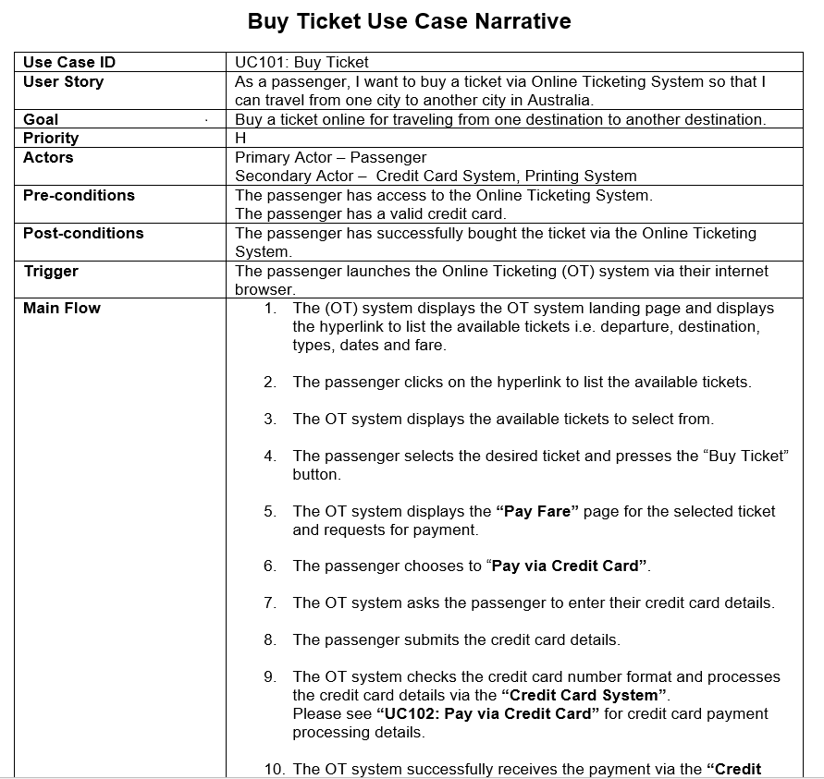
System Sequence Diagram for “Buy Ticket”
System Sequence Diagram shows interaction between Actor and System (OT System) as a black box.

Slide 22
System Sequence Diagram for Ticketing System

Slide 23
Class Diagram for Ticketing System
Identify the object to draw the State Transition Diagram

Slide 24
Steps in drawing a State Transition Diagram
  Refer all the use case narratives and sequence diagrams from previous weeks.
  Read the narratives and follow the following steps:
    Identify States: Identify the different states of the Object that it goes through.
    Identify Events: Identify the Events that cause this transition/changes to these states of this Object.

Slide 25
State Transition Diagram for “Ticket” object
Refer all the use case narratives “Buy Ticket”, “Pay Fare” and “Print Receipt”, and sequence diagrams from previous weeks. While reading the main flow, follow the steps below:
  Identify States: Identify the several states of the “Ticket” object that it goes through.
  Identify Events: Identify the Events that cause this transition/changes to these states of the “Ticket” object.
Below is a draft of the diagram:
What is missing in this diagram?
Notes:
A Ticket is Listed
A Ticket is Selected
A Ticket is Paid
A Ticket is Printed
What causes the Ticket object to change its states from being Listed to Selected to be Paid to being Printed? These will form the transitions/events which need to be shown on the arows.

Slide 26
Summary
States (different states of an Object)
Event (events that cause the transition/change in states)
State Transition Diagrams (one for each Object/Class), so you can/may draw a separate diagram for each object/class in your class diagram to better understand the several States that an object goes through.

Slide 27
Assignment 4 – Improved COS
Object Oriented Requirements Analysis and Specification Report – 30 Marks
Same Case Study as Assignment 1: Customer Onboarding System (COS) for Streamable
Functional and non-functional requirements
  Functional requirements using:
    User Story Map
    User Stories, Use Cases (narratives) and Use Case Diagram (Project boundary)
    Sequence Diagram
  Data Requirements using:
    Class Diagram
    State Transition Diagram
  Non-functional requirements:
    User Interface requirements using wireframes
    Security requirements
    Performance requirements

Slide 28
State Transition Diagram for assignment 4
Document one State Transition Diagram for “Customer” object that covers all user stories and use case narratives that the Customer participates in (across the entire COS).
  State transition diagram must not look like a process flow.
  Show the initial and final states.
  Identify at least five correct states of the Customer object.
  Identify, label and correctly name the Events/Triggers.
  Students must provide at least one alternate flow in this diagram.
User Interface Requirements (refer ATM example provided in Task 3 of Week 3 Workshop). Document two User Interfaces or Wireframes for any two use cases (should be the same as the ones you choose for the sequence diagrams).
Security Requirements
Performance Requirements
Use Assignment 4 Template provided to you – available now.
Refer Frequently Asked Questions (FAQ) – available now.

Slide 29
Conclusion
THIS WEEK
  Class Topic: “State and Event Modelling”
Next Week
  Assignment 4 final review

