Slide 1
31269: Business Requirements Modelling
Week 4 Lecture – Business Process Modelling

Slide 2
Objectives
Appreciate how modelling techniques can help to understand the working of business systems.
Discover how modelling can be used to specify system and user requirements.
Discover how Business Process Model (BPM) can be used to model, analyse and understand the business processes in an organisation.

Slide 3
Topics
Requirements Analysis & Modelling
  Business Process Modelling using BPMN

Slide 4
Requirements Process
Negotiation, Prioritising & Management
Planning & Elicitation
Modelling & Analysis
Specification & Documentation
Validation & Inspection

Slide 5
Requirements Analysis
Last week - How are the requirements collected?
  Interviews, workshops, prototypes, surveys, observation, document review, etc.
This week - How do we analyse and model these requirements collected so far?
  Business Process Modelling

Slide 6
Business Processes
Experts from IT and business engineering disciplines argue that successful systems deployment starts with the understanding of the business processes of an organisation.
A business process has a strong emphasis on how the work is done within an organization.

Slide 7
Business Processes
A business process is the combination of a set of activities within an enterprise with a structure describing their logical order and dependence, whose objective is to produce a desired result.
A business process is a collection of activities designed to produce a specific output for a particular customer.
A business process is thus a specific ordering of work activities across time and place, with a beginning, an end, and clearly defined inputs and outputs.
Examples of business processes:
  Buy goods online
  Place an order
  Withdraw money from an ATM
  Apply for home loan, etc

Slide 8
Introduction to Business Process Modelling
Business process modelling (BPM) in systems engineering is the activity of representing processes of an enterprise, so that the current process may be analyzed or improved.
Source: http://en.wikipedia.org/wiki/Business_process_modeling
Conceptual modelling of business processes is performed to facilitate the development of software that supports the business processes
BPM is used to map out an organization’s current (or “as-is”) processes to create a baseline for process improvements and to design future (or “to-be”) processes with those improvements incorporated.
Modelling of a business process typically shows events, actions and links or connection points, in a logical order from end to end.
Notes:
Business process modeling, often called process modeling, is the analytical representation or illustration of an organization’s business processes.
Along with business process discovery, process modeling is widely viewed as a critical component in successful business process management (BPM). It is used to map out an organization’s current (or “as-is”) processes to create a baseline for process improvements and to design future (or “to-be”) processes with those improvements incorporated. Process modeling often uses Business Process Modeling Notation (BPMN), a standard method of illustrating processes with flowchart-like diagrams that can be easily understood by both IT and business managers.
Source: http://whatis.techtarget.com/definition/business-process-modeling

Slide 9
Process/System Decomposition
A large or complex process (or system) is more easily understood when broken down using process decomposition.
Decomposition is the process of starting at a high level and dividing entities into smaller and smaller related parts.
The main purpose of process decomposition is to break up a large or complex business process (or system) into smaller and more manageable chunks/components (sub-processes and tasks).
It therefore facilitates understanding of the business process and hence is a useful tool in conducting analysis and design.

Slide 10
Process/System Decomposition into different levels
Note: Different Analysts and companies may or may not decompose process/es. And if they do decompose a particular process, they may do it differently and at different levels than what is being taught in this subject.
For example, they may decompose it to just 2 or may be 4 or 5 levels.

Slide 11
Context Diagram
A System Context Diagram (SCD) is a diagram that defines the boundary between the system, or part of a system, and its environment, showing the entities that interact with it.
Source: http://en.wikipedia.org/wiki/System_context_diagram
A Context Diagram allows a team or an individual to produce a high-level model of an existing or planned system that defines the boundary of the system of interest and its interactions with the critical elements in its environment.
Source: http://www.burgehugheswalsh.co.uk/uploaded/documents/CD-Tool-Box-V1.0.pdf
A context diagram shows (parts/components):
  The system that is being analysed.
  The entities (other systems, people and organisations) that interact with the system.
  The information/data (not the processes) that flows between the system and each entity.

Slide 12
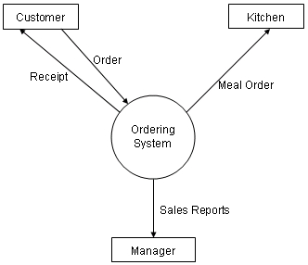
Context Diagram: Example
Fast food restaurant ordering system
Meal Order
Source: http://www.cpanel.stpaulsscience.org/gceict/specifications/aqa/unit3/devsolutions/context/intro.htm

Slide 13
Why have a Context Diagram?
A Context Diagram can:
help define and agree the scope or boundary of the system of interest
provide a simple high-level picture or birds eye view of the system of interest.
Help identify the elements in the environment of the system of interest that it interacts with. All systems operate in an environment; failure to pay attention to that environment will lead to failure.
Identify and define the external interfaces the System of Interest logically has to have with the outside world.
Source: http://www.burgehugheswalsh.co.uk/uploaded/documents/CD-Tool-Box-V1.0.pdf
The interfaces between the system and the external entities are shown with labeled arrows. The context diagram depicts the project scope at a high level of abstraction but reveals nothing about the system functionality, architecture, or look-and-feel. Nor does it explicitly identify the features or functionality that are in or out of scope. The functional behavior of the system is merely implied by the labeled flows that connect the system to the external entities.

Slide 14
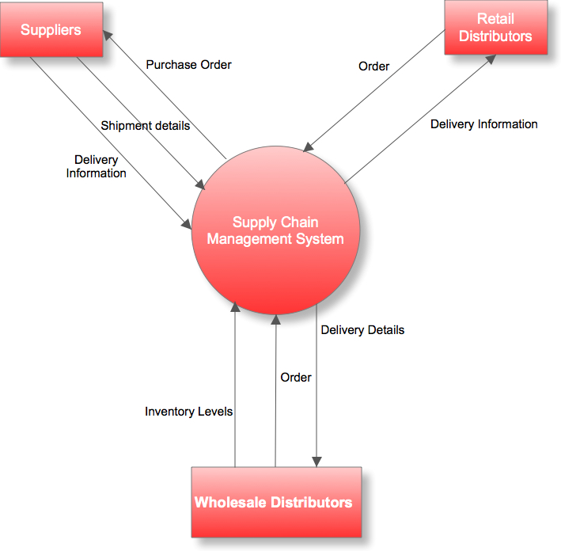
Context Diagram: Another Example –
Supply chain management system
Purchase Order
Purchase Order
Source: http://businessanalystlearnings.com/ba-techniques

Slide 15
Level 1 and 2 Diagrams
Level 1 Diagram:
  Identify all the business processes (main functionalities/features/work activities) within the System.
Level 2 Diagrams:
  Detail/model all sub-processes and tasks within each process identified at Level 1.
  Identify all the tasks from the start to end required to complete each Level 1 process and draw one separate diagram for each Level 1 process.

Slide 16
ATM Process Model (from last week’s tute case study)
Context
  Identify all the External Entities + information that flows between the ATM System and Entities
Level 1: Identify all business processes within the ATM System
  01 Withdraw money
  02 Transfer money
  03 Deposit money
  04 Change PIN
Level 2
  Detail/model all sub-processes and tasks/activities within each process identified at Level 1. Identify all the tasks from the start to end required to complete each Level 1 process and draw one separate diagram for each Level 1 process.

Slide 17
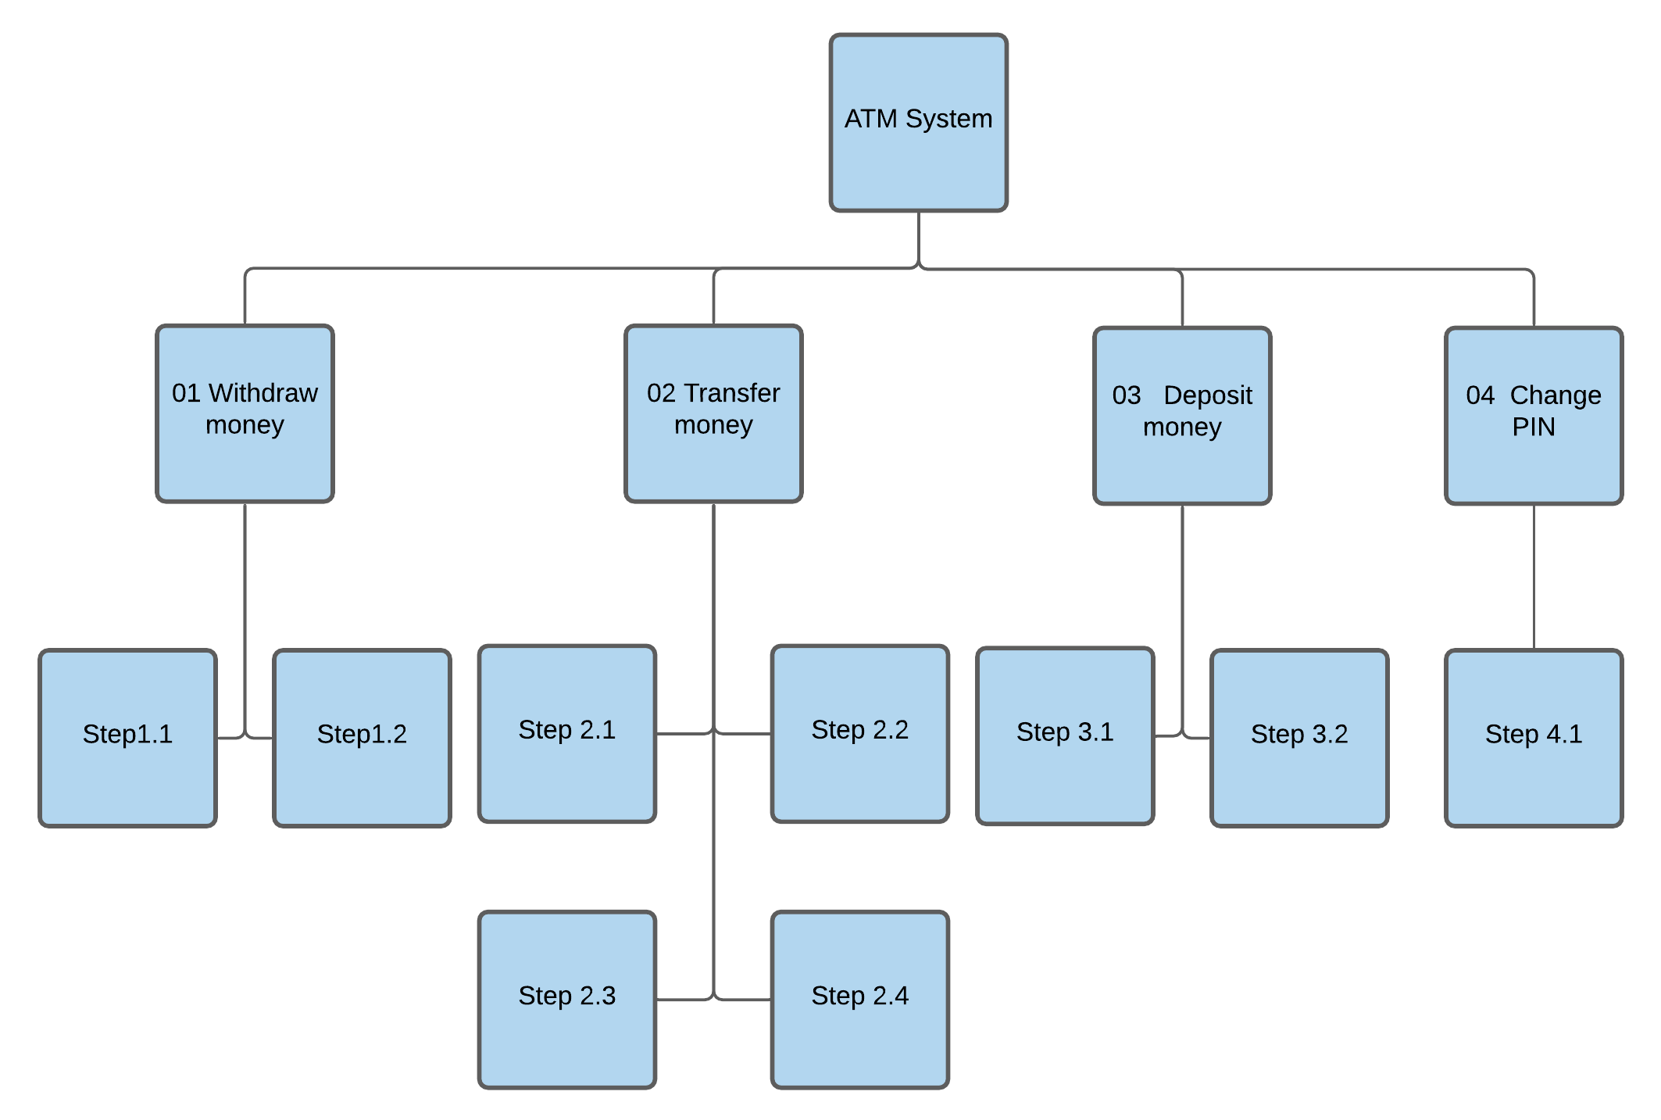
Process Decomposition Diagram for ATM (from last week’s tute case study)
Level 1 Diagram (processes)
Context Diagram
Level 2 Diagram (sub-processes)

Slide 18
BPMN – A Process Modelling Technique
Business Process Modelling Notation (BPMN) is the standard notation used for business process modeling.
The primary objective of developing BPMN is to provide a notation that is readily understandable by all business users, from the analysts that create the initial drafts of the processes, to the technical developers responsible for implementing the technology that will perform those processes, and finally, to the business people who will manage and monitor those processes.
BPMN defines a Business Process Diagram (BPD), which is based on a flowcharting technique tailored for creating graphical models of business process operations.
A Business Process Model, is therefore, a network of graphical objects, which are activities (i.e., work) and the flow controls that define their order of performance.

Slide 19
BPMN –
Notations
Notes:
Source: http://www.scribd.com/doc/75548565/Business-Process-Modelling-Template

Slide 20
BPMN –
Notations
Notes:
For different tool, these notation might be different. Please keep consistency.
https://www.lucidchart.com/pages/bpmn
https://lucidco.zendesk.com/hc/en-us/articles/360049831771-Get-Started-with-an-Educational-Account

Slide 21
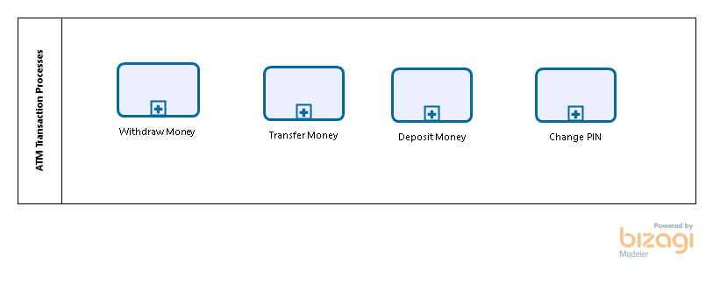
Examples of a simple process in a BPMN diagram
Often known as a Level 1 BPD: the simplest level.
Simple Level 1 Business Process Diagram (BPD) for ATM Transaction Processes
Note: The above diagram contains no Start and End events as it has independent business processes and each of these processes will be detailed in the following Level 2 diagrams which will have the start and end events.
Notice that there are no Sequence/Message Flow arrows between these processes as these processes are independent. In a number of Level 1 diagrams (for example in your workshop case study processes), you will see sequence flow arrows associating the various level 1 processes as those processes maybe be associated to each other (but not in the above example).
So, the sequence flow arrows in Level 1 diagrams should only be shown if the processes within that diagram are associated with each other.

Slide 22
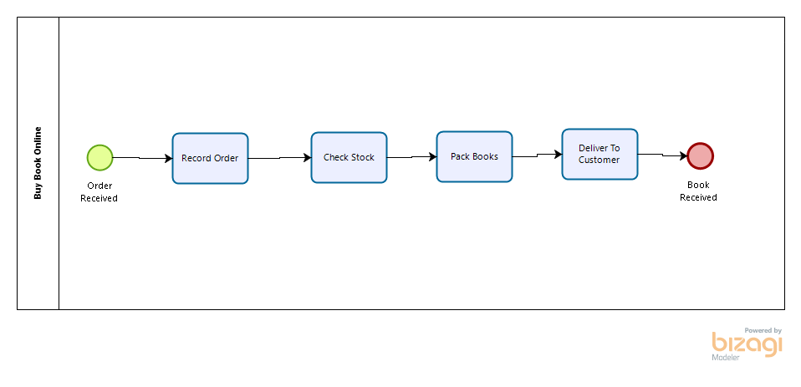
Examples of a simple process in a BPMN diagram
Often known as a Level 1 BPD: the simplest level.
Simple Level 1 Business Process Diagram (BPD) for “Buy Book Online” Processes
Note: The above diagram contains named Start and End events as the processes/activities in the above level 1 diagram are associated with each other. And hence the sequence flow arrows are shown connecting/associating these activities.

Slide 23
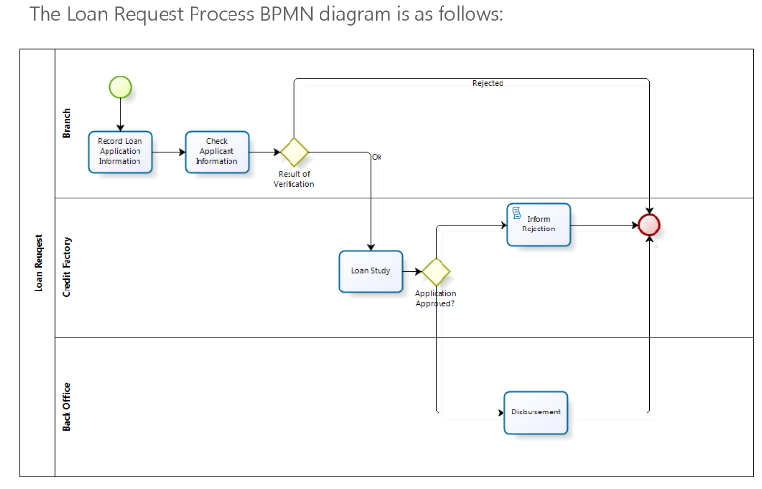
An Example of Business Process Diagram with Lanes – Level 2 Diagram for “Request Loan” Process
A Level 2 business process diagram (based on BPMN) breaks down a level 1 process like “Request Loan” into its sub-processes, as seen below. Level 2 means a greater level of detail than Level 1. It can include lanes, pools, gateways and data objects.
Application received
Outcome completed
Note: Three swimlanes represented by a role/participant or an organisational area

Slide 24
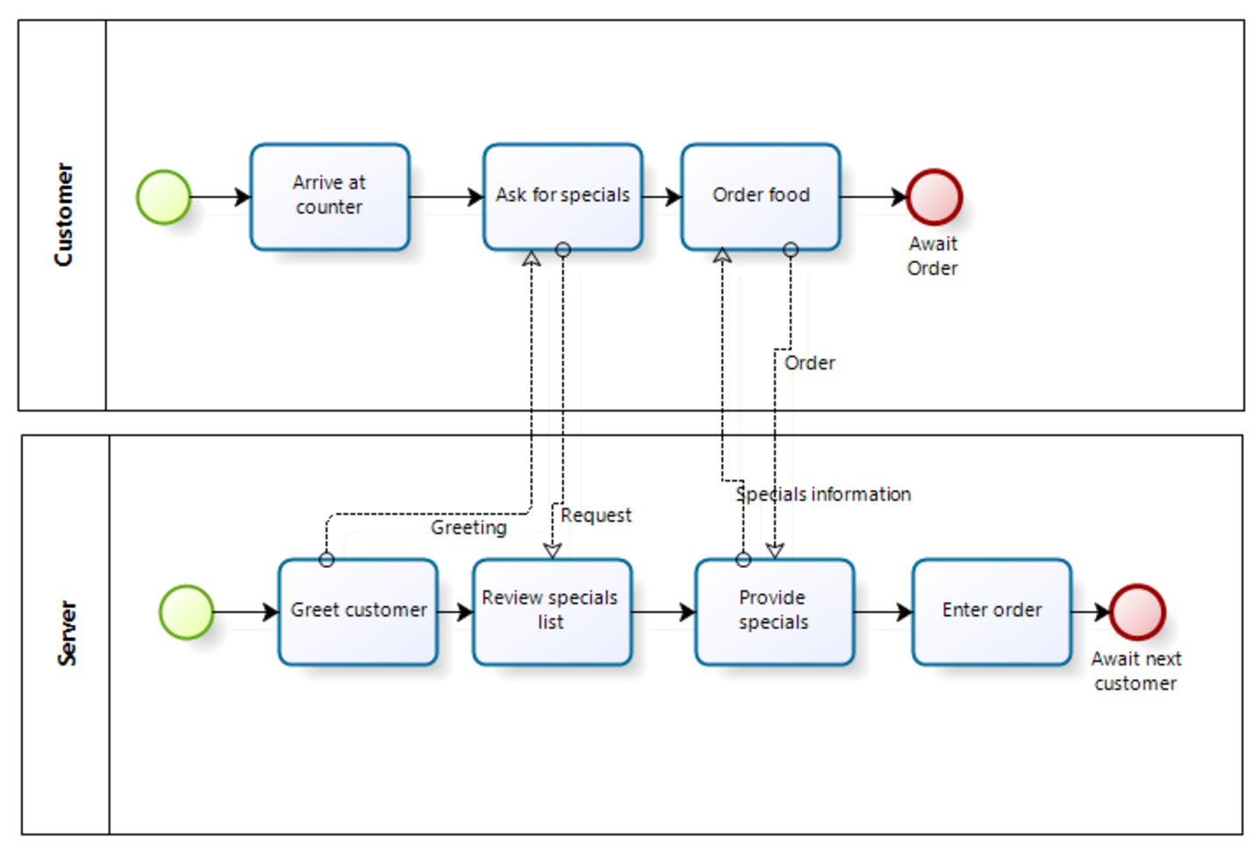
Another example of a Level 2 Business Process Diagram: “Order food”
Customer is hungry
Note: Different
participants are
in different pools.
Waiting
Note: Start and end events are labelled.

Slide 25
Another Example of BPD with Pools:
Level 2 diagram for “Request Doctor’s Appointment”
Note: Message flow across different pools
Consultation complete
Consultation complete

Slide 26
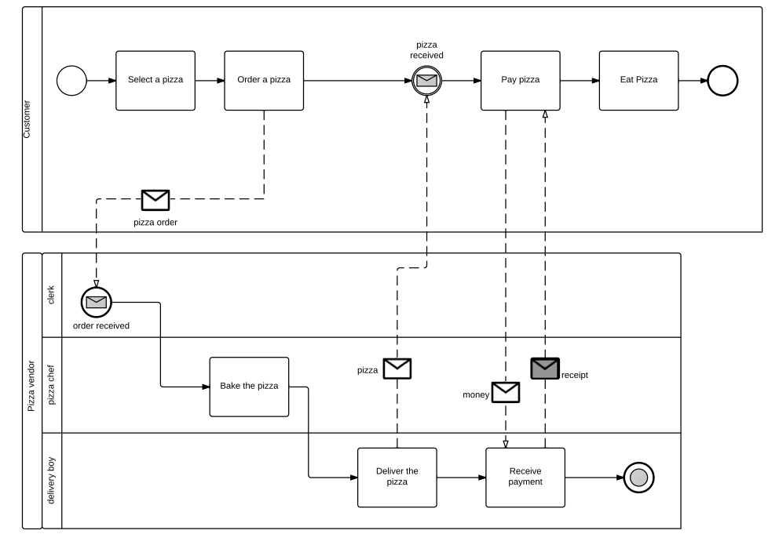
Another Example of BPD with Pools:
Level 2 diagram for “Order Pizza”
Hungry customer
Hunger satisfied
Note: Message flow across different pools
Note: Data objects.
Order complete
Source: http://esspa.com.au/blog/the-bpmn-pizza-store-diagram-tutorial/

Slide 27
An Example of BPD with Lanes –
Level 2 Diagram for Withdraw Money Process
Homework:
Draw a Level 2 Diagram for “Withdraw money” Level 1 process using correct BPMN notations.
Identify sub-processes and tasks/activities within “withdraw money” process that complete the process of withdrawing the money from start to finish.
Make sure these activities/tasks are ordered in a correct sequence and flow logically from start to end.

Slide 28
Objectives of BPM (Why draw a BPD?)
Understand the current business processes
Understand how the work is done in an organisation
Clarify responsibilities
Identify process inefficiencies (problems with current processes)
Support continuous process improvement
Support process management
Support process development
Support process execution

Slide 29
Outcome (Results/benefits) of a BPM
Improved processes (hence better performance of a business and increased competitiveness): future “To Be" processes
New processes (future To Be processes)
Value for customer
Reduced cost
Increased profit and competitiveness
Better staff morale
Customer retention

Slide 30
Resources and Reading
http://www.bizagi.com/docs/BPMN_Quick_Reference_Guide_ENG.pdf
http://www.bizagi.com/docs/Introduction%20to%20BPMN.pdf
BABOK Guide

Slide 31
Assessment 3 – released in week 3
Requirements Analysis Report – 20 Marks
Case Study: Customer Onboarding for “Streamable”
The marking scheme is as follows:
    Business Process Model
    Data Model
    Data Dictionary
    Overall Quality of Report Presentation
    Contribution to Team Work

Slide 32
Conclusion
THIS WEEK
  Lecture Topic: “Process Modelling”
  Quiz 4 – Process Modelling (3.5 marks)
  Pre-Work for Workshop/tutorial this week
    Read the workshop/tutorial document and its tasks for this week.
    Read the Workshop/tutorial Case Study thoroughly and make notes.
    Read Assessment 3 Case Study thoroughly and make your own notes before the start of your workshop class.
    Download BizAgi Modeler (or Lucidchart) from Canvas link so as to draw process models.

Slide 33
Conclusion
NEXT WEEK
  Lecture Topic: “Data Modelling”
  Quiz 5 – Data Modelling (3.5 marks)
  Pre-Work for Workshop next week
    Read the workshop/tutorial document and its tasks for this week.
    Update your business process models for the assessment 3 case study based on the feedback received from your tutor.
    Watch the reference videos available on Canvas

