Slide 1

Chapter 6
The Link Layer and LANs
Adapted by renping.liu@uts.edu.au on 7 May 2023
A note on the use of these PowerPoint slides:
We’re making these slides freely available to all (faculty, students, readers). They’re in PowerPoint form so you see the animations; and can add, modify, and delete slides (including this one) and slide content to suit your needs. They obviously represent a lot of work on our part. In return for use, we only ask the following:
If you use these slides (e.g., in a class) that you mention their source (after all, we’d like people to use our book!)
If you post any slides on a www site, that you note that they are adapted from (or perhaps identical to) our slides, and note our copyright of this material.
For a revision history, see the slide note for this page.
Thanks and enjoy! JFK/KWR
All material copyright 1996-2020
J.F Kurose and K.W. Ross, All Rights Reserved
Computer Networking: A Top-Down Approach
8th Edition, Global Edition
Jim Kurose, Keith Ross
Copyright © 2022 Pearson Education Ltd
Notes:
Version History
8.0 (May 2020)
All slides reformatted for 16:9 aspect ratio
All slides updated to 8th edition material
Use of Calibri font, rather that Gill Sans MT
Add LOTS more animation throughout
lighter header font
Updated datacenter slides, day-in-the-life

Slide 2

Link layer, LANs: roadmap
6.1 introduction
6.2 error detection, correction
6.3 multiple access protocols
6.4 LANs
  addressing, ARP
  Ethernet
  switches
  VLANs
6.5 link virtualization: MPLS
6.6 data center networking
6.7 a day in the life of a web request

Slide 3







Link layer: introduction
Nodes (layer 5-3):
  hosts and routers
Links (layer 2):
  communication channels that connect adjacent nodes
mobile network
national or global ISP
link layer has responsibility of transferring datagram from one node to physically adjacent node over a link
datacenter
network
enterprise
network

Slide 4

Link layer: context
datagram transferred by different link protocols over different links:
  e.g., WiFi on first link, phone line on next link, fibre on the next, ...
  Analogy: postman motorcycle, truck, airplane/ship, ...
each link protocol provides different services

Slide 5









Link layer: introduction
…
Link Media
  wired: fibre, Ethernet, cable, phone line
  wireless: WiFi, Mobile BS
  LAN (Local Area Network): Eth switch, WiFi
link layer has responsibility of transferring datagram from one node to physically adjacent node over a link
…

Slide 6

Link layer: services
framing, link access:
  encapsulate datagram into frame, adding header, trailer
  channel access if shared medium
  “MAC” addresses in frame headers identify source, destination (different from IP address!)
reliable delivery between adjacent nodes
  we already know how to do this!
  seldom used on low bit-error links
  wireless links: high error rates
    Q: why both link-level and end-end reliability?

Slide 7
Link layer: services (more)
flow control:
  pacing between adjacent sending and receiving nodes
error detection:
  errors caused by signal attenuation, noise.
  receiver detects errors, signals retransmission, or drops frame
error correction:
  receiver identifies and corrects bit error(s) without retransmission
half-duplex and full-duplex:
  with half duplex, nodes at both ends of link can transmit, but not at same time
…
…

Slide 8
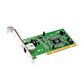
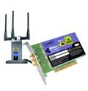

Where is the link layer implemented?
in each-and-every host
link layer implemented in network interface card (NIC) or on a chip
  Ethernet, WiFi card or chip
  implements link, physical layer
attaches into host’s system buses
combination of hardware, software, firmware
application
transport
network
link
cpu
memory
host bus
(e.g., PCI)
controller
link
physical
physical
network interface

Slide 9
Interfaces communicating
application
transport
network
link
application
transport
network
link
cpu
memory
memory
CPU
datagram
link_{h}
datagram
controller
controller
datagram
link_{h}
link
physical
link
physical
physical
physical
sending side:
encapsulates datagram in frame
adds error checking bits, reliable data transfer, flow control, etc.
receiving side:
looks for errors, reliable data transfer, flow control, etc.
extracts datagram, passes to upper layer at receiving side

Slide 10
Link layer, LANs: roadmap
6.1 introduction
6.2 error detection, correction
6.3 multiple access protocols
6.4 LANs
  addressing, ARP
  Ethernet
  switches
  VLANs
6.5 link virtualization: MPLS
6.6 data center networking
6.7 a day in the life of a web request

Slide 11
Error detection
EDC: error detection and correction bits (e.g., redundancy)
D: data protected by error checking, may include header fields
datagram
datagram
Error detection not 100% reliable!
  protocol may miss some errors, but rarely
  larger EDC field yields better detection and correction
otherwise
all
bits in D’
OK
?
N
detected
error
d data bits
D
EDC
D’
EDC’
bit-error prone link

Slide 12
Internet checksum (review)
Goal: detect errors (i.e., flipped bits) in transmitted segment
sender:
treat contents of UDP segment (including UDP header fields and IP addresses) as sequence of 16-bit integers
checksum: addition (one’s complement sum) of segment content
checksum value put into UDP checksum field
receiver:
compute checksum of received segment
check if computed checksum equals checksum field value:
  not equal - error detected
  equal - no error detected. But maybe errors nonetheless? More later ….

Slide 13
Parity checking
single bit parity:
detect single bit errors
two-dimensional bit parity:
detect and correct single bit errors
row parity
0111000110101011
1
d_{1,1}
. . .
d_{1,j}
d_{1,j+1}
d data bits
d_{2,1}
. . .
d_{2,j}
d_{2,j+1}
parity
bit
. . .
. . .
. . .
. . .
d_{i,1}
. . .
d_{i,j}
d_{i,j+1}
column
parity
d_{i+1,1}
. . .
d_{i+1,j}
d_{i+1,j+1}
Even parity: set parity bit so there is an even number of 1’s
no errors:
1 0 1 0 1 1
detected
and
correctable
single-bit
error:
1 0 1 0 1 1
1 1 1 1 0 0
1 0 1 1 0 0
parity
error
0 1 1 1 0 1
0 1 1 1 0 1
0 0 1 0 1 0
0 0 1 0 1 0
* Check out the online interactive exercises for more examples: http://gaia.cs.umass.edu/kurose_ross/interactive/
parity
error

Slide 14
Cyclic Redundancy Check (CRC)
more powerful error-detection coding
D: data bits (given, think of these as a binary number)
G: bit pattern (generator), of r+1 bits (given)
r CRC bits
d data bits
D
R
bit pattern
<D,R> = D 2^{r} XOR R
formula for bit pattern
*
Optional – not tested
goal: choose r CRC bits, R, such that <D,R> exactly divisible by G (mod 2)
  receiver knows G, divides <D,R> by G. If non-zero remainder: error detected!
  can detect all burst errors less than r+1 bits
  widely used in practice (Ethernet, 802.11 WiFi)

Slide 15
Link layer, LANs: roadmap
6.1 introduction
6.2 error detection, correction
6.3 multiple access protocols
6.4 LANs
  addressing, ARP
  Ethernet
  switches
  VLANs
6.5 link virtualization: MPLS
6.6 data center networking
6.7 a day in the life of a web request

Slide 16






Multiple access links, protocols
two types of “links”:
point-to-point
  phone line: ADSL or dial-up access
  point-to-point link: Ethernet cable, fibre
broadcast (shared wire or medium)
  old-fashioned Ethernet
  upstream HFC in cable-based access network
  Wireless: WiFi, 4G/5G. satellite
…
…
shared wire (e.g.,
cabled Ethernet)
shared radio: 4G/5G
shared radio: WiFi
shared radio: satellite
humans at a cocktail party
(shared air, acoustical)

Slide 17
Multiple access protocols
single shared broadcast channel
two or more simultaneous transmissions by nodes: interference
  collision if node receives two or more signals at the same time
humans at a cocktail party
(shared air, acoustical)
multiple access protocol
distributed algorithm that determines how nodes share channel, i.e., determine when node can transmit
communication about channel sharing must use channel itself!
  no out-of-band channel for coordination

Slide 18
An ideal multiple access protocol
given: multiple access channel (MAC) of rate R bps
desiderata:
  1. when one node wants to transmit, it can send at rate R.
  2. when M nodes want to transmit, each can send at average rate R/M
  3. fully decentralized:
    no special node to coordinate transmissions
    no synchronization of clocks, slots
  4. simple

Slide 19
MAC protocols: taxonomy
three broad classes:
channel partitioning
  divide channel into smaller “pieces” (time slots, frequency, code)
  allocate piece to node for exclusive use
random access
  channel not divided, allow collisions
  “recover” from collisions
“taking turns”
  nodes take turns, but nodes with more to send can take longer turns

Slide 20
MAC protocols: taxonomy
three broad classes:
channel partitioning
  divide channel into smaller “pieces” (time slots, frequency, code)
  allocate piece to node for exclusive use
random access
  channel not divided, allow collisions
  “recover” from collisions
“taking turns”
  nodes take turns, but nodes with more to send can take longer turns

Slide 21
Channel partitioning MAC protocols: TDMA
TDMA: time division multiple access
access to channel in “rounds”
each station gets fixed length slot (length = packet transmission time) in each round
unused slots go idle
example: 6-station LAN, 1,3,4 have packets to send, slots 2,5,6 idle
6-slot
frame
6-slot
frame
1
3
4
1
3
4

Slide 22
Channel partitioning MAC protocols: FDMA
FDMA: frequency division multiple access
channel spectrum divided into frequency bands
each station assigned fixed frequency band
unused transmission time in frequency bands go idle
example: 6-station LAN, 1,3,4 have packet to send, frequency bands 2,5,6 idle
time
frequency bands
FDM cable

Slide 23
An ideal multiple access protocol
TDMA/FDMA are used in mobile 4G/5G
TDMA or FDMA satisfactory? No!
  Only use a fraction of the link, even no other traffic
  Heavy coordination processing/traffic
Ideal: given multiple access channel (MAC) of rate R bps
desiderata:
  1. when one node wants to transmit, it can send at rate R.
  2. when M nodes want to transmit, each can send at average rate R/M
  3. fully decentralized:
    no special node to coordinate transmissions
    no synchronization of clocks, slots
  4. simple

Slide 24
MAC protocols: taxonomy
three broad classes:
channel partitioning
  divide channel into smaller “pieces” (time slots, frequency, code)
  allocate piece to node for exclusive use
random access
  channel not divided, allow collisions
  “recover” from collisions
“taking turns”
  nodes take turns, but nodes with more to send can take longer turns

Slide 25
Random access protocols
when node has packet to send
  transmit at full channel data rate R.
  no a priori coordination among nodes
two or more transmitting nodes: “collision”
random access MAC protocol specifies:
  how to detect collisions
  how to recover from collisions (e.g., via delayed retransmissions)
examples of random access MAC protocols:
  ALOHA, slotted ALOHA
  CSMA, CSMA/CD, CSMA/CA

Slide 26
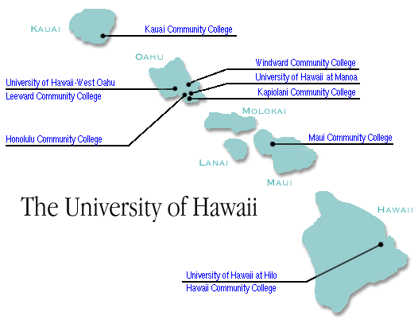
Pure ALOHA
The University of Hawaii
unslotted Aloha: simple, no synchronization
  when frame first arrives: transmit immediately
collision probability increases with no synchronization:
  frame sent at t₀ collides with other frames sent in [t₀-1,t₀+1]
will overlap
with start of
i’s frame
will overlap
with end of
i’s frame
t₀ - 1
t₀
t₀ + 1
Low efficiency: 18% !

Slide 27
Slotted ALOHA
randomization – why?
assumptions:
all frames same size
time divided into equal size slots (time to transmit 1 frame)
nodes start to transmit only slot beginning
nodes are synchronized
if 2 or more nodes transmit in slot, all nodes detect collision
operation:
when node obtains fresh frame, transmits in next slot
  if no collision: node can send new frame in next slot
  if collision: node retransmits frame in each subsequent slot with probability p until success
1
1
1
1
S
S
S
S
... ...

Slide 28
Slotted ALOHA
Total number of nodes: N
Each node transmit in a slot with prob: p
p persistent
node 1
1
1
1
1
Efficiency: 37% !
node 2
2
2
2
C: collision
S: success
E: empty
node 3
3
3
3
C
E
C
S
E
C
E
S
S
Pros:
single active node can continuously transmit at full rate of channel
highly decentralized: only slots in nodes need to be in sync
simple
Cons:
collisions, wasting slots
idle slots
nodes may be able to detect collision in less than time to transmit packet
clock synchronization

Slide 29
Slotted ALOHA: efficiency
efficiency: long-run fraction of successful slots (many nodes, all with many frames to send)
suppose: N nodes with many frames to send, each transmits in slot with probability p
  prob that given node has success in a slot = p(1-p)^{N-1}
  prob that any node has a success = Np(1-p)^{N-1}
  max efficiency: find p* that maximizes Np(1-p)^{N-1}
  for many nodes, take limit of Np*(1-p*)^{N-1} as N goes to infinity, gives:
max efficiency = 1/e = .37
at best: channel used for useful transmissions 37% of time!
Optional – not tested

Slide 30
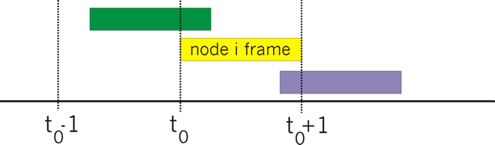

Can we avoid collision
Pure Aloha
Collision due to overlapping
CSMA (carrier sense multiple access)
Listen before transmit:
  if channel sensed idle: transmit entire frame
  if channel sensed busy: defer transmission
human analogy: don’t interrupt others!

Slide 31
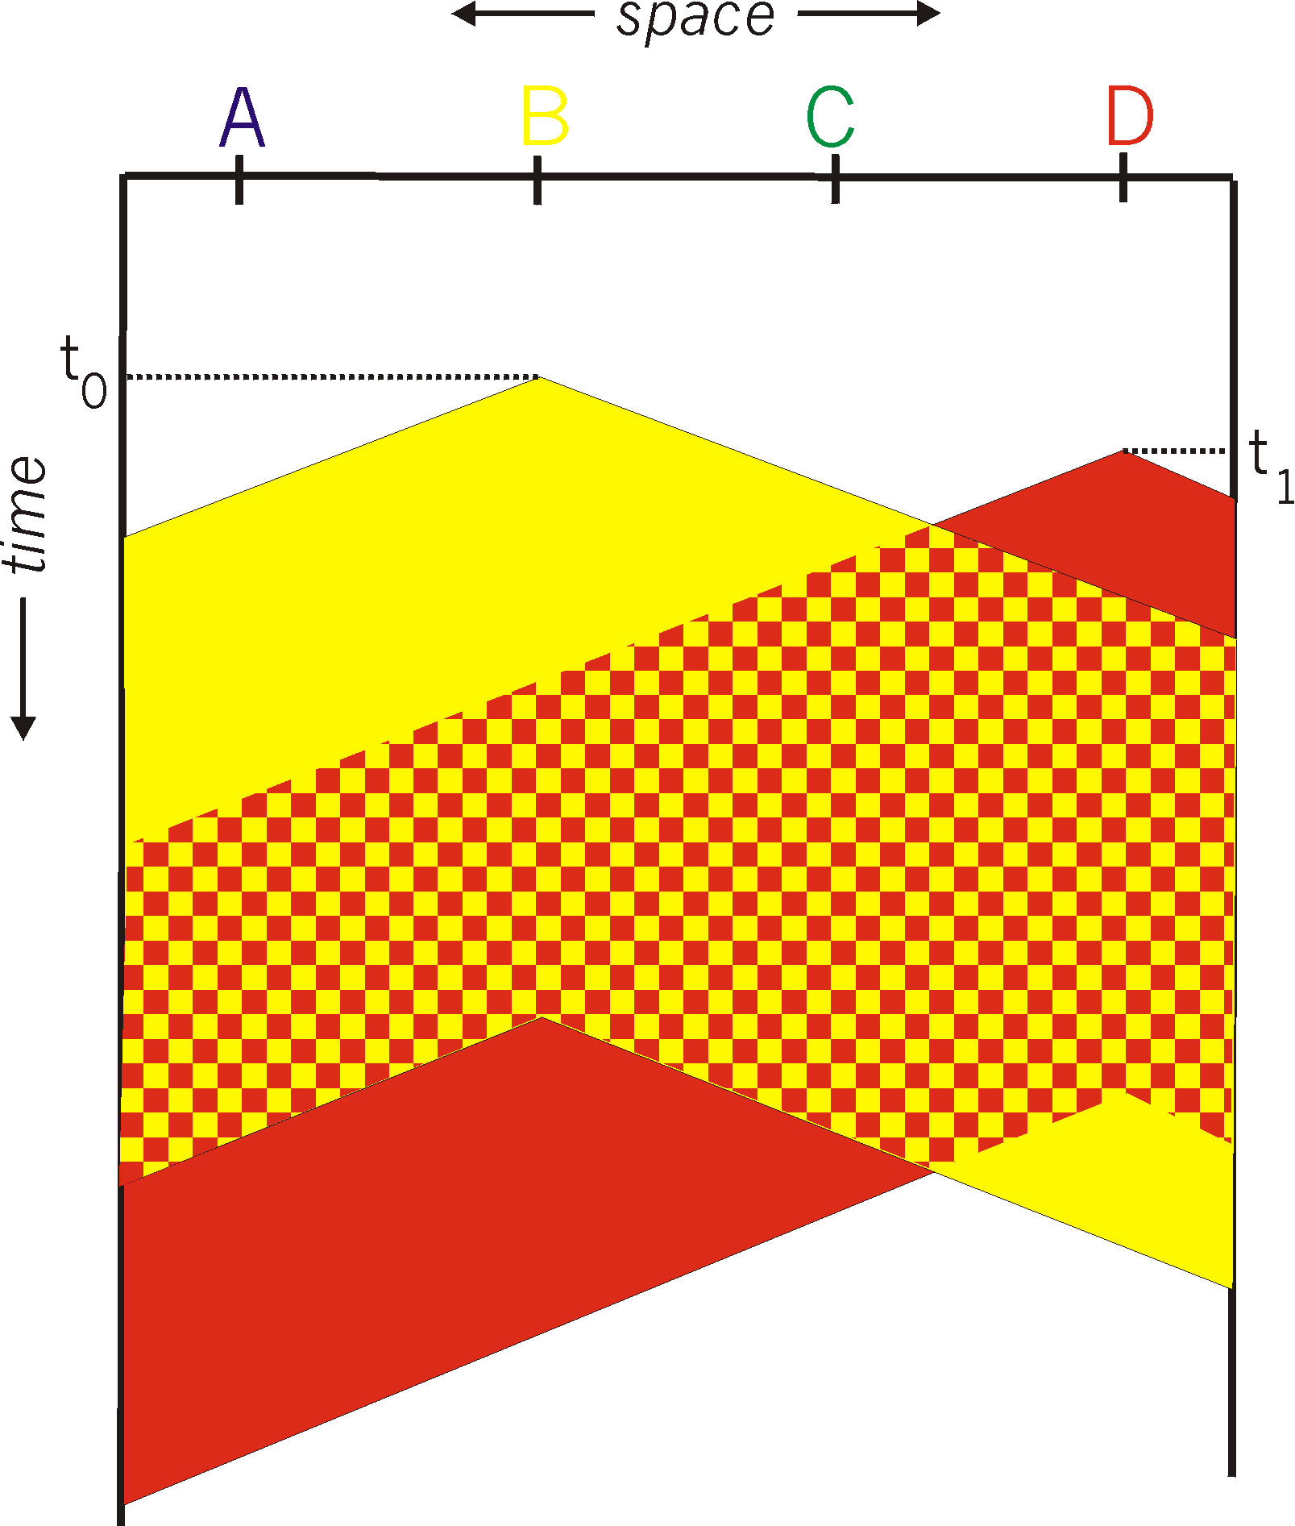
CSMA: collisions
spatial layout of nodes
collisions can still occur with carrier sensing:
  propagation delay means two nodes may not hear each other’s just-started transmission
collision: entire packet transmission time wasted
  distance & propagation delay play role in in determining collision probability

Slide 32
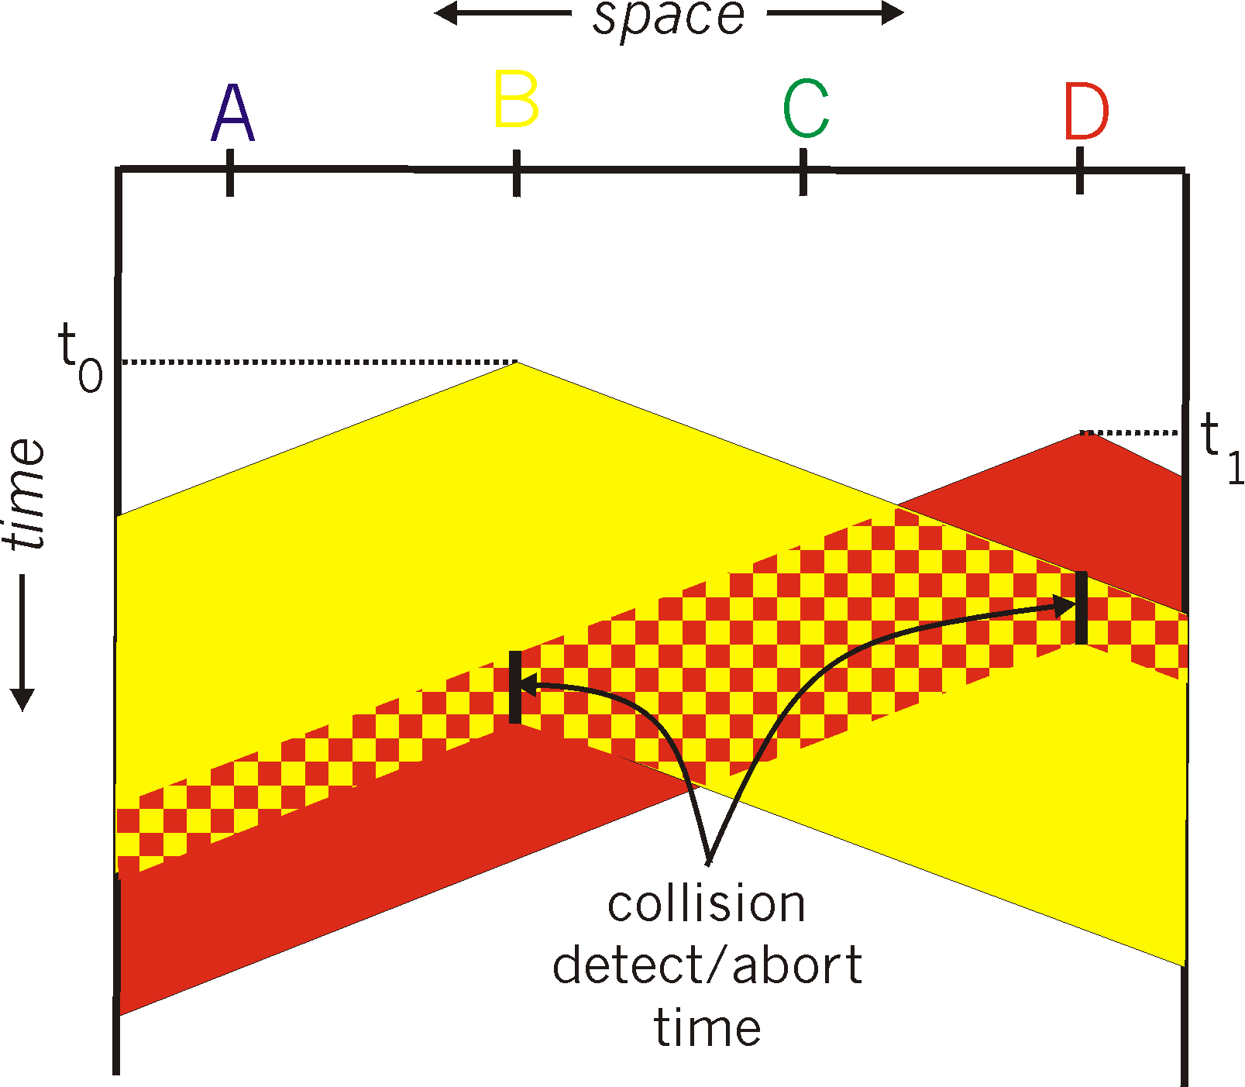
CSMA/CD: Collision Detection
spatial layout of nodes
CSMA/CD:
  collisions detected within short time
  colliding transmissions aborted, reducing channel wastage
  collision detection easy in wired, difficult with wireless
CSMA/CD reduces the amount of time wasted in collisions
  transmission aborted on collision detection
Optional – not tested

Slide 33
CSMA/CD efficiency
T_{prop} = max prop delay between 2 nodes in LAN
t_{trans} = time to transmit max-size frame
efficiency depends on t_{prop} :
  as t_{prop} → 0: efficiency → 100%
  as t_{prop} increases: efficiency goes down
Good for LAN:
Ethernet: CSMA/CD
WiFi: CSMA/CA
Optional – not tested

Slide 34
MAC protocols: taxonomy
three broad classes:
channel partitioning
  divide channel into smaller “pieces” (time slots, frequency, code)
  allocate piece to node for exclusive use
random access
  channel not divided, allow collisions
  “recover” from collisions
“taking turns”
  nodes take turns, but nodes with more to send can take longer turns

Slide 35

“Taking turns” MAC protocols
Bluetooth
polling:
master node “invites” other nodes to transmit in turn
typically used with “dumb” devices
  Bluetooth
concerns:
  polling overhead
  latency
  single point of failure (master)
data
poll
master
data
slaves

Slide 36
“Taking turns” MAC protocols
Fibre Access: FDDI
T
token passing:
control token passed from one node to next sequentially.
token message
concerns:
  token overhead
  latency
  single point of failure (token)
(nothing
to send)
T
data

Slide 37
Summary of MAC protocols
channel partitioning, by time, frequency or code
  Time Division, Frequency Division
random access (dynamic),
  ALOHA, S-ALOHA, CSMA, CSMA/CD
  carrier sensing: easy in some technologies (wire), hard in others (wireless)
  CSMA/CD used in Ethernet
  CSMA/CA used in 802.11
taking turns
  polling from central site, token passing
  Bluetooth, FDDI, token ring

Slide 38
Mid-break
  ☕️
Q&A

Slide 39
Link layer, LANs: roadmap
6.1 introduction
6.2 error detection, correction
6.3 multiple access protocols
6.4 LANs
  addressing, ARP
  Ethernet
  switches
  VLANs
6.5 link virtualization: MPLS
6.6 data center networking
6.7 a day in the life of a web request

Slide 40
MAC addresses
Postal Address
32-bit IP address:
  network-layer address for interface, e.g.: 128.119.40.136
  used for layer 3 (network layer) forwarding
Airport Codes
Shipping port ID
MAC address:
  function: used “locally” to get frame from one interface to another physically-connected interface (same subnet, in IP-addressing sense)
  48-bit MAC address (for most LANs) burned in NIC ROM, also sometimes software settable

Slide 41



MAC addresses
each interface on LAN
has a locally unique 32-bit IP address - configured
has unique 48-bit MAC address - burned into NIC ROM
  hexadecimal (base 16) notation
  each “numeral” represents 4 bits
Unified format for all LANs
  Ethernet, WiFi,
NIC/adapter
137.196.7.78
1A-2F-BB-76-09-AD
LAN
(wired or
wireless)
137.196.7.23
71-65-F7-2B-08-53
137.196.7.14
58-23-D7-FA-20-B0
137.196.7.88
0C-C4-11-6F-E3-98

Slide 42
MAC addresses
MAC address allocation administered by IEEE
manufacturer buys portion of MAC address space (to assure uniqueness)
  cisco: 00-18-89-, A8-9D-21-, …,
  Intel: 00-13-E8-, A0-88-69-, …
analogy:
  IP address: like residential address. stay overseas - hotel address
  MAC address: your name, driver’s license number
Portability
  IP address not portable: depends on IP subnet to which node is attached
  MAC flat address: portable - move interface from one LAN to another

Slide 43

ARP: address resolution protocol
Question: how to determine interface’s MAC address, knowing its IP address?
Week9 Lab
ARP table: each IP node (host, router) on LAN has table
ARP
137.196.7.78
  IP/MAC address mappings for some LAN nodes:
< IP address; MAC address; TTL>
  TTL (Time To Live): time after which address mapping will be forgotten (typically 20 min)
1A-2F-BB-76-09-AD
ARP
ARP
A
LAN
B
71-65-F7-2B-08-53
58-23-D7-FA-20-B0
137.196.7.23
137.196.7.14
ARP
0C-C4-11-6F-E3-98
137.196.7.88

Slide 44
ARP protocol in action
B is in the SAME subnet with A
How do you know?
example: A wants to send datagram to B
  B’s MAC address not in A’s ARP table, so A uses ARP to find B’s MAC address
A broadcasts ARP query, containing B's IP addr
  destination MAC address = FF-FF-FF-FF-FF-FF
  all nodes on LAN receive ARP query
1
Ethernet frame (sent to FF-FF-FF-FF-FF-FF)
C
Source MAC: 71-65-F7-2B-08-53
Source IP: 137.196.7.23
Target IP address: 137.196.7.14
…
ARP table in A
IP addr
MAC addr
TTL
TTL
A
B
1
71-65-F7-2B-08-53
58-23-D7-FA-20-B0
137.196.7.23/24
137.196.7.14/24
D

Slide 45
ARP protocol in action
example: A wants to send datagram to B
  B’s MAC address not in A’s ARP table, so A uses ARP to find B’s MAC address
ARP message into Ethernet frame (sent to 71-65-F7-2B-08-53)
C
Target IP address: 137.196.7.14
Target MAC address:
58-23-D7-FA-20-B0
…
ARP table in A
IP addr
MAC addr
TTL
TTL
A
B
2
71-65-F7-2B-08-53
58-23-D7-FA-20-B0
137.196.7.23/24
137.196.7.14/24
2
B replies to A with ARP response, giving its MAC address
D

Slide 46
ARP protocol in action
example: A wants to send datagram to B
  B’s MAC address not in A’s ARP table, so A uses ARP to find B’s MAC address
C
ARP table in A
IP addr
MAC addr
TTL
TTL
A
B
137.196.
7.14
58-23-D7-FA-20-B0
500
71-65-F7-2B-08-53
58-23-D7-FA-20-B0
137.196.7.23
137.196.7.14
3
A receives B’s reply, adds B entry into its local ARP table
D

Slide 47



Routing to another subnet: addressing
Week10 Lab
walkthrough: sending a datagram from A to B via R
  focus on addressing – at IP (datagram) and MAC layer (frame) levels
  assume that:
    A knows B’s IP address (how? e.g., B is a web server)
    A knows IP address of first hop router, R (how?)
    A knows R’s MAC address (how?)
A
R
B
111.111.111.111
74-29-9C-E8-FF-55
222.222.222.222
49-BD-D2-C7-56-2A
222.222.222.220
1A-23-F9-CD-06-9B
111.111.111.112
111.111.111.110
CC-49-DE-D0-AB-7D
E6-E9-00-17-BB-4B
222.222.222.221
88-B2-2F-54-1A-0F

Slide 48
Routing to another subnet: addressing
A creates IP datagram with IP source A, destination B
A creates link-layer frame containing A-to-B IP datagram
  R's MAC address is frame’s destination
MAC src: 74-29-9C-E8-FF-55
MAC dest: E6-E9-00-17-BB-4B
IP
Eth
Phy
IP src: 111.111.111.111
IP dest: 222.222.222.222
A
R
B
111.111.111.111
74-29-9C-E8-FF-55
222.222.222.222
49-BD-D2-C7-56-2A
222.222.222.220
1A-23-F9-CD-06-9B
111.111.111.112
111.111.111.110
CC-49-DE-D0-AB-7D
E6-E9-00-17-BB-4B
222.222.222.221
88-B2-2F-54-1A-0F

Slide 49
Routing to another subnet: addressing
frame sent from A to R
frame received at R, datagram removed, passed up to IP
MAC src: 74-29-9C-E8-FF-55
MAC dest: E6-E9-00-17-BB-4B
IP src: 111.111.111.111
IP dest: 222.222.222.222
IP
Eth
Phy
IP src: 111.111.111.111
IP dest: 222.222.222.222
IP
Eth
Phy
A
R
B
111.111.111.111
74-29-9C-E8-FF-55
222.222.222.222
49-BD-D2-C7-56-2A
222.222.222.220
1A-23-F9-CD-06-9B
111.111.111.112
111.111.111.110
CC-49-DE-D0-AB-7D
E6-E9-00-17-BB-4B
222.222.222.221
88-B2-2F-54-1A-0F

Slide 50
Routing to another subnet: addressing
R determines outgoing interface, passes datagram with IP source A, destination B to link layer
R creates link-layer frame containing A-to-B IP datagram. Frame destination address: B's MAC address
MAC src: 1A-23-F9-CD-06-9B
MAC dest: 49-BD-D2-C7-56-2A
IP
Eth
Phy
IP src: 111.111.111.111
IP dest: 222.222.222.222
A
R
B
111.111.111.111
74-29-9C-E8-FF-55
222.222.222.222
49-BD-D2-C7-56-2A
222.222.222.220
1A-23-F9-CD-06-9B
111.111.111.112
111.111.111.110
CC-49-DE-D0-AB-7D
E6-E9-00-17-BB-4B
222.222.222.221
88-B2-2F-54-1A-0F

Slide 51
Routing to another subnet: addressing
R determines outgoing interface, passes datagram with IP source A, destination B to link layer
R creates link-layer frame containing A-to-B IP datagram. Frame destination address: B's MAC address
MAC src: 1A-23-F9-CD-06-9B
MAC dest: 49-BD-D2-C7-56-2A
transmits link-layer frame
IP
Eth
Phy
IP
Eth
Phy
IP src: 111.111.111.111
IP dest: 222.222.222.222
A
R
B
111.111.111.111
74-29-9C-E8-FF-55
222.222.222.222
49-BD-D2-C7-56-2A
222.222.222.220
1A-23-F9-CD-06-9B
111.111.111.112
111.111.111.110
CC-49-DE-D0-AB-7D
E6-E9-00-17-BB-4B
222.222.222.221
88-B2-2F-54-1A-0F

Slide 52
Routing to another subnet: addressing
B receives frame, extracts IP datagram destination B
B passes datagram up protocol stack to IP
IP src: 111.111.111.111
IP dest: 222.222.222.222
IP
Eth
Phy
IP
Eth
Phy
A
R
B
111.111.111.111
74-29-9C-E8-FF-55
222.222.222.222
49-BD-D2-C7-56-2A
222.222.222.220
1A-23-F9-CD-06-9B
111.111.111.112
111.111.111.110
CC-49-DE-D0-AB-7D
E6-E9-00-17-BB-4B
222.222.222.221
88-B2-2F-54-1A-0F

Slide 53
Summary
principles behind data link layer services:
error detection, correction
sharing a broadcast channel: multiple access
link layer addressing

Slide 54
Lab, Project2 preview
Lab:
  Wireshark - ARP
  you may practice for Project2 (after completing Wireshark Lab)
Project2 preview – 5pt
  In-class assessment in week12 tutorial/lab class
  Project2 sheet is available in week12 folder

Slide 55
Lecture done
  ✅
Q&A

