Slide 1

Chapter 1
Introduction
Adapted by renping.liu@uts.edu.au on 26 Feb 2022
A note on the use of these PowerPoint slides:
We’re making these slides freely available to all (faculty, students, readers). They’re in PowerPoint form so you see the animations; and can add, modify, and delete slides (including this one) and slide content to suit your needs. They obviously represent a lot of work on our part. In return for use, we only ask the following:
If you use these slides (e.g., in a class) that you mention their source (after all, we’d like people to use our book!)
If you post any slides on a www site, that you note that they are adapted from (or perhaps identical to) our slides, and note our copyright of this material.
For a revision history, see the slide note for this page.
Thanks and enjoy! JFK/KWR
All material copyright 1996-2022
J.F Kurose and K.W. Ross, All Rights Reserved
Computer Networking: A Top-Down Approach
8th edition, Global Edition
Jim Kurose, Keith Ross
Copyright © 2022 Pearson Education Ltd
Notes:
Version History
7.2 (January 2020)
All slides reformatted for 16:9 aspect ratio
Use of Calibri font, rather that Gill Sans MT
Updated slide content for 2020 link technologies and applications
Add more animation throughout
New Master slide
Feb. 2020
a few updates suggest by Catherine Rosenberg (thanks!)
titles in a lighter font

Slide 2

Chapter 1: roadmap
1.1 What is the Internet?
1.2 Network edge: hosts, access network, physical media
1.3 Network core: packet/circuit switching, internet structure
1.4 Performance: loss, delay, throughput
1.5 Protocol layers, service models
1.6 Network Under Attack
1.7 History

Slide 3

How do packet loss and delay occur?
packets queue in router buffers
packets queue, wait for turn.
  e.g. when blue packet arrives, it finds 2.5 packets in front of it → queueing delay
packet being transmitted
(transmission delay = L/R)
A
B
packets in buffers (queueing delay)
Blue packet - Queueing Delay = 2.5 * L/R
Blue packet – total Delay = 2.5*L/R + L/R
… more to come …

Slide 4
Packet delay: four sources
transmission
A
propagation
B
nodal
processing
queueing
D_{nodal} = d_{proc} + d_{queue} + d_{trans} + d_{prop}
d_{proc}: nodal processing
check bit errors
determine output link
typically < msec
d_{queue}: queueing delay
time waiting at output link for transmission
depends on congestion level of router
d_{queue} = 2.5*L/R

Slide 5
Packet delay: four sources
transmission
A
propagation
B
nodal
processing
queueing
D_{nodal} = d_{proc} + d_{queue} + d_{trans} + d_{prop}
d_{trans}: transmission delay:
L: packet length (bits)
R: link transmission rate (bps)
d_{trans} = L/R
d_{prop}: propagation delay:
d: length of physical link
s: propagation speed (~2x10⁸ m/sec)
d_{prop} = d/s
d_{trans} and d_{prop}
very different
* Check out the online interactive exercises: http://gaia.cs.umass.edu/kurose_ross

Slide 6
Conveyor belt analogy
A worker is loading a batch of 10 boxes onto the conveyer belt.
…
1000m
The worker takes 1 second to load one box onto belt
(loading rate 1b/s)
conveyor belt move forward (propagation rate) at 10m/s
box ~ bit; 10box batch ~ packet
Q: How long until the batch reaches the other end?
time to load entire batch onto the belt
d_{trans}= 10b/(1b/s) = 10s
time for boxes to “propagate” to the other end:
d_{prop}= 1000m/(10m/s) = 100s
A: d_{end-to-end} =d_{trans}+d_{prop}
=10 + 100
=110s

Slide 7
Conveyor belt analogy
A worker is loading a batch of 10 boxes onto the conveyer belt.
…
1000m
at time t=d_{trans}=10s, where is the last box/bit?
  Answer: the last box is being loaded onto the belt/link
at time t=d_{trans}=10s, where is the first box/bit?
  Answer: the first box hasn’t reached the end (on the belt/link)
at time t=d_{prop}=100s, where is the first box/bit?
  Answer: the first box is just reaching the end

Slide 8
Conveyor belt analogy (more)
50m
suppose the belt length is 50m now
at time t=d_{trans}=10s, where is the last box/bit?
  Answer: the last box is being loaded onto the belt/link
at time t=d_{trans}=10s, where is the first box/bit?
  Answer: the fist box has reached the destination.
Think:
Propagation delay?

Slide 9
Conveyor belt analogy (more)
50m
suppose the belt length is 50m now
at time t=d_{prop}=5s, where is the first box/bit?
  Answer: the fist box is just reaching the destination.
at time t=d_{prop}=5s, where is the last box/bit?
  Answer: the last box is still in the source, not loaded

Slide 10
Packet delay: four sources
transmission
A
propagation
B
nodal
processing
queueing
Nodal delay:
  d_{proc} = 2ms
  d_{queue} = 2.5*L/R
  d_{trans} = L/R
  d_{prop} = d/s
D_{nodal} = d_{proc} + d_{queue} + d_{trans} + d_{prop} = 2ms+2.5*L/R+L/R+d/s

Slide 11

“Real” Internet delays and routes
what do “real” Internet delay & loss look like?
traceroute program: provides delay measurement from source to router along end-end Internet path towards destination. For all i:
  sends three packets that will reach router i on path towards destination (with time-to-live field value of i)
  router i will return packets to sender
  sender measures time interval between transmission and reply
3 probes
3 probes
3 probes

Slide 12
Real Internet delays and routes
traceroute: gaia.cs.umass.edu to www.eurecom.fr
3 delay measurements from
gaia.cs.umass.edu to cs-gw.cs.umass.edu
1 cs-gw (128.119.240.254) 1 ms 1 ms 2 ms
2 border1-rt-fa5-1-0.gw.umass.edu (128.119.3.145) 1 ms 1 ms 2 ms
3 cht-vbns.gw.umass.edu (128.119.3.130) 6 ms 5 ms 5 ms
4 jn1-at1-0-0-19.wor.vbns.net (204.147.132.129) 16 ms 11 ms 13 ms
5 jn1-so7-0-0-0.wae.vbns.net (204.147.136.136) 21 ms 18 ms 18 ms
6 abilene-vbns.abilene.ucaid.edu (198.32.11.9) 22 ms 18 ms 22 ms
7 nycm-wash.abilene.ucaid.edu (198.32.8.46) 22 ms 22 ms 22 ms
8 62.40.103.253 (62.40.103.253) 104 ms 109 ms 106 ms
9 de2-1.de1.de.geant.net (62.40.96.129) 109 ms 102 ms 104 ms
10 de.fr1.fr.geant.net (62.40.96.50) 113 ms 121 ms 114 ms
11 renater-gw.fr1.fr.geant.net (62.40.103.54) 112 ms 114 ms 112 ms
12 nio-n2.cssi.renater.fr (193.51.206.13) 111 ms 114 ms 116 ms
13 nice.cssi.renater.fr (195.220.98.102) 123 ms 125 ms 124 ms
14 r3t2-nice.cssi.renater.fr (195.220.98.110) 126 ms 126 ms 124 ms
15 eurecom-valbonne.r3t2.ft.net (193.48.50.54) 135 ms 128 ms 133 ms
16 194.214.211.25 (194.214.211.25) 126 ms 128 ms 126 ms
17 * * *
18 * * *
19 fantasia.eurecom.fr (193.55.113.142) 132 ms 128 ms 136 ms
3 delay measurements
to border1-rt-fa5-1-0.gw.umass.edu
trans-oceanic link
looks like delays decrease! Why?
Try this in your Lab
* means no response (probe lost, router not replying)
* Do some traceroutes from exotic countries at www.traceroute.org

Slide 13

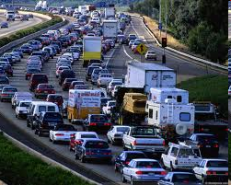
Packet queueing delay (revisited)
R: link bandwidth (bps)
L: packet length (Bytes→bits)
a: average packet arrival rate (packet/s)
Arrival rate: La (bps)
Traffic intensity: La/R
average queueing delay
traffic intensity = La/R
1
La/R ~ 0: avg. queueing delay small
La/R → 1: avg. queueing delay large
La/R > 1: more “work” arriving is more than can be serviced - average delay infinite!
La/R ~ 0
La/R → 1

Slide 14

Packet loss
queue (aka buffer) preceding link in buffer has finite capacity
packet arriving to full queue dropped (aka lost)
lost packet may be retransmitted by previous node, by source end system, or not at all
buffer
(waiting area)
A
packet being transmitted
B
packet arriving to
full buffer is lost
* Check out the Java applet for an interactive animation on queuing and loss

Slide 15
Throughput
throughput: rate (bits/time unit) at which bits are being sent from sender to receiver
  instantaneous: rate at given point in time
  average: rate over longer period of time
link capacity
R_{s} bits/sec
link capacity
R_{c} bits/sec
pipe that can carry
fluid at rate
(R_{s} bits/sec)
pipe that can carry
fluid at rate
(R_{c} bits/sec)
server sends bits
(fluid) into pipe
server, with
file of F bits
to send to client

Slide 16

Throughput
R_{s} < R_{c} What is average end-end throughput?
R_{s} bits/sec
R_{c} bits/sec
Weakest link
➔ Average throughput
R_{s} > R_{c} What is average end-end throughput?
R_{s} bits/sec
R_{c} bits/sec
bottleneck link
link on end-end path that constrains end-end throughput

Slide 17

Throughput: network scenario
per-connection end-end throughput: min(R_{c},R_{s},R/10)
in practice: R_{c} or R_{s} is often bottleneck
R_{s}
…
R_{s}
R_{s}
…
R
R_{c}
R_{c}
R_{c}
…
* Check out the online interactive exercises for more examples: http://gaia.cs.umass.edu/kurose_ross/
10 connections (fairly) share backbone bottleneck link R bits/sec

Slide 18
Mid-break
  ☕️
Q&A

Slide 19
Chapter 1: roadmap
1.1 What is the Internet?
1.2 Network edge: hosts, access network, physical media
1.3 Network core: packet/circuit switching, internet structure
1.4 Performance: loss, delay, throughput
1.5 Protocol layers, service models
1.6 Network Under Attack
1.7 History

Slide 20








Recap Internet Intro from Week1
mobile network
Networks are complex, with many “pieces”:
  hosts: clients / servers
  switches/routers
  links of various media
  network types
  packet transmission
Putting pieces together
  Structure: network of networks
global ISP
home
network
regional ISP
How do they operate?
What is the operation structure?
enterprise
network

Slide 21

Analogy: Australia Post
letter writing
postman pick up
distribute
truck delivery
letter reading
postman delivery
distribute
truck delivery
airplane / ship transport
a series of steps, involving services at different parts/layers

Slide 22

Layering of Australia Post
you&friend
postman
post office
trucking
flight/ship
letter writing
postman pick up
distribute
truck delivery
letter reading
postman delivery
distribute
truck delivery
air transport
ship transport
Focus on one job that you are best at!
layers: each layer implements a service / action
  via its own internal-layer actions
  relying on services provided by layer below

Slide 23
Internet protocol stack
Layer 5. application: supporting network applications
  IMAP, SMTP, HTTP
Layer 4. transport: process-process data transfer
  TCP, UDP
Layer 3. network: routing of datagrams from source to destination
  IP, routing protocols
Layer2. link: data transfer between neighboring network elements
  Ethernet, 802.11 (WiFi), PPP
Layer1. physical: bits “on the wire”
5. application
4. transport
3. network
2. data link
1. physical

Slide 24

source
Encapsulation
message
M
application
transport
network
link
physical
segment
H_{t}
M
H_{t}
M
M
M
datagram
H_{n}
H_{t}
H_{n}
M
frame
H_{l}
H_{n}
H_{t}
M
bit
link
physical
switch
destination
H_{n}
H_{t}
M
network
link
physical
M
application
transport
network
link
physical
H_{l}
H_{n}
H_{t}
M
H_{n}
H_{t}
M
H_{t}
M
H_{n}
H_{t}
M
H_{l}
H_{n}
H_{t}
M
router

Slide 25
Why layering?
dealing with complex systems:
explicit structure allows identification, relationship of complex system’s pieces
  layered reference model for discussion
modularization eases maintenance, updating of system
  change in layer's service implementation: transparent to rest of system
  e.g., change in gate procedure doesn’t affect rest of system
Focus on what you do best!

Slide 26
Protocol layers ⬄ Company products
Focus on what you do best!
 | Facebook, Netflix, WeChat, YouTube
 | MS Windows, MacOS, Google Android
 | Telstra, Optus, Cisco, Juniper
 | Ericsson basestation, Intel WiFi chip
 | CommScope, Corning, Inc. Fujikura
5.application
4. transport
3. network
2. link
1. physical

Slide 27
Chapter 1: roadmap
1.1 What is the Internet?
1.2 Network edge: hosts, access network, physical media
1.3 Network core: packet/circuit switching, internet structure
1.4 Performance: loss, delay, throughput
1.5 Protocol layers, service models
1.6 Network Under Attack
1.7 History

Slide 28
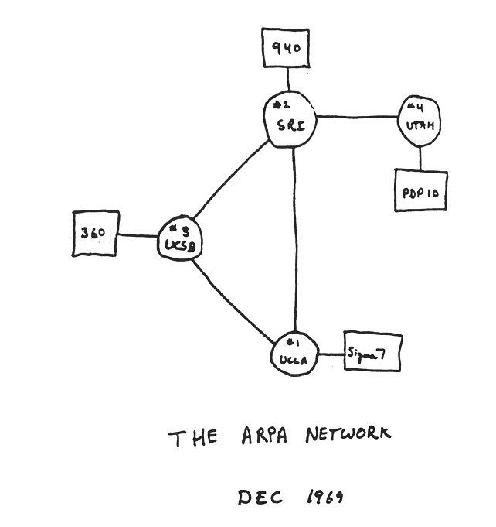
Internet history
1961-1972: Early packet-switching principles
1961: Kleinrock - queueing theory shows effectiveness of packet-switching
1964: Baran - packet-switching in military nets
1967: ARPAnet conceived by Advanced Research Projects Agency
1969: first ARPAnet node operational
1972:
  ARPAnet public demo
  NCP (Network Control Protocol) first host-host protocol
  first e-mail program
  ARPAnet has 15 nodes

Slide 29
Internet history
1972-1980: Internetworking, new and proprietary nets
1970: ALOHAnet satellite network in Hawaii
1974: Cerf and Kahn - architecture for interconnecting networks
1976: Ethernet at Xerox PARC
late70’s: proprietary architectures: DECnet, SNA, XNA
late 70’s: switching fixed length packets (ATM precursor)
1979: ARPAnet has 200 nodes
Cerf and Kahn’s internetworking principles:
  minimalism, autonomy - no internal changes required to interconnect networks
  best-effort service model
  stateless routing
  decentralized control
define today’s Internet architecture

Slide 30
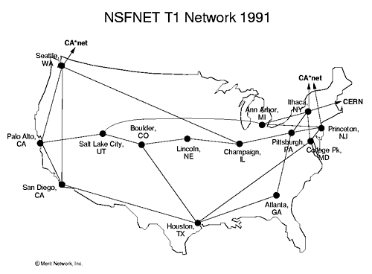
Internet history
1980-1990: new protocols, a proliferation of networks
1983: deployment of TCP/IP
1982: smtp e-mail protocol defined
1983: DNS defined for name-to-IP-address translation
1985: ftp protocol defined
1988: TCP congestion control
new national networks: CSnet, BITnet, NSFnet, Minitel
100,000 hosts connected to confederation of networks

Slide 31
Internet history
1990, 2000s: commercialization, the Web, new applications
early 1990s: ARPAnet decommissioned
1991: NSF lifts restrictions on commercial use of NSFnet (decommissioned, 1995)
early 1990s: Web
  hypertext [Bush 1945, Nelson 1960’s]
  HTML, HTTP: Berners-Lee
  1994: Mosaic, later Netscape
  late 1990s: commercialization of the Web
late 1990s – 2000s:
more killer apps: instant messaging, P2P file sharing
network security to forefront
est. 50 million host, 100 million+ users
backbone links running at Gbps

Slide 32
Internet history
2005-present: more new applications, Internet is “everywhere”
~18B devices attached to Internet (2017)
    rise of smartphones (iPhone: 2007)
aggressive deployment of broadband access
increasing ubiquity of high-speed wireless access: 4G/5G, WiFi
emergence of online social networks:
  Facebook: ~ 2.5 billion users
service providers (Google, FB, Microsoft) create their own networks
    bypass commercial Internet to connect “close” to end user, providing “instantaneous” access to search, video content, …
enterprises run their services in “cloud” (e.g., Amazon Web Services, Microsoft Azure)

Slide 33
Chapter 1: summary
We’ve covered a “ton” of material!
Internet overview
what’s a protocol?
network edge, access network, core
  packet-switching versus circuit-switching
  Internet structure
performance: loss, delay, throughput
layering, service models
history
You now have:
context, overview, vocabulary, “feel” of networking
more depth, detail, and fun to follow!

Slide 34
Assignment 1. Internet Introduction
Earn 5% in NetFun
  Based on weeks 1 and 2 learning materials
  Please answer questions in specified format - strictly!
Timing
  No time limit, has due date.
  Submit before the due date: Sunday, 5th March
  NO late submission accepted!

Slide 35
Enrolment: IN or OUT
Please decide if you want to continue NetFun or Withdraw
  Need accurate enrolment picture in labs
  Some people are waiting to join full lab classes
  If not continue, please withdraw via “My Student Admin” to give up places to others
You are welcome to stay in NetFun
You are welcome to join later in other sessions!
Thank you!

Slide 36
Lecture done
  ✅
Q&A

