Slide 1

Chapter 3
Transport Layer
Adapted by renping.liu@uts.edu.au on 26 March 2023
A note on the use of these PowerPoint slides:
We’re making these slides freely available to all (faculty, students, readers). They’re in PowerPoint form so you see the animations; and can add, modify, and delete slides (including this one) and slide content to suit your needs. They obviously represent a lot of work on our part. In return for use, we only ask the following:
If you use these slides (e.g., in a class) that you mention their source (after all, we’d like people to use our book!)
If you post any slides on a www site, that you note that they are adapted from (or perhaps identical to) our slides, and note our copyright of this material.
For a revision history, see the slide note for this page.
Thanks and enjoy! JFK/KWR
All material copyright 1996-2020
J.F Kurose and K.W. Ross, All Rights Reserved
Computer Networking: A Top-Down Approach
8th Edition, Global Edition
Jim Kurose, Keith Ross
Copyright © 2022 Pearson Education Ltd
Notes:
Version History
8.0 (April 2020)
All slides reformatted for 16:9 aspect ratio
All slides updated to 8th edition material
Use of Calibri font, rather that Gill Sans MT
Add LOTS more animation throughout
added new 8th edition material on QUIC, CUBIC, delay-based congestion control
lighter header font

Slide 2
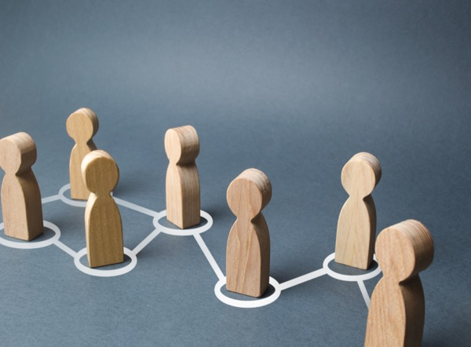
Transport layer: roadmap
3.1 Transport-layer services
3.2 Multiplexing and demultiplexing
3.3 Connectionless transport: UDP
3.4 Principles of reliable data transfer
3.5 Connection-oriented transport: TCP
  segment structure
  reliable data transfer
  flow control
  connection management
3.6 Principles of congestion control
3.7 TCP congestion control
3.8 Evolution of transport-layer functionality

Slide 3
TCP: overview RFCs: 793,1122, 2018, 5681, 7323
point-to-point:
    one sender, one receiver
reliable, in-order byte steam:
    no “message boundaries"
full duplex data:
  bi-directional data flow in same connection
  MSS: maximum segment size
cumulative ACKs
pipelining:
    TCP congestion and flow control set window size
connection-oriented:
  handshaking (exchange of control messages) initializes sender, receiver state before data exchange
flow controlled:
  sender will not overwhelm receiver
Notes:
Typical MSS is 1460 bytes

Slide 4
TCP segment structure
32 bits
source port #
dest port #
segment seq #: counting bytes of data into bytestream (not segments!)
ACK: seq # of next expected byte; A bit: this is an ACK
sequence number
acknowledgement number
length (of TCP header)
head
len
not
used
A
P
S
receive window
flow control: # bytes receiver willing to accept
C
E
U
R
F
Internet checksum
checksum
Urg data pointer
options (variable length)
C, E: congestion notification
TCP options
application
data
(variable length)
data sent by application into TCP socket
RST, SYN, FIN: connection management

Slide 5


TCP: Seq. ACKs - one way: A→B
Host A has 8 bytes to send
Host B has 0 bytes to send
92 | 93 | 94 | 95 | 96 | 97 | 98 | 99 | 100
Sequence number of a segment:
sequence number of the first byte of the segment.
Host A
Host B
Send Seq
SendBase=50
SendBase=92
Seq. & ACK are numbered
in Bytes (not packets)
Seq=92, 8 bytes of data,
ACK 50
ACK the byte after the last byte
of the received packet
(the next expected byte)
Seq=50, 0 byte of data,
ACK=100
ACKed=100
SendBase=100
Seq=100, 20 bytes of data,
ACK 50
Seq=?, 0 byte of data,
ACK=?
SendBase=?

Slide 6
TCP: Seq. ACK - bidirectional
Host A has 8 bytes to send
Host B has 5 bytes to send
92 | 93 | 94 | 95 | 96 | 97 | 98 | 99 | 100
Host A
Host B
Send Seq
SendBase=50
SendBase=92
50 | 51 | 52 | 53 | 54 | 55
Seq=92, 8 bytes of data,
ACK 50
Send Seq
Seq=50, 5 byte of data,
ACK=100
ACKed=100
SendBase=100
Seq=100, 20 bytes of data,
ACK 55
ACKed=55
SendBase=55

Slide 7


TCP Seq. ACKs - socket prog example
Client send ‘test’ (5Bytes) to Server, Server echo ‘TEST’ back
Client
Server
SendBase=42
SendBase=79
Client
types‘test’
Seq=42, ACK=79, data = ‘test’
?
?
Server ACKs
receipt of‘test’; Echoes back ‘TEST’
Seq=79, ACK=47, data = ‘TEST’
?
?
Client ACKs receipt
of echoed‘TEST’
Seq=47, ACK=84
?
?
simple TCP client / server Python Socket Programming

Slide 8
Transport layer: roadmap
3.1 Transport-layer services
3.2 Multiplexing and demultiplexing
3.3 Connectionless transport: UDP
3.4 Principles of reliable data transfer
3.5 Connection-oriented transport: TCP
  segment structure
  reliable data transfer
  flow control
  connection management
3.6 Principles of congestion control
3.7 TCP congestion control
3.8 Evolution of transport-layer functionality

Slide 9
TCP round trip time, timeout
Q: how to set TCP timeout value?
longer than RTT, but RTT varies!
too short: premature timeout, unnecessary retransmissions
too long: slow reaction to segment loss
Q: how to estimate RTT?
SampleRTT:measured time from segment transmission until ACK receipt
  ignore retransmissions
SampleRTT will vary, want estimated RTT “smoother”
  average several recent measurements, not just current SampleRTT

Slide 10
TCP round trip time, timeout
EstimatedRTT = (1- α)*EstimatedRTT + α*SampleRTT
(i) (i-1) (i)
exponential weighted moving average (EWMA)
influence of past sample decreases exponentially fast
typical value: α = 0.125
RTT: gaia.cs.umass.edu to fantasia.eurecom.fr
RTT (milliseconds)
EstimatedRTT(i)
SampleRTT(i)
sampleRTT
EstimatedRTT
time (seconds)
Notes:
This is how TCP re-computes the estimated RTT each time a new SampleRTT is taken.
The process is knows as an exponeitally weighted moving average, shown by the equation here.
<say it>
Where alpha reflects the influence of the most recent measurements on the estimated RTT; a typical value of alpha used in implementaitons is .125
The graph at the bottom show measured RTTs beween a host in the Massachusetts and a host in France, as well as the estimated, “smoothed” RTT

Slide 11

TCP round trip time, timeout
timeout interval: EstimatedRTT plus “safety margin”
  large variation in EstimatedRTT: want a larger safety margin
TimeoutInterval = EstimatedRTT + 4*DevRTT
estimated RTT
“safety margin”
DevRTT: EWMA of SampleRTT deviation from EstimatedRTT:
DevRTT = (1-β)*DevRTT + β*|SampleRTT-EstimatedRTT|
(typically, β = 0.25)
* Check out the online interactive exercises for more examples: http://gaia.cs.umass.edu/kurose_ross/interactive/
Notes:
Given this value of the estimated RTT, TCP computes the timeout interval to be the estimated RTT plus a “safety margin”
And the intuition is that if we are seeing a large variation in SAMPLERTT – the RTT estimates are fluctuating a lot - then we’ll want a larger savety margin
So TCP computes the Timeout interval to be the Estimated RTT plus 4 times a measure of deviation in the RTT.
The deviation in the RTT is computed as the eWMA of the difference between the most recently measured SampleRTT from the Estimated RTT

Slide 12
TCP Sender (simplified)
event: data received from application
create segment with seq #
seq # is byte-stream number of first data byte in segment
start timer if not already running
  expiration interval: TimeOutInterval
transmit the segment
event: ACK received
if ACK acknowledges previously unACKed segments
  update what is known to be ACKed
  start timer if there are still unACKed segments
event: timeout
retransmit segment that caused timeout
restart timer
Notes:
Given these details of TCP sequence numbers, acks, and timers, we can now describe the big picture view of how the TCP sender and receiver operate
You can check out FSMs in book; let’s just give an English text description here and let’s start with the sender.

Slide 13



TCP retransmission - Timeout
92 | 93 | 94 | 95 | 96 | 97 | 98 | 99 | 100
Host A
Host B
Host A
Host B
Send Seq
SendBase=92
Seq=92, 8 bytes of data
Seq=92, 8 bytes of data
timeout
timeout
Seq=100, 20 bytes of data
ACK=100
X
ACK=100
ACK=120
Seq=92, 8 bytes of data
Seq=92, 8
bytes of data
SendBase=100
send cumulative
ACK for 120
SendBase=120
ACK=100
ACK=120
SendBase=120
lost ACK scenario
premature timeout
Notes:
To cement our understanding of TCP reliability, let’s look a a few retransmission scenarios
In the first case a TCP segments is transmited and the ACK is lost, and the TCP timeout mechanism results in another copy of being transmitted and then re-ACKed a the sender
In the second example two segments are sent and acknowledged, but there is a premature timeout e for the first segment, which is retransmitted. Notet that when this retransmitted segment is received, the receiver has already received the first two segments, and so resends a cumulative ACK for both segments received so far, rather than an ACK for just this fist segment.

Slide 14

TCP retransmission - Cumulative ACK
Host A
Host B
Seq=92, 8 bytes of data
92 | 93 | 94 | 95 | 96 | 97 | 98 | 99 | 100
Seq=100, 20 bytes of data
ACK=100
Send Seq
X
ACK=120
100 | 101 | 102 | 103 | 104 | … | 119 | 120
Send Seq
Seq=120, 15 bytes of data
cumulative ACK covers for earlier lost ACK
Notes:
And in this last example, two segments are again transmitted, the first ACK is lost but the second ACK, a cumulative ACK arrives at the sender, which then can transmit a third segment, knowing that the first two have arrived, even though the ACK for the first segment was lost

Slide 15



TCP retransmission - Fast retransmit
Host A
Host B
TCP fast retransmit
if sender receives 3 additional ACKs for same data (“triple duplicate ACKs”), resend unACKed segment with smallest seq #
  likely that unACKed segment lost, so don’t wait for timeout
Seq=92, 8 bytes of data
Seq=100, 20 bytes of data
X
ACK=100
timeout
ACK=100
ACK=100
Receipt of three duplicate ACKs indicates 3 segments received after a missing segment – lost segment is likely. So retransmit!
ACK=100
Seq=100, 20 bytes of data
Seq=120
Seq=140
Seq=160
Seq=180
Notes:
Let’s wrap up our study of TCP reliability by discussing an optimization to the original TCP known as TCP fast retransmit,
Take a look at this example on the right where 5 segments are transmitted and the second segment is lost. In this case the TCP receiver sends an ACK 100 acknowledging the first received segment.
When the third segment arrives at the receiver, the TCP receiver sends another ACK 100 since the second segment has not arrived. And similarly for the 4th and 5th segments to arrive.
Now what does the sender see? The sender receives the first ACK 100 it has been hoping for, but then three additional duplicate ACK100s arrive. The sender knows that somethings’ wrong – it knows the first segment arrived at the receiver but three later arriving segments at the receiver – the ones that generated the three duplicate ACKs – we received correctly but were not in order. That is, that there was a missing segment at the receiver when each of the three duplicate ACK were generated.
With fast retransmit, the arrival of three duplicate ACK causes the sender to retransmit its oldest unACKed segment, without waiting for a timeout event. This allows TCP to recover more quickly from what is very likely a loss event
specifically that the second segment has been lost, since three higher -numbered segments were received

Slide 16
Transport layer: roadmap
3.1 Transport-layer services
3.2 Multiplexing and demultiplexing
3.3 Connectionless transport: UDP
3.4 Principles of reliable data transfer
3.5 Connection-oriented transport: TCP
  segment structure
  reliable data transfer
  flow control
  connection management
3.6 Principles of congestion control
3.7 TCP congestion control
3.8 Evolution of transport-layer functionality

Slide 17

TCP flow control
application
process
Q: What happens if network layer delivers data faster than application layer removes data from socket buffers?
Application removing data from TCP socket buffers
TCP socket
receiver buffers
TCP
code
Network layer delivering IP datagram payload into TCP socket buffers
IP
code
from sender
receiver protocol stack
Notes:
(Presuming an intro)
Before diving into the details of TCP flow control, let’s first get the general context and motivate the need for flow control.
This diagram show a typical transport-layer implementation
A segment is brought up the protocol stack to the transport layer, and the segment’s payload is removed from the segment and written INTO socket buffers.
How does data get taken OUT of socket buffers? By applications performing socket reads, as we learned in Chapter 2.
And so the question is “What happens if network layer delivers data faster than an application-layer process removes data from socket buffers?”
Let’s watch a video of what happens when things arrive way too fast to fast to be processed.
<video>. (I love that video). Another human analogy showing the need for flow control is the saying – to use some English slang - “no one can drink from a firehose”
Flow control is a mechanism to the calamity of a receiver being over-run by a sender that is sending too fast – it allows the RECEIVER to explictly control the SENDER so sender won’t overflow receiver’s buffer by transmitting too much, too fast

Slide 18


TCP flow control
application
process
Q: What happens if network layer delivers data faster than application layer removes data from socket buffers?
Application removing data from TCP socket buffers
TCP socket
receiver buffers
TCP
code
Network layer delivering IP datagram payload into TCP socket buffers
IP
code
from sender
receiver protocol stack
Notes:
(Presuming an intro)
Before diving into the details of TCP flow control, let’s first get the general context and motivate the need for flow control.
This diagram show a typical transport-layer implementation
A segment is brought up the protocol stack to the transport layer, and the segment’s payload is removed from the segment and written INTO socket buffers.
How does data get taken OUT of socket buffers? By applications performing socket reads, as we learned in Chapter 2.
And so the question is “What happens if network layer delivers data faster than an application-layer process removes data from socket buffers?”
Let’s watch a video of what happens when things arrive way too fast to fast to be processed.
<video>. (I love that video). Another human analogy showing the need for flow control is the saying – to use some English slang - “no one can drink from a firehose”
Flow control is a mechanism to the calamity of a receiver being over-run by a sender that is sending too fast – it allows the RECEIVER to explictly control the SENDER so sender won’t overflow receiver’s buffer by transmitting too much, too fast

Slide 19
TCP flow control
application
process
Q: What happens if network layer delivers data faster than application layer removes data from socket buffers?
Application removing data from TCP socket buffers
TCP socket
receiver buffers
TCP
code
receive window
flow control: # bytes receiver willing to accept
IP
code
from sender
receiver protocol stack
Notes:
(Presuming an intro)
Before diving into the details of TCP flow control, let’s first get the general context and motivate the need for flow control.
This diagram show a typical transport-layer implementation
A segment is brought up the protocol stack to the transport layer, and the segment’s payload is removed from the segment and written INTO socket buffers.
How does data get taken OUT of socket buffers? By applications performing socket reads, as we learned in Chapter 2.
And so the question is “What happens if network layer delivers data faster than an application-layer process removes data from socket buffers?”
Let’s watch a video of what happens when things arrive way too fast to fast to be processed.
<video>. (I love that video). Another human analogy showing the need for flow control is the saying – to use some English slang - “no one can drink from a firehose”
Flow control is a mechanism to the calamity of a receiver being over-run by a sender that is sending too fast – it allows the RECEIVER to explictly control the SENDER so sender won’t overflow receiver’s buffer by transmitting too much, too fast

Slide 20
TCP flow control
application
process
Q: What happens if network layer delivers data faster than application layer removes data from socket buffers?
Application removing data from TCP socket buffers
TCP socket
receiver buffers
TCP
code
flow control
receiver controls sender, so sender won’t overflow receiver’s buffer by transmitting too much, too fast
IP
code
from sender
receiver protocol stack
Notes:
(Presuming an intro)
Before diving into the details of TCP flow control, let’s first get the general context and motivate the need for flow control.
This diagram show a typical transport-layer implementation
A segment is brought up the protocol stack to the transport layer, and the segment’s payload is removed from the segment and written INTO socket buffers.
How does data get taken OUT of socket buffers? By applications performing socket reads, as we learned in Chapter 2.
And so the question is “What happens if network layer delivers data faster than an application-layer process removes data from socket buffers?”
Let’s watch a video of what happens when things arrive way too fast to fast to be processed.
<video>. (I love that video). Another human analogy showing the need for flow control is the saying – to use some English slang - “no one can drink from a firehose”
Flow control is a mechanism to the calamity of a receiver being over-run by a sender that is sending too fast – it allows the RECEIVER to explictly control the SENDER so sender won’t overflow receiver’s buffer by transmitting too much, too fast

Slide 21
TCP flow control
TCP receiver “advertises” free buffer space in rwnd field in TCP header
  RcvBuffer size set via socket options (typical default is 4096 bytes)
  many operating systems autoadjust RcvBuffer
sender limits amount of unACKed (“in-flight”) data to received rwnd
guarantees receive buffer will not overflow
to application process
RcvBuffer
buffered data
rwnd
free buffer space
TCP segment payloads
TCP receiver-side buffering
Notes:
Here’s how TCP implement flow control. The basic idea is simple – the receiver informs the sender how much free buffer space there is, and the sender is limited to send no more than this amount of data. That the value o RWND in the diagram to the right.
This information is carried from the receiver to the sender in the “receiver advertised window” (do a PIP of header) in the TCP header, and the value will change as the amount of free buffer space fluctuates over time.

Slide 22
TCP flow control
flow control: # bytes receiver willing to accept
TCP receiver “advertises” free buffer space in rwnd field in TCP header
  RcvBuffer size set via socket options (typical default is 4096 bytes)
  many operating systems autoadjust RcvBuffer
sender limits amount of unACKed (“in-flight”) data to received rwnd
guarantees receive buffer will not overflow
receive window
TCP segment format
Notes:
Here’s how TCP implement flow control. The basic idea is simple – the receiver informs the sender how much free buffer space there is, and the sender is limited to send no more than this amount of data. That the value o RWND in the diagram to the right.
This information is carried from the receiver to the sender in the “receiver advertised window” (do a PIP of header) in the TCP header, and the value will change as the amount of free buffer space fluctuates over time.

Slide 23
TCP sequence numbers, ACKs
outgoing segment from sender
Sequence numbers:
  byte stream “number” of first byte in segment’s data
source port #
dest port #
sequence number
acknowledgement number
rwnd
checksum
urg pointer
window size
N
Acknowledgements:
  seq # of next byte expected from other side
  cumulative ACK
  sender sequence number space
sent
ACKed
sent, not-yet ACKed
(“in-flight”)
usable
but not
yet sent
not
usable
Q: how receiver handles out-of-order segments
  A: TCP spec doesn’t say, - up to implementor
incoming segment from receiver
source port #
dest port #
sequence number
acknowledgement number
rwnd
checksum
A
urg pointer

Slide 24

TCP window flow control
Host A
Host B
outgoing segment from sender
source port #
dest port #
sequence number
SendBase=0000
MSS=1024
Window=5120
acknowledgement number
rwnd
Seq=0000, segment=0-1023
checksum
urg pointer
Seq=1024
window size
N
Seq=2048
Seq=3072
Seq=4096
ACKed=1024
  sender sequence number space
ACKed=2048
Seq=5120
Seq=6144
sent
ACKed
sent, not-yet ACKed
(“in-flight”)
usable
but not
yet sent
not
usable
Seq=?
Seq=?
incoming segment to sender
source port #
dest port #
sequence number
acknowledgement number
A
rwnd
fast retransmit after sender
receipt of triple duplicate ACK
checksum
urg pointer

Slide 25
TCP window flow control
Host A
Host B
outgoing segment from sender
source port #
dest port #
sequence number
SendBase=50000
MSS=1024
Window=5120
acknowledgement number
rwnd
Seq=0000, segment=0-1023
checksum
urg pointer
Seq=1024
window size
N
Seq=2048
Seq=3072
Seq=4096
ACKed=1024
  sender sequence number space
ACKed=2048
Seq=5120
Seq=6144
sent
ACKed
sent, not-yet ACKed
(“in-flight”)
not
usable
Seq=?
Seq=?
incoming segment to sender
source port #
dest port #
sequence number
acknowledgement number
A
rwnd
fast retransmit after sender
receipt of triple duplicate ACK
checksum
urg pointer

Slide 26
Mid-break
  ☕️
Q&A

Slide 27
Transport layer: roadmap
3.1 Transport-layer services
3.2 Multiplexing and demultiplexing
3.3 Connectionless transport: UDP
3.4 Principles of reliable data transfer
3.5 Connection-oriented transport: TCP
  segment structure
  reliable data transfer
  flow control
  connection management
3.6 Principles of congestion control
3.7 TCP congestion control
3.8 Evolution of transport-layer functionality

Slide 28

TCP connection management
before exchanging data, sender/receiver “handshake”:
agree to establish connection (each knowing the other willing to establish connection)
agree on connection parameters (e.g., starting seq #s)
application
application
connection state: ESTAB
connection variables:
  seq # client-to-server
  server-to-client
  rcvBuffer size
  at server,client
connection state: ESTAB
connection Variables:
  seq # client-to-server
  server-to-client
  rcvBuffer size
  at server,client
network
network
clientSocket.connect("server”,”port”);
...
clientSocket.send(…)
connSocket,addr = serverSocket.accept();
...
connSocket.recv(…)
Notes:
The other TCP topic we’ll want to consider here is that of “connection management”
The TCP sender and reciver have a number of pieces of shared state that they must establish before actually communication
FIRST theym ust both agree that they WANT to communicate with each other
Secondly there are connection parameters – the initial sequence number and the initial receiver-advertised bufferspace that they’ll want to agree on
This is done via a so-called handshake protocol – the client reaching our to the server, and the server answering back.
And before diving into the TCP handshake protocol, let’s first consider the problem of handshaking, of establishing shared state.

Slide 29
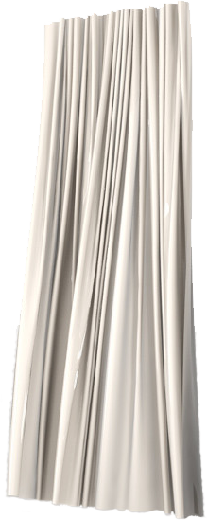



Agreeing to establish a connection
Q: will 2-way handshake always work in network?
variable delays
unreliable channel,
retransmitted messages due to message delay, loss
2-way handshake:
Let’s talk
ESTAB
OK
ESTAB
Byzantine Generals Problem
choose x
req_conn(x)
ESTAB
acc_conn(x)
ESTAB
Notes:
Here’s an example of a two way handshake. Alice reaches out to Bob and say’s “let’s talk” and Bob says OK, and they start their conversation
For a network protocol, the equivalent protocol would be a client sending a “request connection” message saying ”let’s talk, the initial sequence number is x”
And the server would respond with a message ”I accept your connect x”
And the question we want to ask ourselves is <talk through>
Will this work? Let’s look at a few scenarios…

Slide 30

TCP 3-way handshake
client state
server state
LISTEN
LISTEN
choose init seq num, x
send TCP SYN msg
SYNSENT
SYNbit=1, Seq=x
choose init seq num, y
send TCP SYNACK
msg, acking SYN
SYN RCVD
SYNbit=1, Seq=y
ACKbit=1; ACKnum=x+1
received SYNACK(x)
indicates server is live;
send ACK for SYNACK;
ESTAB
this segment may contain
client-to-server data
ACKbit=1, ACKnum=y+1
received ACK(y)
indicates client is live
remember
HTTP request?
ESTAB
Notes:
TCP’s three way handshake, that operates as follows
Let’s say the client and server both create a TCP socket as we learned about in Chapter 2 and enter the LISTEN state
The client then connects to the server sending a SYN message with a sequence number x (SYN Message is an TCP Segment with SYN but set in the header – you might want to go back and review the TCP segment format!)
The server is waiting for a connection, and receives the SYN message enters the SYN received state (NOT the established state and sends a SYN ACK message back.
Finally the client sends an ACK message to the server, and when the server receiver this enters the ESTABLished state. This is when the application process would see the return from the wait on the socket accept() call

Slide 31
Closing a TCP connection
client, server each close their side of connection
  send TCP segment with FIN bit = 1
respond to received FIN with ACK
  on receiving FIN, ACK can be combined with own FIN
simultaneous FIN exchanges can be handled
Notes:
All good things must come to an end, and that’s true for a TCP connection as well.
And of course there’s a protocol for one side to gracefully close of a TCP connection using a FIN message, to which the other side sends a FINACK message and waits around a bit to respond to any retransmitted FIN messages before timing out.

Slide 32
Closing a TCP connection
client state
server state
ESTAB
ESTAB
clientSocket.close()
FIN_WAIT_1
can no longer
send but can
receive data
FINbit=1, seq=x
CLOSE_WAIT
ACKbit=1; ACKnum=x+1
can still
send data
FIN_WAIT_2
wait for server
close
LAST_ACK
FINbit=1, seq=y
TIMED_WAIT
can no longer
send data
ACKbit=1; ACKnum=y+1
timed wait
for 2*max
segment lifetime
CLOSED
CLOSED
Why not 3-way closing?

Slide 33
Transport layer: roadmap
3.1 Transport-layer services
3.2 Multiplexing and demultiplexing
3.3 Connectionless transport: UDP
3.4 Principles of reliable data transfer
3.5 Connection-oriented transport: TCP
3.6 Principles of congestion control
3.7 TCP congestion control
3.8 Evolution of transport-layer functionality

Slide 34
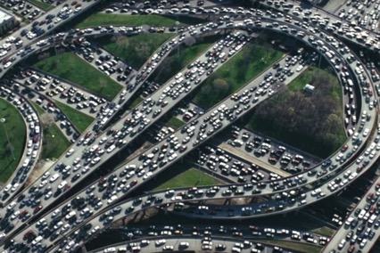
Principles of congestion control
Congestion:
informally: “too many sources sending too much data too fast for network to handle”
manifestations:
  long delays (queueing in router buffers)
  packet loss (buffer overflow at routers)
different from flow control (one-to-one)!
congestion control: too many senders, sending too fast
a top-10 problem!
flow control: one sender too fast for one receiver

Slide 35

Causes/costs of congestion: scenario 1
original data: λ_{in}
throughput: λ_{out}
two senser/receiver pairs
one router, two flows,
link capacity: R
As traffic increases → R/2
  Delay increase - timeout → retransmit
  Packet loss → retransmit
Host A
finite shared output link buffers
R
R
maximum per-connection throughput: R/2
Host B
R/2
λ_{out}
How can we?
  Avoid congestion
  Resolve congestion
“wasted” capacity due to un-needed retransmissions
loss
delay
throughput:
λ_{in}
R/2
  Delay increase
  Packet loss
λ_{in}
R/2

Slide 36
Congestion: multi-hop scenario
Sender ➔ Receiver
  Download100MB file, using FTP/TCP
  Via multiple hops of various BW (unknown!)
Question:
  Decide sending data rate? (wnd/RTT)
  not too low, not too high – just right!
Strategy:
  Start from low rate
  Slowly ramp up
  Stabilise at allowed
1
v
10
w
50
5
Sender
u
50
z
Receiver
10
100
100Mbps
x
y
1Mbps
100Mbps

Slide 37
Transport layer: roadmap
3.1 Transport-layer services
3.2 Multiplexing and demultiplexing
3.3 Connectionless transport: UDP
3.4 Principles of reliable data transfer
3.5 Connection-oriented transport: TCP
3.6 Principles of congestion control
3.7 TCP congestion control
3.8 Evolution of transport-layer functionality

Slide 38

TCP slow start
Host A
Host B
when connection begins, increase rate exponentially until first loss event:
  initially cwnd = 1 MSS
  double cwnd every RTT
  done by incrementing cwnd for every ACK received
one segment
RTT
two segments
four segments
summary: initial rate is slow, but ramps up exponentially fast
time

Slide 39
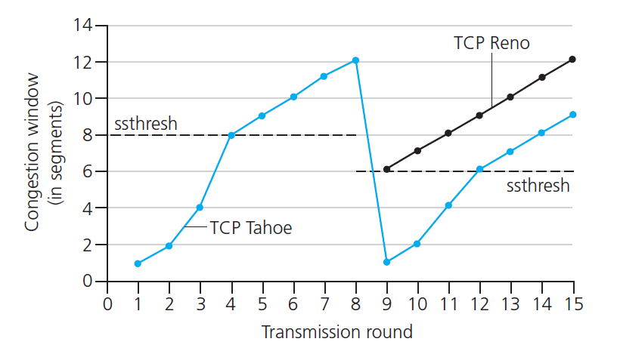

TCP: from slow start to congestion avoidance
Q: when should the exponential increase switch to linear?
A: when cwnd ≥ ssthresh
X
Implementation:
variable ssthresh
on loss event, ssthresh is set to 1/2 of cwnd just before loss event
* Check out the online interactive exercises for more examples: http://gaia.cs.umass.edu/kurose_ross/interactive/

Slide 40
TCP congestion control: AIMD
approach: senders can increase sending rate until packet loss (congestion) occurs, then decrease sending rate on loss event
Additive Increase
Multiplicative Decrease
  increase sending rate by 1 maximum segment size every RTT until loss detected
  cut sending rate in half at each loss event
AIMD sawtooth
behavior: probing
for bandwidth
TCP sender Sending rate
time

Slide 41
TCP AIMD: more
Multiplicative decrease detail: sending rate is
Cut in half on loss detected by triple duplicate ACK (TCP Reno)
Cut to 1 MSS (maximum segment size) when loss detected by timeout (TCP Tahoe)
Why AIMD?
AIMD – a distributed, asynchronous algorithm – has been shown to:
  optimize congested flow rates network wide!
  have desirable stability properties

Slide 42
TCP congestion control: details
sender sequence number space
TCP sending behavior:
roughly: send cwnd bytes, wait RTT for ACKS, then send more bytes
cwnd
last byte
ACKed
cwnd
sent, but not-yet ACKed
(“in-flight”)
available but not used
TCP rate
~
bytes/sec
~
RTT
last byte sent
TCP sender limits transmission:
cwnd is dynamically adjusted in response to observed network congestion (implementing TCP congestion control)
<
cwnd
LastByteSent- LastByteAcked

Slide 43
TCP throughput
avg. TCP thruput as function of window size, RTT?
  ignore slow start, assume there is always data to send
W: window size (measured in bytes) where loss occurs
  avg. window size (# in-flight bytes) is ¾ W
  avg. thruput is 3/4W per RTT
avg TCP thruput =
3
W
4
RTT
bytes/sec
W
W/2

Slide 44
Chapter 3: summary
principles behind transport layer services:
  multiplexing, demultiplexing
  reliable data transfer
  flow control
  congestion control
instantiation, implementation in the Internet
  UDP
  TCP
Up next:
leaving the network “edge” (application, transport layers)
into the network “core”
two network-layer chapters:
  data plane
  control plane

Slide 45
Assignment2 - 5%, Exam info
Assignment2 – 5%: Transport Layer
  Based on weeks 5 & 6 learning materials
  Answer in required format - strictly!
  Due by Sunday 2nd April - No late submission accepted!
Final Exam – 45%: preliminary info
  Time: Exam period (no date/time yet), Duration: 120min
  Format: online open book
  Scope: weeks 5-12

Slide 46
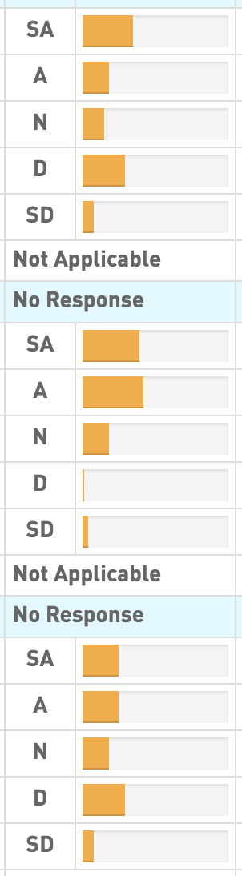
Student Feedback Survey (SFS) Results
Some Positive
  Detailed explanation – that’s the way!
  Engaging Q&A during lecture – making the most!
Some Issues:
  Content heavy – reducing load, keeping fundamental
  Tutorial/Lab need more explanation – passed to the tutors
Response rate: 9%
Expectation Opportunity Quality

Slide 47
Lecture done
  ✅
Q&A

