Slide 1

Chapter 4
Network Layer: Data Plane
Adapted by renping.liu@uts.edu.au on 2 April 2023
A note on the use of these PowerPoint slides:
We’re making these slides freely available to all (faculty, students, readers). They’re in PowerPoint form so you see the animations; and can add, modify, and delete slides (including this one) and slide content to suit your needs. They obviously represent a lot of work on our part. In return for use, we only ask the following:
If you use these slides (e.g., in a class) that you mention their source (after all, we’d like people to use our book!)
If you post any slides on a www site, that you note that they are adapted from (or perhaps identical to) our slides, and note our copyright of this material.
For a revision history, see the slide note for this page.
Thanks and enjoy! JFK/KWR
All material copyright 1996-2020
J.F Kurose and K.W. Ross, All Rights Reserved
Computer Networking: A Top-Down Approach
8th Edition, Global Edition
Jim Kurose, Keith Ross
Copyright © 2022 Pearson Education Ltd
Notes:
Version History
8.0 (May 2020)
All slides reformatted for 16:9 aspect ratio
All slides updated to 8th edition material
Use of Calibri font, rather that Gill Sans MT
Add LOTS more animation throughout
added new 8th edition material on middleboxes (and Internet arch), Net neutrality, buffering …
lighter header font

Slide 2

Network layer: “data plane” roadmap
4.1 Network layer: overview
  data plane
  control plane
4.2 What’s inside a router
  input ports, switching, output ports
  buffer management, scheduling
4.3 IP: the Internet Protocol
  datagram format
  addressing
  network address translation
  IPv6
4.4 Generalized Forwarding, SDN
  Match+action
  OpenFlow: match+action in action
4.5 Middleboxes

Slide 3






Network-layer services and protocols
transport segment from sending to receiving host
  sender: encapsulates segments into datagrams, passes to link layer
  receiver: delivers segments to transport layer protocol
network layer protocols in every Internet device: hosts, routers
routers:
  examines header fields in all IP datagrams passing through it
  moves datagrams from input ports to output ports to transfer datagrams along end-end path
application
transport
network
data link
physical
network
data link
physical
network
data link
physical
network
data link
physical
network
data link
physical
network
data link
physical
network
data link
physical
network
data link
physical
network
data link
physical
network
data link
physical
application
transport
network
data link
physical
network
data link
physical
network
data link
physical

Slide 4
Two key network-layer functions
Trip: Forster → Orange
network-layer functions:
routing: determine route taken by packets from source to destination
  routing algorithms
forwarding: move packets from router’s input to appropriate router output
analogy: taking a trip
routing: process of planning trip from source to destination
forwarding: process of getting through single interchange

Slide 5
Network layer: data plane, control plane
Control plane
determines how datagram is routed among routers along end-end path from source host to destination host
network-wide logic
Based on network topology
Data plane
determines how datagram arriving on router input port is forwarded to router output port
local, per-router function
Based on pre-determined forwarding
values in arriving
packet header
0111
1
3
2

Slide 6
Network layer: data plane, control plane
Control plane
determines how datagram is routed among routers along end-end path from source host to destination host
network-wide logic
Based on network topology
Two control-plane approaches:
traditional routing algorithms: implemented in routers
software-defined networking (SDN): implemented in (remote) servers

Slide 7


Per-router control plane
Individual routing algorithm components in each and every router interact in the control plane
Routing
Algorithm
control
plane
data
plane
0111 4
0111 2
values in arriving
packet header
0111
1
0111 network
3
2

Slide 8
Software-Defined Networking (SDN) control plane
Remote controller computes, installs forwarding tables in routers
Remote Controller
control
plane
data
plane
CA
CA
CA
CA
CA
values in arriving
packet header
0111
1
3
2

Slide 9
Network service model
think of services by Aust Post: letter, registered, express, parcel,
Q: What service model do we need for “network” to pass datagrams from sender to receiver?
example services for individual datagrams:
guaranteed delivery
guaranteed timing, e.g., delivery within 40 msec delay
example services for a flow of datagrams:
in-order datagram delivery
guaranteed minimum bandwidth to flow
restrictions on changes in inter-packet spacing

Slide 10
Network-layer service model
Quality of Service (QoS) Guarantees ?
Network
Architecture
Internet
ATM
ATM
Internet
Internet
Service
Model
best effort
Constant Bit Rate
Available Bit Rate
Intserv Guaranteed
(RFC 1633)
Diffserv (RFC 2475)
Bandwidth
none
Constant rate
Guaranteed min
yes
possible
Loss
no
yes
no
yes
possibly
Order
no
yes
yes
yes
possibly
Timing
no
yes
no
yes
no
Internet “best effort” service model
No guarantees on:
  successful datagram delivery to destination
  timing or order of delivery
  bandwidth available to end-end flow

Slide 11
Network-layer service model
Quality of Service (QoS) Guarantees ?
Network
Architecture
Internet
ATM
ATM
Internet
Internet
Service
Model
best effort
Constant Bit Rate
Available Bit Rate
Intserv Guaranteed
(RFC 1633)
Diffserv (RFC 2475)
Bandwidth
none
Constant rate
Guaranteed min
yes
possible
Loss
no
yes
no
yes
possibly
Order
no
yes
yes
yes
possibly
Timing
no
yes
no
yes
no
🚫QoS: too hard, too expensive!

Slide 12
Reflections on best-effort service:
simplicity of mechanism has allowed Internet to be widely deployed adopted
sufficient provisioning of bandwidth allows performance of real-time applications (e.g., interactive voice, video) to be “good enough” for “most of the time”
replicated, application-layer distributed services (datacenters, content distribution networks) connecting close to clients’ networks, allow services to be provided from multiple locations
congestion control of “elastic” services helps
It’s hard to argue with success of best-effort service model

Slide 13
Network layer: “data plane” roadmap
4.1 Network layer: overview
  data plane
  control plane
4.2 What’s inside a router
  input ports, switching, output ports
  buffer management, scheduling
4.3 IP: the Internet Protocol
  datagram format
  addressing
  network address translation
  IPv6
4.4 Generalized Forwarding, SDN
  Match+action
  OpenFlow: match+action in action
4.5 Middleboxes

Slide 14
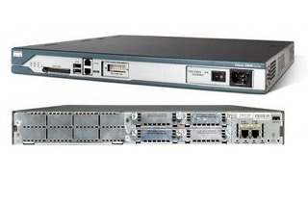
Router architecture overview
A specialised computer
Four parts:
  routing processor
  Input ports
  Switching fabrics
  Output ports
control plane (software)
operates in ms time frame
routing, management
Software
Hardware
data plane (hardware)
Operates in ns timeframe
forwarding datagram

Slide 15
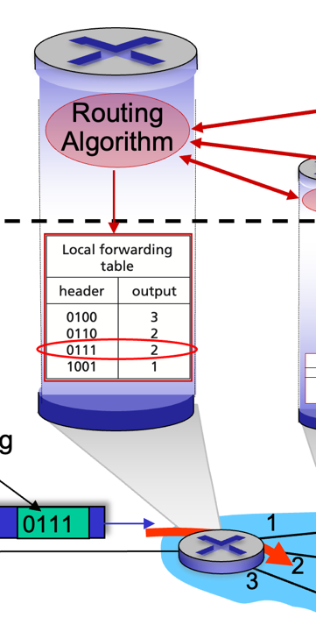
Input port functions
lookup,
forwarding
queueing
line
termination
link
layer
protocol
(receive)
switch
fabric
physical layer:
bit-level reception
decentralized switching:
using header field values, lookup output port using forwarding table in input port memory (“match plus action”)
goal: complete input port processing at ‘line speed’
input port queuing: if datagrams arrive faster than forwarding rate into switch fabric
link layer:
e.g., Ethernet
(chapter 6)

Slide 16
Input port functions
lookup,
forwarding
queueing
line
termination
link
layer
protocol
(receive)
switch
fabric
physical layer:
bit-level reception
decentralized switching:
using header field values, lookup output port using forwarding table in input port memory (“match plus action”)
destination-based forwarding: forward based only on destination IP address (traditional)
generalized forwarding: forward based on any set of header field values
link layer:
e.g., Ethernet
(chapter 6)

Slide 17
Input port queuing
If switch fabric slower than input ports combined -> queueing may occur at input queues
  queueing delay and loss due to input buffer overflow!
Head-of-the-Line (HOL) blocking: queued datagram at front of queue prevents others in queue from moving forward
switch
fabric
switch
fabric
output port contention: only one red datagram can be transferred. lower red packet is blocked
one packet time later: green packet experiences HOL blocking

Slide 18
Switching fabrics
transfer packet from input link to appropriate output link
switching rate: rate at which packets can be transfer from inputs to outputs
  often measured as multiple of input/output line rate
  N inputs: switching rate N times line rate desirable
R
(rate: NR, ideally)
R
. . .
high-speed
switching
fabric
. . .
N input ports
N output ports
R
R

Slide 19
Switching fabrics
transfer packet from input link to appropriate output link
switching rate: rate at which packets can be transfer from inputs to outputs
  often measured as multiple of input/output line rate
  N inputs: switching rate N times line rate desirable
three major types of switching fabrics:
memory
memory
bus
interconnection
network

Slide 20
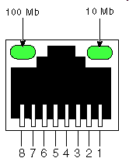
Switching via memory
first generation routers:
traditional computers with switching under direct control of CPU
packet copied to system’s memory
speed limited by memory bandwidth (2 bus crossings per datagram)
input
port
(e.g.,
Ethernet)
output
port
(e.g.,
Ethernet)
memory
system bus

Slide 21
Switching via a bus
datagram from input port memory to output port memory via a shared bus
bus contention: switching speed limited by bus bandwidth
32 Gbps bus, Cisco 5600: sufficient speed for access routers

Slide 22
Switching via interconnection network
Crossbar, Clos networks, other interconnection nets initially developed to connect processors in multiprocessor
multistage switch: nxn switch from multiple stages of smaller switches
3x3 crossbar
3x3 crossbar
exploiting parallelism:
  fragment datagram into fixed length cells on entry
  switch cells through the fabric, reassemble datagram at exit
8x8 multistage switch
built from smaller-sized switches

Slide 23
Output port queuing
switch
fabric
switch
fabric
at t, packets more
from input to output
one packet time later
buffering when arrival rate via switch exceeds output line speed
queueing (delay) and loss due to output port buffer overflow!

Slide 24
Output port queuing
datagram
buffer
queueing
switch
fabric
(rate: NR)
link
layer
protocol
(send)
line
termination
R
Buffering required when datagrams arrive from fabric faster than link transmission rate.
Priority scheduling – who gets best performance, network neutrality
Scheduling discipline chooses among queued datagrams for transmission
Datagrams can be lost due to congestion, lack of buffers
Drop policy: which datagrams to drop if no free buffers?

Slide 25
Packet Scheduling: FCFS
packet scheduling: deciding which packet to send next on link
  first come, first served
  priority
  round robin
  weighted fair queueing
FCFS: packets transmitted in order of arrival to output port
also known as: First-in-first-out (FIFO)
real world examples?
Abstraction: queue
R
packet
departures
packet
arrivals
queue
(waiting area)
link
(server)

Slide 26
Scheduling policies: priority
Real life example:
Airline check-in
Priority scheduling:
arriving traffic classified, queued by class
  any header fields can be used for classification
high priority queue
arrivals
classify
link
departures
low priority queue
2
send packet from highest priority queue that has buffered packets
  FCFS within priority class
1
3
4
5
arrivals
packet in service
1
3
2
4
5
departures
1
3
2
4
5

Slide 27
Scheduling policies: round robin
Real life example:
RMS, Medicare, …
true round robin, or?
Round Robin (RR) scheduling:
arriving traffic classified, queued by class
  any header fields can be used for classification
server cyclically, repeatedly scans class queues, sending one complete packet from each class (if available) in turn
R
classify
arrivals
link
departures

Slide 28
Scheduling policies: weighted fair queueing
Real life example:
RMS, Medicare, …
true round robin, or WFQ
Weighted Fair Queuing (WFQ):
generalized Round Robin
each class, i, has weight, w_{i}, and gets weighted amount of service in each cycle:
w₁
w₂
R
w_{i}
Σ_{j}w_{j}
classify
arrivals
link
departures
w₃
minimum bandwidth guarantee (per-traffic-class)

Slide 29
Buffer Management
buffer management:
drop: which packet to add, drop when buffers are full
  tail drop: drop arriving packet
  priority: drop/remove on priority basis
datagram
buffer
queueing
scheduling
switch
fabric
link
layer
protocol
(send)
line
termination
R
Abstraction: queue
marking: which packets to mark to signal congestion (ECN, RED)
R
packet
departures
packet
arrivals
queue
(waiting area)
link
(server)

Slide 30
Sidebar: Network Neutrality
What is network neutrality?
  technical: how an ISP should share/allocation its resources
  packet scheduling, buffer management are the mechanisms
  social, economic principles
    protecting free speech
    encouraging innovation, competition
  enforced legal rules and policies
Optional – not tested
Different countries have different “takes” on network neutrality

Slide 31
Sidebar: Network Neutrality
2015 US FCC Order on Protecting and Promoting an Open Internet: three “clear, bright line” rules:
no blocking … “shall not block lawful content, applications, services, or non-harmful devices, subject to reasonable network management.”
no throttling … “shall not impair or degrade lawful Internet traffic on the basis of Internet content, application, or service, or use of a non-harmful device, subject to reasonable network management.”
no paid prioritization. … “shall not engage in paid prioritization”
Optional – not tested

Slide 32
ISP: telecommunications or information service?
Is an ISP a “telecommunications service” or an “information service” provider?
the answer really matters from a regulatory standpoint!
US Telecommunication Act of 1934 and 1996:
  Title II: imposes “common carrier duties” on telecommunications services: reasonable rates, non-discrimination and requires regulation
  Title I: applies to information services:
    no common carrier duties (not regulated)
    but grants FCC authority “… as may be necessary in the execution of its functions”4
Optional – not tested

Slide 33
Mid-break
  ☕️
Q&A

Slide 34
Network layer: “data plane” roadmap
4.1 Network layer: overview
  data plane
  control plane
4.2 What’s inside a router
  input ports, switching, output ports
  buffer management, scheduling
4.3 IP: the Internet Protocol
  datagram format
  addressing
  network address translation
  IPv6
4.4 Generalized Forwarding, SDN
  Match+action
  OpenFlow: match+action in action
4.5 Middleboxes

Slide 35
Network Layer: Internet
host, router network layer functions:
transport layer: TCP, UDP
IP protocol
datagram format
addressing
packet handling conventions
Path-selection algorithms: implemented in
routing protocols (OSPF, BGP)
SDN controller
network
layer
forwarding
table
ICMP protocol
error reporting
router “signaling”
link layer
physical layer

Slide 36
IP Datagram format
32 bits
IP protocol version number
head.
len
type of
service
total datagram
length (bytes)
ver
length
header length(bytes)
“type” of service:
diffserv (0:5)
ECN (6:7)
flgs
fragment
offset
fragmentation/
reassembly
16-bit identifier
time to
live
upper
layer
header
checksum
header checksum
TTL: remaining max hops
(decremented at each router)
source IP address
32-bit source IP address
destination IP address
Maximum length: 64K bytes
Typically: 1500 bytes or less
upper layer protocol (e.g., TCP or UDP)
32-bit destination IP address
options (if any)
e.g., timestamp, record route taken
payload data
(variable length,
typically a TCP
or UDP segment)

Slide 37
IP Datagram format
32 bits
ver
head.
len
type of
service
length
flgs
fragment
offset
16-bit identifier
time to
live
upper
layer
header
checksum
20 bytes
source IP address
destination IP address
options (if any)
overhead
20 bytes of TCP
20 bytes of IP
= 40 bytes + app layer overhead for TCP+IP
payload data
(variable length,
typically a TCP
or UDP segment)

Slide 38
IP Datagram format - TTL
32 bits
ver
head.
len
type of
service
length
flgs
fragment
offset
16-bit identifier
time to
live
upper
layer
header
checksum
TTL: remaining max hops
(decremented at each router)
source IP address
TTL
destination IP address
options (if any)
Purpose:
get rid of looping datagram
Router process:
  TTL -= 1
  if TTL == 0:
  drop(datagram)
payload data
(variable length,
typically a TCP
or UDP segment)

Slide 39


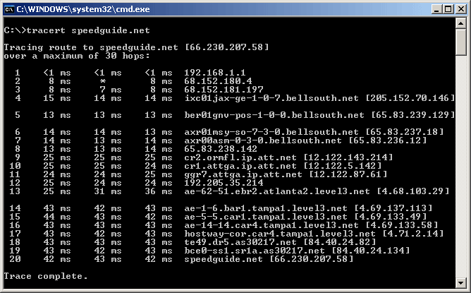
TTL and Traceroute
3 probes
3 probes
3 probes
source sends series of UDP segments to destination
  1st set has TTL =1, discarded at 1st router → notify source, source record router and round-trip time.
  2nd set has TTL=2, discarded at 2nd router → notify source, source record router and round-trip time.
  ...
  reach destination with unlikely port number: destination host notify source with “port unreachable”, source record destination and round-trip time.
Source now has
  A list of all routers and their round-trip time along the path
  the destination and destination round-trip time.
This week’s Lab

Slide 40
Network layer: “data plane” roadmap
4.1 Network layer: overview
  data plane
  control plane
4.2 What’s inside a router
  input ports, switching, output ports
  buffer management, scheduling
4.3 IP: the Internet Protocol
  datagram format
  addressing
  network address translation
  IPv6
4.4 Generalized Forwarding, SDN
  Match+action
  OpenFlow: match+action in action
4.5 Middleboxes

Slide 41

IP address: introduction
One IP address for each interface
IP address: 32-bit identifier associated with each host or router interface
interface: connection between host/router and physical link
  router’s typically have multiple interfaces
  host typically has one or two interfaces (e.g., wired Ethernet, wireless 802.11)
    only one interface is active at a time
223.1.10.5 = 11011111 00000001 00001010 00000101
223
1
10
5
223.1.10.5
223.1.1.4
223.1.2.9
223.1.3.27

Slide 42
IP address: decimal ➔ binary
223.1.10.5 = 11011111.01100100.00001010.00000101
223
100
10
5
1. Write down binary table:
7 | 6 | 5 | 4 | 3 | 2 | 1 | 0 |  | i
128 | 64 | 32 | 16 | 8 | 4 | 2 | 1 |  | 2^{i}
2. convert 10 to binary: 10-8=2; 2-2=0. (deduct numbers: high to low)
3.
0 | 0 | 0 | 0 | 1 | 0 | 1 | 0
2. converting 100 to binary: deduct numbers: high to low
100 - 64 = 36; 36 - 32 = 4; 4 - 4 = 0
3.
0 | 1 | 1 | 0 | 0 | 1 | 0 | 0
Try 223?

Slide 43
IP address: binary ➔decimal
223.1.10.5 = 11011111.01100100.00001010.00000101
223
100
10
5
1. Write down binary table:
7 | 6 | 5 | 4 | 3 | 2 | 1 | 0 |  | i
128 | 64 | 32 | 16 | 8 | 4 | 2 | 1 |  | 2^{i}
2. write binary byte under the table:
0 | 1 | 1 | 0 | 0 | 1 | 0 | 0
3. add 1’s values:
64 + 32 + 4 = 100

Slide 44

IP addressing: introduction
subnet
223.1.1.1
subnet
Q: how are interfaces actually connected?
subnet
223.1.2.1
223.1.1.2
A: we’ll learn about that in chapters 6, 7
A: wired
Ethernet interfaces connected by Ethernet switches
223.1.1.4
223.1.2.9
223.1.1.3
223.1.3.27
223.1.2.2
subnet
223.1.3.1
223.1.3.2
A: wireless WiFi interfaces connected by WiFi base station

Slide 45
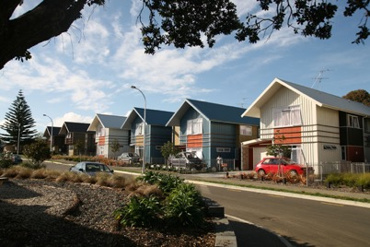
Subnets
3 Smith St
223.1.1.1
What’s a subnet ?
  device interfaces that can physically reach each other without passing through an intervening router
  Analogy: Houses in a Street
IP addresses have structure:
  subnet part: common high order bits
  host part: low order bits
IP address: subnet.host#
223.1.1.3
Street addr: street.house#
Smith St.3
223.1.2.1
223.1.1.2
223.1.1.4
223.1.2.9
223.1.1.3
223.1.3.27
223.1.2.2
223.1.3.1
223.1.3.2
network consisting of 3 subnets

Slide 46
Subnets
subnet 223.1.1.0/24
223.1.1.1
subnet 223.1.2.0/24
Recipe for defining subnets:
group IP addresses with the same high order part
creating “islands” of isolated networks
each isolated network is called a subnet
223.1.2.1
223.1.1.2
223.1.1.4
223.1.2.9
223.1.1.3
223.1.3.27
223.1.2.2
subnet
223.1.3.0/24
223.1.3.1
223.1.3.2
Write IP address
  IP address: 223.1.1.3
  subnet mask: 255.255.255.0
  shorthand: 223.1.1.3/24
subnet mask: /24
(high-order 24 bits: subnet part of IP address)

Slide 47
Subnets
223.1.1.2
subnet 223.1.1.0/24
223.1.1.1
where are the subnets?
  how many subnets?
what are the subnet addresses?
  223.1.1.0/24
  ...
  223.1.9.0/24
host IP address?
router IP address?
  router: gateway to outside
223.1.1.4
223.1.1.3
223.1.9.2
223.1.7.0
subnet 223.1.7.0/24
subnet 223.1.9.0/24
223.1.9.1
223.1.7.1
223.1.8.1
223.1.8.0
subnet 223.1.2.0/24
223.1.2.6
subnet 223.1.8.0/24
223.1.3.27
subnet 223.1.3.0/24
223.1.2.1
223.1.2.2
223.1.3.1
223.1.3.2

Slide 48
IP Address - Classful
Class | Start Address | End Address | Subnet Mask | shorthand
A | 0.0.0.0 | 127.255.255.255 | 255.0.0.0 | /8
B | 128.0.0.0 | 191.255.255.255 | 255.255.0.0 | /16
C | 192.0.0.0 | 223.255.255.255 | 255.255.255.0 | /24

Slide 49
IP addressing: CIDR
CIDR: Classless InterDomain Routing (pronounced “cider”)
  subnet portion of address of arbitrary length
  address format: a.b.c.d/x, where x is # bits in subnet portion of address
subnet
part
host
part
11001000 00010111 00010000 00000000
200.23.16.0/23

Slide 50

Chapter 4 – part1: Summary
Network layer: overview
What’s inside a router
IP addressing, subnet
Forwarding/routing
Middleboxes
Question: how are forwarding tables (destination-based forwarding) or flow tables (generalized forwarding) computed?
Answer: by the control plane (next chapter)

Slide 51
Good Friday
Friday tut/lab moved to the following week
– your tutor will let you know.

Slide 52
Lecture done
  ✅
Q&A

