Slide 1
Chapter 4 Network Layer: Data Plane
Adapted by renping.liu@uts.edu.au on 17 April 2023
A note on the use of these PowerPoint slides:
We’re making these slides freely available to all (faculty, students, readers). They’re in PowerPoint form so you see the animations; and can add, modify, and delete slides (including this one) and slide content to suit your needs. They obviously represent a lot of work on our part. In return for use, we only ask the following:
If you use these slides (e.g., in a class) that you mention their source (after all, we’d like people to use our book!)
If you post any slides on a www site, that you note that they are adapted from (or perhaps identical to) our slides, and note our copyright of this material.
For a revision history, see the slide note for this page.
Thanks and enjoy! JFK/KWR
All material copyright 1996-2020
J.F Kurose and K.W. Ross, All Rights Reserved
Computer Networking: A Top-Down Approach 8th Edition, Global Edition Jim Kurose, Keith Ross Copyright © 2022 Pearson Education Ltd
Notes:
Version History
8.0 (May 2020)
All slides reformatted for 16:9 aspect ratio
All slides updated to 8th edition material
Use of Calibri font, rather that Gill Sans MT
Add LOTS more animation throughout
added new 8th edition material on middleboxes (and Internet arch), Net neutrality, buffering …
lighter header font

Slide 2
Network layer: “data plane” roadmap
4.1 Network layer: overview
data plane
control plane
4.2 What’s inside a router
input ports, switching, output ports
buffer management, scheduling
4.3 IP: the Internet Protocol
datagram format
addressing
network address translation
IPv6
4.4 Generalized Forwarding, SDN
Match+action
OpenFlow: match+action in action
4.5 Middleboxes

Slide 3
IP addresses: how to get one?
That’s actually two questions:
Q: How does a host get IP address within its network (host part of address)?
Q: How does a network get IP address for itself (network part of address)

Slide 4
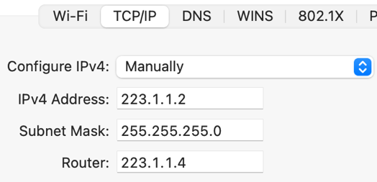
IP addresses: how to get one?
That’s actually two questions:
Q: How does a host get IP address within its network (host part of address)?
Manually config by sysadmin in config file
Windows: control-panel→network→configuration→TCP/IP
Apple: system preferences→networks→advanced →TCP/IP
DHCP: Dynamic Host Configuration Protocol:
dynamically get address from as server
“plug-and-play”

Slide 5
DHCP: Dynamic Host Configuration Protocol
goal: host dynamically obtains IP address from network server when it “joins” network
can renew its lease on address in use
allows reuse of addresses (only hold address while connected/on)
support for mobile users who join/leave network
DHCP overview:
host broadcasts DHCP discover msg [optional]
DHCP server responds with DHCP offer msg [optional]
host requests IP address: DHCP request msg
DHCP server sends address: DHCP ack msg

Slide 6
DHCP client-server scenario
Typically, DHCP server will be co-located in router, serving all subnets to which router is attached
DHCP server
223.1.1.1
223.1.2.1
223.1.2.5
223.1.1.2
223.1.1.4
223.1.2.9
223.1.1.3
223.1.3.27
arriving DHCP client needs
address in this network
223.1.2.2
223.1.3.1
223.1.3.2

Slide 7
DHCP client-server scenario
DHCP server: 223.1.2.5
DHCP discover
Arriving client
src : 0.0.0.0, 68
dest.: 255.255.255.255,67
yiaddr: 0.0.0.0
transaction ID: 654
Broadcast: is there a DHCP server out there?
DHCP offer
src: 223.1.2.5, 67
dest: 255.255.255.255, 68
yiaddr: 223.1.2.4
transaction ID: 654
lifetime: 3600 secs
Broadcast: I’m a DHCP server! Here’s an IP address you can use
The two steps above can be skipped “if a client remembers and wishes to reuse a previously allocated network address” [RFC 2131]
DHCP request
src: 0.0.0.0, 68
dest:: 255.255.255.255, 67
yiaddr: 223.1.2.4
transaction ID: 655
lifetime: 3600 secs
Broadcast: OK. I would like to use this IP address!
DHCP ACK
src: 223.1.2.5, 67
dest: 255.255.255.255, 68
yiaddr: 223.1.2.4
transaction ID: 655
lifetime: 3600 secs
Broadcast: OK. You’ve got that IP address!

Slide 8
DHCP: example
DHCP
DHCP
UDP
IP
Eth
Phy
Connecting laptop will use DHCP to get IP address, address of first-hop router, address of DNS server.
DHCP
DHCP
DHCP
DHCP
DHCP REQUEST message encapsulated in UDP, encapsulated in IP, encapsulated in Ethernet
DHCP
DHCP
UDP
IP
Eth
Phy
168.1.1.1
DHCP
DHCP
DHCP
Ethernet frame broadcast (dest: FFFFFFFFFFFF) on LAN, received at router running DHCP server
DHCP
router with DHCP
server built into
router
Ethernet demux’ed to IP demux’ed, UDP demux’ed to DHCP

Slide 9
DHCP: example
DHCP
UDP
IP
Eth
Phy
DCP server formulates DHCP ACK containing client’s IP address, IP address of first-hop router for client, name & IP address of DNS server
DHCP
DHCP
DHCP
DHCP
encapsulated DHCP server reply forwarded to client, demuxing up to DHCP at client
DHCP
DHCP
UDP
IP
Eth
Phy
DHCP
DHCP
DHCP
router with DHCP
server built into
router
client now knows its IP address, name and IP address of DNS server, IP address of its first-hop router
DHCP

Slide 10
DHCP: more than IP addresses
DHCP can return more than just allocated IP address on subnet:
network mask
indicating network versus host portion of address
so given a dest IP address, I know if it is in my local area network or outside
address of first-hop router for client
to access the wide Internet
name and IP address of DNS sever
to resolve www.amazon.com.au into 13.224.170.88

Slide 11
IP addresses: how to get one?
That’s actually two questions:
Q: How does a host get IP address within its network (host part of address)?
Q: How does a network get IP address for itself (network part of address)
A: gets allocated from its provider ISP’s address space
Q: how does an ISP get block of addresses?
A: ICANN: Internet Corporation for Assigned Names and Numbers http://www.icann.org/
allocates IP addresses, through 5 regional registries (RRs)

Slide 12
IP routing: forwarding
Internet
Forwarding in a Host
Forwarding in a Router
Forwarding table
Aggregation
Longest match
223.1.1.1
203.5.121.6
223.1.2.1
223.1.1.2
223.1.1.4
223.1.2.9
223.1.1.3
223.1.3.27
223.1.2.2
223.1.3.1
223.1.3.2

Slide 13
IP routing: forwarding in a Host
Internet
Configure host IP address:
Forwarding a datagram:
subnet = (IP address) AND (subnet mask)
if src.subnet == dest.subnet (dest: 223.1.1.3) send directly to current subnet – layer2, no routing.
if src.subnet != dest.subnet (dest: 223.1.3.2) go via router (223.1.1.4)
Router to do further routing …
223.1.1.1
IP address: 223.1.1.2
Subnet mask: 255.255.255.0
Router: 223.1.1.4
203.5.121.6
223.1.2.1
223.1.1.2
223.1.1.4
223.1.2.9
223.1.1.3
223.1.3.27
223.1.2.2
223.1.3.1
223.1.3.2

Slide 14
IP Routing: forwarding table in a router
Forwarding Table: match IP network address to outgoing interface
Dest Addr Range | Int
200.23.1.0/24 | 0
200.23.2.0/24 | 1
200.23.3.0/24 | 2
… | …
200.23.7.0/24 | 7
otherwise | 15
Get dest.subnet
Match forwarding table entry?
Yes: forward to int# – done.
No: try next entry – loop…
No match (otherwise) → default interface
Team 1
200.23.1.0/24
Team 2
200.23.2.0/24
Destination-based Forwarding
int1
int0
incoming IP datagram:
Dest: 200.23.2.5
Team 3
int2
int15
200.23.3.0/24
.
.
.
.
int7
.
int0
Team 7
.
200.23.7.0/24
int1
Internet
ISPs-R-Us

Slide 15
Hierarchical addressing: route aggregation
hierarchical addressing allows efficient advertisement of routing
information:
Dest Addr Range | Int
200.23.1.0/24 | 0
200.23.2.0/24 | 1
… | …
200.23.7.0/24 | 7
otherwise | 15
Team 1
200.23.1.0/24
Team 2
Dest Addr Range | Int
200.23.0.0/16 | 0
199.31.0.0/16 | 1
… | …
200.23.2.0/24
“Send me anything
with addresses
beginning
200.23.0.0/16”
int1
int0
Team 3
int2
int15
200.23.3.0/24
.
.
.
.
.
int7
incoming IP datagram:
int0 ← 200.23.2.5
int1 ← 199.31.1.8
Team 7
.
int0
200.23.7.0/24
int1
“Send me anything
with addresses
beginning
199.31.0.0/16”
Internet
ISPs-R-Us
199.31.1.0/24
.
.
.

Slide 16
Longest prefix matching
when looking for forwarding table entry for given destination address,
use longest address prefix that matches destination address.
Dest Addr Range | Int
200.23.1.0/24 | 0
200.23.2.0/24 | 1
… | …
200.23.34.0/24 | 7
otherwise | 15
incoming IP datagram:
200.23.5.2
Team 1
200.23.1.0/24
Dest Addr Range | Int
199.31.0.0/16 | 1
200.23.0.0/16 | 0
200.23.5.0/24 | 1
… | …
Team 2
“Send me anything
with addresses
beginning
200.23.0.0/16”
200.23.2.0/24
int1
int0
Team 3
int2
int15
200.23.4.0/24
.
.
.
.
int7
Internet
.
int0
200.23.5.0/24
Team 7
.
Team 5
200.23.7.0/24
int1
ISPs-R-Us has a more specific route to Team 18
ISPs-R-Us
“Send me anything
with addresses
beginning
199.31.0.0/16
or 200.23.5.0/24”
.
199.31.1.0/24
.
.

Slide 17
IP addressing: last words ...
Q: are there enough 32-bit IP addresses?
ICANN allocated last chunk of IPv4 addresses to RRs in 2011
NAT (next) helps IPv4 address space exhaustion
IPv6 has 128-bit address space
"Who the hell knew how much address space we needed?" Vint Cerf (reflecting on decision to make IPv4 address 32 bits long)

Slide 18
Mid-break
☕️
Q&A

Slide 19
Network layer: “data plane” roadmap
4.1 Network layer: overview
data plane
control plane
4.2 What’s inside a router
input ports, switching, output ports
buffer management, scheduling
4.3 IP: the Internet Protocol
datagram format
addressing
network address translation (NAT)
IPv6
4.4 Generalized Forwarding, SDN
Match+action
OpenFlow: match+action in action
4.5 Middleboxes

Slide 20
NAT: network address translation
NAT: all devices in local network share just one public IPv4 address as far as outside world is concerned
local network
(e.g., campus, home network)
private IP address:
192.168.1.0/24
Internet
public IP address:
138.76.29.7
192.168.1.1
192.168.1.4
192.168.1.2
138.76.29.7
192.168.1.3
Private IP Address
Class | Private IP address range | Subnet mask
A | 10.0.0.0 - 10.255.255.255 | 255.0.0.0
B | 172.16.0.0 - 172.16.31.255 | 255.255.0.0
C | 192.168.0.0-192.168.255.255 | 255.255.255.0
Private IP: free, reuse!
Cannot go to public Internet

Slide 21
NAT: network address translation
all devices in local network have “private” IP addresses
10.0.0.0/8, 172.16.0.0/12, 192.168.0.0/16 prefixes
can only be used in local network, discarded in public routers
advantages:
just one IP address needed from provider ISP for all devices
can change addresses of host in local network without notifying outside world
can change ISP without changing addresses of devices in local network
security: devices inside local net not directly addressable, invisible to outside world

Slide 22
NAT: network address translation
NAT: all devices in local network share just one IPv4 address as far as outside world is concerned
rest of
Internet
local network (e.g., home network) 192.168.1/24
192.168.1.1
138.76.29.7
192.168.1.4
192.168.1.2
192.168.1.3
all datagrams leaving local network have same source NAT IP address: 138.76.29.7, but different source port numbers
datagrams with source or destination in this network have 192.168.1/24 address for source, destination (as usual)

Slide 23
NAT: network address translation
implementation: NAT router must (transparently):
outgoing datagrams: replace (source IP address, port #) of every outgoing datagram to (NAT IP address, new port #)
remote clients/servers will respond using (NAT IP address, new port #) as destination address
remember (in NAT translation table) every (source IP address, port #) to (NAT IP address, new port #) translation pair
incoming datagrams: replace (NAT IP address, new port #) in destination fields of every incoming datagram with corresponding (source IP address, port #) stored in NAT table

Slide 24
NAT: network address translation
NAT translation table
WAN side addr LAN side addr
2: NAT router
changes datagram
source addr from
192.168.1.1, 3345 to
138.76.29.7, 5001,
updates table
1: host 192.168.1.1
sends datagram to
128.119.40.186, 80
138.76.29.7, 5001 192.168.1.1, 3345
…… ……
S: 192.168.1.1, 3345
D: 128.119.40.186, 80
192.168.1.1
1
2
S: 138.76.29.7, 5001
D: 128.119.40.186, 80
192.168.1.4
192.168.1.2
128.119.40.186
138.76.29.7
S: 128.119.40.186, 80
D: 192.168.1.1, 3345
4
S: 128.119.40.186, 80
D: 138.76.29.7, 5001
3
192.168.1.3
4: NAT router
changes datagram
dest addr from
138.76.29.7, 5001 to 192.168.1.1, 3345
3: reply arrives
dest. address:
138.76.29.7, 5001

Slide 25
NAT: network address translation
NAT translation table
WAN side addr LAN side addr
2: NAT router
changes datagram
source addr from
192.168.1.1, 3345 to
138.76.29.7, 5001,
updates table
1: host 192.168.1.1
sends datagram to
128.119.40.186, 80
138.76.29.7, 5001 192.168.1.1, 3345
…… ……
S: 192.168.1.1, 3345
D: 128.119.40.186, 80
192.168.1.1
1
2
S: 138.76.29.7, 5001
D: 128.119.40.186, 80
192.168.1.4
192.168.1.2
128.119.40.186
138.76.29.7
S: 128.119.40.186, 80
D: 192.168.1.1, 3345
4
This week’s Lab
S: 128.119.40.186, 80
D: 138.76.29.7, 5001
3
192.168.1.3
4: NAT router
changes datagram
dest addr from
138.76.29.7, 5001 to 192.168.1.1, 3345
3: reply arrives
dest. address:
138.76.29.7, 5001

Slide 26
NAT: network address translation
NAT has been controversial:
routers “should” only process up to layer 3
address “shortage” should be solved by IPv6
violates end-to-end argument (port # manipulation by network-layer device)
NAT traversal: what if client wants to connect to server behind NAT?
but NAT is here to stay:
extensively used in home and institutional nets, 4G/5G cellular nets

Slide 27
IPv6: motivation
initial motivation: 32-bit IPv4 address space would be completely allocated
additional motivation:
speed processing/forwarding: 40-byte fixed length header
enable different network-layer treatment of “flows”

Slide 28
IPv6 datagram format
flow label: identify datagrams in same "flow.” (concept of “flow” not well defined).
32 bits
priority: identify priority among datagrams in flow
ver
pri
flow label
payload len
next hdr
hop limit
source address
(128 bits)
40 Bytes
128-bit
IPv6 addresses
destination address
(128 bits)
payload (data)
What’s missing (compared with IPv4):
no checksum (to speed processing at routers)
no fragmentation/reassembly
no options (available as upper-layer, next-header protocol at router)

Slide 29
Transition from IPv4 to IPv6
not all routers can be upgraded simultaneously
no “flag days”
how will network operate with mixed IPv4 and IPv6 routers?
tunneling: IPv6 datagram carried as payload in IPv4 datagram among IPv4 routers (“packet within a packet”)
tunneling used extensively in other contexts (4G/5G)
IPv4 header fields
IPv6 header fields
IPv4 payload
IPv4 source, dest addr
IPv6 source dest addr
UDP/TCP payload
IPv6 datagram
IPv4 datagram

Slide 30
Tunneling and encapsulation
Ethernet connecting two IPv6 routers:
A
B
Ethernet connects two IPv6 routers
E
F
IPv6
IPv6
IPv6
IPv6
IPv6 datagram
Link-layer frame
The usual: datagram as payload in link-layer frame
IPv4 network connecting two IPv6 routers
A
B
E
F
IPv6
IPv6/v4
IPv6/v4
IPv6
IPv4 network

Slide 31
Tunneling and encapsulation
Ethernet connecting two IPv6 routers:
A
B
Ethernet connects two IPv6 routers
E
F
IPv6
IPv6
IPv6
IPv6
IPv6 datagram
Link-layer frame
The usual: datagram as payload in link-layer frame
IPv4 tunnel connecting two IPv6 routers
A
B
IPv4 tunnel
connecting IPv6 routers
E
F
IPv6
IPv6/v4
IPv6/v4
IPv6
IPv6 datagram
IPv4 datagram
tunneling: IPv6 datagram as payload in a IPv4 datagram

Slide 32
Tunneling
A
B
IPv4 tunnel
connecting IPv6 routers
E
F
logical view:
IPv6
IPv6/v4
IPv6/v4
IPv6
A
B
C
D
E
F
physical view:
IPv6
IPv6/v4
IPv4
IPv4
IPv6/v4
IPv6
flow: X
src: A
dest: F
data
src:B
dest: E
src:B
dest: E
src:B
dest: E
flow: X
src: A
dest: F
data
Flow: X
Src: A
Dest: F
data
Flow: X
Src: A
Dest: F
data
Flow: X
Src: A
Dest: F
data
Note source and destination addresses!
A-to-B:
IPv6
B-to-C:
IPv6 inside
IPv4
B-to-C:
IPv6 inside
IPv4
B-to-C:
IPv6 inside
IPv4
E-to-F:
IPv6

Slide 33
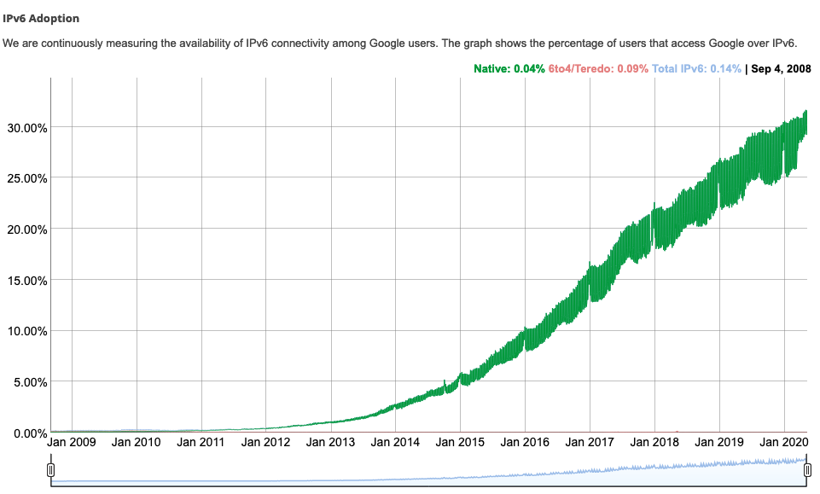
IPv6: adoption
Google¹: ~ 30% of clients access services via IPv6
NIST: 1/3 of all US government domains are IPv6 capable
¹ https://www.google.com/intl/en/ipv6/statistics.html

Slide 34
IPv6: adoption
Google¹: ~ 30% of clients access services via IPv6
NIST: 1/3 of all US government domains are IPv6 capable
Long (long!) time for deployment and use
25 years and counting!
think of application-level changes in last 25 years: WWW, social media, streaming media, gaming, telepresence, …
Why?
¹ https://www.google.com/intl/en/ipv6/statistics.html

Slide 35
Chapter 4: done!
Network layer: overview
What’s inside a router
IP: the Internet Protocol
Generalized Forwarding, SDN
Middleboxes
Question: Where do we get the forwarding tables?
Answer: by the control plane (next chapter)

Slide 36
Exam info (tentative)
Date,Time: 05/06/2023, 9:30am,
Duration: 120min
Format: online open book
Scope: weeks 5-12

Slide 37
Lecture done
✅
Q&A

