Slide 1
41080 Theory of Computing
Week 1, Spring 2023
Youming Qiao

Slide 2
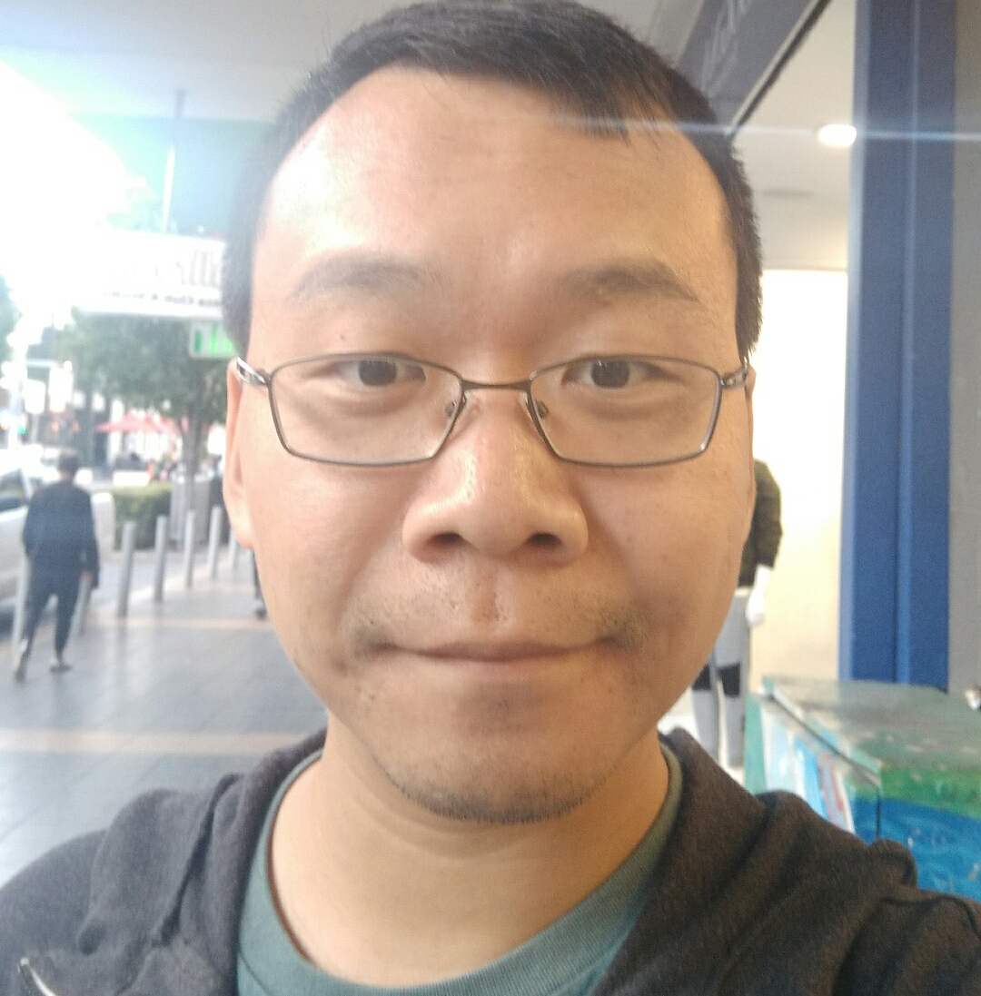
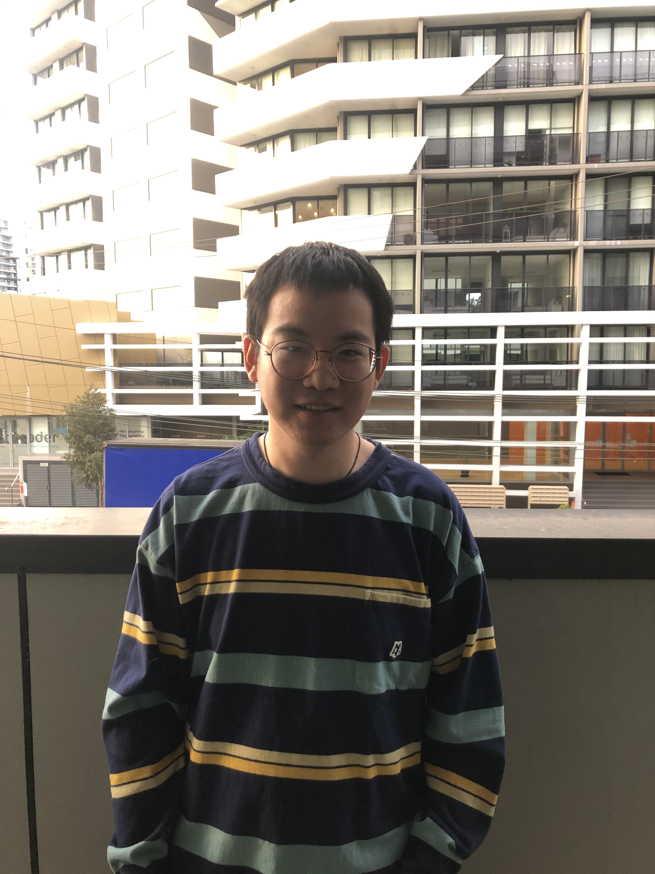
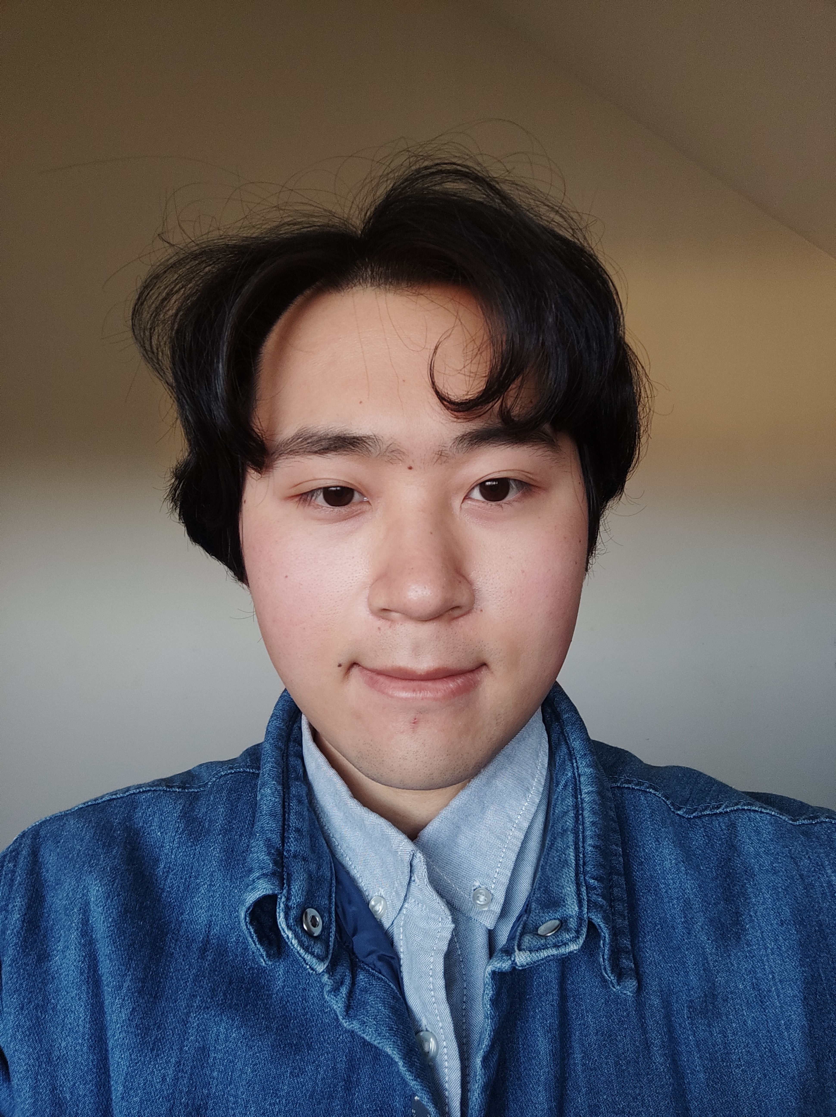
Welcome!
Welcome to Theory of Computing!
Subject coordinator: Youming QIAO ->
TA: Zhili CHEN (left)
TA: Chuanqi ZHANG (middle)
TA: Gang TANG (right)

Slide 3
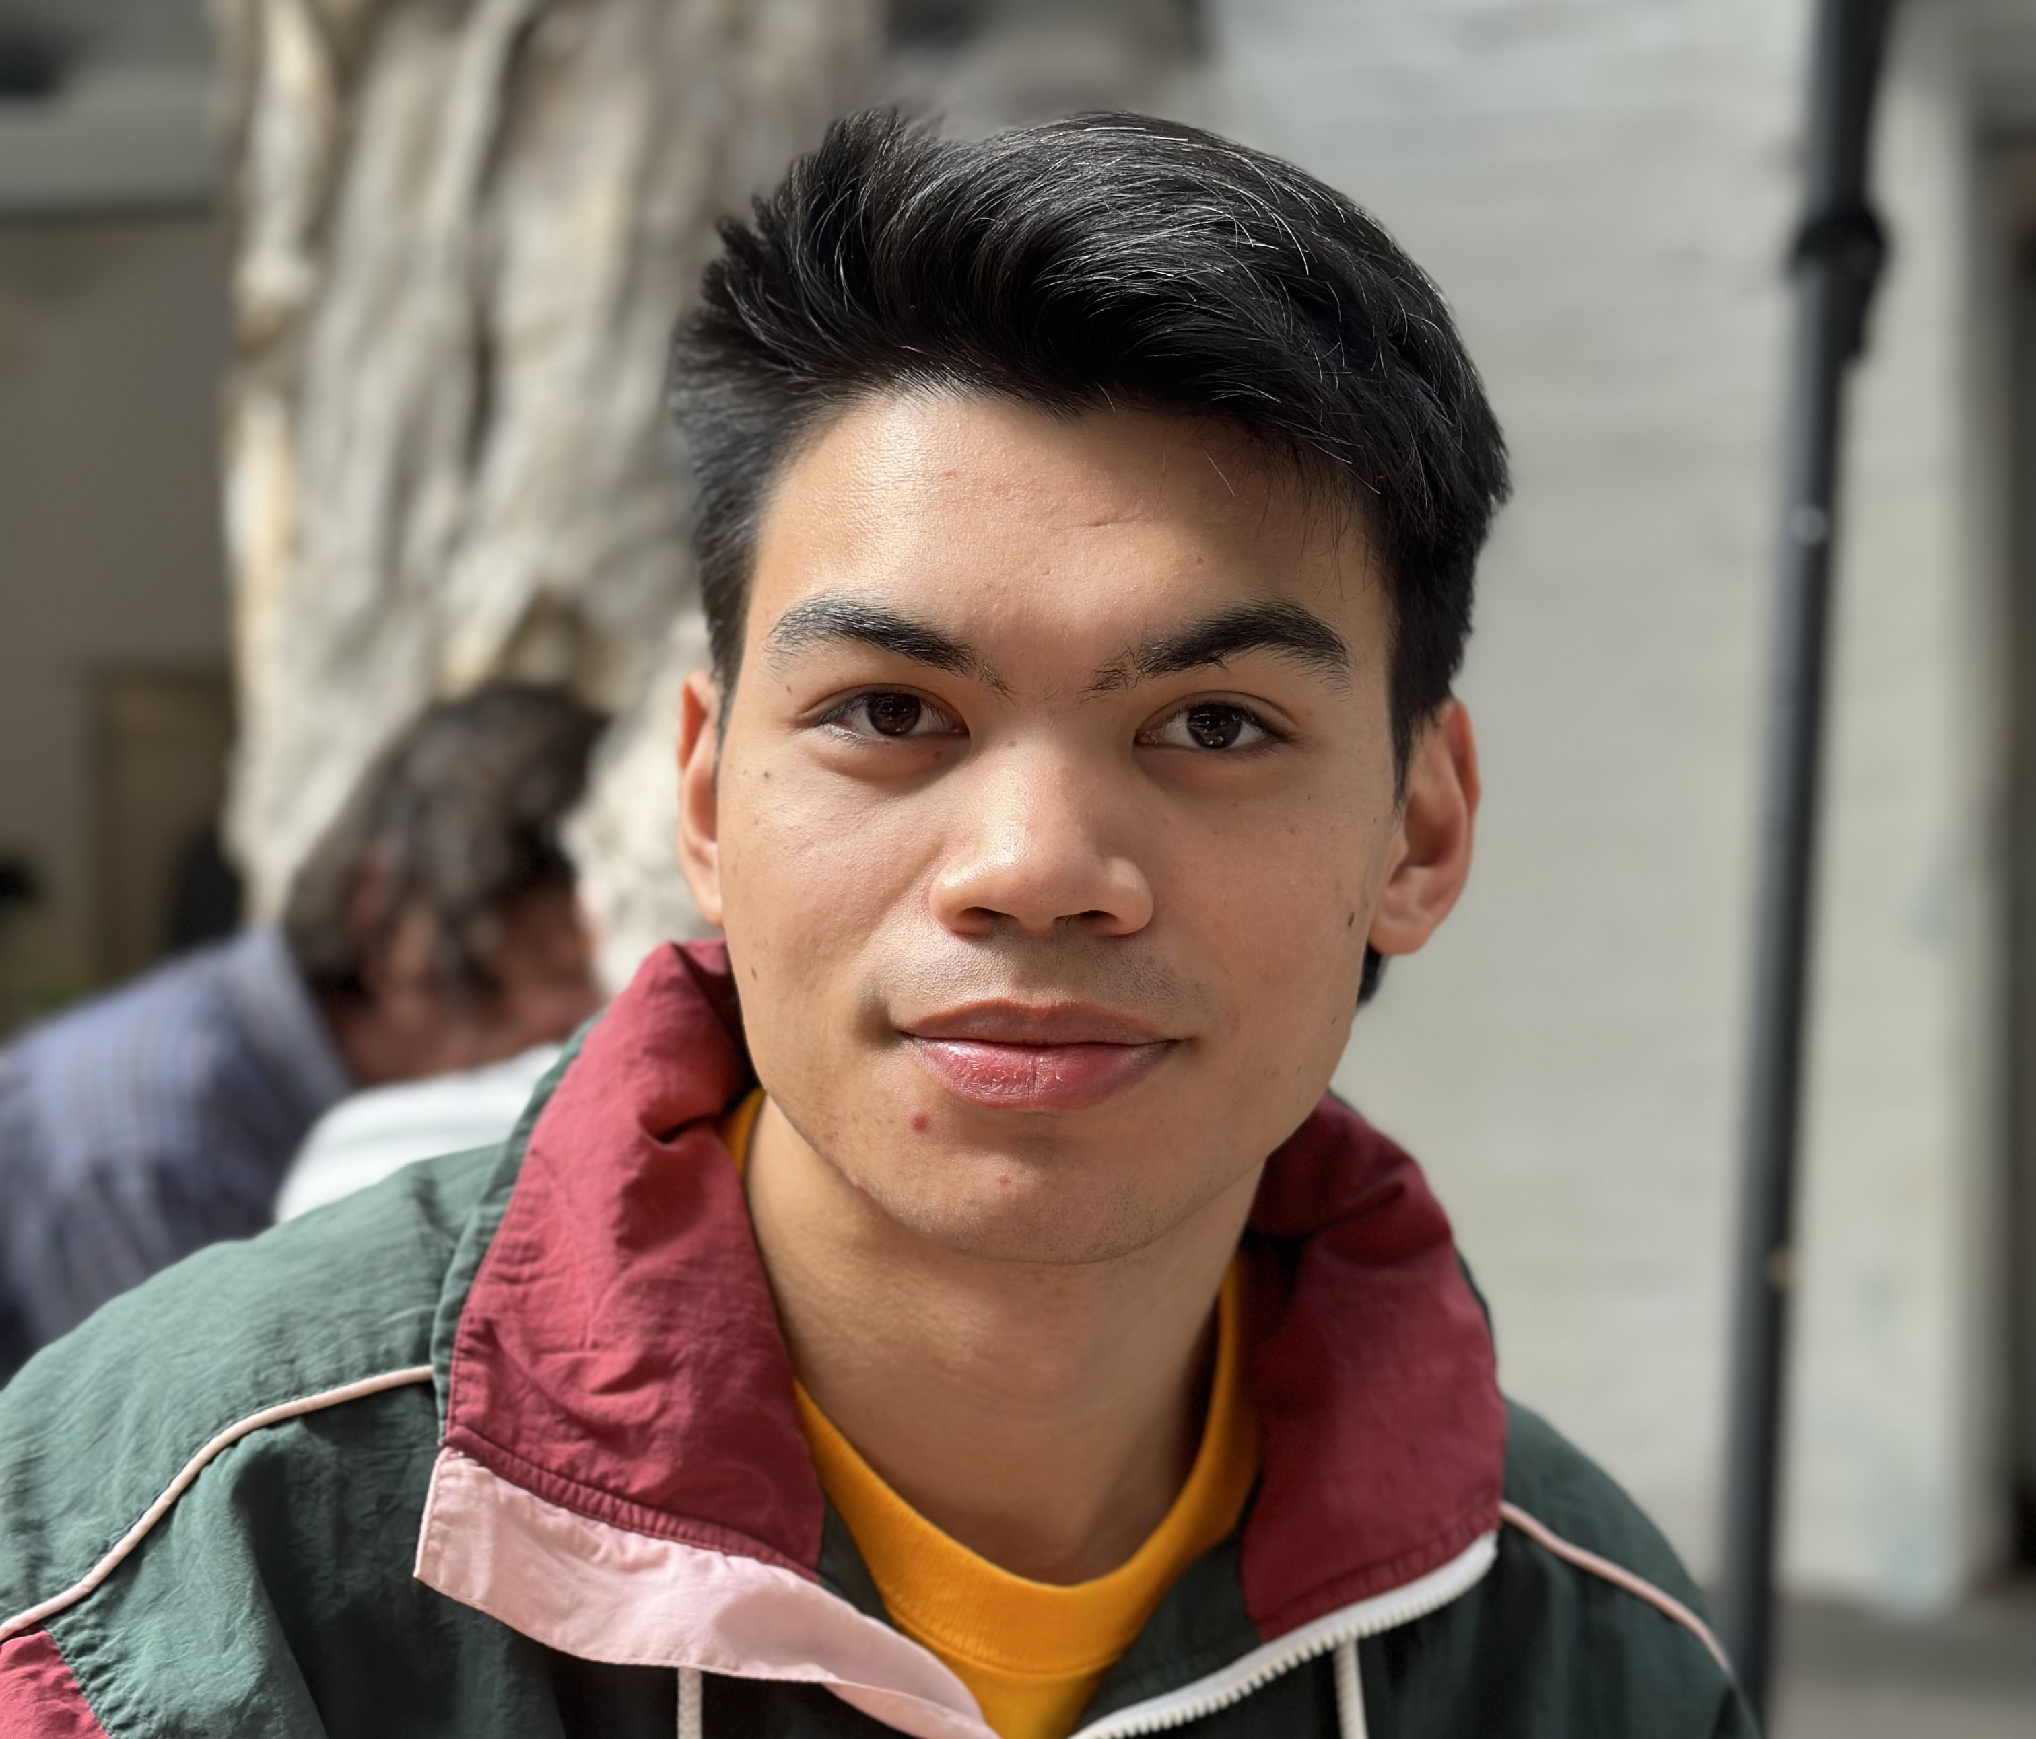
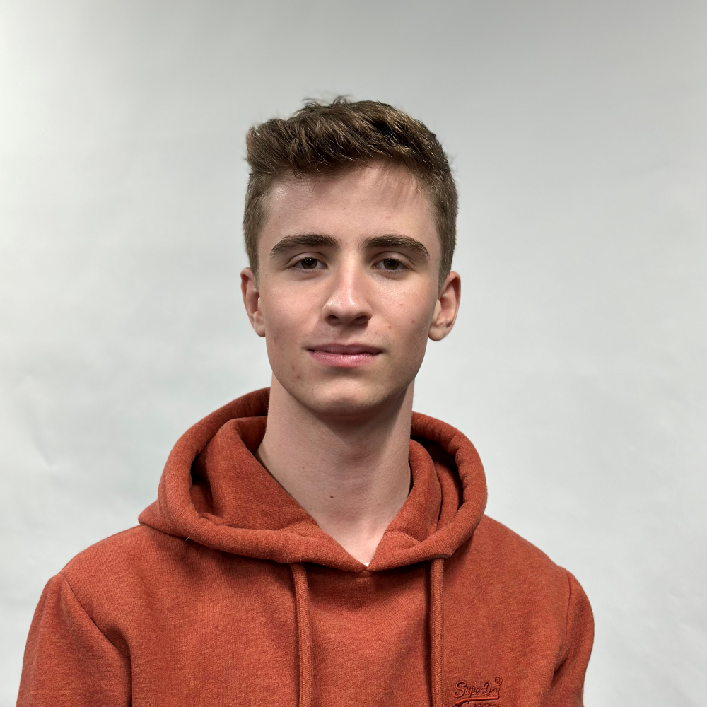
Tutors cont’d…
Euan MENDOZA (up)
Chris Atchison (down)
For detailed tutorial classes times and locations, please check on Canvas

Slide 4
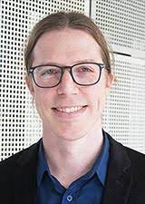
Acknowledgement
Luke Mathieson, who created this course at UTS
Similar/related courses:
Automata, Computability, and Complexity Theory: MIT
Introduction to Theoretical Computer Science: Harvard
Introduction to the Theory of Computation: Stanford

Slide 5
What we will do today
The “adminstrivia” of this course
An overview of the course content

Slide 6
Lectures and tutorials
Lectures
By 9am Monday, some reading materials and questions are posted on Canvas
Lectures on Tuesday at 10am
Slides and recordings will be available on Canvas by 9am Wednesday
Tutorial classes: six in-person tutorial classes on Friday
STRONGLY recommended
Problem sets will be handed out. They will be related to your assignments.
Tutors will work out example problems, and then you work in small groups to solve more

Slide 7
Assessments
Three assessments:
1st one: individual programming assignment, 30% (released on 14 August; due on 8 Sept)
2nd one: group programming assignment, 30% (released on 4 Sept; due on 13 Oct)
3rd one: theory assignment, 40% (released on 3 Nov; due on 17 Nov)
Programming assignment consists of programs and reports. Details see on Canvas and EdStem.
It is critical to keep the academic integrity and ethics in mind!
In case of any difficulty, do not hesitate to seek help from me or the tutors.

Slide 8
Discussions and interactions
Discussions and assessments on EdStem (link to it on Canvas)
Feel free to drop emails to me or the TAs if you need some one-on-one discussions
During lectures, there will be occasionally five-minute breaks.
You are welcome to ask questions any time using chat (start your question with “Question”), and TA and I will try to answer some of them after each break.
If I do not come to your questions, do ask them on Ed!

Slide 9
Reminder: requisites
Two requisites for this course:
37181 Discrete Mathematics
48024 Programming 2
Assignments 1 and 2 are programming assignments
Assignment 1 can be done with Java, C++, Python, Ruby
Assignment 2 (group programming) can be only be done with Java
You are expected to be familiar/comfortable with:
The languages of sets, graphs, functions
Basic understanding of proofs (by contradiction, induction)

Slide 10
What is theory of computing?
Theory of computing are motivated by the following big questions:
What is computation?
What can and cannot be computed?
What can be efficiently computed?
This study has roots in philosophy, mathematics, and engineering.

Slide 11
Why study theory of computing?
Grasp a high-level understanding of computing;
Learn new ways of modelling and new perspectives of computing;
Sometimes, to solve your problem at hand is just to find or formulate an appropriate model!
Theory often drives practice;
Mathematical models of computation predates the modern computers;
Quantum computing has been studied intensively in theory, motivating the currently huge investment in building actual quantum computers.
Practice mathematical and logical reasonings.

Slide 12
What you will see in this course
Simple yet useful models: finite and pushdown automata
What can be computed: Turing machines, computability theory…
What can be computed efficiently: polynomial-time algorithms, computational complexity…
Advanced topics: quantum computing and cryptography.
In the rest of the lecture, we will have a glimpse into motivations, see some historical anecdotes, and get familiar with some basic ideas.

Slide 13
Computing and computers

Slide 14
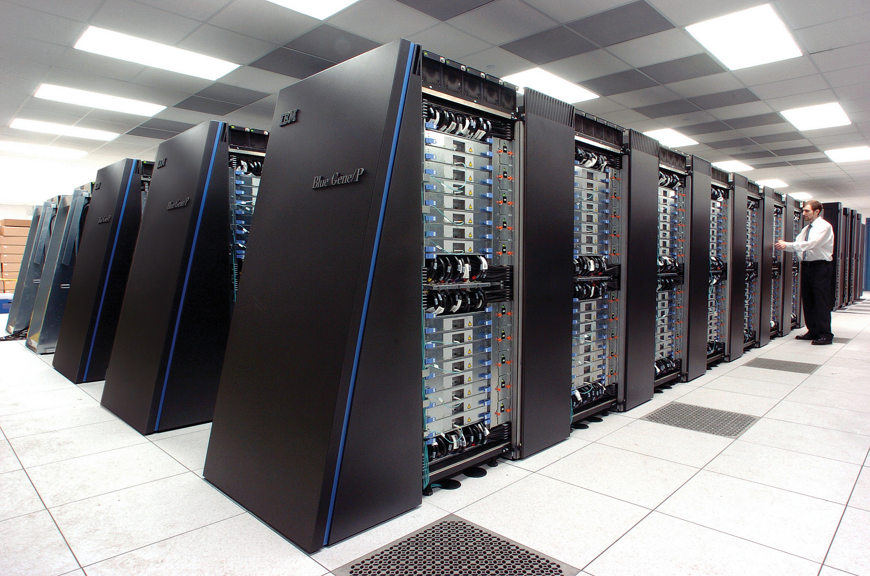
Some modern computers
Desktop computer
Laptop
Supercomputer

Slide 15
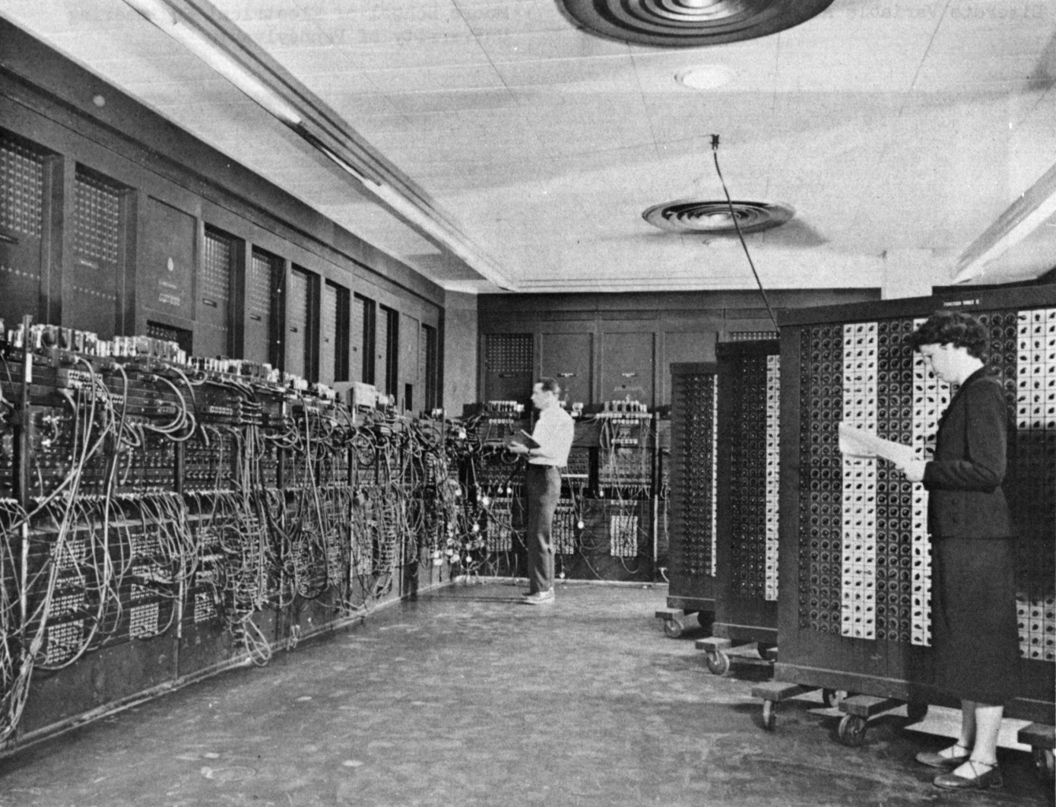
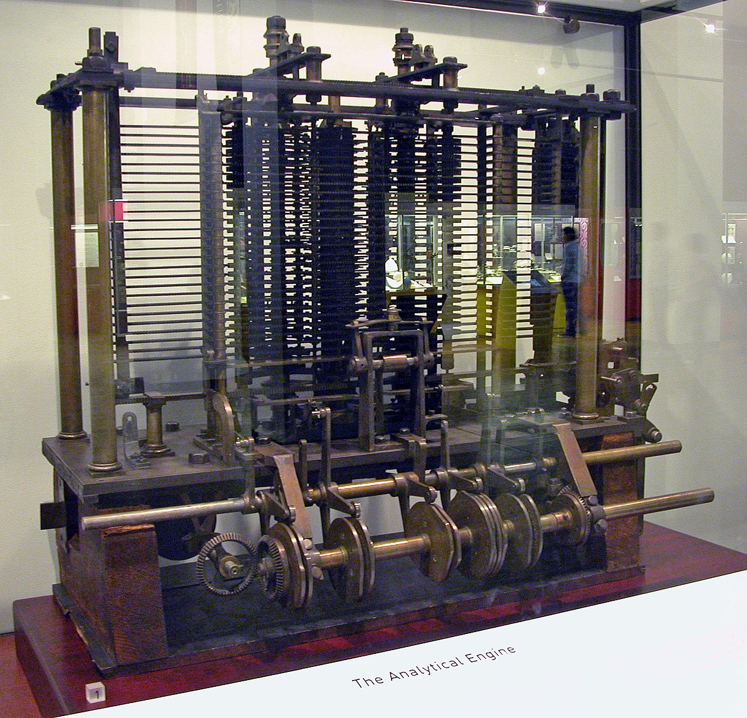
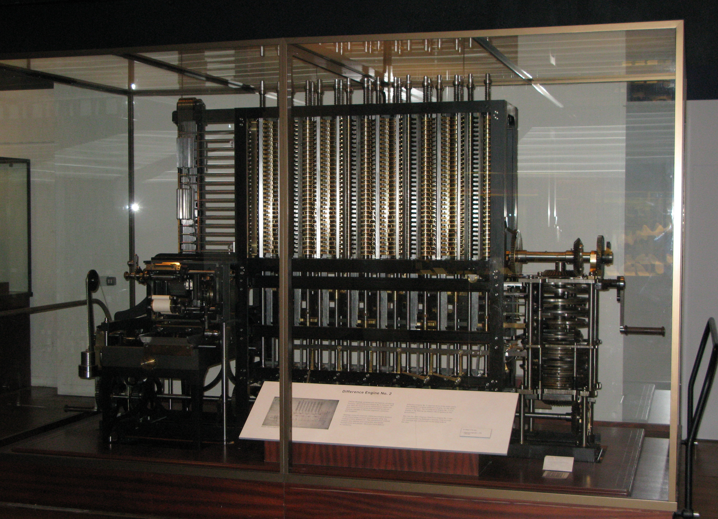
Some old computers
ENIAC (~1940s)
Difference engine (designed in 1820s)
Analytical engine (designed in 1830s)
This Photo by Unknown Author is licensed under CC BY-SA
This Photo by Unknown Author is licensed under CC BY-SA
Notes:
ENIAC: the first programmable general-purpose electronic digital computer
Difference engine: automatic mechanical calculator designed to tabulate polynomial functions
Analytical engine: mechanical general-purpose computer

Slide 16
Charles Babbage
English polymath (1791– 1871)
Designer of difference engine and analytical engine
Considered by some as the father of computers
Difference engine: function interpolation
Analytical engine: a general-purpose computer
This Photo by Unknown Author is licensed under CC BY-SA

Slide 17
Difference engine at work (Credit: Seth Ladd)

Slide 18
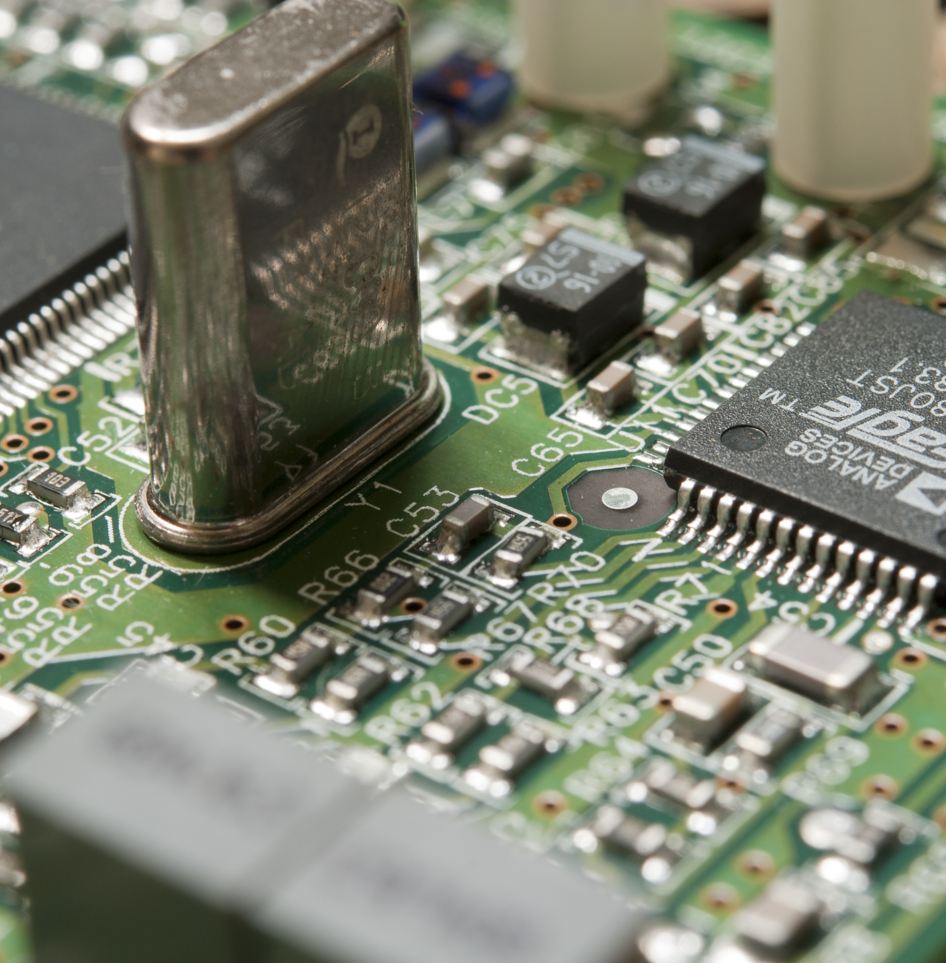
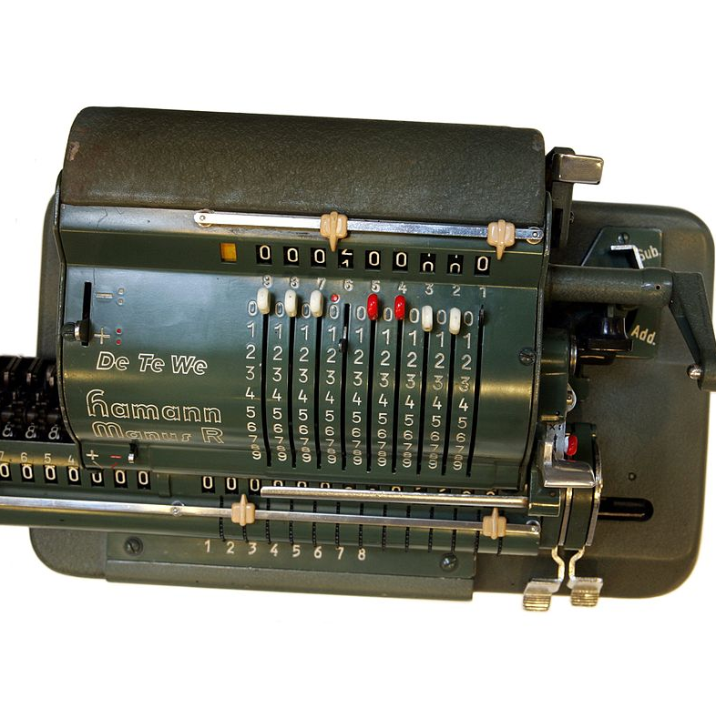
The evolutions of the physics for computers
This Photo by Unknown Author is licensed under CC BY-SA
This Photo by Unknown Author is licensed under CC BY-SA
This Photo by Unknown Author is licensed under CC BY-SA
Modern computers: integrated circuits
ENIAC: vacuum tubes
Difference and analytic engines: gears and levers
Notes:
https://www.tomshardware.com/reviews/upgrade-repair-pc,3000-2.html

Slide 19
Polling: various computing machines
Which one is different from others from the theory viewpoint?
Desktop computers
Laptop
Supercomputers
ENIAC
Difference engines
Analytical engines
Notes:
Add ENIAC, Barbbage’s differential engines, analytic engines

Slide 20
Result of the poll
Which one is different from others from the theory viewpoint?
Desktop computers
Laptop
Supercomputers
ENIAC
Difference engines
Analytical engines
Difference engines can only do specific tasks, namely function interpolation
Analytical engines incorporated logic unit, control flow, and memory. It can be programmed!

Slide 21
What do we learn from these?
Computers can vary in sizes, looks, and underlying physical principles.
The efforts of building general-purpose “computers” dated back to at least the 19th century.
Rather than calculators which perform specific functions.
Analytical engines and supercomputers are both general-purpose computers!
Any task solvable by supercomputers can also be solved by an analytical engine.
Of course, that analytical engine would probably be too enormous to be built…
In computer science jargons, they are called Turing-complete.

Slide 22
The theoretical foundation of computers
In the early 20th century, many models of computation were proposed.
Alan Turing proposed a model which has now become standard…
Turing Machines

Slide 23
Turing machines
Tape: divided into cells, with each cell containing some letter
Read/write head: read and write letters on the cell
Program (or control unit): depending on the letter read and the internal state, a function decides the moves including some of the following:
Rewrite the letter;
Move the head left or right;
Change its internal state;
Terminate the computation.

Slide 24
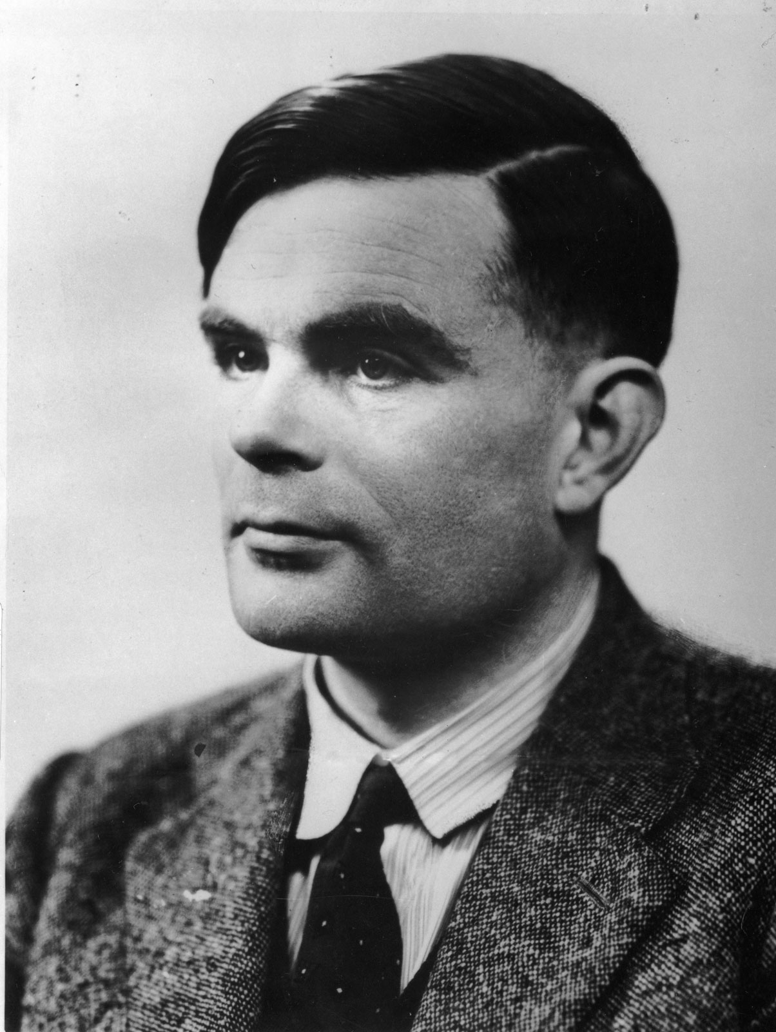
Alan Turing
English mathematician, computer scientist, logician…
Proposed Turing machine in 1936 motivated by Hilbert’s “Decision Problem”
Many significant contributions: Turing’s test (in artificial intelligence), breaking the encryption machine Enigma used by German army…
This Photo by Unknown Author is licensed under CC BY

Slide 25
A criteria: The Church-Turing thesis
Church-Turing Thesis: A function that be computed by an algorithm if and only if it can be computed by a Turing machine.
This is a thesis, or a hypothesis, because it tries to capture an intuitive notion using a formal mathematical model
This establishes Turing machines as the central model in the study of
Computability Theory

Slide 26
Computability
Which problems can be computed?
There exist problems that cannot be computed by algorithms (or Turing machines)!
Problems that are not computable range from mathematical questions, to puzzle-like problems, and to games.
We will examine computability in detail later in this course.

Slide 27
Break time!
Take a rest or a cup of coffee ☺

Slide 28
What problems can be computed efficiently?
Notes:
Start from the basic question of “What is Fast Computation”, to the definition of the complexity class P.
Use integer multiplication, integer factorisation, and travelling salesman as examples.
The question of P vs NP.

Slide 29
From computability to computational complexity
Computability theory is concerned about:
Which problems can be solved by computers?
Now let’s restrict to problems that can be solved by computers.
Integer multiplication: given two integers $a$ and $b$, compute $a×b$.
Integer factorisation: given an integer $c$, compute a non-trivial factorisation of $c=a×b$.
Integer multiplication and integer factorisation can be solved by computers! Why?

Slide 30
Polling: integer multiplications
How many single digit operations (multiplication and addition) do you need to compute $113×127$ (roughly)?
~20
~100
~1000

Slide 31
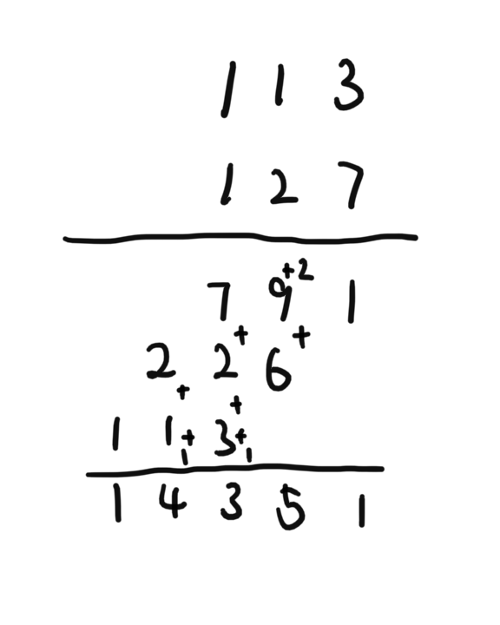
Polling: integer multiplications
How many (roughly) single digit operations do you need to compute $113×127$?
~20
~100
~1000
By the long multiplication method (high school arithmetic), roughly we need
Number of multiplications: 9
Number of additions: ~10
Given two n-digit integers, the long multiplication method gives an algorithm in time $Θ(n2)$.
Notes:
TODO: insert a picture of long multiplication here.

Slide 32
A conceptual message
In algorithm analysis, we measure the running time of the algorithm in terms of the input size n, usually expressed as a function in n.
This is also known as the asymptotic analysis of algorithms.
In practice, sometimes people adopt the more practical viewpoint, namely designing algorithms that work ”reasonably well” for input of sizes that are meaningful in practice.
This practical viewpoint and the asymptotic viewpoint both have values. In theory, we will mostly stick to this asymptotic viewpoint.

Slide 33
How fast can we multiply integers?
Given two n-digit integers, the long multiplication method gives an algorithm in time $Θ(n2)$.
Can this be improved?
This question was asked by Andrei Kolmogorov in 1960 in Moscow
He conjectured that this was impossible.

Slide 34
How fast can we multiply integers?
Given two n-digit integers, the long multiplication method gives an algorithm in time $Θ(n2)$.
Kolmogorov thought that this was best possible.
Anatoly Karatsuba (then 23 years old) then presented an algorithm in time $O\left(n1.58\right).$
Harvey & van der Hoeven (2019) showed an algorithm in time $O(n\log{n})$.
This Photo by Unknown Author is licensed under CC BY-SA

Slide 35
A conceptual message
Algorithms can do surprising things!
Karatsuba’s algorithm is very surprising (how to improve over the long multiplication method)?
There are many algorithms that are surprising: matrix multiplication (from O(n³) to O(n^{2.3})), Fast Fourier Transform, quantum algorithm for integer factorisation…

Slide 36
Polling: integer factorisation
Suppose we want to factor the number 14351. How quickly can you find a proper factor of it?
~20
~100
~1000

Slide 37
Polling: integer factorisation
Suppose we want to factor the number 14351. How quickly can you find a proper factor of it?
~20
~100
~1000
A naïve method: try all integers from 2 to $\sqrt{14351}≈120$, see if one of them divides 14351.
So to factor an n-digit integer, this method takes time (roughly) $exp⁡(\frac{1}{2}n)$.
Can this naïve method be improved?
Yes! The best algorithm at present runs in time (roughly) $exp⁡(\sqrt[3]{n})$.

Slide 38
Uses of the difficulty of integer factorisation
Integer factorisation seems a difficult problem
In 2019, it was estimated that factoring a 240-digit integer requires 900 core-years of computation power [ref]
Why do people care about this problem?
Current Internet protocols such as HTTPS utilises the RSA protocol to ensure security
Solving integer factorisation would break RSA!

Slide 39
Comparing integer multiplication and factorisation
Multiplying two n-digit integers: solvable in time $O(n\log{n})$
Factoring an n-digit integer: solvable in time $exp⁡(\sqrt[3]{n})$
Put simply:
Multiplying two n-digit integers can be done in time polynomial in n
Factoring an n-digit integer, at present, can only be done in time exponential in n
Notes:
To say that the theoretical criteria for fast computation is polynomial-time

Slide 40
A criteria: the Cobham-Edmonds thesis
Cobham-Edmonds thesis: A function that can be efficiently solved by a computer if and only if it admits a polynomial-time algorithm.
Again, it is a thesis (or a hypothesis), and a controversial one (compared to the Church-Turing thesis).
Still, this establishes the complexity class P (problems solvable in polynomial time) as a central object in
Computational Complexity

Slide 41
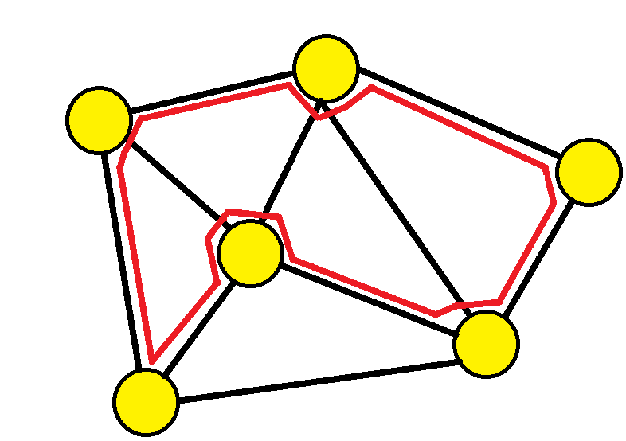
Computational complexity
Which problems can be computed efficiently?
There exist problems that cannot be computed in polynomial time.
However, many problems we wish to solve fast share a common feature: their solutions, if exist, can be verified in polynomial time.
The class of such problems form a complexity class called NP.
Hamiltonian cycle problem:
Given a graph (a set of vertices connected by a set of edges), decide if there exists a path that visits each vertex exactly once.

Slide 42
The P vs NP problem
The P vs NP problem can be formulated as:
Is there a polynomial-time algorithm for the Hamiltonian cycle problem?
One of the seven Millennium Prize Problems.
This formulation is the result of several significant conceptual innovations.
What is NP? Why Hamiltonian cycle problem?
We will examine computational complexity in detail later in this course.

Slide 43
Summary of the lecture
Some basic questions guiding the theory of computing
What problems can be computed?
What problems can be computed fast?
Some efforts to address these questions
Turing machines, Church-Turing thesis…
Polynomial time, Cobham-Edmonds thesis, P vs NP…
Next lecture: a concrete computing model -- deterministic finite automata (DFA)
Languages, DFAs…

Slide 44
Thanks!

