Slide 1
41080 Theory of Computing
Week 11, Spring 2023
Youming Qiao

Slide 2
Note
Assignment 3 from last year is online
Assignment 3 from this year will be online on 3rd Nov (Friday). Due date: 17 November (Friday)

Slide 3
Review of lecture in the last week
Big Oh and algorithm running times
Polynomial-time reductions and NP-complete
SAT and 3SAT are NP-complete

Slide 4
Outline of today’s lecture
Three NP-complete problems
Independent set
Hamiltonian cycles
Subset sum
An overview of the landscape of NP-complete problems

Slide 5
More NP-complete problems

Slide 6
NP-complete problems
There are thousands of NP-complete problems
Your favorite topic certainly has an NP-complete problem somewhere in it
Even the other sciences are not safe: biology, chemistry, physics have NP-complete problems too!
So far we have only two NP-complete problems: SAT and 3SAT
SAT = { F | F is a satisfiable Boolean formula }
3SAT={ F | F is a 3CNF-formula, and F is satisfiable}

Slide 7
How to get more NP-complete problems?
Given a favorite problem Π ∈ NP, how can we prove it is NP-hard?
Generic Recipe:
Take a problem Σ that you know to be NP-hard (3-SAT)
Prove that Σ ≤_{P} Π
Then for all A ∈ NP, A ≤_{P} Σ and Σ ≤_{P} Π
We conclude that A ≤_{P} Π, and Π is NP-hard

Slide 8
Π is NP-Complete
NP
P
Σ
Π

Slide 9
Independent sets

Slide 10
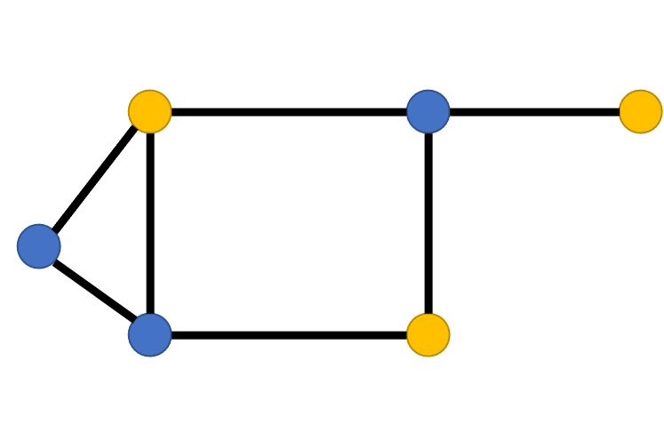
Independent sets on graphs
Let G=(V, E) be a graph
S$⊆$V is an independent set, if no edges in E connect two vertices in S
IND={(G, s) | G has a size-s ind. set}
Theorem. IND is NP-complete.
Proof. 1. IND is in NP (as seen in tutorial class)
2. IND is NP-hard.

Slide 11
IND={(G, s) | G has a size-s ind. set}
IND is NP-hard: devise a polynomial-time reduction from 3SAT to IND
Let F be a 3CNF formula
Construct a graph G_{F} and a number s, such that
F is satisfiable $⇔$ G_{F} has a size-s independent set
How to relate Boolean formulas with graphs?

Slide 12
Interpreting 3SAT
F=$\left(¬x_{1}∨x_{2}∨x_{3}\right)∧\left(x_{1}∨¬x_{2}∨x_{3}\right)∧(¬x_{1}∨x_{2}∨x_{4})$
There are two ways to think about 3SAT
Find a way to assign 0/1 (false/true) to the variables such that the formula evaluates to true, that is each clause evaluates to true.
Pick a literal from each clause and find a truth assignment to make all of them true. You will fail if two of the literals you pick are in conflict, i.e., you pick both x_{i} and $¬$x_{i}
We will take the second view of 3SAT to construct the reduction.

Slide 13
The reduction: step 1
G_{F} will have one vertex for each literal in a clause.
Graph for F=$\left(¬x_{1}∨x_{2}∨x_{3}\right)∧\left(x_{1}∨¬x_{2}∨x_{3}\right)∧(¬x_{1}∨x_{2}∨x_{4})$

Slide 14
The reduction: step 2
G_{F} will have one vertex for each literal in a clause.
Connect the 3 literals in a clause to form a triangle; the independent set will pick at most one vertex from each clause, which will correspond to the literal to be set to true.
Graph for F=$\left(¬x_{1}∨x_{2}∨x_{3}\right)∧\left(x_{1}∨¬x_{2}∨x_{3}\right)∧(¬x_{1}∨x_{2}∨x_{4})$

Slide 15
The reduction: step 3
G_{F} will have one vertex for each literal in a clause.
Connect the 3 literals in a clause to form a triangle; the independent set will pick at most one vertex from each clause, which will correspond to the literal to be set to true.
Connect 2 vertices if they label complementary literals; this ensures that the literals picked do not have a conflict.
Graph for F=$\left(¬x_{1}∨x_{2}∨x_{3}\right)∧\left(x_{1}∨¬x_{2}∨x_{3}\right)∧(¬x_{1}∨x_{2}∨x_{4})$

Slide 16
The reduction: step 4
G_{F} will have one vertex for each literal in a clause.
Connect the 3 literals in a clause to form a triangle; the independent set will pick at most one vertex from each clause, which will correspond to the literal to be set to true.
Connect 2 vertices if they label complementary literals; this ensures that the literals picked do not have a conflict.
Take s to be the number of clauses.
Graph for F=$\left(¬x_{1}∨x_{2}∨x_{3}\right)∧\left(x_{1}∨¬x_{2}∨x_{3}\right)∧(¬x_{1}∨x_{2}∨x_{4})$

Slide 17
Correctness of the reduction
Proposition. F is satisfiable $⇔$ G_{F} has a size-s independent set.
Note. s is the number of clauses.
Proof. $⇒$:
Let b=(b₁, …, b_{n}) be an assignment satisfying F
Each clause contains at least one literal that is true under b
In G_{F}, for each triangle, choose a vertex corresponding to a true literal
These vertices form a size-s independent set

Slide 18
Correctness of the reduction
Proposition. F is satisfiable $⇔$ G_{F} has a size-s independent set.
Note. s is the number of clauses.
Proof. $⇐$:
Let S be a size-s independent set in G_{F}
S must contain exactly one vertex from each clause
S cannot contain vertices labelled by conflicting literals
Thus, it is possible to obtain a truth assignment that makes literals in S true; such an assignment satisfies one literal in every clause

Slide 19
Summary of 3SAT to IND
Running time analysis (s is number of clauses:
For each literal, construct a triangle: $O(s)$-time
For each pair of vertices, check if their labels conflict: $O(s^{2})$-time
The reduction consists of three steps:
Given a 3CNF F, describe the construction of (G_{F}, s)
Proof of correctness: F is satisfiable iff G_{F} has a size-s ind. set
Estimate the running time of the reduction

Slide 20
Exam problem from three years ago
You are a legal aide tasked with evaluating the testimony of a series of n witnesses to a crime. Unfortunately there are a large number of conflicting stories between the witnesses, however you are pretty sure that at most k of the witnesses are lying. Can you find a set of at most k witness whose removal from the evidence leaves the remaining n−k stories consistent?
POLL: what is the corresponding graph-theoretic problem?

Slide 21
Hamiltonian cycles

Slide 22
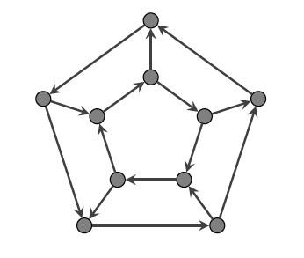
Hamiltonian cycle on graphs
Let G=(V, E) be a directed graph
A Hamiltonian cycle is a cycle that visits each vertex exactly once

Slide 23
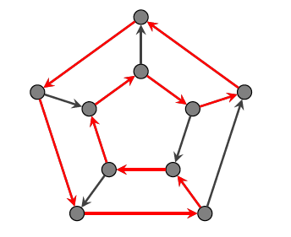
Hamiltonian cycle on graphs
Let G=(V, E) be a directed graph
A Hamiltonian cycle is a cycle that visits each vertex exactly once

Slide 24
Hamiltonian cycle on graphs
Let G=(V, E) be a directed graph
A Hamiltonian cycle is a cycle that visits each vertex exactly once
HAMCYCLE={ G | G is a directed graph with a Hamiltonian cycle}
Theorem. HAMCYCLE is NP-complete.
Proof. 1. HAMCYCLE is in NP (the same as HAMPATH in NP)
2. HAMCYCLE is NP-hard

Slide 25
HAMCYCLE={ G | G is a directed graph with a Hamiltonian cycle}
HAMCYCLE is NP-hard: devise a polynomial-time reduction from 3SAT to HAMCYCLE
Let F be a 3CNF formula with
n variables: x₁, …, x_{n}
m clauses: C₁, …, C_{m}
Construct a directed graph G_{F}, such that
F is satisfiable $⇔$ G_{F} has a Hamiltonian cycle

Slide 26
Reduction: First Ideas
Viewing 3SAT: Assign values to n variables, and each clauses has 3 ways in which it can be satisfied.
Construct graph with 2^{n} Hamiltonian cycles, where each cycle corresponds to some boolean assignment.
Then add more graph structure to encode constraints on assignments imposed by the clauses.

Slide 27
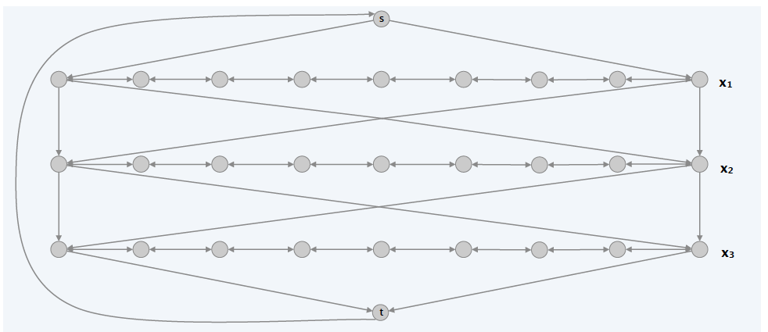
The Reduction: Phase 1
Traverse path i from left to right iff x_{i} is set to true
Each path has 3(m+1) vertices where m is number of clauses;
Vertices numbered from left to right (1 to 3m + 3)
POLL: How many are Hamiltonian cycles in the following graph?

Slide 28
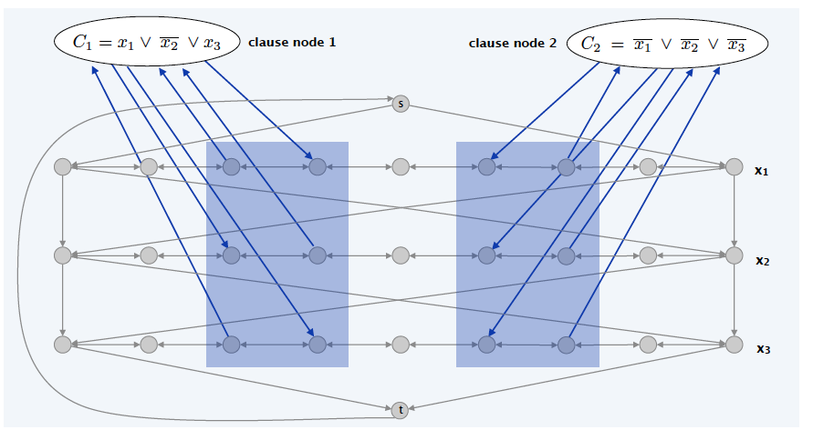
The Reduction: Phase 2
Add vertex c_{j} for clause C_{j}
If x_{i} appears in C_{j}: on path i, vertex 3j $→$ c_{j}, c_{j} $→$ vertex 3j+1
If $¬$x_{i} appears in C_{j} : on path i, vertex 3j+1 $→$ c_{j}, c_{j} $→$ vertex 3j

Slide 29
Correctness of the reduction
Proposition. F is satisfiable $⇔$ G_{F} has a Hamiltonian cycle
Proof. $⇒$: Let b=(b₁, …, b_{n}) be an assignment satisfying F
Construct a Hamiltonian cycle in G_{F} as follows
If b_{i}=1, traverse row i from left to right
If b_{i}=0, traverse row i from right to left
For each clause C_{j}, there will be at least one row i in which we are going in “correct” direction to splice clause vertex C_{j} into cycle (and we splice in C_{j} exactly once)

Slide 30
x₁=1, x₂=0, x₃=0 is a satisfying assignment

Slide 31
x₁=1, x₂=0, x₃=0 is a satisfying assignment

Slide 32
Correctness of the reduction
Proposition. F is satisfiable $⇔$ G_{F} has a Hamiltonian cycle
Proof. $⇐$: Let H be a Hamiltonian cycle of G_{F}
H visits the clause vertex C_{j}, from the ith row
Note: H must jump back to the ith row!

Slide 33
If H jumps back to a different row…

Slide 34
Correctness of the reduction
Proposition. F is satisfiable $⇔$ G_{F} has a Hamiltonian cycle
Proof. $⇐$: Let H be a Hamiltonian cycle of G_{F}
H visits the clause vertex C_{j}, from the ith row
Note: H must jump back to the ith row!
Remove C_{j} from the cycle, add the edge 3j$→$3j+1 (or 3j+1$→$3j)
Do the above for every C_{j} to get a H-cycle D for the “base graph”
Assign x_{i}=1 iff D goes from left to right
As G_{F} visits every C_{j}, at least one of the paths is traversed in the right direction, so each clause is satisfied

Slide 35
Summary of 3SAT to HAMCYCLE
Running time analysis:
The base graph: 2+n(3m+3) vertices, O(nm) edges: O(nm)-time
For each clause, add 6 edges: $O(m)$-time
The reduction consists of three steps:
Given a 3CNF F, describe the construction of G_{F}
Proof of correctness: F is satisfiable iff G_{F} has a Hamiltonian cycle
Estimate the running time of the reduction

Slide 36
Subset sum

Slide 37
Subset sum problem
For n $∈ℕ$, [n]={1, 2, …, n}
SS-SUM={(w₁, …, w_{n}, W) | w_{i}, W$∈ℕ$, $∃S⊆[n]$, $\sum_{i∈S}{w_{i}}=W$}
Example:
Input: (1, 4, 16, 64, 256, 1040, 1041, 1093, 1284, 1344, W= 3754)
Answer: Yes. 1 + 16 + 64 + 256 + 1040 + 1093 + 1284 = 3754
Remark: Polynomial time means poly in the number of digits
That is, polynomial in $O(\sum_{i}{\log{w_{i}}}+\log{W})$

Slide 38
SS-SUM is NP-complete
Theorem. SS-SUM is NP-complete.
Proof. 1. SS-SUM is in NP: guess the set S…
2. SS-SUM is NP-hard: devise a polynomial-time reduction from 3SAT to SS-SUM
Let F be a 3CNF formula with
n variables: x₁, …, x_{n}
m clauses: C₁, …, C_{m}
Construct 2n+2m+1 numbers S_{F}=(w₁, …, w_{2n+2m}, W), such that
F is satisfiable $⇔$ S_{F} is in SS-SUM

Slide 39
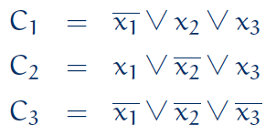
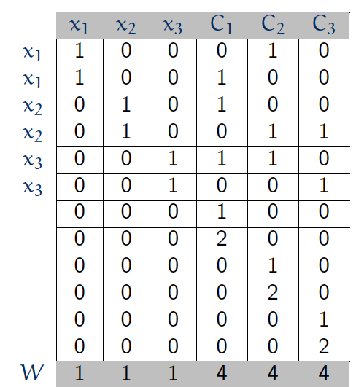
Reducing 3SAT to SS-SUM
F: 3CNF formula w/ n variables & m clauses
Construct 2n+2m+1 numbers in n+m digits
Numbers are indexed by x_{i}, $¬$x_{i}, C_{j,1}, C_{j, 2}
Digits are indexed by x_{i} and C_{j}
(x_{i}, $¬$x_{i})-number:
x_{i}-digit=1, other x_{j}-digit=0
C_{j}-digit=1 iff C_{j} includes x_{i} (resp. $¬$x_{i})
C₁₁
C₁₂
C₂₁
C₂₂
C₃₁
C₃₂

Slide 40
Reducing 3SAT to SS-SUM
F: 3CNF formula w/ n variables & m clauses
Construct 2n+2m+1 numbers in n+m digits
Numbers are indexed by x_{i}, $¬$x_{i}, C_{j,1}, C_{j, 2}
Digits are indexed by x_{i} and C_{j}
C_{j,1}-number: x_{i}-digit=0, C_{j}-digit=1, other C_{k}-digit=0
C_{j,2}-number: x_{i}-digit=0, C_{j}-digit=2, other C_{k}-digit=0
W: x_{i}-digit=1, C_{j}-digit=4
C₁₁
C₁₂
C₂₁
C₂₂
C₃₁
C₃₂

Slide 41
Reducing 3SAT to SS-SUM
Claim. F is satisfiable $⇔$ there exists a subset that sums to W.
Proof. $⇒:$ Suppose F is satisfiable.
Let (b₁, …, b_{n}) be a satisfying assignment
Choose integers corresponding to each true literal.
x_{i}-digits are satisfied
C_{j}-digit sums to at least 1 from x_{i} rows
Use C_{j,1} and C_{j,2} to add to 4

Slide 42
Reducing 3SAT to SS-SUM
Claim. F is satisfiable $⇔$ there exists a subset that sums to W.
Proof. $⇐:$ Suppose there is a subset that sums to W
Digit-x_{i} forces subset to select either row x_{i} or $¬$x_{i} (but not both).
Digit-C_{j} forces subset to select at least one literal in clause.
Assign x_{i} = 1 iff row x_{i} selected.

Slide 43
The landscape of NP-complete problems

Slide 44
More NP-Complete Problems
Basic genres of NP-complete problems and paradigmatic examples
Packing/covering problems: Set Cover, Vertex Cover, Independent Set
Constraint satisfaction problems: SAT, 3SAT
Sequencing problems: Hamiltonian Cycle, Travelling Salesman Problem
Partitioning problems: 3D-Matching, 3-Color
Numerical problems: Subset Sum, Partition
Most NP problems are known to be either in P or NP-complete
Notable exceptions: Factoring, Graph Isomorphism, Nash Equilibrium

Slide 45
Karp’s 21 NP-complete problems

Slide 46
Small difference? Big difference!

Slide 47
Summary
Three NP-complete problems
Independent set
Hamiltonian cycles
Subset sum
An overview of the landscape of NP-complete problems

Slide 48
Thanks!

