Slide 1
41080 Theory of Computing
Week 5, Spring 2023
Youming Qiao

Slide 2
Some common problems for assignment 1
How to get started?
Design the DFA first, and then turn to coding
Ask for tutors for a 1-on-1 session if needed
How to handle “1+”?
Either do a final check after processing the whole string
Or incorporate an “end of string” symbol
How to make sure that I follow the “DFA” rule?
If your program processes the string letter-by-letter, you are ”almost” good
Make sure that your current decision only based on “state” and “current letter”

Slide 3
Submission of assignment 1
Code: on Ed (click mark), and on Canvas (download and zip)
Report: on Canvas (PDF, word…)
Due date: this Friday!

Slide 4
Assignment 2 is alive
Please take a look when you have time
Our next lecture will be directly related to assignment 2
You can start thinking of forming your group!

Slide 5
Summary of the last lecture
Pumping lemma
A useful approach to prove that a language is non-regular
Myhill-Nerode theorem
Equivalence classes on strings
Can be used to prove non-regularity
Pushdown automata
Automata augmented with a stack
Examples

Slide 6
Pushdown automata
Let M be a finite automata, and suppose M has access to a stack
How will the stack help M?
Previously the transition is determined by a state and a letter
Now it has access to the stack
So the top stack symbol can help
Previously the transition goes to a second state
Now it also needs to operate the stack…

Slide 7
Pushdown automata: definitions
Def. A pushdown automaton is $M=(Q,Σ,Γ,δ,q0, F)$:
A set of states Q;
The string alphabet Σ;
The stack alphabet $Γ$;
A transition function $δ:Q×\left(Σ∪\left\{ε\right\}\right)×\left(Γ∪\left\{ε\right\}\right)→𝒫(Q×\left(Γ∪\left\{ε\right\}\right))$.
The start state $q0∈Q$;
A set of accept states $F⊆Q$.
Some remarks:
Let $ be a special stack symbol, denoting the end of the stack
About the transition function
The first $Γ∪\left\{ε\right\}$ denotes that popping a symbol from the stack
The second $Γ∪\left\{ε\right\}$ denotes that pushing a symbol to the stack
$ε$ means possibly popping/pushing nothing
Nondeterminism
$𝒫\left(S\right)$ denotes the power set of S.

Slide 8
Context free grammars

Slide 9
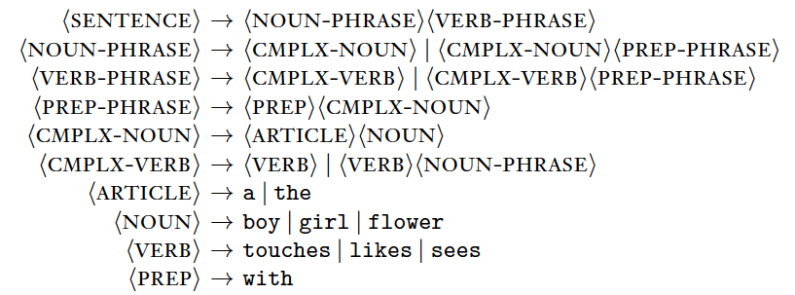
Grammars
In linguistics, people study rules for generating sentences

Slide 10
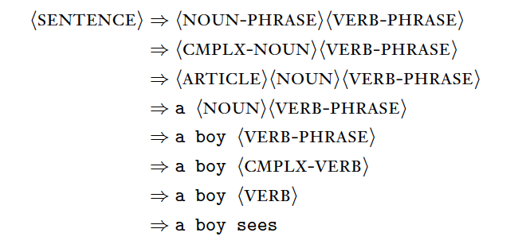
Grammars
These rules generate grammatically correct sentences:

Slide 11
Programming languages
Programming languages also need to specify grammars for correct programs
Fragments of Pascal language specification:
if-statement = `if' Boolean-expression `then' statement [ else-part ] .
Boolean-expression= expression .
expression = simple-expression [ relational-operator simple-expression ] .
simple-expression = [ sign ] term f adding-operator term g .
term = factor f multiplying-operator factor g .
…
digit-sequence = digit { digit }

Slide 12
if-statement
`if’
BoolExp
`then’
statement
expr->term->factor…
digit-sequence
digit
digit
1
0

Slide 13
Context free grammars
Definition. A context free grammar (CFG) is $G=(V, Σ, R, S)$, where
V is the set of variables
$Σ$ is the set of terminals, disjoint from V
R is a set of rules. A rule is of the form
$$A→w$$
where A is a variable, and w is a string of variables and terminals
$S∈V$ is called the start variable
Note: A more general grammar can allow rules of the form $v→w$ where v and w are both in ${\left(V∪Σ\right)}^{∗}$.

Slide 14
CFGs and strings
Let $G=(V, Σ, R, S)$ be a CFG.
Suppose ${u, v∈\left(V∪Σ\right)}^{∗}$, and $A∈V$.
Let $A→w$ be a rule. So ${w∈\left(V∪Σ\right)}^{∗}$.
A string of the form $uAv$ yields $uwv$, written as $uAv⇒uwv$.
Def. Suppose ${s, t∈\left(V∪Σ\right)}^{∗}$. We say s derives t in G, denoted as $s⇒^{∗}t$, if there exist $u_{1},…, u_{n}{∈\left(V∪Σ\right)}^{∗}$, such that
$s⇒u_{1}⇒u_{2}⇒…⇒u_{n}⇒t$.
The language of G is $L\left(G\right)=\{w∈Σ^{∗} :S⇒^{∗}w\}$.

Slide 15
CFGs: examples
How to design a CFG for L={0^{n}1^{n} : n $∈ℕ$}?
Need to design the four components $G=(V, Σ, R, S)$…
V={S}
$Σ=\{0,1\}$
R={$S→0S1, S→ε$}
S=S

Slide 16
CFGs: examples?
V={S}
$Σ=\{a, b\}$
R={$S→aSb, S→SS, S→ε$}
S=S
What language does this CFG generate? Polling time!

Slide 17
Break time ☺
Come back in five minutes

Slide 18
From CFG to PDA

Slide 19
Equivalence between CFGs and PDAs
Pushdown automata: automata with a stack
Context free grammars: variables, terminals, and derivation rules
What is their relation?
Theorem. A language can be generated by a CFG if and only if it is recognised by a PDA.

Slide 20
From CFG to PDA
Theorem. A language can be generated by a CFG if and only if it is recognised by a PDA.
The $⇒$ direction: we construct a PDA from the CFG.
Let $G=(V, Σ, R, S)$ be a CFG.
Naturally, we wish to use the stack to keep track of the rule we apply.
To start with, we can push ”S$” to the stack.
When the stack top is a variable A, apply a rule $A→w$, and push the string w to the stack…
When the stack top is a terminal v, match it with the string...
Accept when meeting $ at the end of the string

Slide 21
From CFG to PDA
Question: how to handle $A→w$?

Slide 22
V={S, T}
$$Σ=\{a, b\}$$
R={$S→aTb, S→b,$
$T→Ta, T→ε$}
S=S

Slide 23
Formal construction of PDA from CFG
From $G=(V, Σ, R, S)$, we construct $M=(Q,Σ,Γ,δ,q0, F)$
$Γ=V∪Σ∪\{\$\}$
$q_{0}=q_{start}$
$F=\{q_{accept}\}$
$δ:Q×\left(Σ∪\left\{ε\right\}\right)×\left(Γ∪\left\{ε\right\}\right)→𝒫(Q×\left(Γ∪\left\{ε\right\}\right))$ is defined as:
$δ\left(q_{start}, ε,ε\right)=\{(q_{loop}, S\$)\}$: the initial preparation
$δ\left(q_{loop}, ε, \$\right)=\{\left(q_{accept},ε\right)\}$: go to accept state
$δ\left(q_{loop},a, a\right)=\{\left(q_{loop},ε\right)\}$: when the top stack symbol is a terminal, match with the string

Slide 24
Formal construction of PDA from CFG
$δ:Q×\left(Σ∪\left\{ε\right\}\right)×\left(Γ∪\left\{ε\right\}\right)→𝒫(Q×\left(Γ∪\left\{ε\right\}\right)$ is defined as:
$δ\left(q_{start}, ε,ε\right)=\{(q_{loop}, S\$)\}$: the initial preparation
$δ\left(q_{loop}, ε, \$\right)=\{\left(q_{accept},ε\right)\}$: go to accept state
$δ\left(q_{loop},a, a\right)=\{\left(q_{loop},ε\right)\}$: when the top stack symbol is a terminal, match with the string
$δ\left(q_{loop},ε, A\right)$? For each rule $A→w$, $w=w_{1}…w_{ℓ}∈{\left(V∪Σ\right)}^{∗}$, we do:
Introduce new states $q_{1},…, q_{ℓ−1}$
Set $\left(q_{1},w_{ℓ}\right)∈δ\left(q_{loop}, ε, A\right)$
$δ\left(q_{1}, ε, ε\right)={(q}_{2}, w_{ℓ−1})$ …
$δ\left(q_{ℓ−1}, ε, ε\right)={(q}_{loop}, w_{1})$

Slide 25
Why does this construction work?
The resulting PDA has a transition for each rule, and each terminal
It simulates the process of applying the rules, with the stack as a piece of paper
It can only clear the stack by getting rid of all the variables, and matching off terminal symbols from the input
So it can only accept if you can get from S to the input string using the rules of the grammar

Slide 26
From PDA to CFG

Slide 27
From PDA to CFG
Theorem. A language can be generated by a CFG if and only if it is recognised by a PDA.
The $⇐$ direction: we construct a CFG from the PDA.
Let $M=(Q,Σ,Γ,δ,q0, F)$ be a PDA.
We need to devise a CFG, $G=(V, Σ, R, S)$.
The key: study how the stack changes between two states…

Slide 28
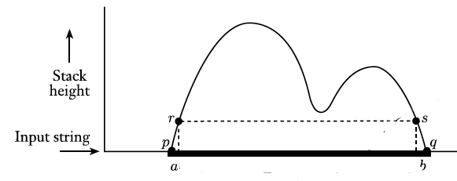
How the stack changes
1. At some intermediate point, the stack becomes empty.
$M=(Q,Σ,Γ,δ,q0, F)$ is a PDA
$p, q∈Q$ are two states
What the stack looks like, during the process of:
starting with p with the empty stack
ending at q with the empty stack
Two possibilities:
2. If not, read a & move to r from p, and read b & move from s to q

Slide 29
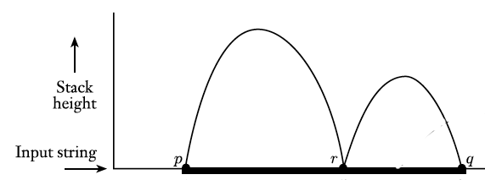
Set A_{pq} to be the variable, representing the set of strings that can be generated in M from p with empty stack, and from q with empty stack
1. At some intermediate point, the stack becomes empty.
What rule do we deduce for case 1? Polling time!
A_{pq}=A_{pr}A_{rq}

Slide 30
Set A_{pq} to be the variable, representing the set of strings that can be generated in M from p with empty stack, and from q with empty stack
2. If not, read a & move to r from p, and read b & move from s to q
What rule do we deduce for case 2? Polling time!
A_{pq}=aA_{rs}b
Wait… At state r there is something on the stack!
If x is pushed at state p, we may want to think of x is the new stack bottom symbol
So x should only be popped from s to q

Slide 31
2. If not, read a & move to r from p, and read b & move from s to q
2. A_{pq}=aA_{rs}b
If x is pushed at state p, we may want to think of x is the new stack bottom symbol
So x should only be popped from s to q
If this can be done, then the above equation makes sense
How to ensure that?
Bad case: at state r, pop x and push y
To avoid bad case: each transition only does push or pop
Set A_{pq} to be the variable, representing the set of strings that can be generated in M from p with empty stack, and from q with empty stack

Slide 32
Pre-process the PDA
We wish to put the PDA M in the following format:
It has a single accept state
Add a new accept state, use $ε$-transitions to transit from old accept states to it
2. It accepts with empty stack
In the unique accept state, add self-loops that pop stack symbols
3. Every transition either pops a symbol, or pushes a symbol…

Slide 33
Pre-process the PDA
3. Every transition either pops a symbol, or pushes a symbol…
$$a, x→y$$
$$a, ε→ε$$
$$a, x→ε$$
$$ε, ε→y$$
$$a, ε→x$$
$$ε, x→ε$$

Slide 34
From PDA to CFG
PDA: $M=(Q, Σ, Γ,δ, q_{0}, \left\{q_{f}\right\}=F)$
Construct CFG $G=(V, Σ, R, S)$
$V=\{A_{p, q}\}$, for $p, q∈Q$
$S=A_{q_{0}, q_{f}}$
For any $q∈Q$, add the rule $A_{q, q}→ε$
For $p, q, r∈Q$, add the rule $A_{p, q}→A_{p, r}A_{r, q}$
For $p, q, r, s∈Q$, $t∈Σ$, $a, b∈Σ∪\{ε\}$, such that $δ\left(p, a, ε\right)∋(r, t)$, and $δ\left(s, b, t\right)∋(q, ε)$, add the rule $A_{p, q}→aA_{r, s}b$

Slide 35
An example
Notes:
Note: A_alpha, beta -> 0A_alpha, beta: because p=alpha, q=beta, r=alpha, s=beta

Slide 36
Why this construction works?
Anything the PDA puts on the stack will be removed if it accepts (rules generated in step 5)
If you from state p to state q ending with an empty stack at q, it might go from state p to r emptying the stack, then r to q filling it up and emptying it again (rules generated in step 4).
So it’s really creating a grammar that tracks how the stack is manipulated.

Slide 37
Summary
Context free grammar
Grammar: another way to generate languages
Context free: left-hand side of the rule is a single variable
CFG and PDA
Equivalence in power
From CFG to PDA: use stacks to track the rules applied
From PDA to CFG: use rules to track the stack changes

Slide 38
Thanks!

