Slide 1
41080 Theory of Computing
Week 7, Spring 2023
Youming Qiao

Slide 2
Assignment 2: overview
To realise a syntactic analyser for a simple Java grammar
What your program is intended to do:
Take a string as input, which is supposed to be a Java program
First step: use lexical analyser to turn the input string to a sequence of tokens
Second step: use syntactic analyser to build a parse tree out of the tokens
More liberal in terms of how you do it, but – NO third party tools!
How to do the syntactic analysis?
Parsing table from the last lecture!
No left recursion; no need to do left factoring…
Or any other approach you come up with/learn of

Slide 3
Example
Input string: public class Test { public static void main(String[] args){ }}
Tokens: [[PUBLIC], [CLASS], [ID: Optional[Test]], [LBRACE], [PUBLIC], [STATIC], [VOID], [MAIN], [LPAREN], [STRINGARR], [ARGS], [RPAREN], [LBRACE], [RBRACE], [RBRACE]]
Syntactic analyser:

Slide 4
Summary of last lecture
Deterministic PDAs
Useful in practice
Not as powerful as general PDAs
LL(1) parser
Left recursion removal / left factoring
FIRST sets
FOLLOW sets
Parsing table
Parsing a concrete string

Slide 5
Non context-free languages

Slide 6
Beyond context-free languages
Pushdown automata are more powerful than finite automata
Or in other words, context-free languages strictly contain regular languages
Example: L={0^{n}1^{n} : n in N}
Are there languages that are not context-free?
Or in other words, is there a pushdown automaton for every language?
How about L={ww : w in {0, 1}^{n}}?
How to prove that it is not context free?

Slide 7
Recall: Pumping lemma for regular languages
Pumping lemma. Let L be a regular language. There exists an integer P, such for any string w of length $≥P$, we can write w=xyz, such that
|y|>0;
|xy|<P;
For any i$≥0$, xy^{i}z$∈L$.
Why “pumping”? w is getting pumped into longer and longer strings…
x
yyy…
z

Slide 8
Intuition of pumping lemma
Let M be a DFA recognising L
Suppose M has P states
Let w be a string of length > P that is accepted by M
When processing w, there must be a state q that gets visited twice…
This means that there is a cycle – it can be used again…

Slide 9
Pumping lemma for context-free languages?
“Weakness” of finite automata: the number of states is finite. So a long enough string needs to visit some state twice
How about weakness of pushdown automata? Or context free grammars?
The number of variables is finite!
So in the process of deriving a long enough string, some variable needs to be used twice…

Slide 10
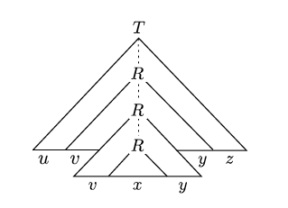
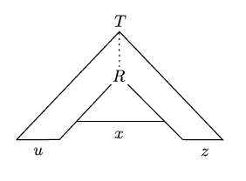
A CFG generating a long string
Let G be a CFG with start variable T
Suppose it generates a long string w
During the process, it uses a variable R twice
Then we can divide w into uvxyz
Now this implies that we can ”pump” the v and y segments…

Slide 11
Pumping lemma for CFLs
Pumping lemma for CFLs. Let L be a context free language. There exists an integer P, such for any string w of length $≥P$, we can write w=uvxyz, such that
|vy|>0;
|vxy|<P;
For any i$≥0$, uv^{i}xy^{i}z$∈L$.
Proof idea. Already in the last slide! How “long” does w need to be? Suppose b is the max length of strings on the RHS of the rules. Suppose we have v variables… Polling time!

Slide 12
An example of using pumping lemma
Proposition. L={ww : w in {0, 1}*} is not context free.
Proof. Suppose it is. Then there exists P, s.t. pumping lemma applies.
Consider w=0^{P}1^{P}. So s=ww= 0^{P}1^{P}0^{P}1^{P}.
Pumping lemma gives that s=uvxyz, where |vxy|< P, |vy|>0.
Suppose vxy appears in the first half of s. Consider t=uv²xy²z. Then 1 goes past the mid point, which means that t cannot be of the form w’w’ for some w’.

Slide 13
An example of using pumping lemma
Proposition. L={ww : w in {0, 1}*} is not context free.
Proof. Suppose it is. Then there exists P, s.t. pumping lemma applies.
Consider w=0^{P}1^{P}. So s=ww=0^{P}1^{P}0^{P}1^{P}.
Pumping lemma gives that s=uvxyz, where |vxy|< P, |vy|>0.
So vxy must straddle the mid point of s. Then consider s’=uxz. (This is called pump down.) s’ is of the form 0^{P}1^{i}0^{j}1^{P}. Either j<P or i<P, so s’ is not of the form w’w’.

Slide 14
Another example of using pumping lemma
Proposition. L={a^{n}b^{n}c^{n}} is not context free.
Proof. Suppose it is. Then there exists P, s.t. pumping lemma applies.
Consider w=a^{P}b^{P}c^{P}.
Pumping lemma gives that w=uvxyz, where |vxy|< P, |vy|>0.
This means that vxy cannot contain all of a, b, or c.
For example, suppose vxy =a^{s}b^{t}.
Then v^{i}xy^{i} increases the lengths of a or b, but not c.
It follows that uv^{i}xy^{i}z is not in L anymore, a contradiction.

Slide 15
Another example of using pumping lemma
Proposition. L={0^{n}#0^{2n}#0^{3n} : n in N} is not context free.
Proof. Suppose it is. Then there exists P, s.t. pumping lemma applies.
Consider w=0^{P}#0^{2P}#0^{3P}.
Pumping lemma gives that w=uvxyz, where |vxy|< P, |vy|>0.
If vxy doesn’t contain #, then vxy is in one of 0^{P} or 0^{2P} or 0^{3P} so…
If vxy contains #, then # must be in x, as otherwise…
If # is the first, then pumping doesn’t affect 0^{3P}
If # is the second, then pumping doesn’t affect 0^{P}

Slide 16
Break time
Take a rest, ask questions, or grab a coffee ☺

Slide 17
Turing machines

Slide 18
The theoretical foundation of computers
In the early 20th century, many models of computation were proposed.
Alan Turing proposed a model which has now become standard…
Turing Machines

Slide 19
Turing machines
Tape: divided into cells, with each cell containing some letter
Read/write head: read and write letters on the cell
Program (or control unit): depending on the letter read and the internal state, a function decides the moves including some of the following:
Rewrite the letter;
Move the head left or right;
Change its internal state;
Terminate the computation.

Slide 20
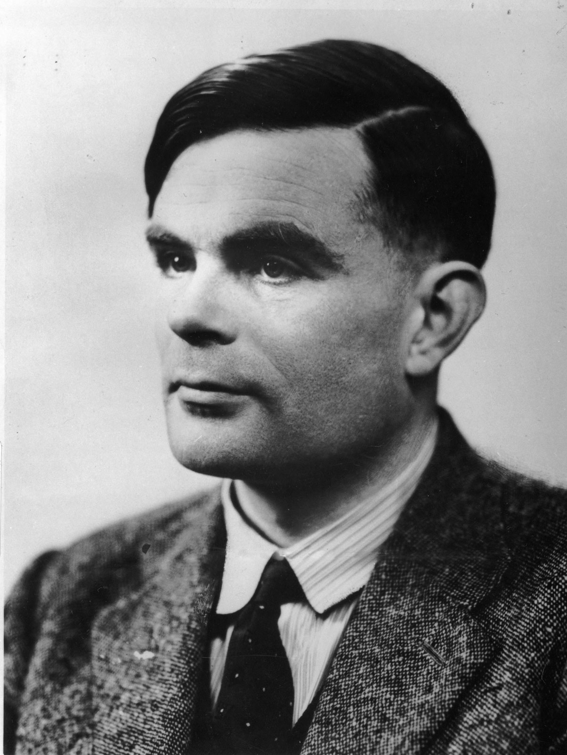
Alan Turing
English mathematician, computer scientist, logician…
Proposed Turing machine in 1936 motivated by Hilbert’s “Decision Problem”
Many significant contributions: Turing’s test (in artificial intelligence), breaking the encryption machine Enigma used by German army…
This Photo by Unknown Author is licensed under CC BY

Slide 21
A criteria: The Church-Turing thesis
Church-Turing Thesis: A function that be computed by an algorithm if and only if it can be computed by a Turing machine.
This is a thesis, or a hypothesis, because it tries to capture an intuitive notion using a formal mathematical model
This establishes Turing machines as the central model in the study of
Computability Theory

Slide 22
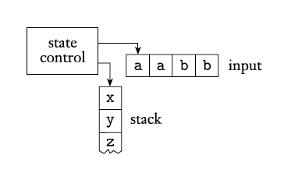
How Turing machines compare to DFA and PDA?

Slide 23
Turing Machines versus DFAs
TM can both write to and read from the tape
The head can move left and right
The input doesn’t have to be read entirely,
and the computation can continue further (even, forever) after all input has been read
Accept and Reject take immediate effect

Slide 24
Turing machines and PDAs
A Turing machine’s memory is the tape
The memory of PDAs is the stack
Turing machines can access the memory in an arbitrary order
PDAs access stack in a first-in-last-out fashion

Slide 25
Formal definition of Turing machines
Definition. A Turing machine is a 7-tuple $\left(Q, Σ, Γ, δ, q_{0}, q_{accept}, q_{reject}\right)$:
Q is the state set;
$Σ$ is the input alphabet, not containing the blank symbol ⊔;
$Γ$ is the tape alphabet, where ⊔$∈Γ$ and $Σ⊆Γ$;
$δ:Q×Γ→Q×Γ×\{L, R\}$ is the transition function;
q₀ is the start state;
$q_{accept}$ is the accept state;
$q_{reject}$ is the reject state.

Slide 26
Turing machines in action
At the beginning, the tape is of the form [input] ⊔ ⊔… ⊔
The tape is infinitely long to the right hand side
During the computation, the read/write head may make use of those additional spaces marked by ⊔
What may happen during an execution of a Turing machine? POLLING TIME!
If ending at $q_{accept}$,or $q_{reject}$, the computation stops
It is possible that the computation ”runs forever”

Slide 27
Graph representation of Turing machines
A Turing machine can also be represented as a labelled directed graph G=(Q, E).
Vertex set of G: Q
Accept state: labelled as q_{accept}
Reject state: labelled as q_{reject}
Initial state: pointed by an arrow
Edge set of G: (q, q’) such that
$∃x∈Γ, δ\left(q, x\right)=(q^{′},y, D)$ where D=L or R.
Edge labels: for (q, q’) in E, label it with $x→y, D$ such that
$δ\left(q, x\right)={(q}^{′}, y, D)$.

Slide 28
read
write
move
Σ = {0}
0 → 0, R
◻ → ◻, R
q_{accept}
0 → 0, R
◻ → ◻, R
q_{reject}
This Turing machine decides the language {0}

Slide 29
read
write
move
Σ = {0}
0 → 0, R
◻ → ◻, R
q_{accept}
0 → 0, R
◻ → ◻, R
0 → 0, R
◻ → ◻, L
This Turing machine recognizes the language {0}

Slide 30
Describing a Turing machine
As DFAs or PDAs, we can describe a Turing machine by either listing the transition function or drawing the graph.
However, low-level programming of Turing machines can be too detailed.
For our purpose, it is usually enough to describe a Turing machine in a pseudo-code style.
This is like pseudo-codes for programming, but tailored for the Turing machines.

Slide 31
An example of describing Turing machines
Task. Describe a Turing machine for recognising L={w#w : w in {0, 1}^{n}}.
If there’s no # on the tape (or more than one #), reject.
While there is a bit to the left of #, Replace the first bit with X, and check if the first bit b to the right of the # is identical. (If not, reject.) Replace that bit b with an X too.
If there’s a bit to the right of #, then reject else accept

Slide 32
Turing machines and languages

Slide 33
Turing machines and strings
Given a string w and a TM T, the execution of T on w may lead to:
Accept state (and stop);
Reject state (and stop);
Some other state and stop;
No stopping!

Slide 34
A TM M recognizes a language L if M accepts exactly those strings in L
A language L is recognizable (a.k.a. recursively enumerable)
if some TM recognizes L
A TM M decides a language L if M accepts all strings in L and rejects all strings not in L
A language L is decidable (a.k.a. recursive) if some TM decides L

Slide 35
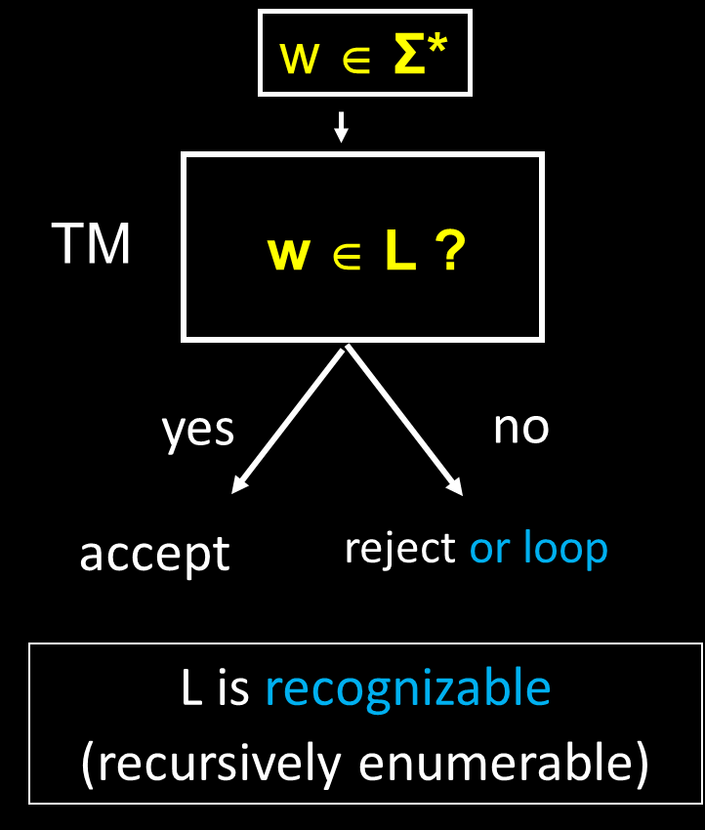

Slide 36
Summary
Non-context-free languages
Pumping lemma
Turing machines
Comparisons with DFAs and PDAs
Definitions
Examples
Decidable and recognisable

Slide 37
Thanks!

