Slide 1
41080 Theory of Computing
Week 4, Spring 2023
Youming Qiao

Slide 2
Some thoughts for your study of this course
Plan your study schedule
In general, study the lecture material and then come to tutorials
Don’t be afraid if things are unfamiliar at first sight
Try to use mathematical notations and reasonings
Basic set theory, mathematical definitions, inductions, and so on
Important for your future development
Timely communications through appropriate channels
“Technical questions” go on EdStem
“Personal questions” please contact me or the tutors

Slide 3
Summary of the last lecture
NFA to DFA: the powerset construction
Concluding the closure properties of regular languages
Regular expressions
A compact way to represent regular languages
Equivalence with regular languages

Slide 4
Outline of today’s lecture
Beyond regular languages: languages that are not regular
Pumping lemma
Myhill-Nerode theorem
Pushdown automata: automata augmented with stacks
Examples and definitions

Slide 5
Motivating question: the language {0^{n}1^{n}}
Suppose a DFA M wants to recognise L={0^{n}1^{n} : n $∈ℕ$}
Suppose M has k states
Before seeing 1, M needs to record the number of 0s
As long as n is larger than k, it is impossible for M to keep track of this number!
“DFAs cannot count.”

Slide 6
Languages that are not regular
From computing model perspective, finite automata have constant memory
It is not surprising that there exist languages that are not regular
To formally prove that a language is regular, we have the following two methods
Pumping lemma: a property of regular languages
Myhill-Nerode theorem: a characterisation of regular languages

Slide 7
Pumping lemma for regular languages

Slide 8
The structure of regular languages
Pumping lemma. Let L be a regular language. There exists an integer P, such for any string w of length $≥P$, we can write w=xyz, such that
|y|>0;
|xy|<P;
For any i$≥0$, xy^{i}z$∈L$.
Why “pumping”? w is getting pumped into longer and longer strings…
x
yyy…
z

Slide 9
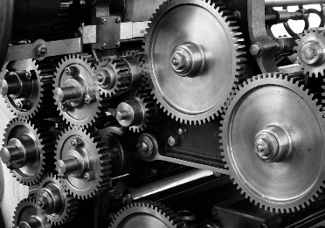
Applying the Pumping Lemma
Let’s prove that L={0^{n}1^{n} : n $∈ℕ$} is not regular.
By contradiction. Assume L is regular.
Let P be as in pumping lemma. Let w = 0^{P}1^{P}$∈$ L.
⇒ Can write w = xyz, with |y| > 0, |xy| ≤ P, such that for all i ≥ 0, xy^{i}z is also in L
Claim: The string y must be all zeroes.
Why? Because |xy| ≤ P and w = xyz = 0^{P}1^{P}
But then xyyz has more 0s than 1s
Contradiction!

Slide 10
Intuition of pumping lemma
Let M be a DFA recognising L
Suppose M has P states
Let w be a string of length > P that is accepted by M
When processing w, there must be a state q that gets visited twice…
This means that there is a cycle – it can be used again…

Slide 11
Proof: Let M be a DFA that recognizes L
Let P be the number of states in M
Let w be a string where w ∈ L and |w| ≥ P
We show: w = xyz
|y| > 0
|xy| ≤ P
xy^{i}z ∈ L for all i ≥ 0
y
x
w
z
…
q₀
q_{j}
q_{k}
q_{|w|}
Claim: There must exist j and k such that 0 ≤ j < k ≤ P, and q_{j} = q_{k}

Slide 12
Applying the Pumping Lemma
Prove: SQ = {0^{n2} | n ≥ 0} is not regular
Assume SQ is regular. Let w = 0^{P2}
⇒ Can write w = xyz, with |y| > 0, |xy| ≤ P, such that for all i ≥ 0, xy^{i}z is also in SQ
So xyyz ∊ SQ. Note that xyyz = 0^{P2+|y|}
Note that 0 < |y| ≤ P
So |xyyz| = P² + |y| ≤ P² + P < P² + 2P + 1 = (P+1)²
and P² < |xyyz| < (P+1)²
Therefore |xyyz| is not a perfect square!
Hence 0^{P2+|y|} = xyyz ∉ SQ, so our assumption must be false.
⇒ SQ is not regular!

Slide 13
The Myhill-Nerode Theorem

Slide 14
Review: equivalence relations
Let X be a set.
We say that $R⊆X×X$ is an equivalence relation, if it satisfies
(Reflexive) $∀x∈X, \left(x, x\right)∈R$
(Symmetry) $∀x, y∈X,\left(x, y\right)∈X⇔\left(y, x\right)∈X$
(Transitivity) $∀x, y, z∈X, \left(x, y\right)∈X, \left(y, z\right)∈X⇒\left(x, z\right)∈X$
An equivalence relation R partitions X into equivalence classes
Example: $X=ℕ$, $\left(r, s\right)∈R$ if and only if $r≡s mod 10$
A non-example: POLLING time

Slide 15
z distinguishes x and y w.r.t. L
Def. Let L be a language in $Σ^{∗}$. Let x and y be two strings. A string z distinguishes x and y relative to L, if one of the following holds:
$xz∈L$ and $yz∉L$, or
$xz∉L$ and $yz∈L$.
Example. L={0^{n}1^{n} : n $∈ℕ$}. x=000, y=0000. POLLING time.
z=111 distinguishes x and y relative to L. Why?
xz=000111 is in L. yz=0000111 is not in L.

Slide 16
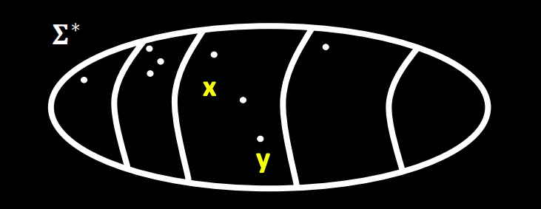
An equivalence relation on strings
Def. x and y are indistinguishable relative to L, written as $x≡_{L}y$, if no string distinguishes x and y relative to L.
That is, for any string z, $xz∈L⇔yz∈L$.
Claim. $≡_{L}$ is an equivalence relation.
This allows us to partition $Σ^{∗}$ into equivalence classes according to $≡_{L}$

Slide 17
The Myhill-Nerode Theorem
For two strings x and y, $x≡_{L}y$if for any string z, $xz∈L⇔yz∈L$.
Myhill-Nerode Theorem. A language L is regular if and only if the number of equivalence classes under $≡_{L}$ is finite.
That is, if the number of equivalence classes under $≡_{L}$ is finite, one can construct a DFA for L.
If the number of equivalence classes under $≡_{L}$ is infinite, no DFAs can recognise L.
Interested in the proof? Read the note on Canvas (credit: Paul Beame)

Slide 18
Non-regular languages?
Let L be a language. If the number of equivalence classes under $≡_{L}$ is infinite, no DFAs can recognise L – so L is not regular!
How to use this to show that L is not regular?
We need to exhibit infinitely many strings $s_{i}, i=1, 2, …$, such that any two s_{i} and s_{j} are distinguishable by some string z
That is, exactly one of s_{i}z and s_{j}z is in L

Slide 19
Use Myhill-Nerode for non-regularity
Theorem. L={0^{n}1^{n} : n $∈ℕ$} is not regular.
Proof.
Let S={0^{k} : k $∈ℕ$}.
Take 0^{i}, 0^{j}, $i<j$.
Note that 0^{i}1^{i} $∈L$, 0^{j}1^{i}$∉L$.
So all pairs of strings in S are distinguishable.
By Myhill-Nerode, L is not regular.

Slide 20
Reflections on regular languages
Why DFAs cannot count?
There is only a constant memory!
Caveat: sometimes counting may not be needed…
To go beyond DFA, we need to augment it with some form of memory
This leads us to the next model…
D = { w | w has equal number of occurrences of 01 and 10 }
Polling time!

Slide 21
Break time
Take a rest, ask questions, or grab a coffee ☺

Slide 22
Pushdown automata

Slide 23
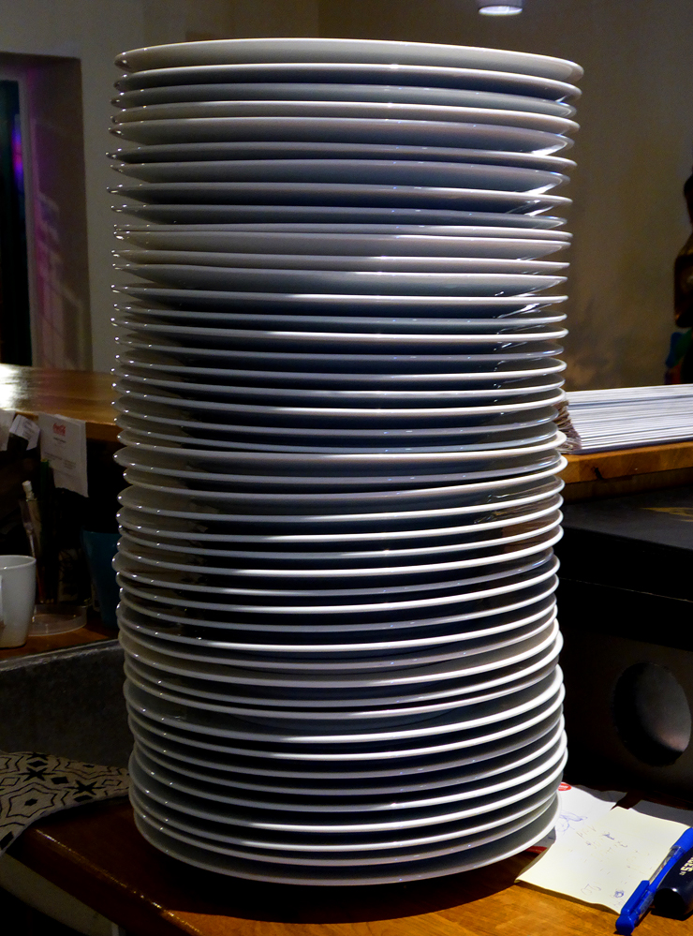
Stacks as a data structure
A stack is a data structure which follows the principle of Last-in-First-out.
It can be thought of as a memory with limited operations
Pushing
Popping
We will augment finite automata with a stack

Slide 24
Pushdown automata
Let M be a finite automata, and suppose M has access to a stack
How will the stack help M?
Previously the transition is determined by a state and a letter
Now it has access to the stack
So the top stack symbol can help
Previously the transition goes to a second state
Now it also needs to operate the stack…

Slide 25
Recognising L={0^{n}1^{n}}
How will a stack help us to recognise L={0^{n}1^{n} : n $∈ℕ$}?
Intuitively, when 0 is read, push 0 to the stack
After 1 is read, pop 0 out of the stack
When all 1s are read, if there are still 0s left, reject
When $ is read but there are still 1s to read, reject
Only accept when the string is all read, and the stack is empty

Slide 26
Actions of the Example PDA
0 0 0 1 1 1
q₁
$

Slide 27
Actions of the Example PDA
0 0 1 1 1
q₂
0
$

Slide 28
Actions of the Example PDA
0 1 1 1
q₂
0
0
$

Slide 29
Actions of the Example PDA
1 1 1
q₂
0
0
0
$

Slide 30
Actions of the Example PDA
1 1
q₃
0
0
$

Slide 31
Actions of the Example PDA
1
q₃
0
$

Slide 32
Actions of the Example PDA
q₃
$

Slide 33
Actions of the Example PDA
q₄

Slide 34
Pushdown automata: definitions
Def. A pushdown automaton is $M=(Q,Σ,Γ,δ,q0, F)$:
A set of states Q;
The string alphabet Σ;
The stack alphabet $Γ$;
A transition function $δ:Q×\left(Σ∪\left\{ε\right\}\right)×\left(Γ∪\left\{ε\right\}\right)→𝒫(Q×\left(Γ∪\left\{ε\right\}\right))$.
The start state $q0∈Q$;
A set of accept states $F⊆Q$.
$𝒫\left(S\right)$ denotes the power set of S.

Slide 35
Some remarks
Let $ be a special stack symbol, denoting the end of the stack
About the transition function $δ:Q×\left(Σ∪\left\{ε\right\}\right)×\left(Γ∪\left\{ε\right\}\right)→𝒫(Q×\left(Γ∪\left\{ε\right\}\right))$
The first $Γ∪\left\{ε\right\}$ denotes that popping a symbol from the stack
The second $Γ∪\left\{ε\right\}$ denotes that pushing a symbol to the stack
$ε$ means popping/pushing nothing
Nondeterminism is incorporated already

Slide 36
Graph representation of pushdown automata
A Pushdown automata can also be represented as a labelled directed graph G=(Q, E).
Vertex set of G: Q
Accept states: double circled
Initial state: pointed by an arrow
Edge set of G: (q, q’) such that
$∃a∈Σ∪\left\{ε\right\}, x, y∈Γ∪\{ε\}, δ\left(q, a,x\right)={(q}^{′}, y)$.
Edge labels: for (q, q’) in E, label it with $a, x→y$ such that
$δ\left(q, a,x\right)={(q}^{′}, y)$.

Slide 37
Recognising L={0^{n}1^{n}}

Slide 38
Pushdown automata and strings
Intuitively, a pushdown automata accepts a string if there is a sequence of valid transitions which lead to an accept state.
Def. Given a pushdown automata $M=(Q, Σ, Γ, q0, F, δ)$ and a string $w=w_{1}…w_{n}∈Σ^{n}$, M accepts w if there exists a sequence of states $\left(r_{0}, …, r_{n}\right), r_{i}∈Q$, and a sequence of strings $(s0, …, sn)$, $si∈Γ^{∗}$, s.t.
$r_{0}=q_{0}$ (begin with the start state);
$δ\left(r_{i}, w_{i+1},a\right)={(r}_{i+1}, b)$ and $s_{i}=at, s_{i+1}=bt$ (read a letter and a stack symbol, change its state and write a stack symbol);
$rn∈F$ (end with an accept state).
M rejects w if it does not accept w.

Slide 39
Well-matched parentheses
Let $Σ=\left\{\left(, \right)\right\}$. Let L={ a sequence of well-matched parentheses }
Let s be a sequence of parentheses of length k.
s=( () ( () ) )
Let s_{i} be the substring of s consisting of the first i letters
s₄=( () (
s is well-matched, if
there are equal number of “(” and “)”
for any s_{i}, the number of “(” is no less than the number of “)”
s is well-matched, because…

Slide 40
Recognising well-matched parentheses
Let $Σ=\left\{\left(, \right)\right\}$. Let L={ a sequence of well-matched parentheses }
How to design a PDA that recognises L?
Intuitively, pushing some symbol, say ★, to the stack when seeing (
Then popping out ★ when seeing )
Reject when (1) seeing $ and ) or (2) seeing ★ after the whole string is processed…

Slide 41
Recognising well-matched parentheses
”), $” is not defined, so more “)” than “(” is not allowed
No outgoing arcs at the accept state: the only way to accept is to see $ at the end of the string
In particular, seeing ★ after the whole string is processed is not possible

Slide 42
PDAs and languages
Def. Given a PDA M, the language recognised by M is
L(M)={all strings accepted by M}
Def. A language is context free if there exists a PDA that recognises it.
Is every regular language context free? Polling time!
Why the name context free? This has to do with linguistics…
There is yet another way to define languages called “grammars”

Slide 43
Context free grammars

Slide 44
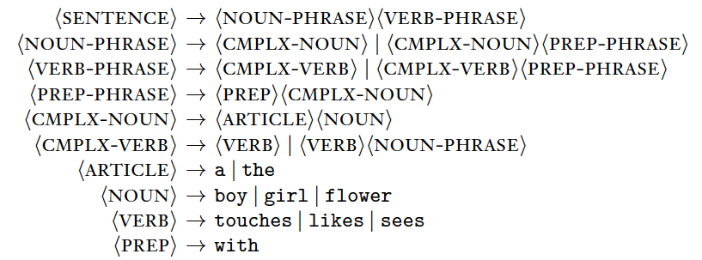
Grammars
In linguistics, people study rules for generating sentences

Slide 45
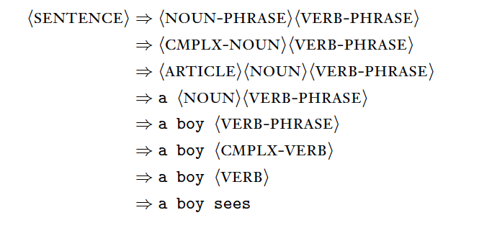
Grammars
These rules generate grammatically correct sentences:

Slide 46
Programming languages
Programming languages also need to specify grammars for correct programs
Fragments of Pascal language specification:
if-statement = `if' Boolean-expression `then' statement [ else-part ] .
Boolean-expression= expression .
expression = simple-expression [ relational-operator simple-expression ] .
simple-expression = [ sign ] term f adding-operator term g .
term = factor f multiplying-operator factor g .
…
digit-sequence = digit { digit }

Slide 47
if-statement
`if’
BoolExp
`then’
statement
expr->term->factor…
digit-sequence
digit
digit
1
0

Slide 48
Context free grammars
Definition. A context free grammar (CFG) is $G=(V, Σ, R, S)$, where
V is the set of variables
$Σ$ is the set of terminals, disjoint from V
R is a set of rules. A rule is of the form
$$A→w$$
where A is a variable, and w is a string of variables and terminals
$S∈V$ is called the start variable
Note: A more general grammar can allow rules of the form $v→w$ where v and w are both in ${\left(V∪Σ\right)}^{∗}$.

Slide 49
CFGs and strings
Let $G=(V, Σ, R, S)$ be a CFG.
Suppose ${u, v∈\left(V∪Σ\right)}^{∗}$, and $A∈V$.
Let $A→w$ be a rule. So ${w∈\left(V∪Σ\right)}^{∗}$.
A string of the form $uAv$ yields $uwv$, written as $uAv⇒uwv$.
Def. Suppose ${s, t∈\left(V∪Σ\right)}^{∗}$. We say s derives t in G, denoted as $s⇒^{∗}t$, if there exist $u_{1},…, u_{n}{∈\left(V∪Σ\right)}^{∗}$, such that
$s⇒u_{1}⇒u_{2}⇒…⇒u_{n}⇒t$.
The language of G is $L\left(G\right)=\{w∈Σ^{∗} :S⇒^{∗}w\}$.

Slide 50
CFG: examples
How to design a CFG for L={0^{n}1^{n} : n $∈ℕ$}?
Need to design the four components $G=(V, Σ, R, S)$…
V={S}
$Σ=\{0,1\}$
R={$S→0S1, S→ε$}
S=S

Slide 51
Summary
Pumping lemma
A useful approach to prove that a language is non-regular
Myhill-Nerode theorem
Equivalence classes on strings
Can be used to prove non-regularity
Pushdown automata
Automata augmented with a stack
Examples

Slide 52
Thanks!

