Slide 1
41080 Theory of Computing
Week 8, Spring 2023
Youming Qiao

Slide 2
Review of last lecture
Non-context-free languages
Pumping lemma
Turing machines
Comparisons with DFAs and PDAs
Definitions
Examples
Decidable and recognisable

Slide 3
Turing machines
Tape: divided into cells, with each cell containing some letter
Read/write head: read and write letters on the cell
Program (or control unit): depending on the letter read and the internal state, a function decides the moves including some of the following:
Rewrite the letter;
Move the head left or right;
Change its internal state;
Terminate the computation.

Slide 4
Formal definition of Turing machines
Definition. A Turing machine is a 7-tuple $\left(Q, Σ, Γ, δ, q_{0}, q_{accept}, q_{reject}\right)$:
Q is the state set;
$Σ$ is the input alphabet, not containing the blank symbol ⊔;
$Γ$ is the tape alphabet, where ⊔$∈Γ$ and $Σ⊆Γ$;
$δ:Q×Γ→Q×Γ×\{L, R\}$ is the transition function;
q₀ is the start state;
$q_{accept}$ is the accept state;
$q_{reject}$ is the reject state.

Slide 5
Turing machines in action
At the beginning, the tape is of the form [input] ⊔ ⊔… ⊔
The tape is infinitely long to the right hand side
During the computation, the read/write head may make use of those additional spaces marked by ⊔
What may happen during an execution of a Turing machine?
Accept and stop
Reject and stop
Loop

Slide 6
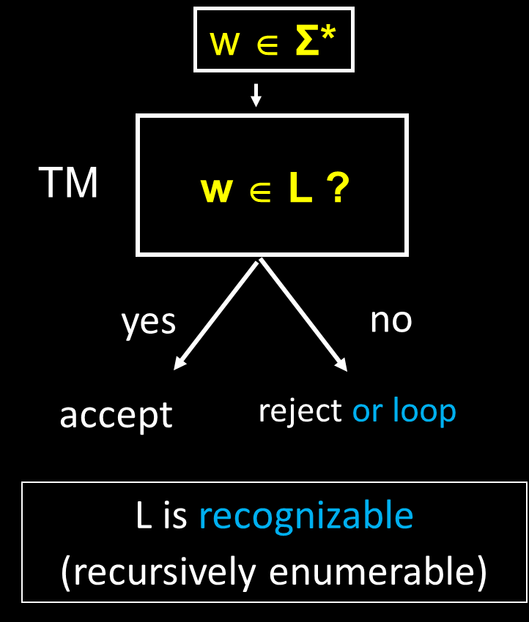

Slide 7
Outline of today’s lecture
Universal Turing machines
Unrecognisable problems by counting
Undecidable problems by the diagonal method
Reductions: from one undecidable problem to more

Slide 8
Universal Turing machines

Slide 9
Program as data
Program: a set of instructions for handling data
Data: an array of numbers, a list of strings…
Program as data: We can encode programs (this set of instructions) as data too
This happens to us in daily life:
We download software from the internet.
Software is a program.
But to the downloading software (or the browser), software is the data.

Slide 10
Encoding Turing machines
This idea can be brought to the Turing machine setting
We can encode Turing machines as strings
That is, we need to encode $\left(Q, Σ, Γ, δ, q_{0}, q_{accept}, q_{reject}\right)$
So one Turing machine can be the input to another Turing machine
How? The description $\left(Q, Σ, Γ, δ, q_{0}, q_{accept}, q_{reject}\right)$ itself is a string!
It is a string over the alphabet $Λ$:
The names of the states
$Σ$ and $Γ$
How $δ$ is represented: $δ\left(q, a\right)=(p, b, D)$ where D=L or R
Parenthesis, commas…

Slide 11
Encoding Turing machine, cont’d
So a Turing machine can be described as a string over alphabet $Λ$
We can set $Λ$ to be {0, 1}
Why? Because we can use $⌈\log_{2}{|Λ|⌉}$ bits to represent letters in $Λ$
For example, $Λ=\{a, b, c, d, e\}$. Then map a to 000, b to 001, c to 010, d to 011, e to 100.
Theorem. Any Turing machine can be encoded as a bit string

Slide 12
A more systematic way to encode a Turing machine
Can encode a TM as a string of numbers, comma, parentheses: n (states), m (tape symbols), (first) k (are input symbols), s (start state), t (accept state), r (reject state), u (blank symbol), transition1, transition2, …
( (p, i), (q, j, L) ), ( (p, i), (q, j, R) ) , …

Slide 13
Yet another way to encode a TM:
start state
reject state
n states
0^{n}10^{m}10^{k}10^{s}10^{t}10^{r}10^{u}1 …
m tape symbols
(first k are input symbols)
blank symbol
accept state
( (p, i), (q, j, L) ) = 0^{p}10^{i}10^{q}10^{j}10
( (p, i), (q, j, R) ) = 0^{p}10^{i}10^{q}10^{j}100

Slide 14
Why encoding Turing machines?
Theorem. Any Turing machine can be encoded as a Boolean string.
So we can use Turing machines as input to another Turing machine
A_{TM} = { (M, w) | M encodes a TM over some Σ, w encodes a string over Σ and M accepts w}
A_{TM} is a language in {0, 1}*
We can adopt any of the encoding schemes described
A technical issue: what is some string is not following the encoding scheme?
Set up a special “dummy” TM that accepts nothing.

Slide 15
Universal Turing machines
Theorem. There is a Turing machine U which takes as input:
the code of an arbitrary TM M
an input string w
such that U accepts (M, w) ⬄ M accepts w.
Proof. Upon receiving M, U does the following:
Check that M is a proper encoding of a TM
Simulate M on input w
U accepts if and only if M accepts

Slide 17
Quoting Turing
It is possible to invent a single machine which can be used to compute any computable sequence. If this machine U is supplied with a tape on the beginning of which is written the S.D ["standard description" of an action table] of some computing machine M, then U will compute the same sequence as M.
From Turing’s 1936 paper

Slide 18
Unrecognisable problems

Slide 19
Unrecognisable through counting
Theorem. There exist languages that are not recognisable by TMs.
Proof strategy: counting!
We will show there is no onto function from the set of all Turing Machines to the set of all languages over {0,1}
That is, every mapping from Turing machines to languages fails to cover all possible languages

Slide 20
“There are more problems to solve than there are programs to solve them.”
Languages over {0,1}

Slide 21
Russell’s barber paradox
There is a barber in a town
The barber claimed: I only cut hair for those people who don’t cut their own hair
Does the barber cut his own hair?
If so, he should not cut for himself
How about he doesn’t cut his own hair?
If so, he should cut for himself

Slide 22
Russell’s barber paradox
Using set theoretic language:
Let U be the set of people in the town
For every u in U (i.e. a person), define a set
S_{u}={ x : u cuts the hair of x}
Let the barber be b
Define S_{b}={ u : u not in S_{u}}
Question: is b in S_{b}?
If yes, by definition of S_{b}, b should not be in S_{b}
If no, by definition of S_{b}, b should be in S_{b}

Slide 23
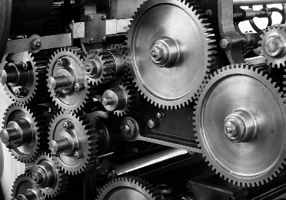
f : A → B is not onto ⬄ ($∃$b $∈$ B)($∀$a $∈$ A)[f(a) ≠ b]
Let L be any set and 2^{L} be the power set of L
Theorem: There is no onto function from L to 2^{L}
Proof: Assume, for a contradiction, there is an onto function f : L → 2^{L}
Define S = { x ∈ L | x ∉ f(x) } ∈ 2^{L}
If f is onto, then there is a y ∈ L with f(y) = S
Suppose y ∈ S. By definition of S, y ∉ f(y) = S.
Suppose y ∉ S. By definition of S, y ∈ f(y) = S.
Contradiction!

Slide 24
What does this mean?
No function from L to 2^{L} can “cover” all the elements in 2^{L}
No matter what the set L is,
the power set 2^{L} always has strictly larger cardinality than L

Slide 25
Thm:There are non-recognizable languages
Proof: Suppose all languages are recognizable. Then for all L, there’s a Turing machine M for recognizing L. Hence there is an onto R: {Turing Machines} → {Languages}
{Languages over {0,1}}
{Turing Machines}
⊆
{Sets of strings of 0s and 1s}
{0,1}*
Set M
2^{M}
But there is no onto function from {Turing Machines} ⊆ M to 2^M. Contradiction!

Slide 26
Undecidable problems

Slide 27
Unrecognisable to undecidable
We just saw that there exist unrecognisable languages
However, it does not tell us a specific one!
In practice, we care about decidability more
It will be useless/undesirable if we cannot be sure if TM rejects
Goal: to show that there exist undecidable languages
Recall: A_{TM} = { (M, w) | M encodes a TM over some Σ, w encodes a string over Σ and M accepts w}
Observation. A_{TM} is recognizable.
Theorem.[Turing 1936] A_{TM} is not decidable.

Slide 28
A_{TM} = { (M,w) | M is a TM that accepts string w }
A_{TM} is undecidable:
(proof by contradiction)
Suppose H is a machine that decides A_{TM}
Accept if M accepts w
Reject if M does not accept w
H( (M,w) ) =
Define a new machine D as follows: D(M): Run H on (M,M) and output the opposite of H
D
D
Reject if M accepts M
Accept if M does not accept M
D( M ) =
D
D
D

Slide 29
The table of outputs of H(x,y)
M₁
M₂
M₃
M₄
…
D
M₁
accept
accept
accept
reject
accept
M₂
reject
accept
reject
reject
reject
M₃
accept
reject
reject
accept
accept
M₄
accept
reject
reject
reject
accept
:
?
D
reject
reject
accept
accept

Slide 30
The outputs of D(x)
M₁
M₂
M₃
M₄
…
D
M₁
accept
accept
accept
reject
accept
reject
M₂
reject
reject
reject
accept
reject
reject
M₃
accept
reject
reject
accept
accept
accept
M₄
accept
reject
reject
reject
accept
accept
:
?
D
reject
reject
accept
accept
D(x) outputs the opposite of H(x,x)
D(D) outputs the opposite of H(D,D)=D(D)

Slide 31
A_{TM} = { (M,w) | M is a TM that accepts string w }
A_{TM} is undecidable:
(constructive proof)
Let H be a machine that recognizes A_{TM}
Accept if M accepts w
Reject or loops if M does not accept w
H( (M,w) ) =
Define a new machine D_{H} as follows: D_{H}(M): Run H on (M,M) until the simulation halts Output the opposite answer

Slide 32
D_{H}
D_{H}
Reject if M accepts M
(i.e. if H( M , M ) = Accept)
Accept if M rejects M
(i.e. if H( M , M ) = Reject)
Loops if M loops on M
(i.e. if H( M , M ) loops)
D_{H}
D_{H}
D_{H}
D_{H}
D_{H} ( M ) =
D_{H}
D_{H}
D_{H}
D_{H}
D_{H}
D_{H}
D_{H}
Note: There is no contradiction here!
D_{H} must loop on D_{H}
We have an instance (D_{H}, D_{H}) which is not in A_{TM} but H fails to tell us that! H(D_{H}, D_{H}) runs forever

Slide 33
That is:
Given the code of any machine H that recognizes A_{TM} we can effectively construct an instance ( D_{H}, D_{H} ), where:
( D_{H}, D_{H} ) does not belong to A_{TM}
H runs forever on the input ( D_{H}, D_{H} )
So H cannot decide A_{TM}
Given any program that recognizes the Acceptance Problem, we can efficiently construct an input where the program hangs!
Is there a problem we care about that in non-recognizable?

Slide 34
From undecidable to unrecognisable
First undecidable language: A_{TM} is not decidable
We know the existence of unrecognizable languages
Is there a concrete unrecognizable language?

Slide 35
Theorem: L is decidable iff both L and ¬L are recognizable

Slide 36
Theorem: A_{TM} is recognizable but NOT decidable
Corollary: ¬A_{TM} is not recognizable!
POLL: What is ¬A_{TM} ?
Proof: Suppose ¬A_{TM} is recognizable. Then ¬A_{TM} and A_{TM} are both recognizable…
But that would mean they’re both decidable!

Slide 37
Reductions: from one to more undecidable problems

Slide 38
How to compare two problems?
We have proved that A_{TM} is undecidable
Can we find more undecidable languages?
When we say that one problem is more difficult than another, what do we mean?
These require a key notion called reductions

Slide 39
The Halting Problem
HALT_{TM} = { (M,w) | M is a TM that halts on string w }
Theorem: HALT_{TM} is undecidable
Proof:
Assume (for a contradiction) there is a TM H that decides HALT_{TM}
We use H to construct a TM M’ that decides A_{TM}
M’(M,w): Run H(M,w)
If H rejects then reject
If H accepts, run M on w until it halts:
If M accepts, then accept If M rejects, then reject

Slide 40
(M,w)
(M,w)
If M halts
M’
H
Does M halt on w?
w
M
If M doesn’t halt: reject

Slide 41
The use of HALT being undecidable?
Suppose you work in an IT company
Your boss just wrote a brilliant program P
P sometimes loops forever
You fixed the program P
Boss accidentally wrote for (i=0; i<100; i--) {…}
Your boss is happy. He wrote so many such programs
He then had a brilliant idea: why don’t you write a program that can test if any program will ever enter a loop on some input?
What can you tell your boss? POLL!

Slide 42
Can often prove a language L is undecidable by proving: if L is decidable, then so is A_{TM}
We reduce A_{TM} to the language L
A_{TM} ≤_{m} L

Slide 43
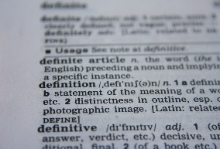
Mapping Reductions
f : Σ* → Σ* is a computable function if there is a Turing machine M that halts with just f(w) written on its tape, for every input w
A language A is mapping reducible to language B, written as A ≤_{m} B, if there is a computable f : Σ* → Σ* such that for every w,
w ∈ A ⇔ f(w) ∈ B
f is called a mapping reduction
(or many-one reduction) from A to B

Slide 44
Let f : Σ* → Σ* be a computable function such that w ∈ A ⇔ f(w) ∈ B
Σ*
B
Σ*
A
f
f
Say: A is mapping reducible to B Write: A ≤_{m} B

Slide 45
Theorem: If A ≤_{m} B and B ≤_{m} C, then A ≤_{m} C
A
f
B
C
g
f
g

Slide 46
Theorem: If A ≤_{m} B and B is decidable, then A is decidable
Proof:
Let M decide B.
Let f be a mapping reduction from A to B
To decide A, we build a machine M’
M’(w):
1. Compute f(w)
2. Run M on f(w), output its answer
w ∈ A ⇔ f(w) ∈ B so w ∈ A ⇒ M’ accepts w
w ∉ A ⇒ M’ rejects w

Slide 47
Theorem: If A ≤_{m} B and B is decidable, then A is decidable
Corollary: If A ≤_{m} B and A is undecidable,
then B is undecidable
Theorem: If A ≤_{m} B and B is recognizable, then A is recognizable (Tutorial problem)
Corollary: If A ≤_{m} B and A is unrecognizable,
then B is unrecognizable

Slide 48
The proof that the Halting Problem is undecidable can be seen as constructing a mapping reduction from A_{TM} to HALT_{TM}
Theorem: A_{TM} ≤_{m} HALT_{TM}
f(M, w) := (M’, w) where “M’(w) = accepts if M(w) accepts else loops forever” how?
We have (M, w) ∈ A_{TM} ⇔ (M’, w) ∈ HALT_{TM}

Slide 49
Theorem: HALT_{TM} ≤_{m} A_{TM}
Proof: Define the computable function
f(M, w) := (M’, w) where “M’(w) accepts if M(w) halts else loop forever” (how?)
Observe (M, w) ∈ HALT_{TM} ⇔ (M’, w) ∈ A_{TM}

Slide 50
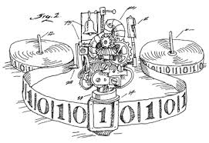
Corollary: HALT_{TM} ≡_{m} A_{TM}
I can give you the magical power to either compute the halting problem, or
the acceptance problem. Which do you want?
Surprise me

Slide 51
Today’s lecture
Universal Turing machines
Languages that are not recognisable
Languages that are not decidable
Reductions: from one undecidable problem to more

Slide 52
Thanks!

