Slide 1
Tutorial 02 “Introduction to Electrical and Electronic Engineering” (48510) Basic Circuit Laws

Slide 2
Combining Resistors :
1. Series Resistors
2. Parallel Resistors

Slide 3
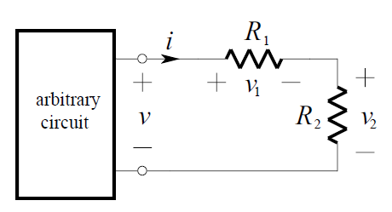
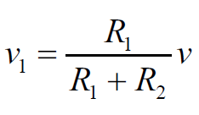
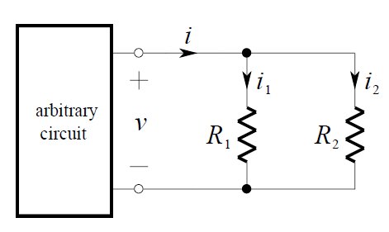
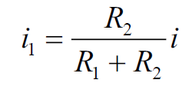
Part A: Circuit Laws
The Voltage Divider Rule: voltage is divided between the resistors in series. Because of this, a pair of resistors in series is often called a voltage divider.
$$\frac{V_{1}}{V_{t}}=\frac{R_{1}}{R_{t}}$$
The Current Divider Rule: current is divided between the resistors in parallel. Because of this, a pair of resistors in parallel is often called a current divider.
$$\frac{i_{1}}{i_{t}}=\frac{R_{2}}{R_{t}}$$
Keep in mind that the larger the resistance, the smaller the current.

Slide 4
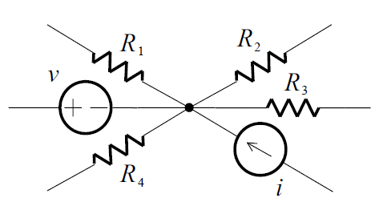
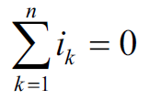
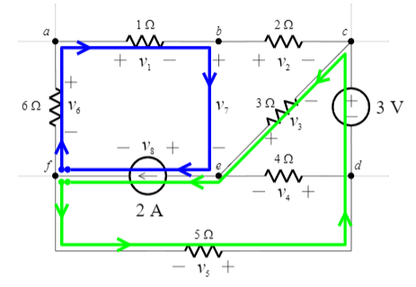
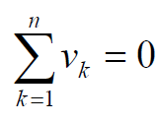
Kirchhoff’s Current Law (KCL): At any node of a circuit, the currents algebraically sum to zero. (The sum of the currents entering a node is equal to the sum of the currents leaving a node.)
A connection of two or more elements is called a node.
You can define currents leaving the node are positive, and currents entering the node are negative (or vice versa).
Kirchhoff’s Voltage Law (KVL): Around any loop in a circuit, the voltages algebraically sum to zero. (In traversing a loop, the sum of the voltage rises equals the sum of the voltage drops.)
a loop: traversing through elements (open-circuits included!) and returning to the starting node, never encountering any other node more than once.

Slide 5
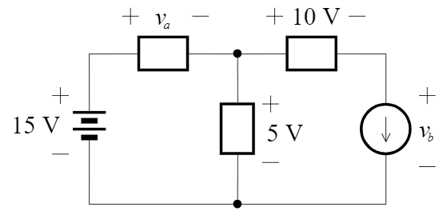
Part A: Circuit Laws
Q1:
Q2:
A parallel circuit has more than one path for current. Each path for current is called a branch. In parallel circuits, there are junctions where two or more components are connected.

Slide 6
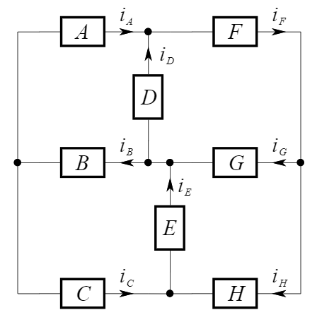
Part A: Circuit Laws
Q3:
KCL: The sum of the currents entering a node is equal to the sum of the currents leaving a node.

