Slide 1
Tutorial 01
“Introduction to Electrical and Electronic Engineering” (48510)
Basic Concepts of Electrical Circuit

Slide 2
Current
The magnitude of the current can be calculated using this formula.

Slide 3
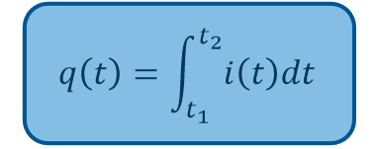
Current
On the contrary, if the current 𝑖(𝑡) is known, you are able to find out the amount of charges that pass through the cross section of a metallic wire in a period of time.

Slide 4
Voltage
We define voltage as the amount of potential energy between two points on a circuit. It is measured in volts (V).
Resistance is a component’s tendency to resist the flow of charge (current).
where R is the resistance in Ω (Ohm), ρ is the resistivity of the material in (Ω*m), L is the length of the wire and A is the cross-sectional area of the wire.

Slide 5
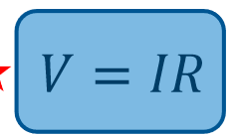
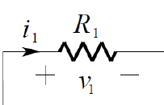
Ohm’s Law
At a constant temperature, the electrical current flowing through a fixed linear resistance is directly proportional to the voltage applied across it, and also inversely proportional to the resistance.
We can define electrical energy (E) as the energy generated by the movement of electrons from one point to another.
E = qV, where E is the electric energy, V is the voltage, and q is the amount of charge moved in the time interval under consideration. The unit of energy is Joule (J).

Slide 6
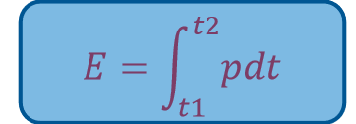
Electric power
Electric power is the rate, per unit time, at which electrical energy is transferred by an electric circuit. The unit of power is the watt (W), one joule per second. It can be calculated as
On the other hand, to calculate the energy E delivered to a circuit element between time instant t1 and t2, we can integrate power:
If the power is constant, it can be simplified as 𝐸 = 𝑃𝑡

Slide 9
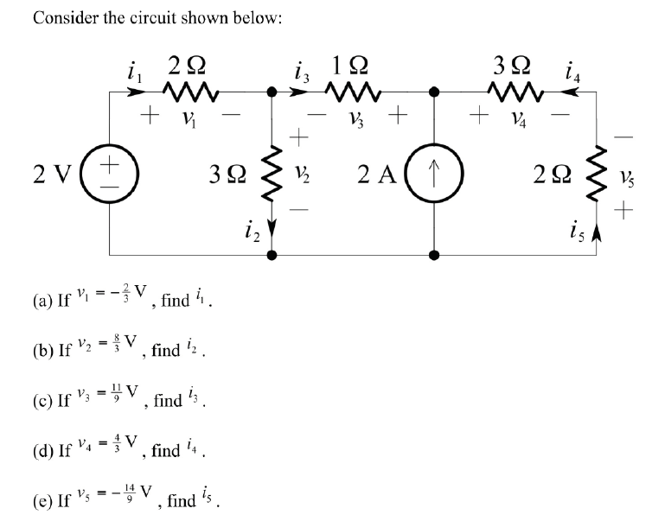

Slide 10
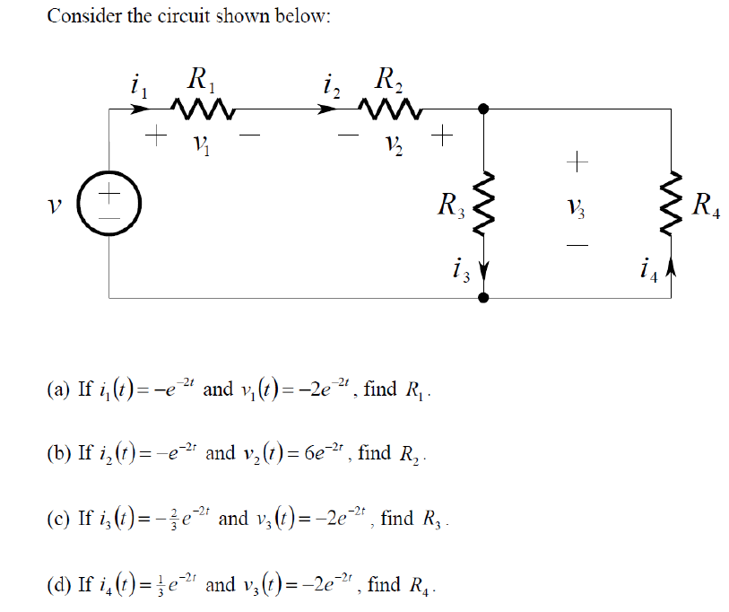

Slide 11
