Slide 1
Tutorial 04 (Thévenin’s Theorem and Norton’s Theorem)
IEEE 48510

Slide 2
Superposition
Superposition Theorem: In any linear network containing several sources, we can calculate any response by adding algebraically all the individual responses caused by each independent source acting alone, with all other independent sources set to zero. (We can treat several inputs separately, then combine individual responses to obtain the total response. )
Setting a voltage source to zero creates a short-circuit. Setting a current source to zero creates an open-circuit.
Limitation: It is applicable only to linear responses, and thus the most common nonlinear response – power – is not subject to superposition.

Slide 3
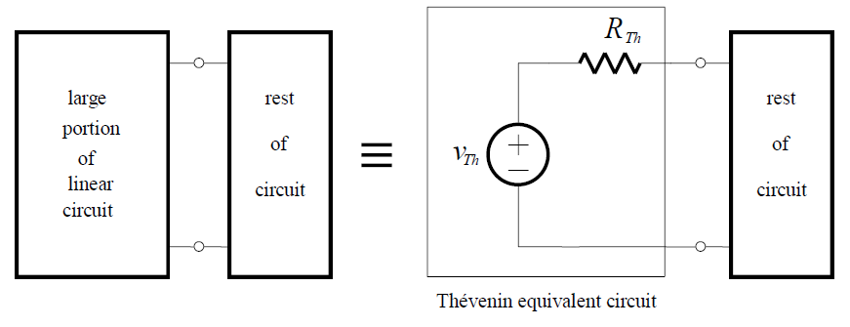
Thévenin’s Theorem
Thévenin’s theorem tells us that it is possible to replace a large portion of a linear circuit (often a complicated and / or uninteresting portion) by an equivalent circuit containing only an independent voltage source in series with a resistor:
It allows us to replace part of a circuit with a practical voltage source:
Separate the original circuit into circuits A (uninteresting portion) and B (load resisitor).
Disconnect circuit B and calculate open circuit voltage Voc=Vth.
Set all independent sources in circuit A to zero, then “looking back” into the inactive A circuit for equivalent resistor Rth.

Slide 4
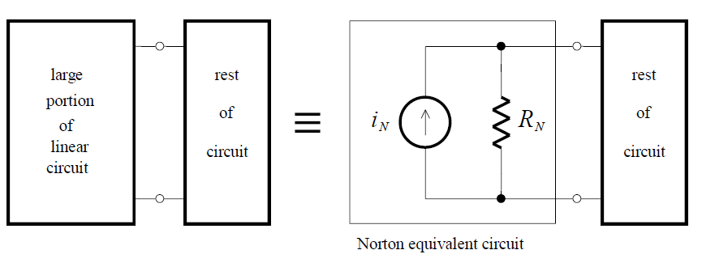
Norton’s Theorem
Norton’s theorem tells us that it is possible to replace a large portion of a linear circuit by an equivalent circuit containing only an independent current source in parallel with a resistor.
It allows us to replace part of a circuit with a practical current source:
Separate the original circuit into circuits A (uninteresting portion) and B (load resistor).
Short-circuit circuit B and calculate the current i_{N}.
Set all independent sources in circuit A to zero, then “looking back” into the inactive A circuit for equivalent resistor R_{N}.

Slide 5
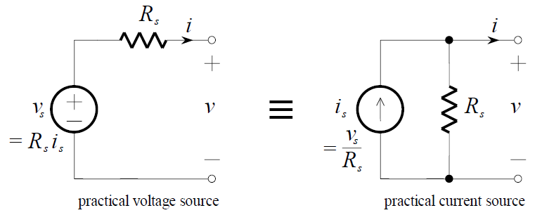
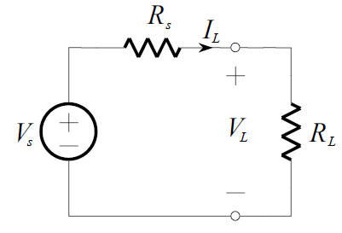
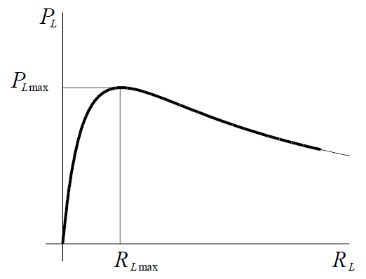
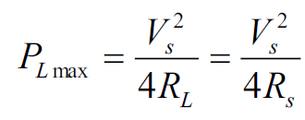
Review
Practical Source Equivalence:
Maximum Power Transfer Theorem: Considering the load resistance connected to a practical voltage source, we denote the power delivered to load RL is PL.

