Slide 1
Tutorial 08 (Diodes)
IEEE 48510

Slide 2
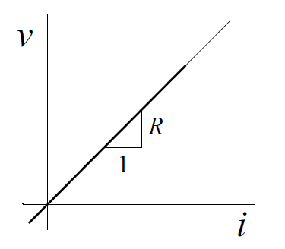
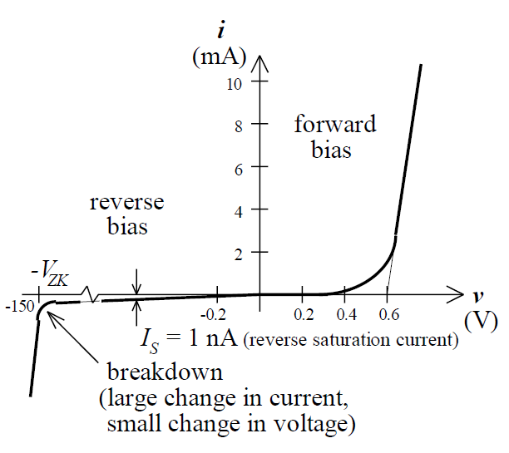
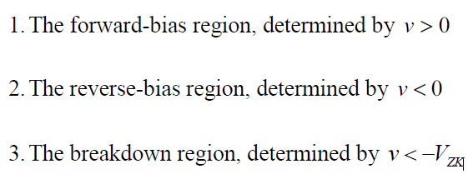
Diode
Linear element: the relationship between “cause” and “effect” is a straight line through the origin.
The diode is clearly a nonlinear element: its characteristic is not a straight line through the origin! The i-v characteristic can be divided up into three distinct regions:

Slide 3
Forward-Bias Region
Shockley equation
The forward-bias region of operation is entered when the terminal voltage v is positive. There is not much increase in current until the “internal barrier voltage” is overcome (approximately 0.6 V in silicon). Then large conduction results. For a “fully conducting” diode, the voltage drop lies in a narrow range, approximately 0.6 to 0.8 V for silicon.

Slide 4
Reverse-Bias Region
The reverse-bias region of operation is entered when the diode voltage v is
made negative. The current in the reverse direction is constant and equal to Is (saturation current), which is negligibly small.

Slide 5
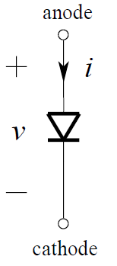
Breakdown Region
The breakdown region is entered when the magnitude of the reverse voltage exceeds a threshold value called the breakdown voltage V_{ZK} is much higher than the forward conduction voltage. The Breakdown is only exploited in certain types of diodes, e.g., Zener diode.
Diode Symbol

Slide 6
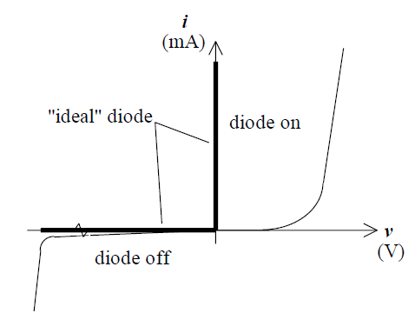
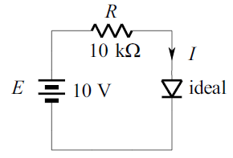
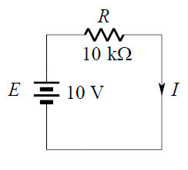
Analysis Techniques
Linear modelling: substitute a linear circuit model in place of the actual diode.
The Ideal Diode Model: an ideal switch.
To determine which of these states the diode is in, we have to determine the conditions imposed upon the diode by an external circuit.

Slide 7
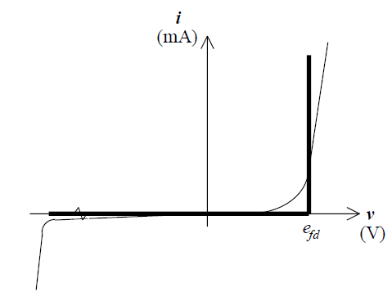
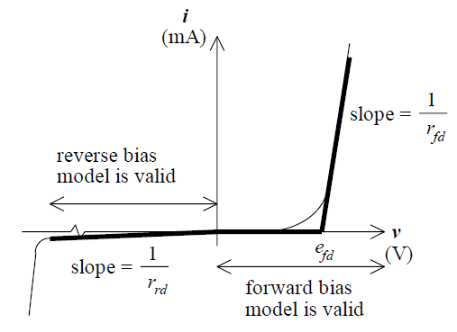
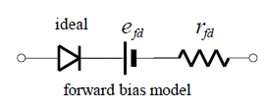
Linear Modelling
The Constant Voltage Drop Model: take into account the forward voltage drop. It is the one most frequently employed in the initial phases of analysis and design, because it more closely approximates the characteristic in the forward bias region. e_{fd}=0.7 V.
The Piece-Wise Linear Model: for each section, we use a different diode model (one for the forward bias region and one for the reverse bias region).

Slide 8
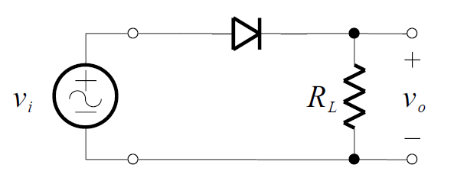
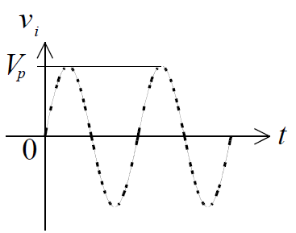
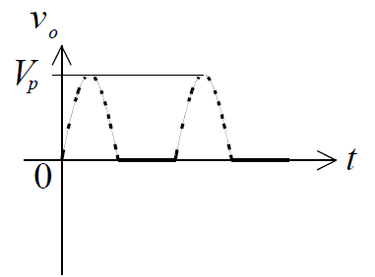
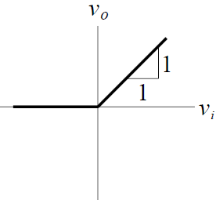
Basic Diode Circuits
Half-Wave Rectifier: A rectifier is a circuit that converts a bipolar (AC) signal into a unidirectional one. As can be seen, the half-wave rectifier produces an output voltage equal to the input voltage when the input voltage is positive and produces zero output voltage when the input voltage is negative.
Transfer characteristic

Slide 9
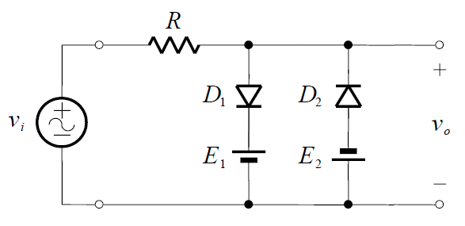
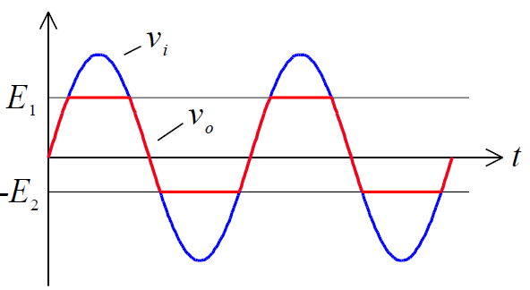
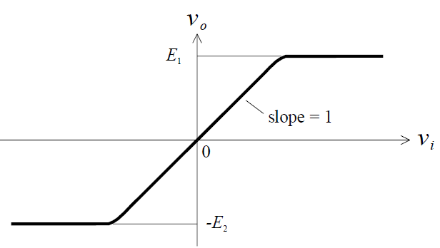
Basic Diode Circuits
Limiter Circuits:
When both D1 and D2 are off:
If the output voltage is greater than E1, then diode D1 will be on.
If the output voltage is less than –E2, then diode D2 will be on.
Transfer characteristic

